Slide 1
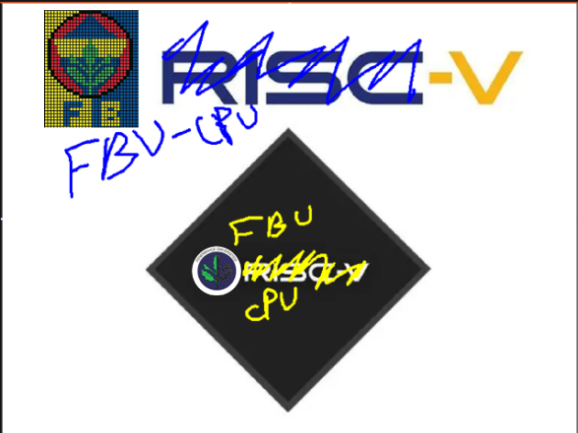

RISC-V Based FBU-CPU
Şadi Göktuğ DEVECİ, Aydoğan ARSLANTAŞ, Deni UTSIEV

Slide 2

What is RISC-V?
RISC-V (pronounced "RISC Five") is an open-source instruction set architecture (ISA) designed for computer processors. It stands for "Reduced Instruction Set Computer – Five."
RISC-V is an open standard, which means it is publicly available and can be used without any licensing fees. This openness encourages innovation, collaboration, and customization.

Slide 3

Why is RISC-V important for our Project?
Instruction Sets: RISC-V offers several instruction sets, including RV32 (32-bit), RV64 (64-bit), and RV128 (128-bit). This flexibility allows RISC-V to be used in a wide range of applications, from low-power embedded devices to high-performance servers.
Customization: RISC-V allows designers to customize the instruction set to fit specific needs. This enables the development of application-specific processors and accelerators, optimizing performance and power efficiency.

Slide 4
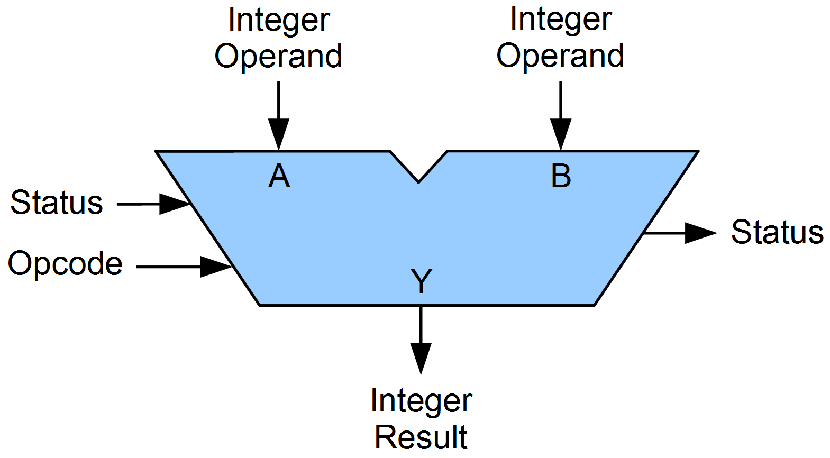
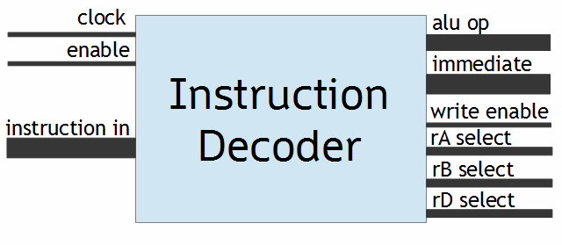
What Did We Do In Our Project?
We implemented 2 different modules to RISC-V.
First one is ALU(Algorithmic Logic Unit).
Second one is ID(Instruction Decoder).

Slide 5
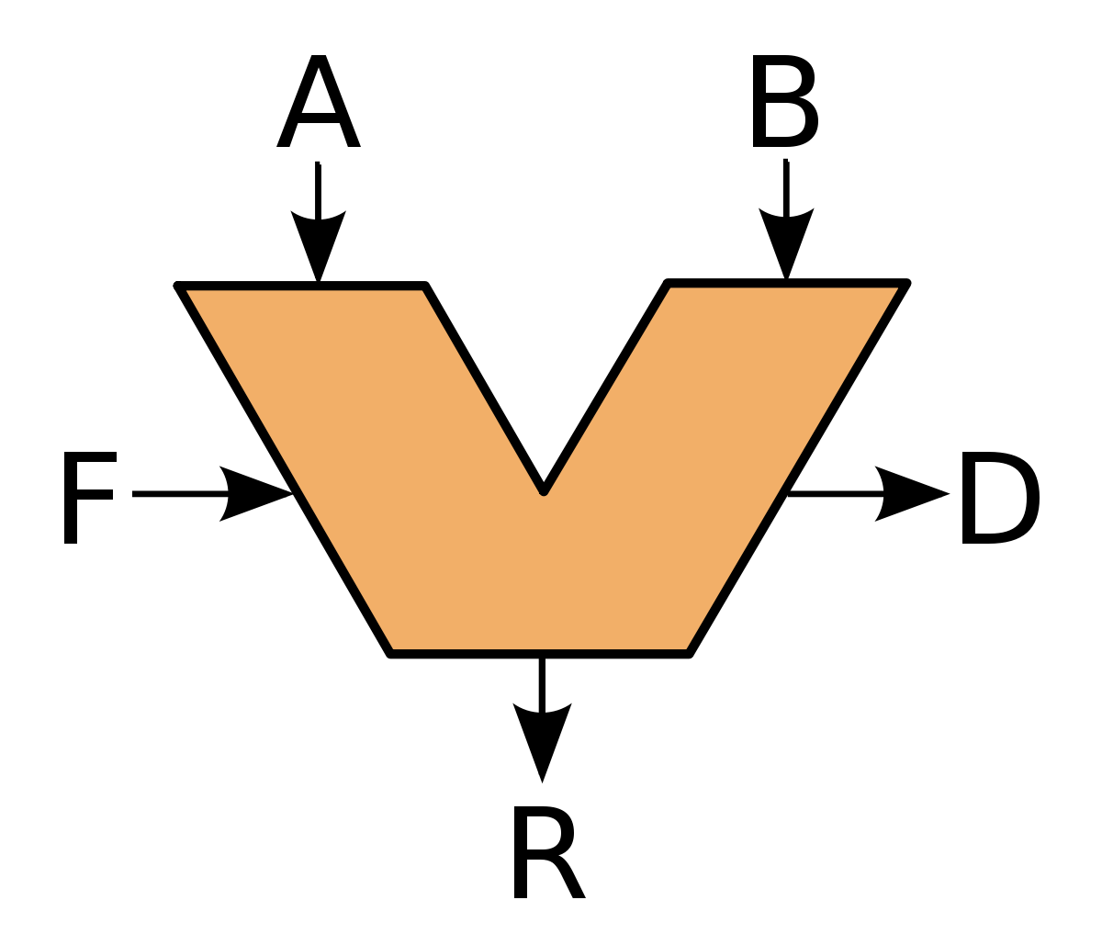
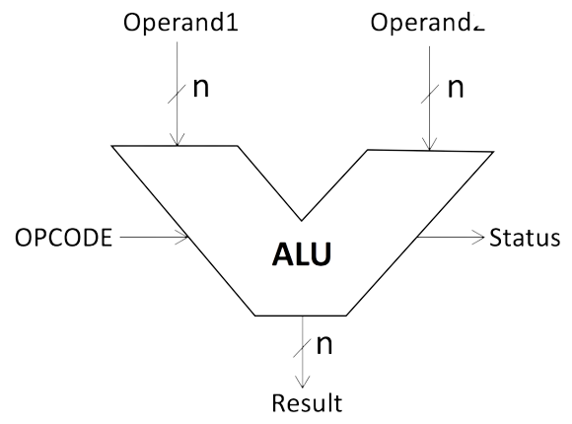
What’s ALU?
The Arithmetic Logic Unit (ALU) is a crucial component of a computer's central processing unit (CPU). It is responsible for performing arithmetic and logical operations on data.
The ALU performs fundamental arithmetic operations such as addition, subtraction, multiplication, and division. It also handles logical operations like AND, OR, NOT, XOR and much more!

Slide 6
What is ID?
The Instruction Decoder (ID) is a crucial stage in the instruction execution pipeline of a computer processor. It is responsible for decoding and preparing instructions for execution.
Instruction Decoder(ID) divides instruction signals into parts. For RISC-V, these parts are generally OPCODE, rd, func3, rs1, rs2, and func7.

Slide 7
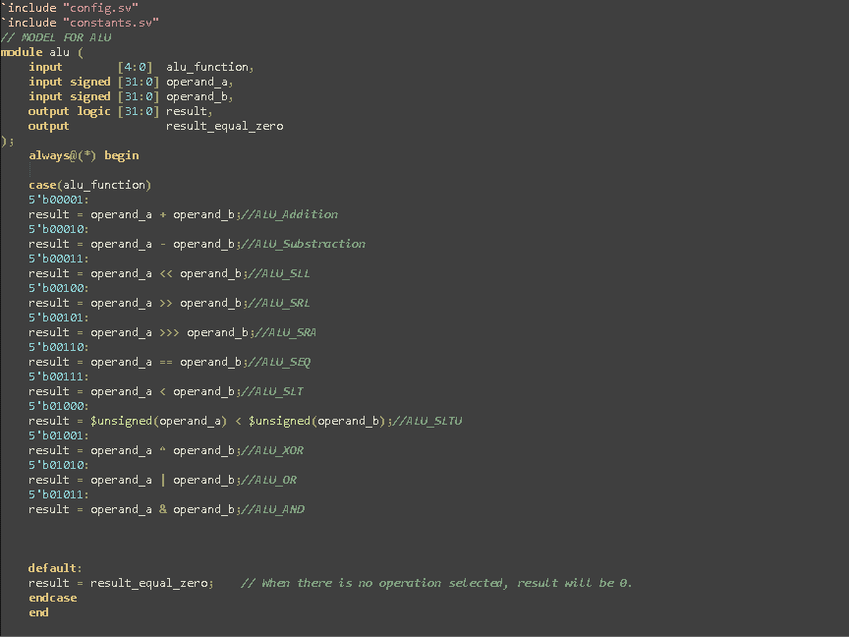
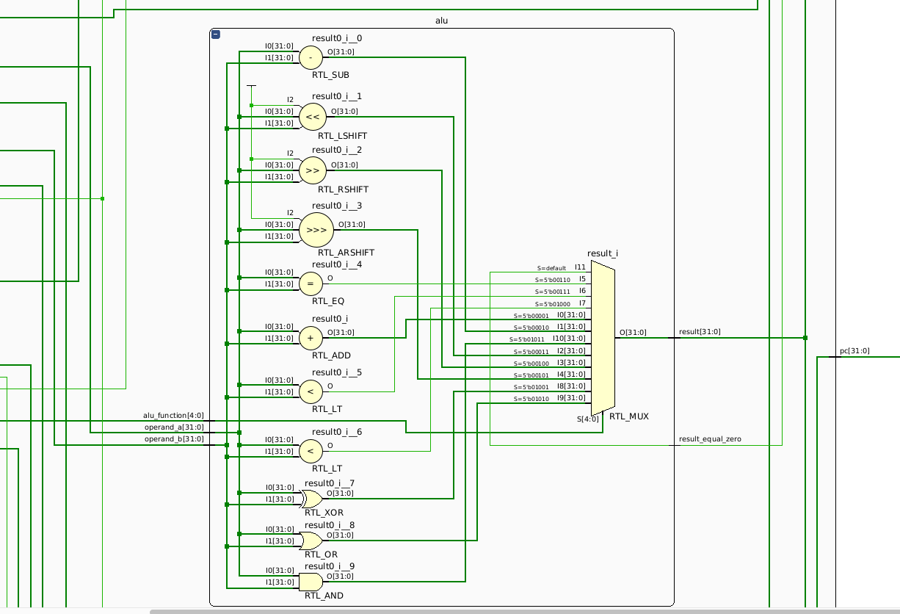
Code For Arithmetic Logic Unit(ALU)

Slide 8
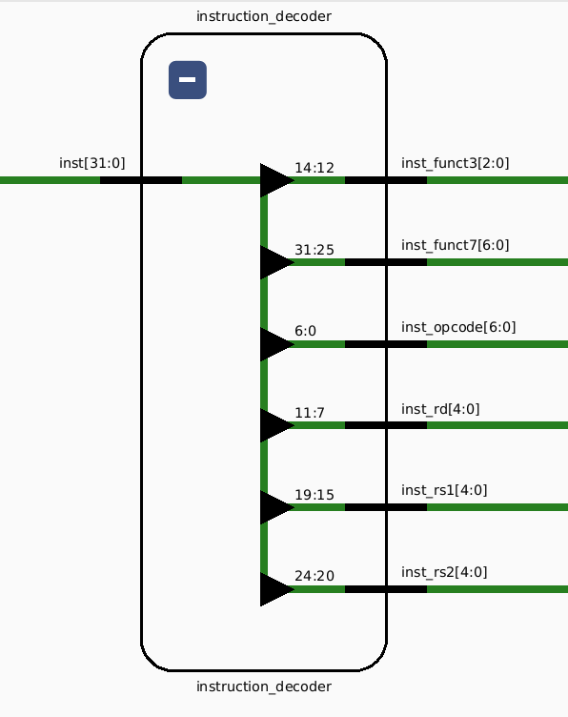
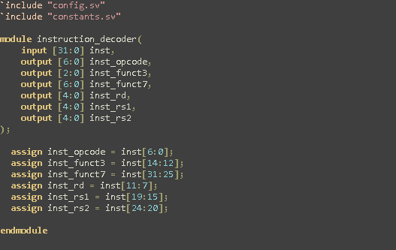
Code for Instruction Decoder(ID)

Slide 9
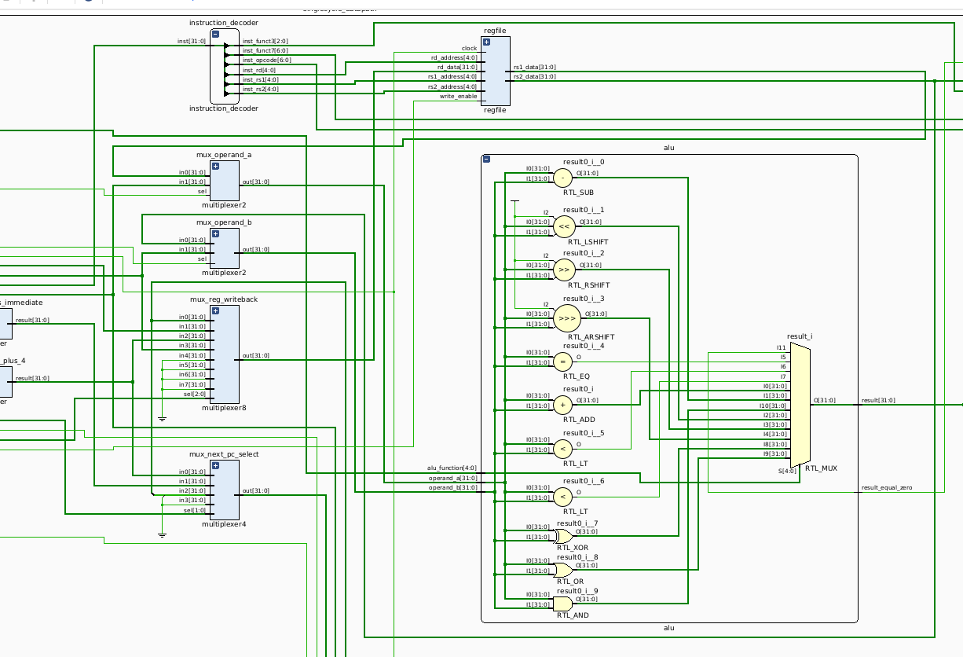
General Schema including ID and ALU modules

Slide 10
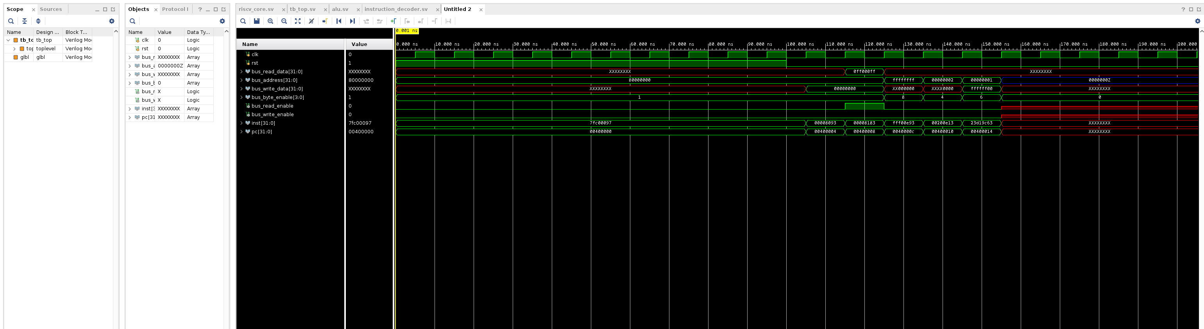
Waveform of RISC-V based FBU-CPU

Slide 11
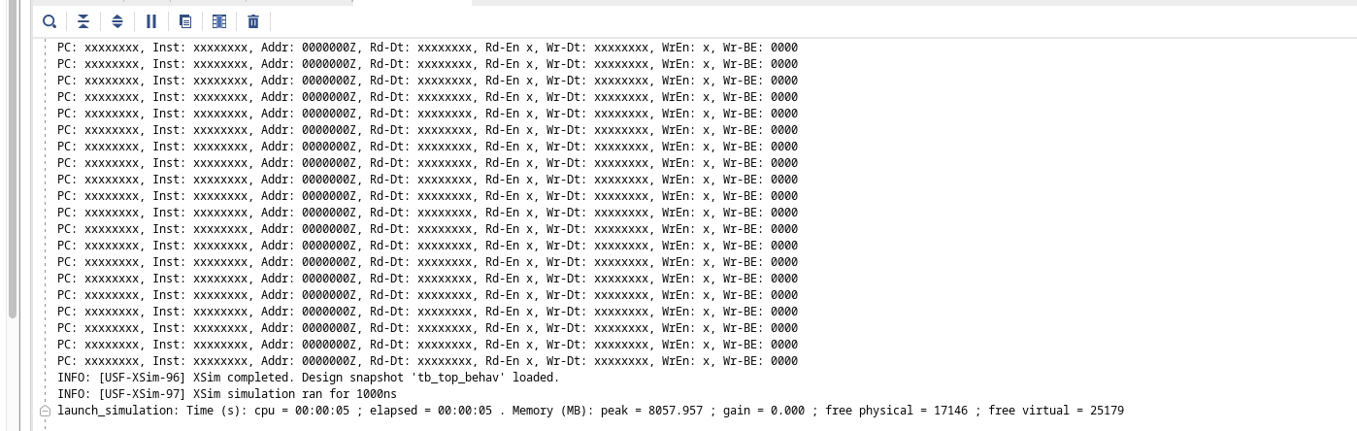
Test Result

Slide 12
THANKS FOR WATCHING

