Slide 1
GEO_Charli (Mandalay)

Slide 2
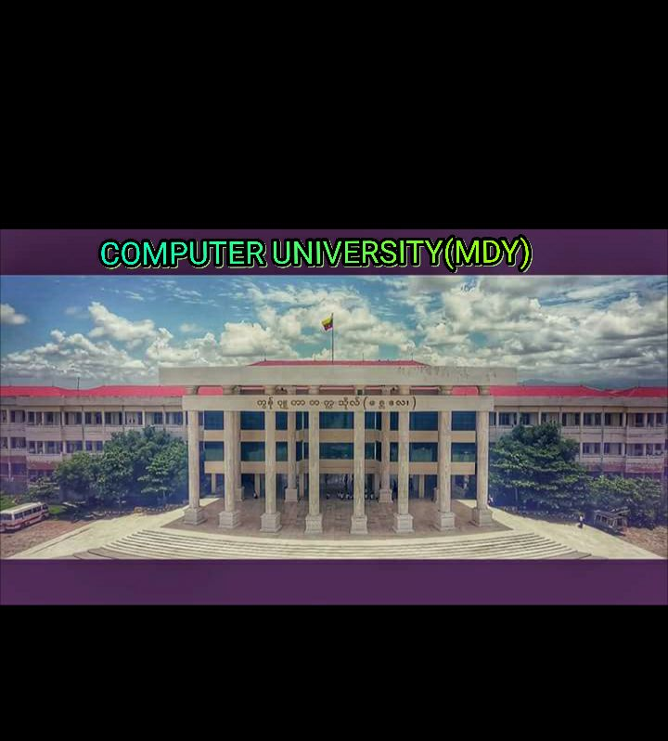

Slide 3
Electronic Thesis and Dissertation

Slide 4
Supervisor – Daw Cho Cho Myint
Presented by
5CS-19 Ma Phyo Ei Ei Bo
5CS-20 Ma Su Mon Hlaing
5CS-21 Ma Thida Lwin
5CS-22 Ma Shoon Waddy Soe Moe
5CS-23 Ma Cho Cho Thet
5CS-24 Ma Aye Aye Nwe

Slide 5
Words from Heart
We truly thank U Kyaw Swar Soe, Rector, Computer University (Mandalay) for his kind permission to send us internship Program.
Then, We would like to express any special thanks to Daw Cho Cho Myint,Hardware
Then , also thanks to Mr. Ravi Chhabra , GMIT for his trust to give us such a heavy responsibility project.

Slide 6
Abstract
The changing electronic environment is forcing Computer University (Mandalay), to think about digitizing their theses and dissertations and introduce ETD Systems.
Admin can control this system’s records and user views these data. He can control user permission.
For Back end, the system was implemented using databases.
For Front End, the system was implemented using html, javascript.
We used methodologies such as SAD during the project development.
Most of the academics are supporting the idea of ETDs ,but still a moderate majority is supporting its Global access through Internet.

Slide 7
Objectives
To study how theses can be modified in real project.
To decrease, time consuming for searching via the Internet.
To gain data easily from this project.
To provide the best service to users.
Theses can be submitted form anywhere in the world.
Students learn about electronic document preparation and digital libraries.

Slide 8
Introduction of Electronic Thesis and Dissertation
Electronic thesis and dissertation will involve admins and users.
Users can see database records in databases.
Admin can insert new records and change data.
Admin permitted users who can update data in project.

Slide 9
Requirement Analysis
The description of the services and constraints are the requirements for the system. Requirement Analysis is the process of deriving the system requirements through observation of existing system, discussions with potential users and procures, task analysis, etc;
We get all information of data we use in this project from library.

Slide 10
Background
Our team has received to do electronic thesis and dissertation by a director.
He said to make many process easily step by step.
Moreover, he want to access from anywhere at any time.
So, there are many processes to develop manual system and it may be time waste. So, he decided to develop Electronic thesis and dissertation to reduce the problems.

