Slide 1


Introduction to Quantum Machine Learning
IBM Quantum / © 2021 IBM Corporation
Notes:
‹#›
Group Name / DOC ID / Month XX, 2019 / © 2019 IBM Corporation

Slide 2
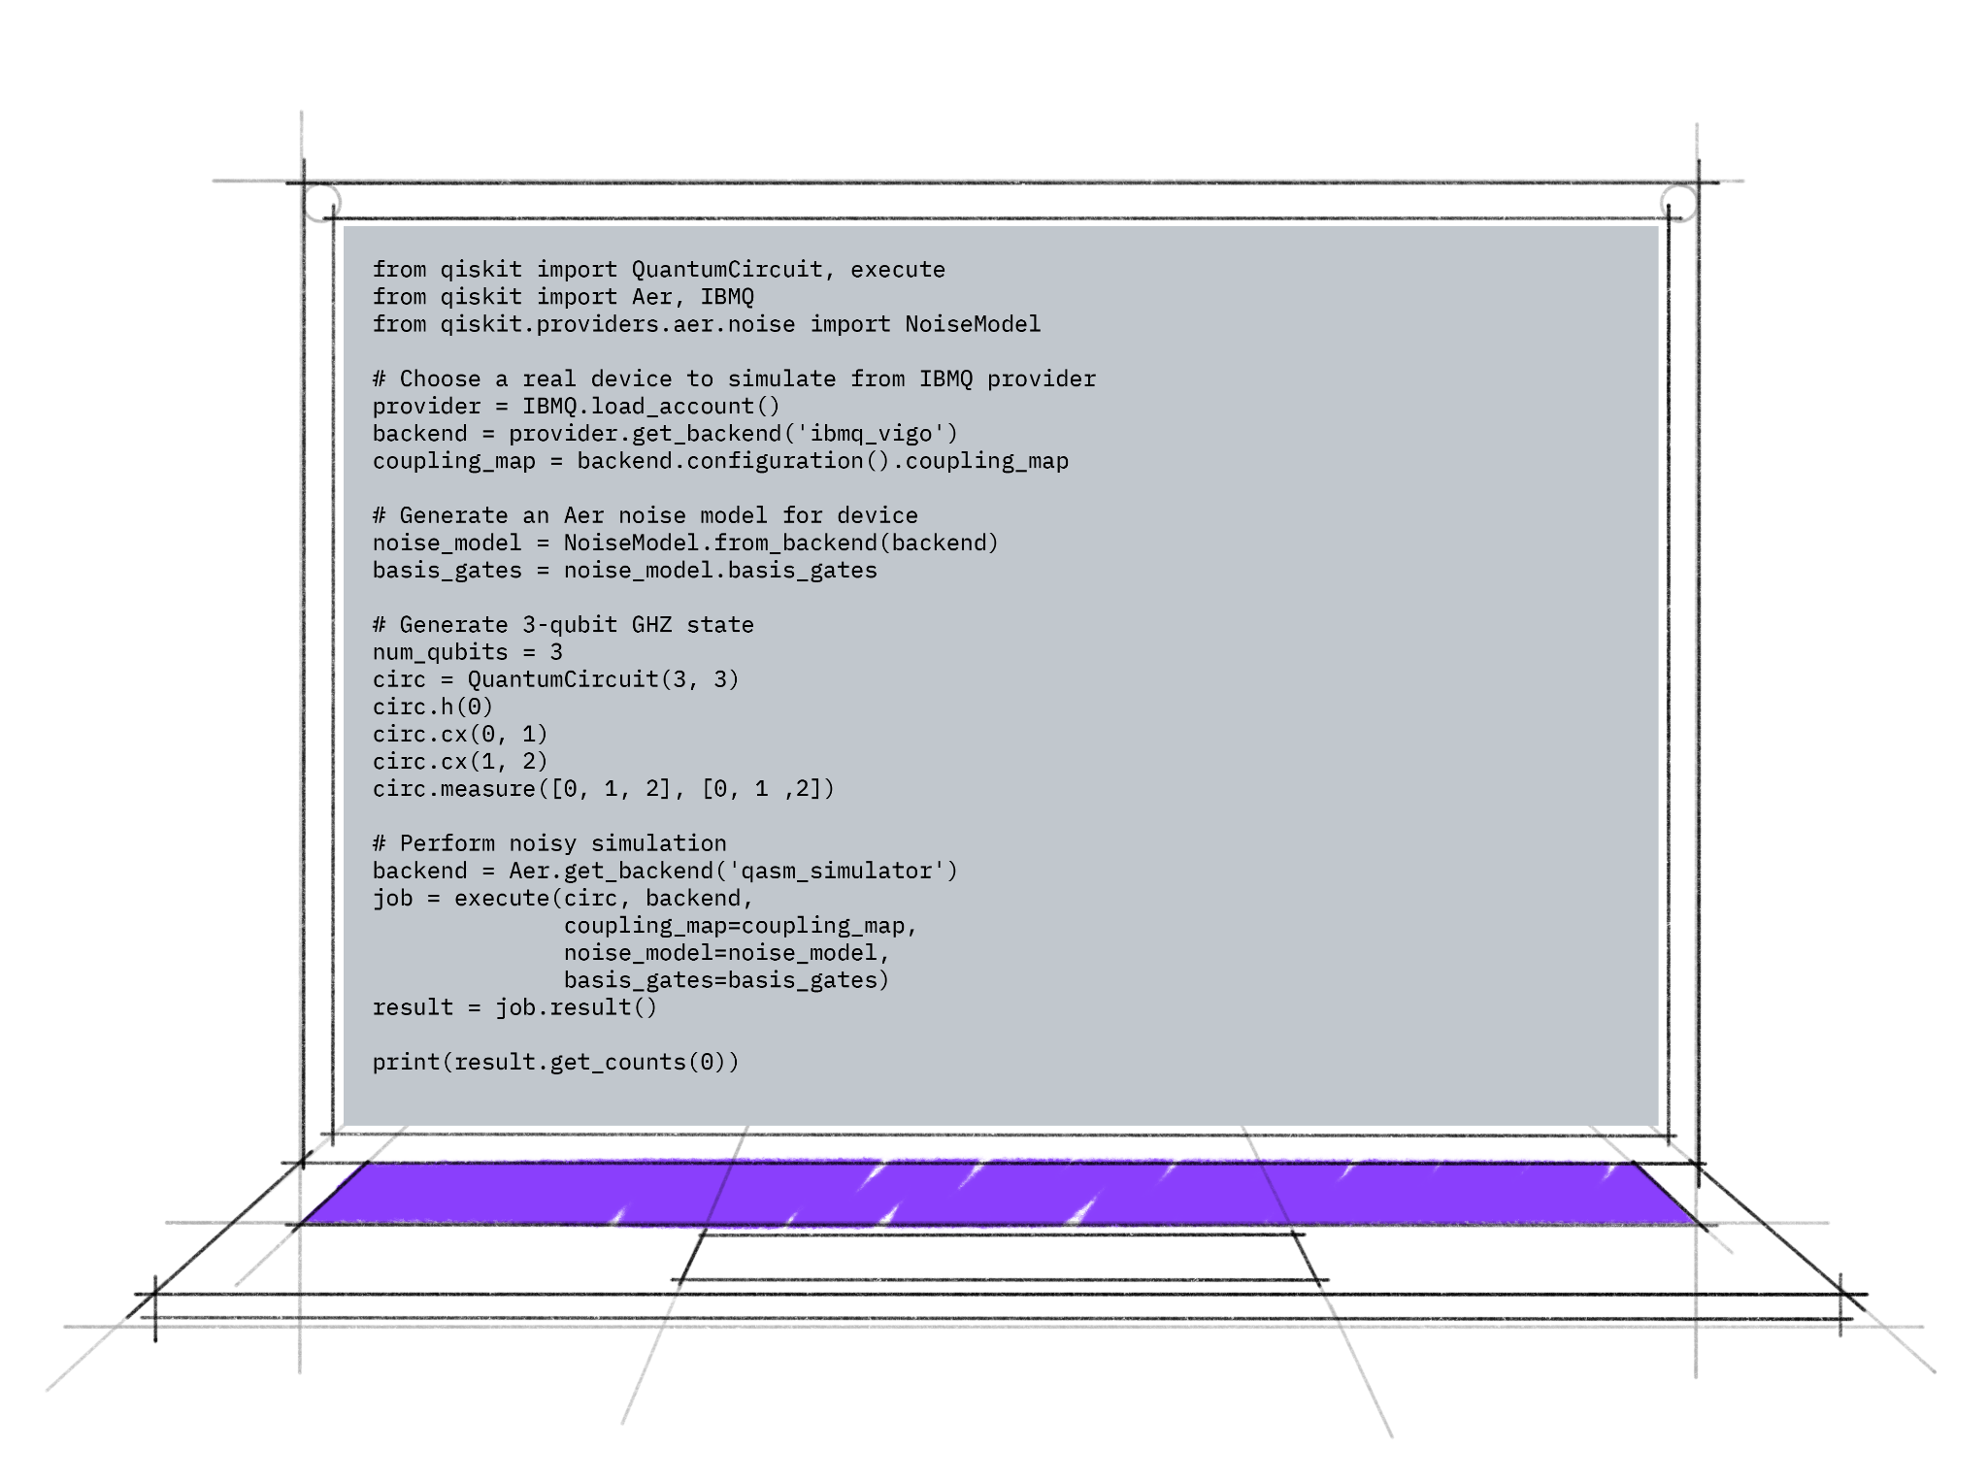
Machine Learning
Machine learning’s primary goal is to train computers to make sense of an ever-expanding pool of data. However, in order to learn from these increasingly complex datasets, the underlying models, such as deep neural networks, also become more sophisticated and expensive to train.
Machine learning applications touch almost every angle of business, science, and private life, ranging from speech and image recognition to generative models to improve drug design
IBM Quantum / © 2021 IBM Corporation
‹#›

Slide 3
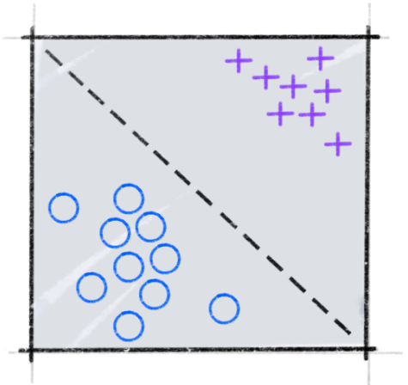
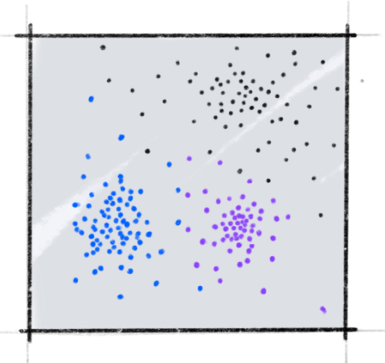
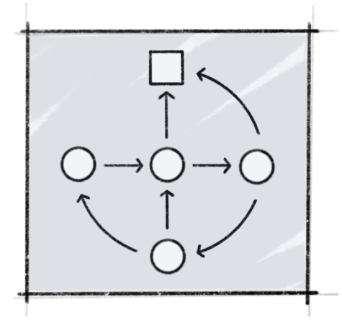
Machine Learning
Machine learning can be split roughly into three subfields: supervised learning, unsupervised learning, and reinforcement learning.
Supervised Learning
Unsupervised Learning
Reinforcement Learning
IBM Quantum / © 2021 IBM Corporation
Images from https://qiskit.org/textbook-beta/course/machine-learning-course/ .
‹#›

Slide 4

Quantum Machine Learning (QML)
There are four different approaches for combining quantum computing and machine learning, which are differentiated by whether the data is classical (C) or quantum (Q) in nature, or whether the algorithm is executed on a classical (C) or quantum (Q) computer,
Gif from https://medium.com/qiskit/were-releasing-a-free-hands-on-quantum-machine-learning-course-online-c9313e78ea2d
IBM Quantum / © 2021 IBM Corporation

Slide 5

Parameterized quantum circuits
Parameterized quantum circuits, where the gates are defined through tunable parameters, are a fundamental building block of near-term quantum machine learning algorithms.
Properties
Expressibility
Entangling capability
Hardware efficiency
Gif from https://medium.com/qiskit/were-releasing-a-free-hands-on-quantum-machine-learning-course-online-c9313e78ea2d
IBM Quantum / © 2021 IBM Corporation

Slide 6
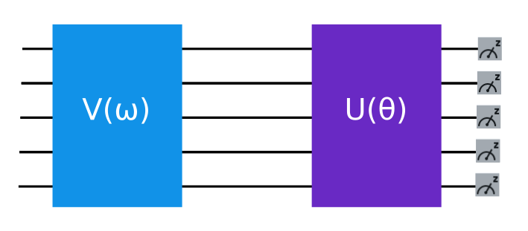
Parameterized quantum circuits
In quantum machine learning, parameterized quantum circuits tend to be used for two things:
To encode data, where the parameters are determined by the data being encoded.
As a quantum model, where the parameters are determined by an optimization process.
IBM Quantum / © 2021 IBM Corporation

Slide 7



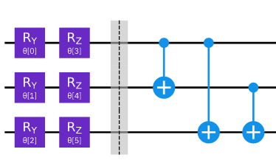
Data Encoding
It is essential to effectively represent classical data in a quantum system, so that it can be processed by a quantum machine learning algorithm. This is often referred to as data encoding, but it is also called data embedding or data loading.
Basis encoding
Amplitude encoding
Angle encoding
Arbitrary encoding
IBM Quantum / © 2021 IBM Corporation
Images from https://qiskit.org/textbook-beta/course/machine-learning-course/ .

Slide 8

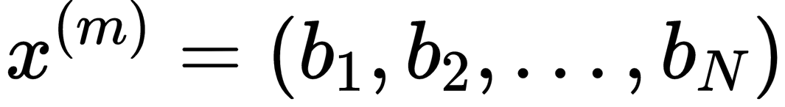
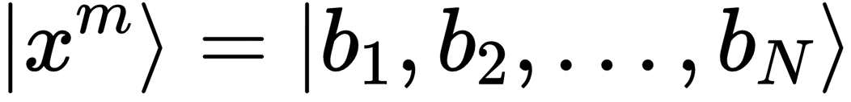
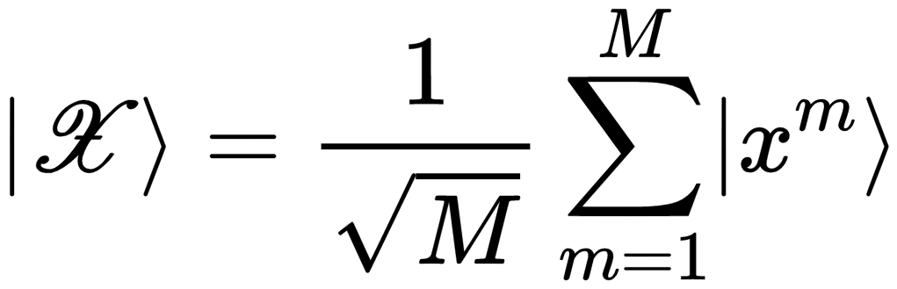
Basis Encoding
For the classical dataset to use basis encoding, each datapoint must be an N-bit string: , which then can be mapped directly to the quantum state with . We can represent the entire dataset as superposition of computational basis states:
IBM Quantum / © 2021 IBM Corporation
Images from https://qiskit.org/textbook-beta/course/machine-learning-course/ .

Slide 9
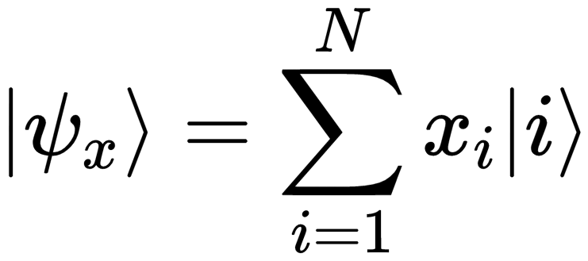
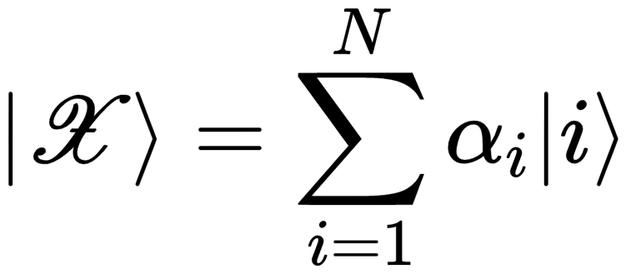
Amplitude Encoding
The amplitudes of a -qubit quantum state,
The dataset can be represented in the computational basis as:
IBM Quantum / © 2021 IBM Corporation
Images from https://qiskit.org/textbook-beta/course/machine-learning-course/ .

Slide 10

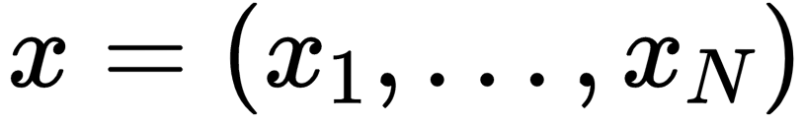
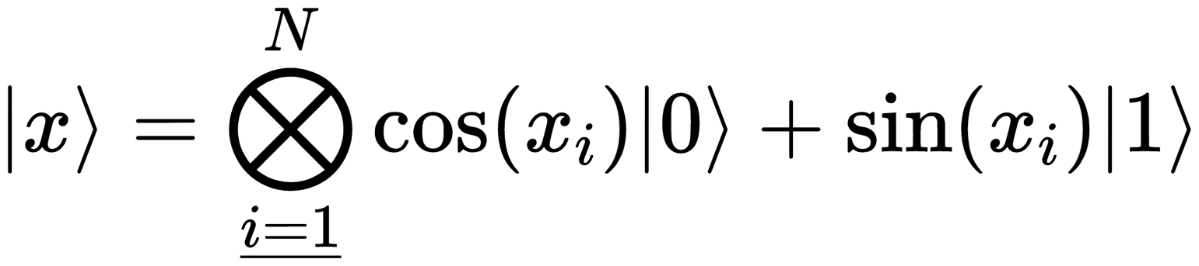
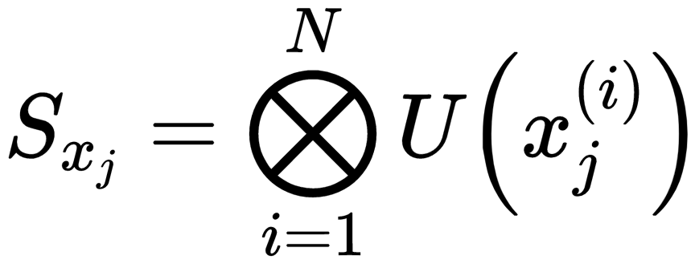
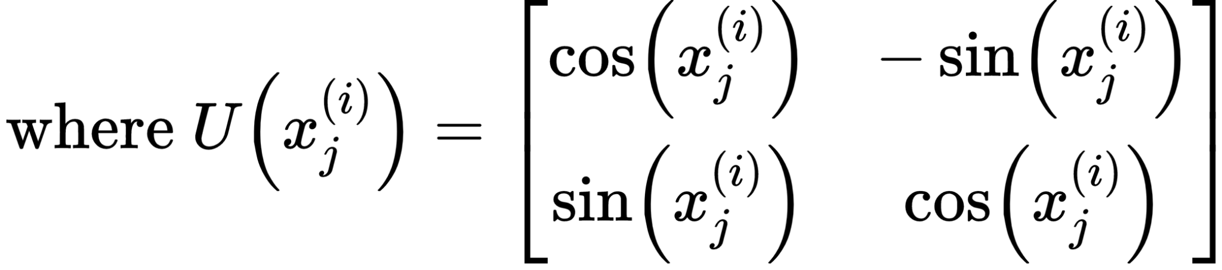
código: EECC-D8-1802
Angle Encoding
Angle encoding, encodes N features into the rotation angles of qubits, where . For example, the datapoint can be encoded as:
The dataset can be represented using a unitary
IBM Quantum / © 2021 IBM Corporation
Images from https://qiskit.org/textbook-beta/course/machine-learning-course/ .

Slide 11
código: EECC-D8-1802
Arbitrary encoding
Arbitrary encoding, encodes N features as rotations on N parameterized gates on n qubits, where . Like angle encoding, it only encodes one datapoint at a time, rather than a whole dataset.
IBM Quantum / © 2021 IBM Corporation
Image from https://qiskit.org/textbook-beta/course/machine-learning-course/ .

Slide 12
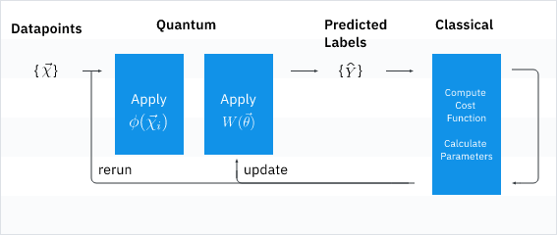
Variational classification
The goal of the algorithm is to find the circuit parameters θ for the parameterized quantum circuit U(θ) that minimizes the cost function C(θ).
IBM Quantum / © 2021 IBM Corporation
Images from https://qiskit.org/textbook-beta/course/machine-learning-course/ .

Slide 13
Links
Qiskit Quantum machine learning Course: https://qiskit.org/textbook-beta/course/machine-learning-course/
Qiskit textbook: https://qiskit.org/textbook/preface.html
Qiskit YouTube channel: https://www.youtube.com/c/qiskit
Qiskit medium: https://medium.com/qiskit
Qiskit slack: qiskit.slack.com

Slide 14
References
https://medium.com/qiskit/introducing-qiskit-machine-learning-5f06b6597526
https://medium.com/qiskit/were-releasing-a-free-hands-on-quantum-machine-learning-course-online-c9313e78ea2d
https://qiskit.org/textbook-beta/course/machine-learning-course
Vedran Dunjko, Jacob M. Taylor and Hans J. Briegel, Quantum-Enhanced Machine Learning, Physical Review Letters 117 (13), 130501 (2016) doi:10.1103/PhysRevLett.117.130501 arXiv:1610.08251
Sukin Sim, Peter D. Johnson and Alan Aspuru-Guzik, Expressibility and entangling capability of parameterized quantum circuits for hybrid quantum-classical algorithms, Advanced Quantum Technology 2 (2019) 1900070, doi:10.1002/qute.201900070, arXiv:1905.10876.
Thomas Hubregtsen, Josef Pichlmeier, and Koen Bertels, Evaluation of Parameterized Quantum Circuits: On the Design, and the Relation between Classification Accuracy, Expressibility and Entangling Capability 2020, arXiv:2003.09887.
Abhinav Kandala, Antonio Mezzacapo, Kristan Temme, Maika Takita, Markus Brink, Jerry M. Chow and Jay M. Gambetta, Hardware-efficient variational quantum eigensolver for small molecules and quantum magnets, Nature 549, 242–246 (2017), doi.org/10.1038/nature23879, arXiv:1704.05018

Slide 15
References
Vojtech Havlicek, Antonio D. Córcoles, Kristan Temme, Aram W. Harrow, Abhinav Kandala, Jerry M. Chow and Jay M. Gambetta, Supervised learning with quantum enhanced feature spaces, Nature 567, 209-212 (2019), doi.org:10.1038/s41586-019-0980-2, arXiv:1804.11326.
Maria Schuld and Francesco Petruccione, Supervised Learning with Quantum Computers, Springer 2018, doi:10.1007/978-3-319-96424-9.
Ryan LaRose and Brian Coyle, Robust data encodings for quantum classifiers, Physical Review A 102, 032420 (2020), doi:10.1103/PhysRevA.102.032420, arXiv:2003.01695.
Alberto Peruzzo, Jarrod McClean, Peter Shadbolt, Man-Hong Yung, Xiao-Qi Zhou, Peter J. Love, Alán Aspuru-Guzik and Jeremy L. O'Brien, A variational eigenvalue solver on a quantum processor, Nature Communications, 5:4213 (2014), doi.org:10.1038/ncomms5213, arXiv:1304.3061.
Edward Farhi, Jeffrey Goldstone and Sam Gutmann, A Quantum Approximate Optimization Algorithm (2014), arXiv:1411.4028.
Vojtech Havlicek, Antonio D. Córcoles, Kristan Temme, Aram W. Harrow, Abhinav Kandala, Jerry M. Chow and Jay M. Gambetta, Supervised learning with quantum enhanced feature spaces, Nature 567, 209-212 (2019), doi.org:10.1038/s41586-019-0980-2, arXiv:1803.07128.

