Slide 1


(2025W)COMP-5413 Data Science
Thunder Bay House Price Analysis and Recommendation System
Professor Name: Mahzabeen Emu
Presented By : Group 15
Asma UI Husna 1276327
Aye Kyi Kyi Cho 1276026
Kinjalben Gherawada 1279651
Kunj Amitkumar Patel 1265570

Slide 2

How exciting would it be if you could predict the price of a house before buying it?
"With our new data prediction model and recommendation system, we’ve made that possible!"

Slide 3
Contents
Introduction
Feature Engineering
Process Workflow
Methodology
Data Collection
Results
Data Preprocessing
Significance and Limitations
Numerical Data Visualization
Conclusion
Categorical Data Visualization
Team Contribution & References

Slide 4
Introduction
Background
Most housing applications only display listings posted by users.
They lack in-depth trend analysis and market insights.
Buyers and sellers often struggle to understand fair pricing.
Overview
Our project goes beyond just showing listings.
It provides price analysis, predicts house prices for new listings, and offers data-driven recommendations for buyers and sellers.
Data & Methodology
We used current house sales listings data from Thunder Bay.
Applied machine learning models to analyze trends and predict prices.

Slide 5
Process Workflow
Data Collection
Data Preprocessing
Exploratory Data Analysis (EDA)
Model Training & Prediction
Recommendation System
Final Dashboard & Insights

Slide 6
Data Collection
Data Source
Data collected through web scraping from housing listing applications like Kijiji and tcreality.ca in Thunder Bay.
Dataset Size
Contains 62 entries and 9 features (columns).
Feature | Description | Range/Values
Price | Market value of the property | $100,000 – $1,000,000
Bedrooms | Number of bedrooms available | 1 – 5
Bathrooms | Number of bathrooms | 1 – 3
SqFt | Property size in square feet | 800 – 4000 sq. ft.
Nearest Intersection | Encoded key intersections for location context | Arthur Street & Edward Street = 0, Balmoral Street & Harbour Expressway = 1, Fort William Road & Central Avenue = 2, Memorial Avenue & John Street = 3, Red River Road & Junot Avenue = 4
Type | Property category (Apartment, House, Condo) | Categorical

Slide 7
Data Preprocessing
Handling
Handling Null Values
Used the complete dataset to predict and fill null values in the dataset scraped from Kijiji.
This ensured that the data was complete and ready for model training.
Identifying
Identifying Features
Checked for null values across all features to ensure data integrity.
Identified numerical and categorical features in the dataset.
Encoding
Encoding Categorical Variables
Used Label Encoding to convert categorical values (e.g., property type) into numerical values for model compatibility.

Slide 8
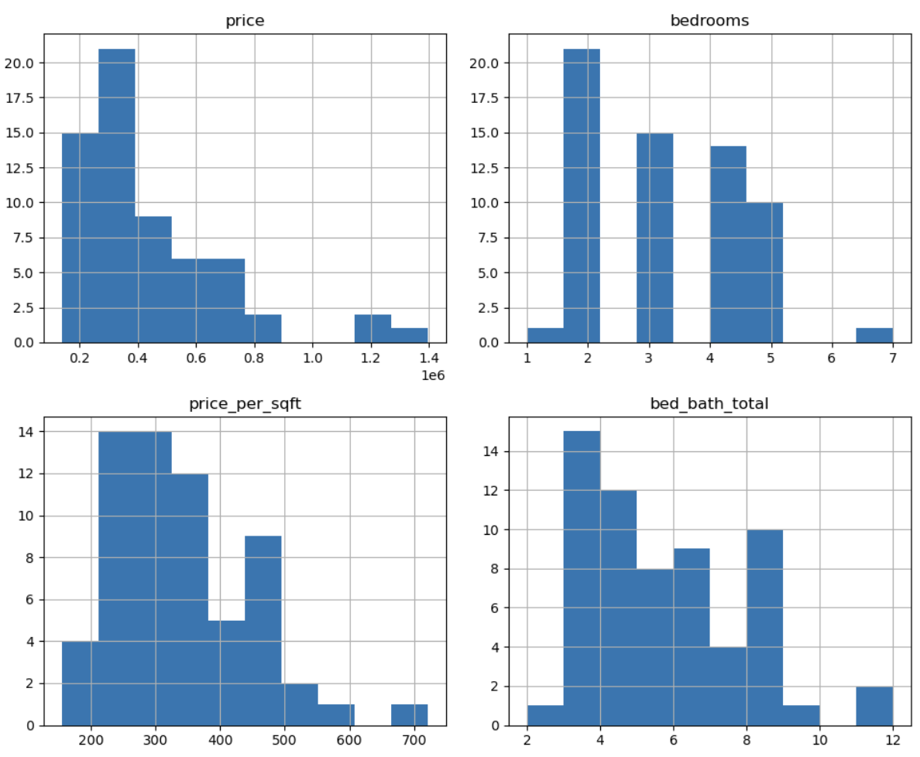
Numerical Data Visualization
Some of the distribution and relationships of numerical features such as Bathrooms, Sqft, Price, and Bedrooms.
We used dynamic grid sizing to efficiently display varying numbers of plots.

Slide 9
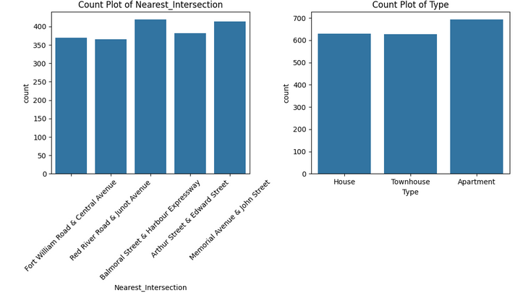
Categorical Data Visualization
Category Distribution: Displays the frequency of each category within the dataset.
Group Comparisons: Highlights dominant and less common categories.
Detecting Patterns in Qualitative Data: Reveals relationships between different categorical variables.

Slide 10
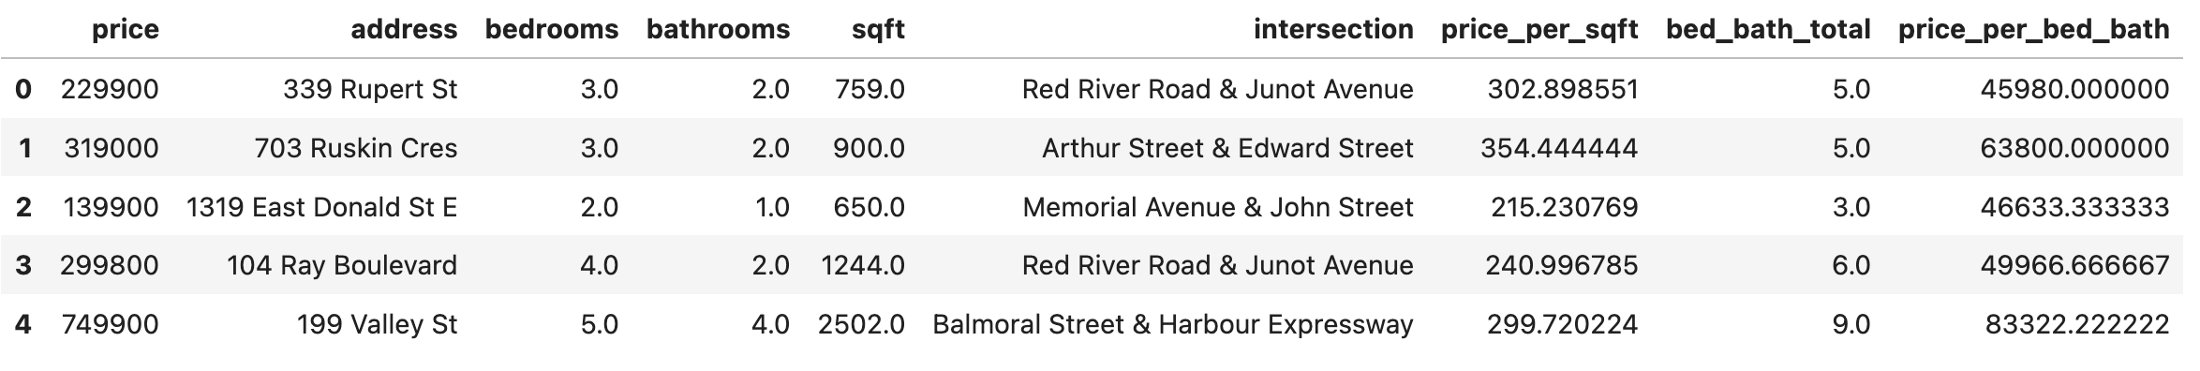
Feature Engineering
New Features:
Price per SqFt, Price per Bedroom and Bathroom, Total Living Space: number of bedrooms and bathrooms.
Normalization:
Applied StandardScaler to scale the features with a mean of 0 and a standard deviation of 1. This helps in improving model performance by ensuring that all features have the same scale.
Dimensionality Reduction:
Skipped due to the small number of features (12 features in total).

Slide 11
Methodology
Model Selection
Linear Regression provides a baseline performance for continuous target variables.
Random Forest offers strong predictive performance, especially for datasets with complex relationships.
Decision Tree helps in interpreting feature importance and can handle non-linear data well.
Model Training Process
Split the dataset into training (80%) and test (20%) sets.
Trained the models using the preprocessed data, including the engineered features.
Model Evaluation Metrics
Mean Absolute Error (MAE): Measures the average magnitude of errors in predictions.
Mean Squared Error (MSE): Gives more weight to larger errors, useful for penalizing outliers.
R-squared (R²): Indicates how well the model explains the variance in the target variable (house price).

Slide 12
Methodology (Cont.)
Model Comparison
Random Forest outperformed the other models in terms of accuracy and predictive power.
Lowest MAE: It has the smallest Mean Absolute Error (MAE) at 8,583.64, indicating more accurate predictions.
Lowest MSE & RMSE: Random Forest also has the lowest Mean Squared Error and Root Mean Squared Error meaning it generates fewer large errors.
Highest R²: With 0.9977, Random Forest explains almost 100% of the variance in house prices, showing that it captures the underlying relationships better than other models.
Model | MAE | MSE | R²
Decision Tree | 56938.46 | 5497972307.69 | 0.93
Random Forest | 42880.15 | 4151186197.38 | 0.94
Linear Regression | 42505.70 | 4466783804.02 | 0.94

Slide 13
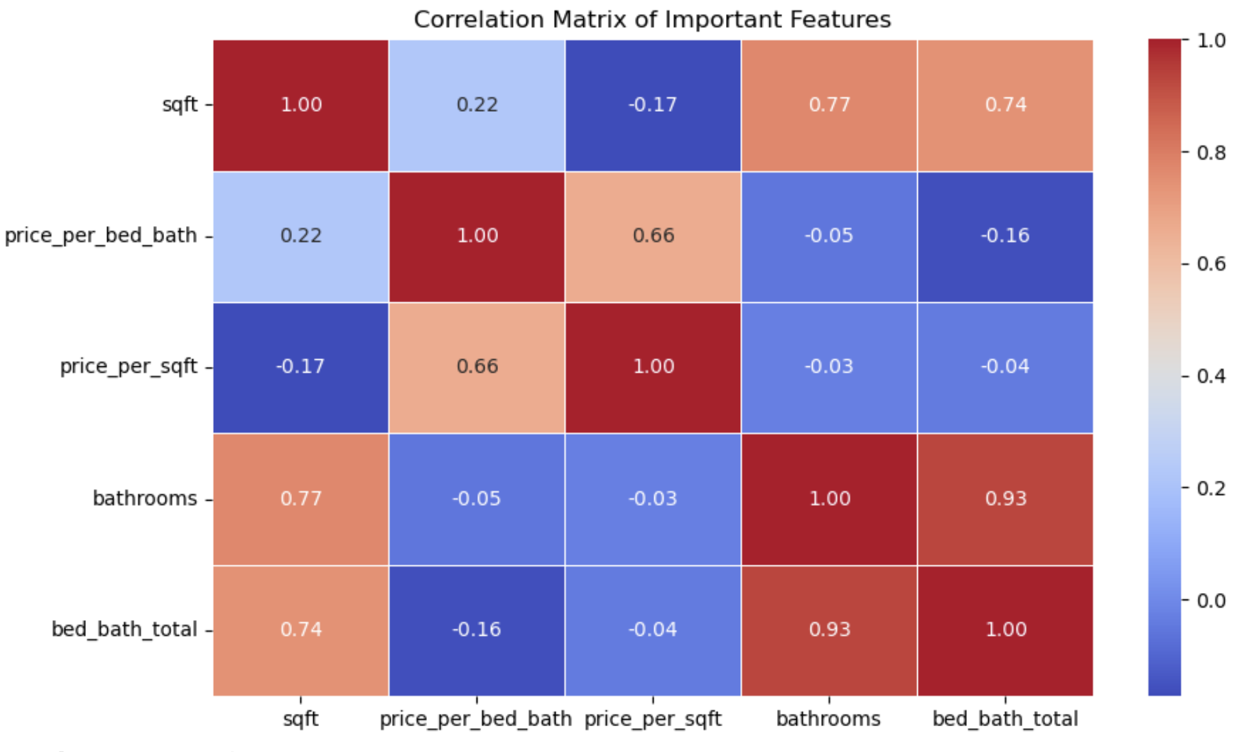
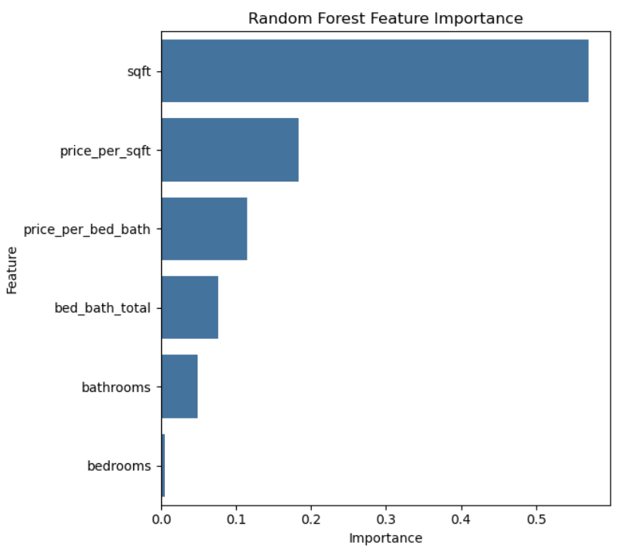
Methodology (Cont.)
Key Findings
Significant Factors:
Size of the property (sqft).
Number of bedrooms.
Intersection.
Interesting Insights:
Properties with similar features can have vastly different prices due to location and neighbourhood amenities.

Slide 14
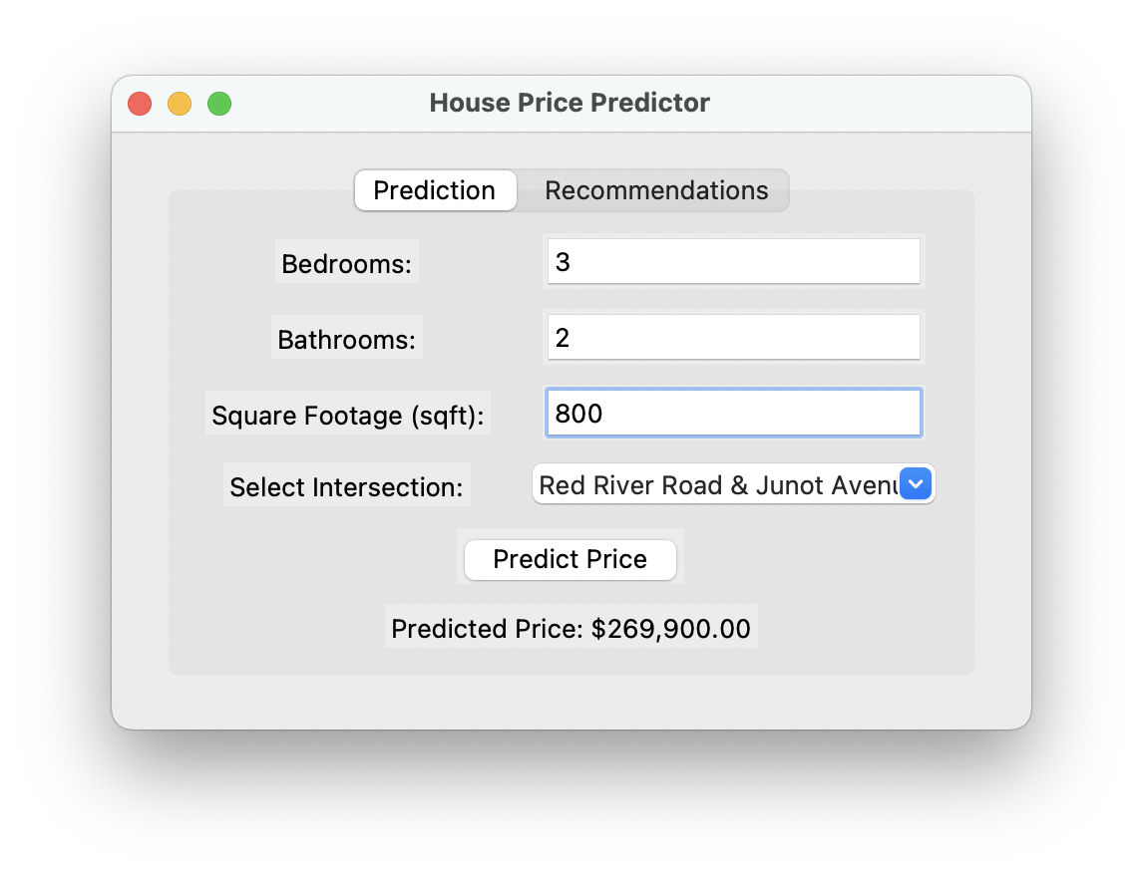
Results
Prediction:
The Random Forest model, which outperformed other models, is used to predict the price for new, unseen data.
The model takes in the user input (e.g., property features such as number of bedrooms, square footage, etc.).
Random Forest predicts the price based on patterns learned during the training phase. The predicted price is outputted to the user.

Slide 15
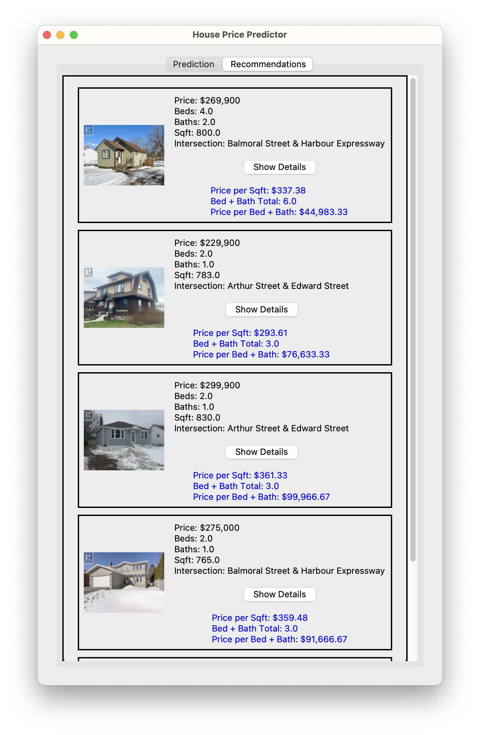
Results
Recommendations:
User Input: Based on the user's input (e.g., number of bedrooms, square footage, and other features), the model will recommend similar houses in the dataset.
Recommendation Logic: The system compares the input features with the available listings and selects the most similar houses based on the similarity in features (e.g., price, size, location).
Similarity Calculation: The model calculates similarity scores using metrice like Euclidean distance.

Slide 16
Significance, Challenges & Limitations
Significance
Ensures fair pricing and reduces financial risks.
Helps buyers and sellers make data-backed decisions.
Improves market transparency through predictive insights.
Challenges
Handling missing values and outliers.
Processing geospatial features like "Nearest Intersection.”
Limited availability of detailed real estate data can affect model accuracy.
Limitations
Thunder Bay’s diverse housing market leads to price variability.
Lack of data may not fully replicate real-world variations.

Slide 17
Conclusion
The predictive model using Random Forest offers valuable insights into property prices in Thunder Bay.
The model can help buyers, sellers, and stakeholders make more informed decisions by providing accurate price predictions based on various features.
Despite the challenges, such as data shortage and handling geospatial features, the model demonstrates strong predictive capabilities.
Future Work:
Expand dataset, use advanced ML models, and improve recommendation accuracy, integrate real-time updates.

Slide 18
Team Contribution
Team Member Contributions:
Asma Ul Husna: 25% (Data collection, Preprocessing, Model Building and Evaluation, Recommendations, Presentation, Report ).
Aye Kyi Kyi Cho: 25% (Presentation, Report, Recommendation System & Dashboard )
Kinjalben Gherawada: 25% (Presentation, Report, Recommendation System & Dashboard)
Kunj Amitkumar Patel: 25% (Recommendation System & Dashboard, Report)

Slide 19
References
City of Thunder Bay. (n.d.). Open Data Portal. Retrieved from https://opendata.thunderbay.ca
Town & Country (Reality Real Estate Brokerage Inc ) retrieved from https://tcrealty.ca/
Géron, A. (2019). Hands-On Machine Learning with Scikit-Learn, Keras, and TensorFlow. O'Reilly Media.
Hastie, T., Tibshirani, R., & Friedman, J. (2009). The Elements of Statistical Learning. Springer.
Han, J., Pei, J., & Kamber, M. (2011). Data Mining: Concepts and Techniques. Elsevier.
Zillow Research. (2023). Housing Market Trends & Analysis. Retrieved from https://www.zillow.com/research/
Kaggle House Price Dataset & Predictions: https://www.kaggle.com/c/house-prices-advanced-regression-techniques
Waskom, M. (2021). Seaborn: Statistical Data Visualization. Journal of Open Source Software, 6(60), 3021.
McKinney, W. (2017). Python for Data Analysis. O'Reilly Media.
Canadian Real Estate Association (CREA). (2023). Housing Market Reports. Retrieved from https://www.crea.ca

Slide 20
Thank You
Thank You

