Slide 1
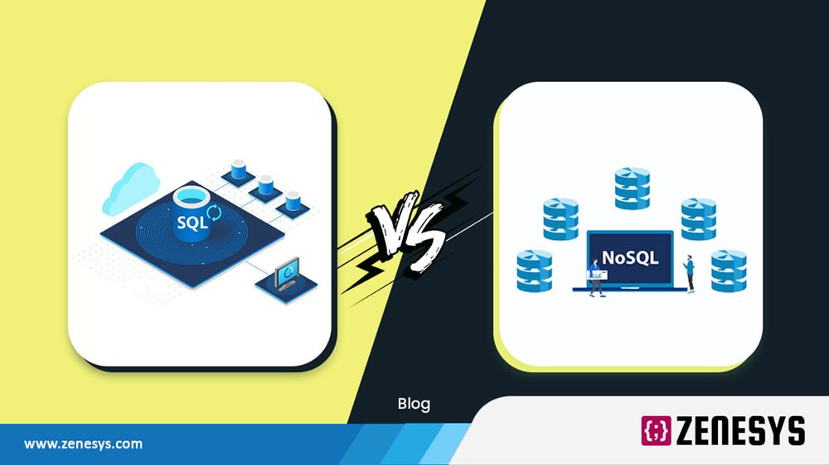

Slide 2
SQL VS NoSQL: Top 10 Head-to-Head Comparisons
Are you confused while choosing the modern database? Or don't know whether SQL or NoSQL; which one to choose? SQL refers to a decades-old database but is still ubiquitous and effectively being used by Analysts, Engineers, data scientists, and IT decision-makers. However, the increasing volumes of unstructured data, process chunks of data, and the need for storage availability spark interest in different technologies such as NoSQL.

Slide 3

What is Structured Query language (SQL)?

Slide 4
SQL is a programming language that differs from a general-purpose programming language such as Python, Java, and JavaScript. It has a specific purpose: to access and manage data in relational databases. It uses relations (referred to as tables) with a schema to manage and store data.
Some of the relational database examples which use SQL are:
Oracle
Microsoft SQL server
Ingres
Microsoft office Access
IBM DB2
Sybase
Google Cloud SQL
Amazon RDS
PostgreSQL

Slide 5
