Slide 1
Evaluating the Robustness of
Computer Vision Models
Project by: Ayelet & Noa
BDD100K road scenes · YOLOv8 · Mask R-CNN · MiDaS
1

Slide 2
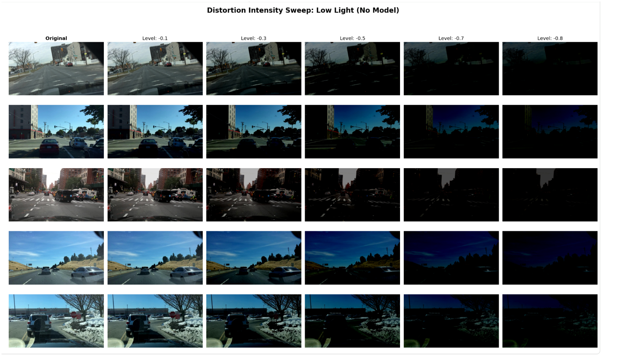
Project Goal
Measure how vision models behave when image quality drops
Test three tasks: object detection, instance segmentation and depth estimation
Compare clean baselines, classical enhancement and fine-tuning
Identify when simple filtering is enough and when model adaptation is needed
Example: gradual low-light degradation
Ayelet & Noa | Computer Vision Robustness
2

Slide 3
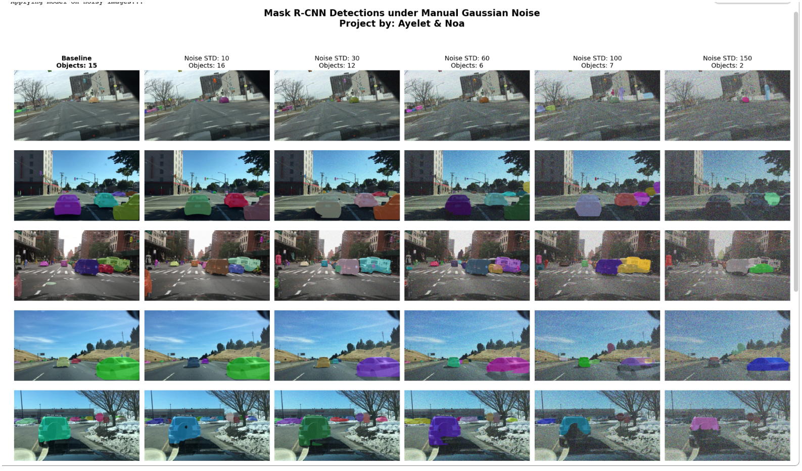
Evaluation Method
Start from clean images and define a baseline output
Apply one distortion at several severity levels
Run the model again and compare against the clean baseline
Use Recall and Precision (when needed)
for detection and segmentation Use RMSE and SSIM for depth-map comparison
Clean baseline outputs were used as the reference for later comparisons
Ayelet & Noa | Computer Vision Robustness
3

Slide 4
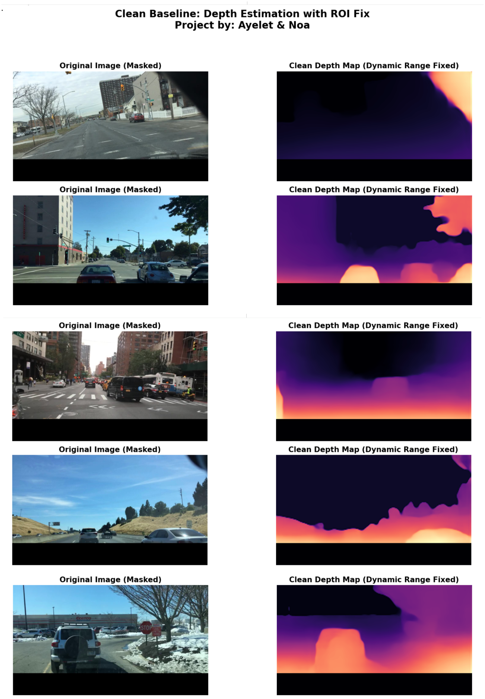
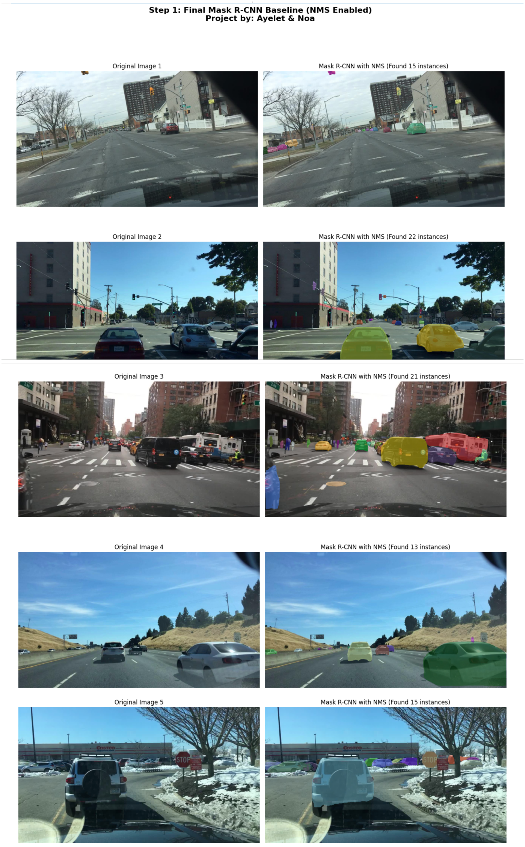
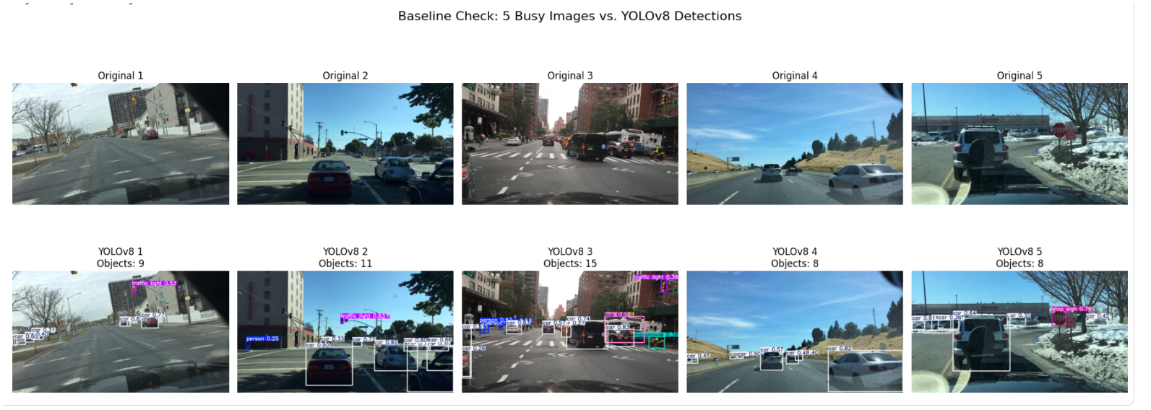
Models and Metrics
YOLOv8
Mask R-CNN
MiDaS
Monocular depth estimation
RMSE, lower is better
SSIM, higher is better
Instance segmentation
Recall and Precision
Effect of masks under noise and compression
Object detection
Recall vs. distortion level
Confidence loss and misclassification
One dataset, three tasks, separate metrics
Ayelet & Noa | Computer Vision Robustness
4

Slide 5
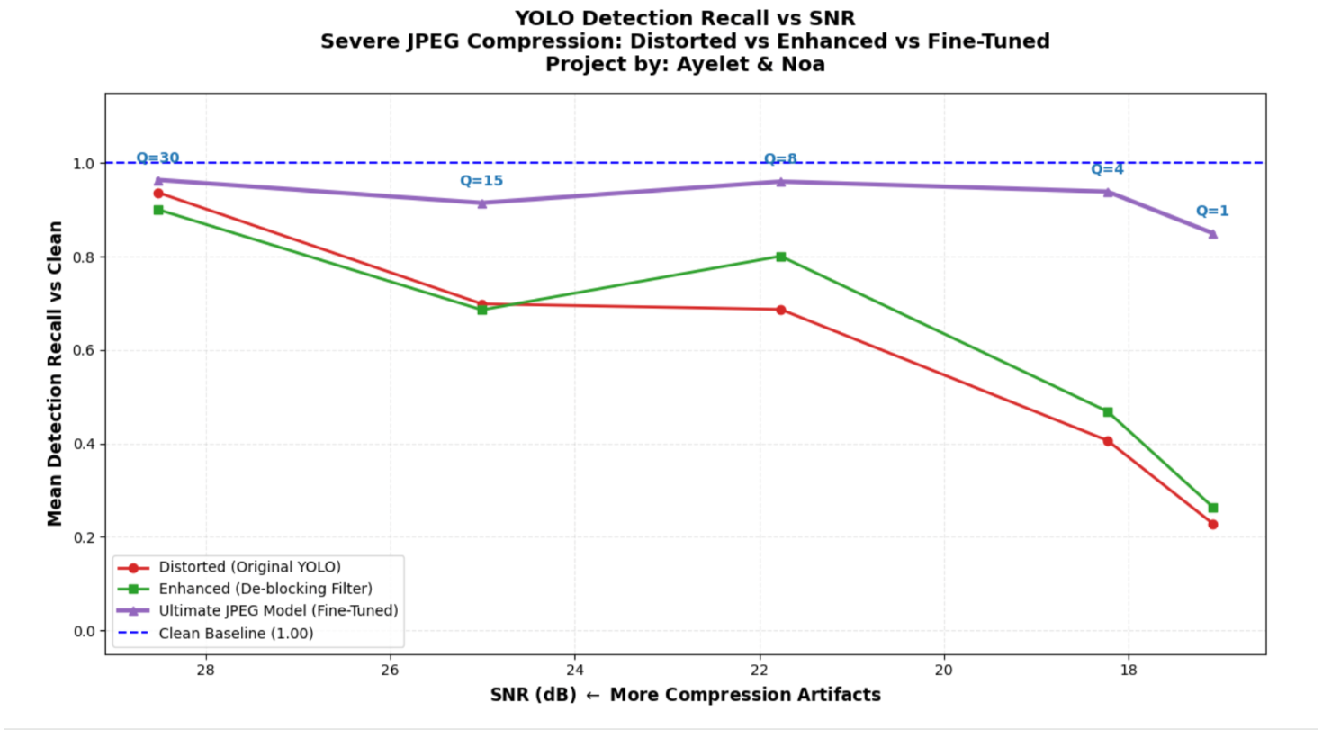
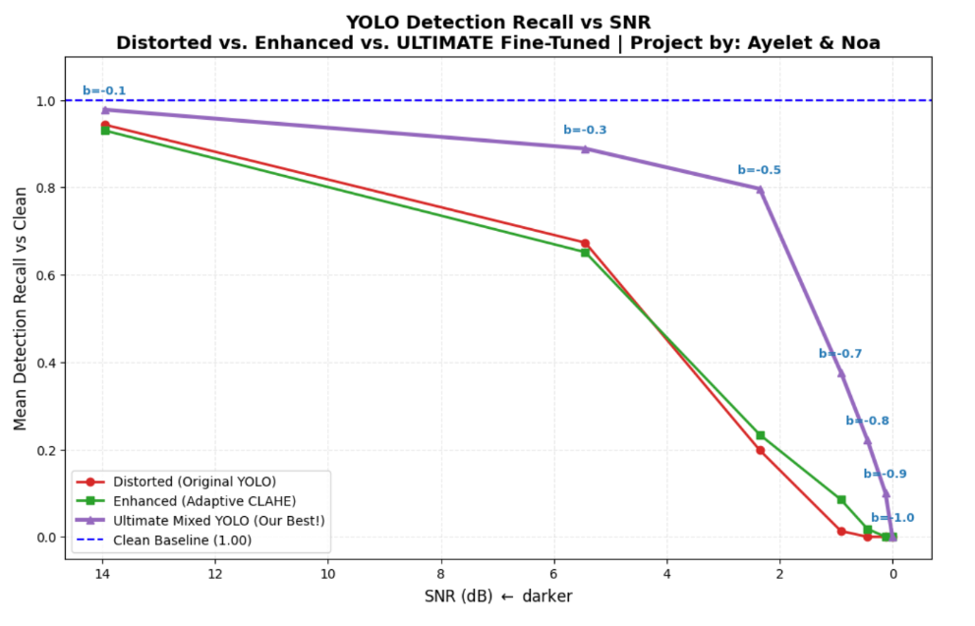
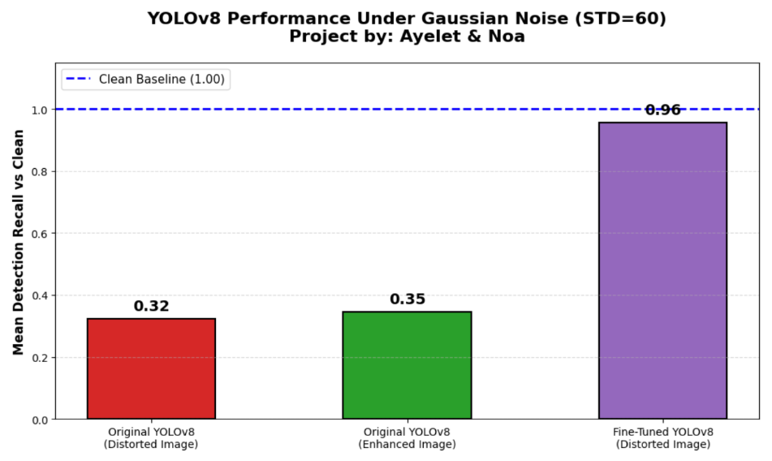
YOLOv8: Detection Robustness
Low light gradually removes visible objects from the detector
Gaussian noise reduces feature stability and confidence
JPEG artifacts may create false object-like structures
Fine-tuning improves recall under difficult distortions, but the original model can remain best under mild distortion
YOLOv8 results show a clear trade-off between clean accuracy and robustness
Ayelet & Noa | Computer Vision Robustness
5

Slide 6
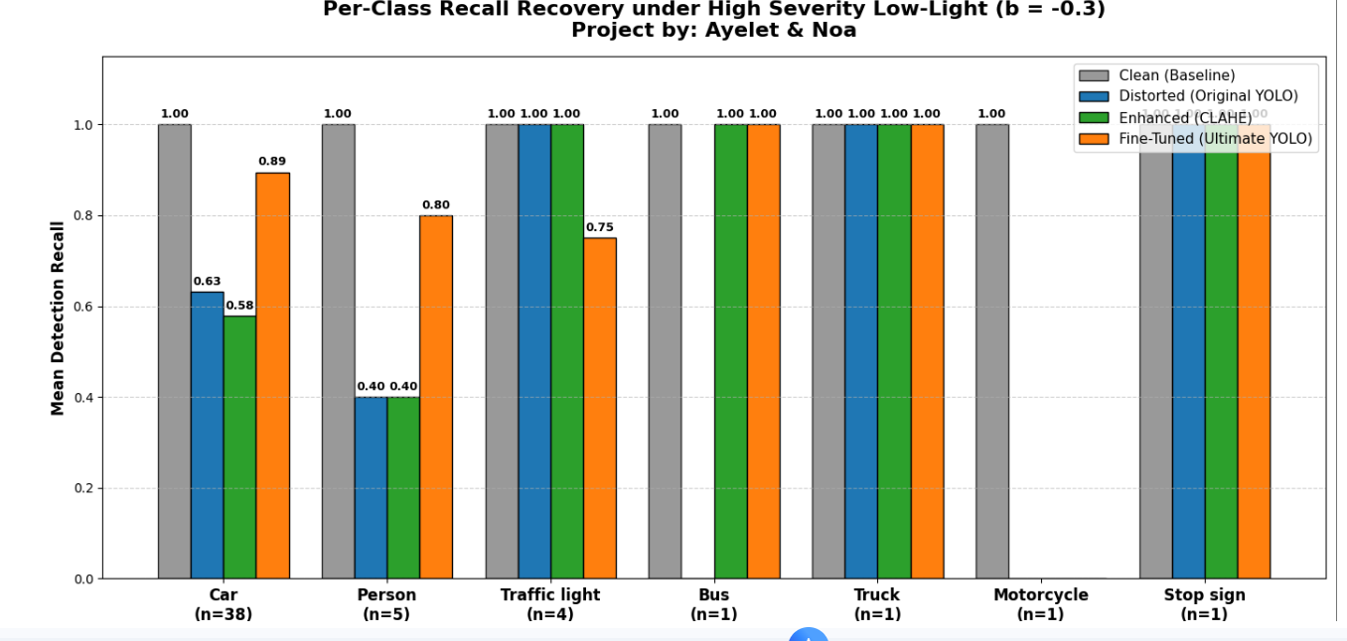
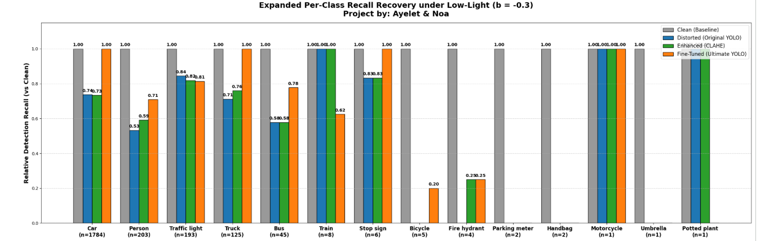
YOLOv8 Per-Class Recovery: Low Light
5 and 300-images sample
Ayelet & Noa | Computer Vision Robustness
6

Slide 7
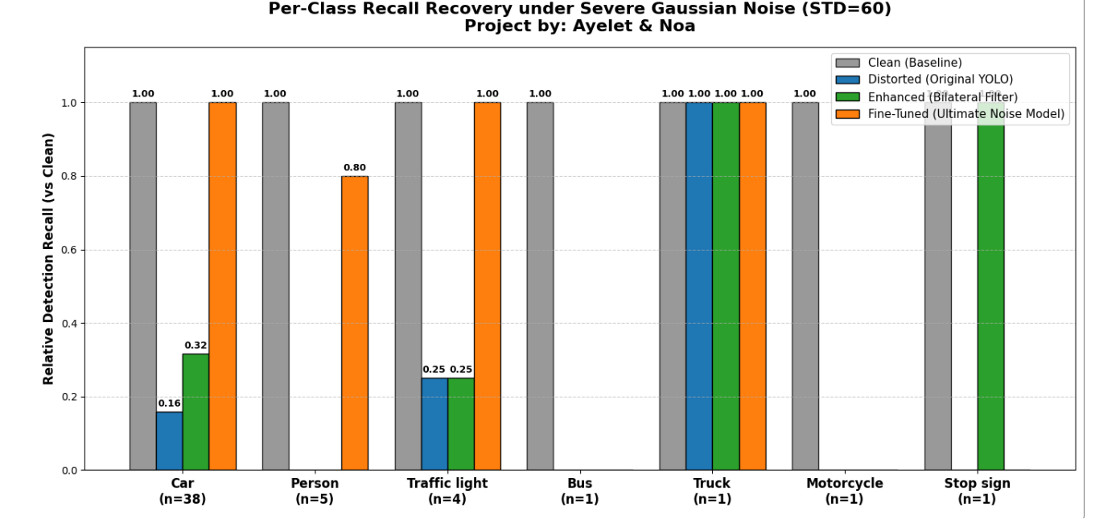
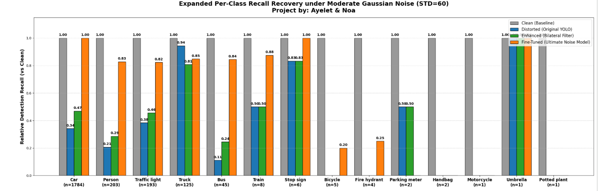
YOLOv8 Per-Class Recovery: Gaussian Noise
5 and 300-images sample
Ayelet & Noa | Computer Vision Robustness
8

Slide 8
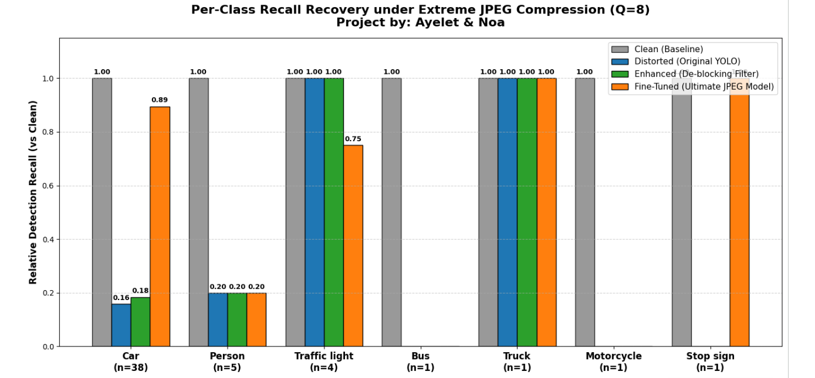
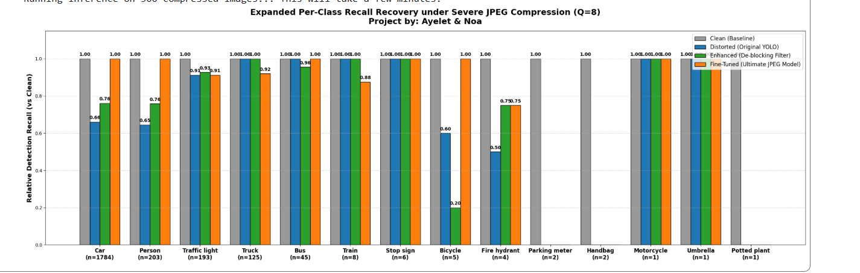
YOLOv8 Per-Class Recovery: JPEG Compression
5 and 300-images sample
Ayelet & Noa | Computer Vision Robustness
10

Slide 9
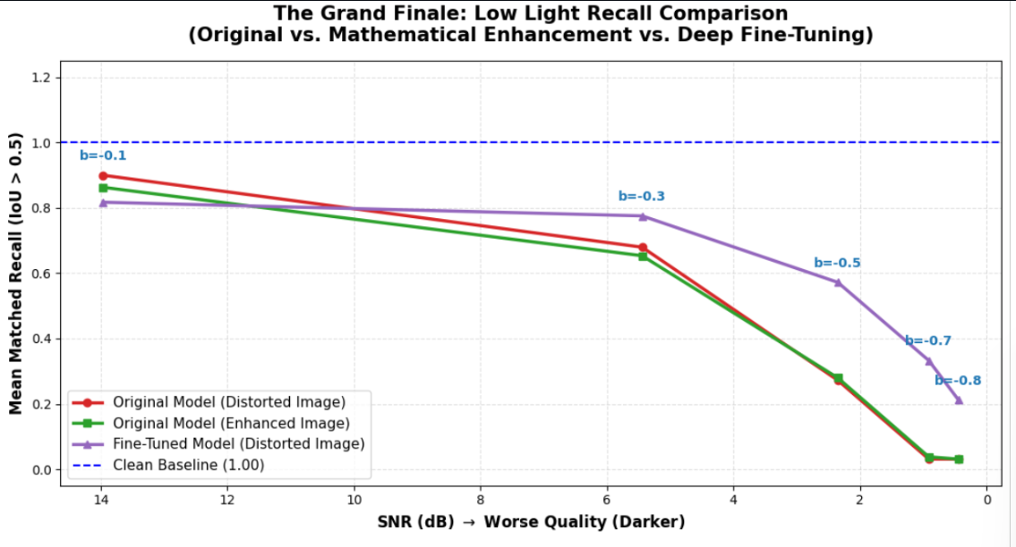
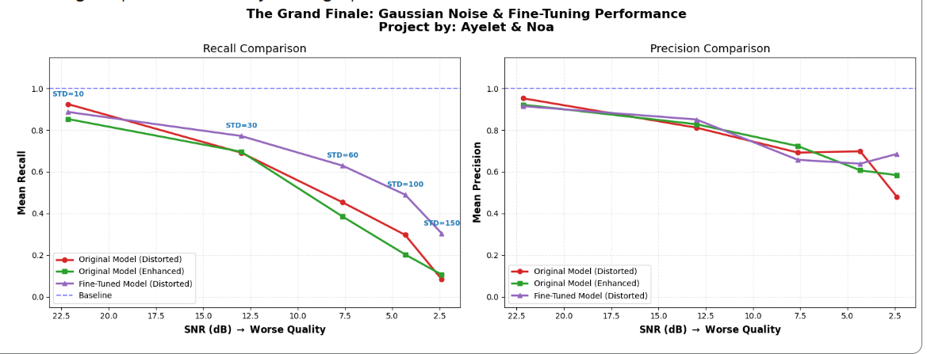
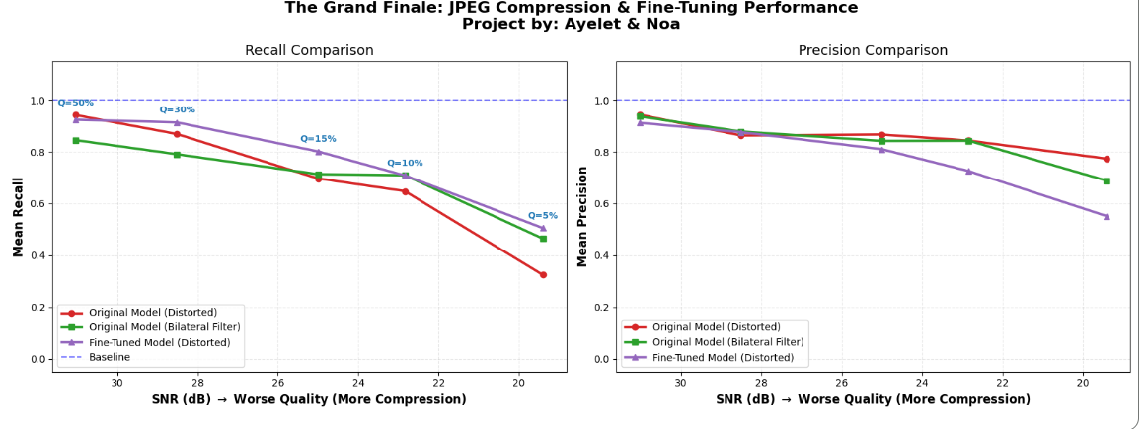
Mask R-CNN: Segmentation Robustness
Instance masks become unstable when textures are corrupted
Classical filters can help, but the effect depends on the distortion
Fine-tuning was trained with pseudo-labels generated from clean images
At extreme noise and compression, the fine-tuned model preserved higher recall
Fine-tuning compared against the original model and classical enhancement
Ayelet & Noa | Computer Vision Robustness
12

Slide 10
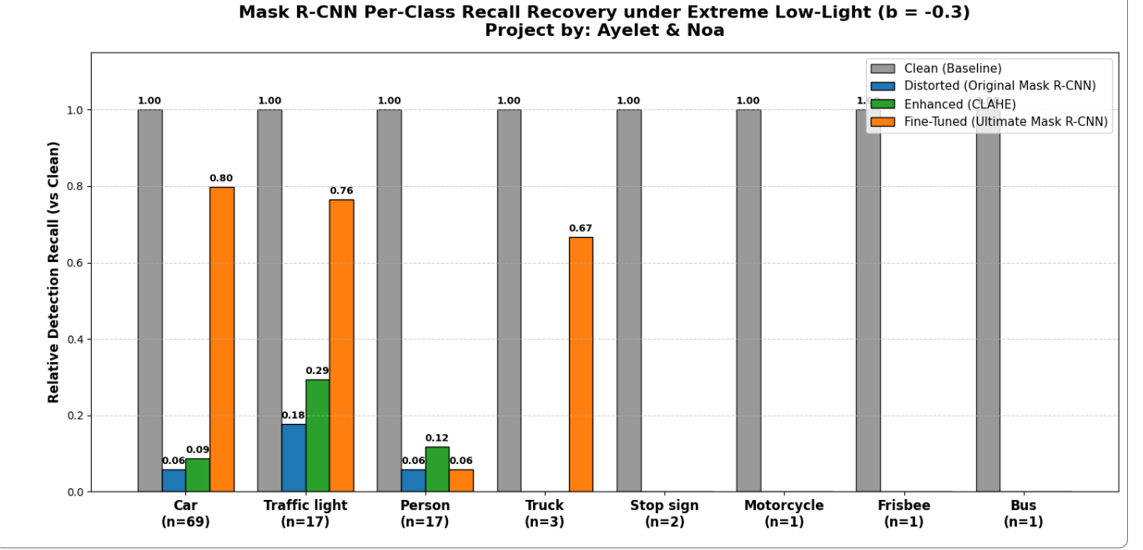
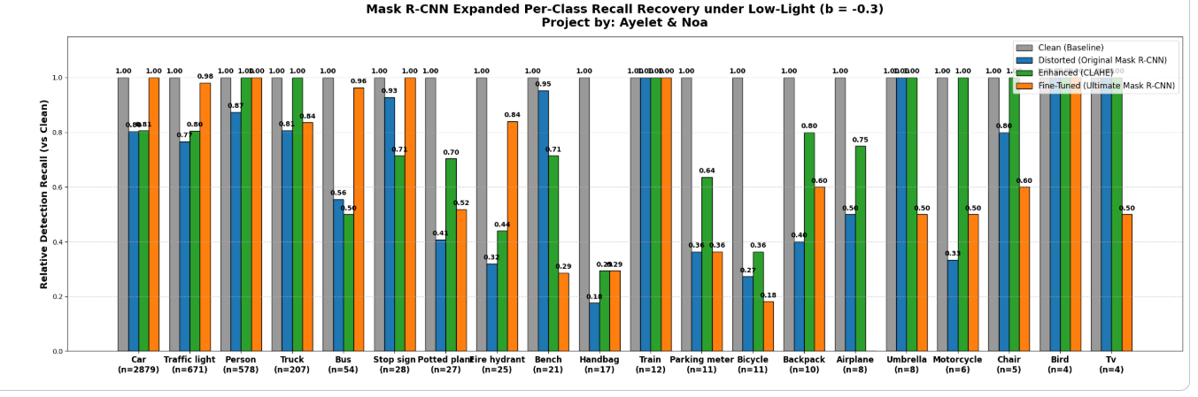
Mask R-CNN Per-Class Recovery: Low Light
5 and 300-images sample
Ayelet & Noa | Computer Vision Robustness
13

Slide 11
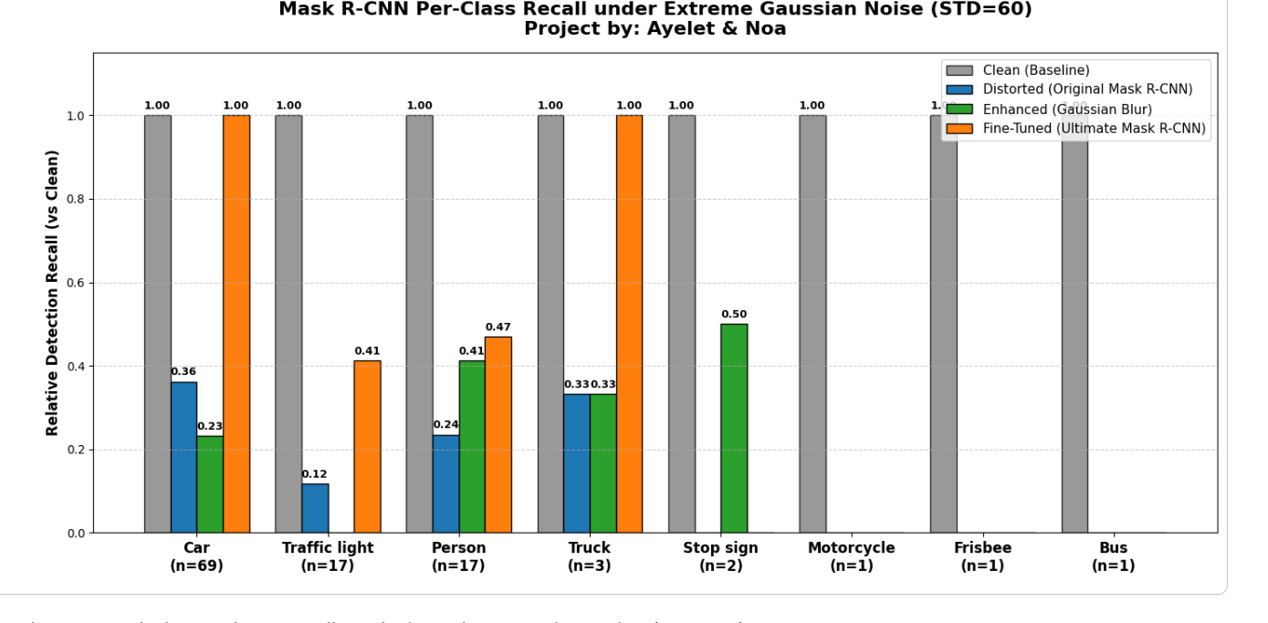
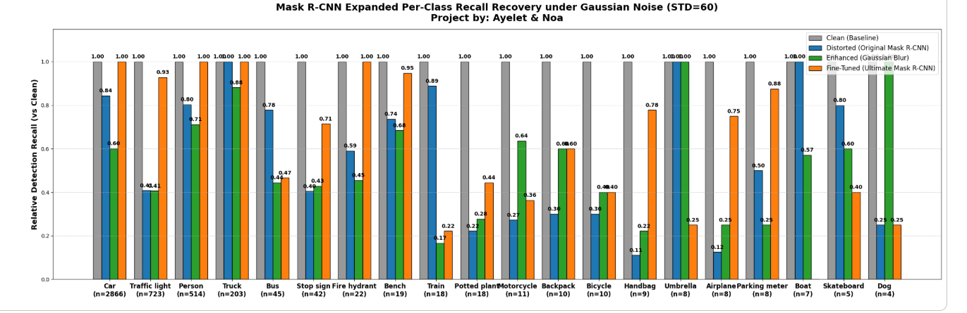
Mask R-CNN Per-Class Recovery: Gaussian Noise
5 and 300-images sample
Ayelet & Noa | Computer Vision Robustness
15

Slide 12
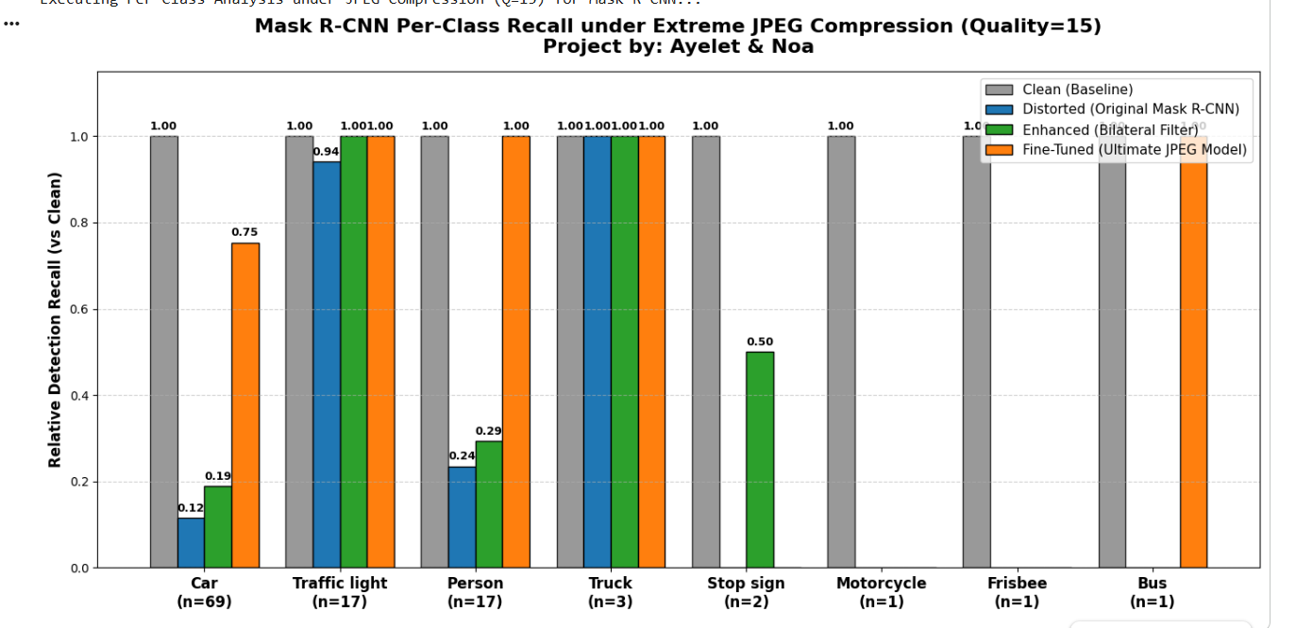
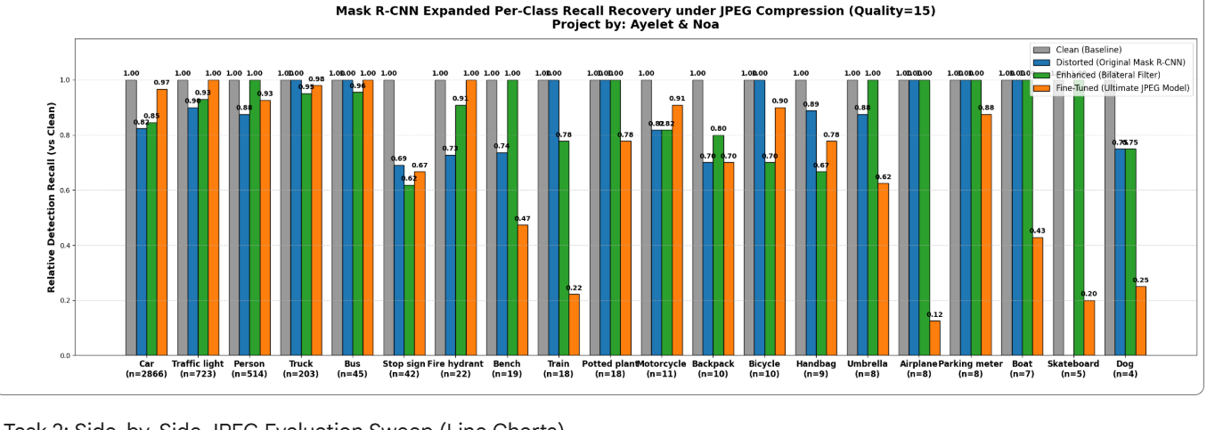
Mask R-CNN Per-Class Recovery: JPEG Compression
5 and 300-images sample
Ayelet & Noa | Computer Vision Robustness
17

Slide 13
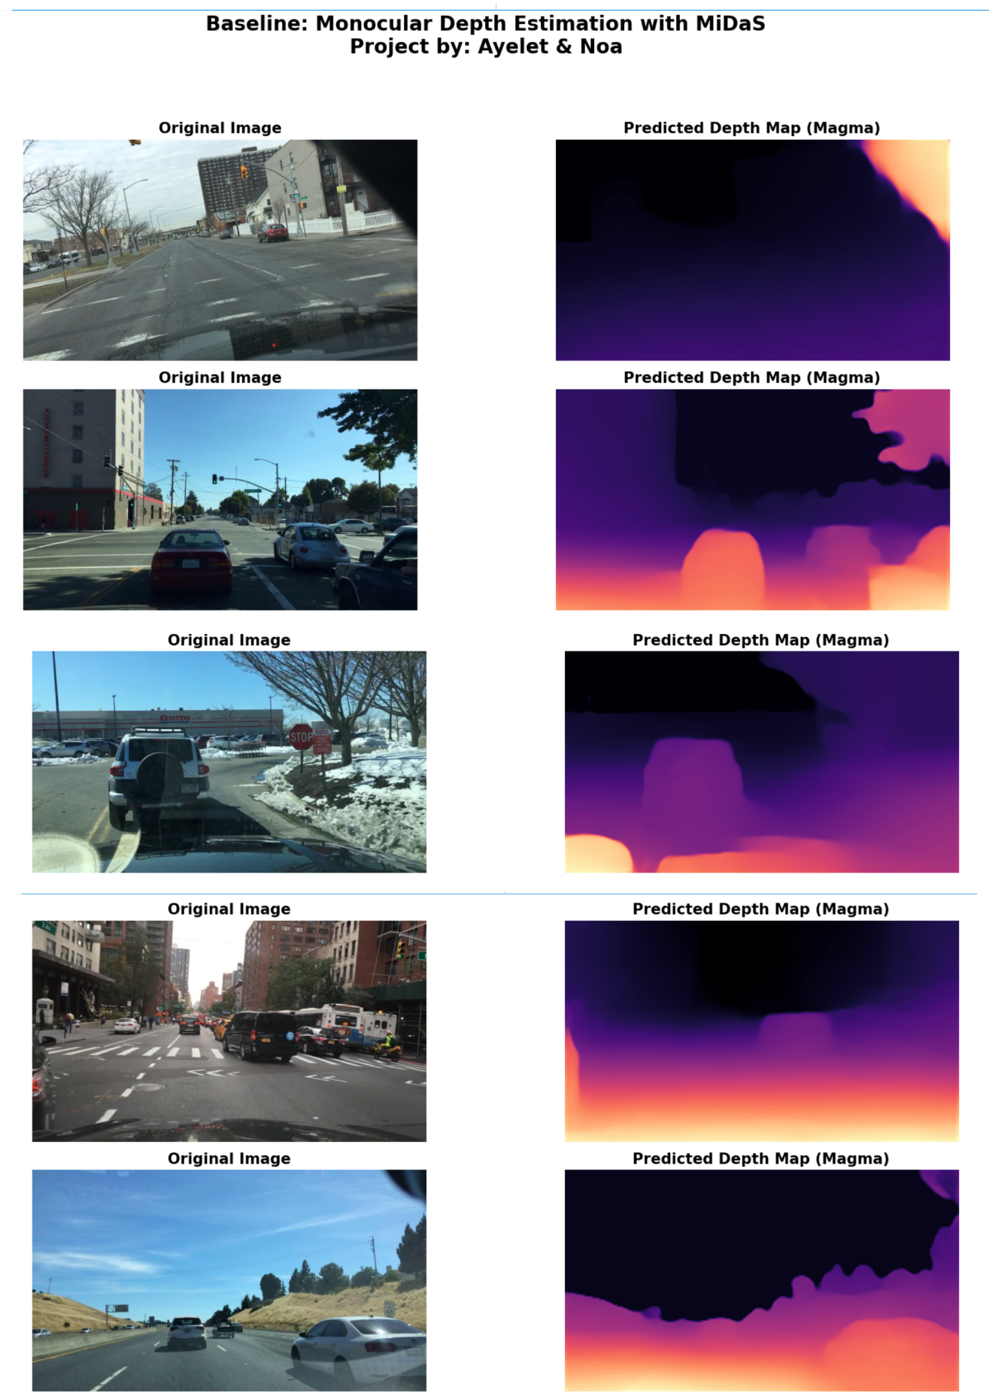
MiDaS: Depth Estimation Setup
MiDaS predicts a relative depth map from a single image
The dashboard region was removed from evaluation using an upper 80% ROI
Depth maps were normalized before comparison
RMSE captures numeric error; SSIM captures structural similarity
Baseline depth maps before and after ROI correction
Ayelet & Noa | Computer Vision Robustness
19

Slide 14
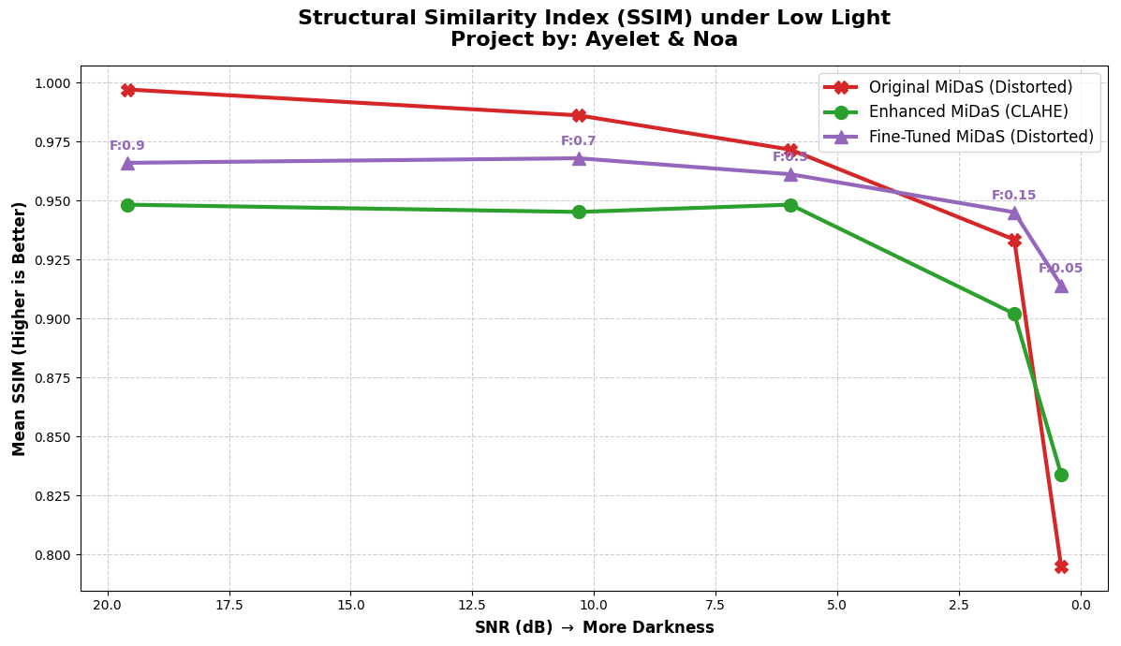
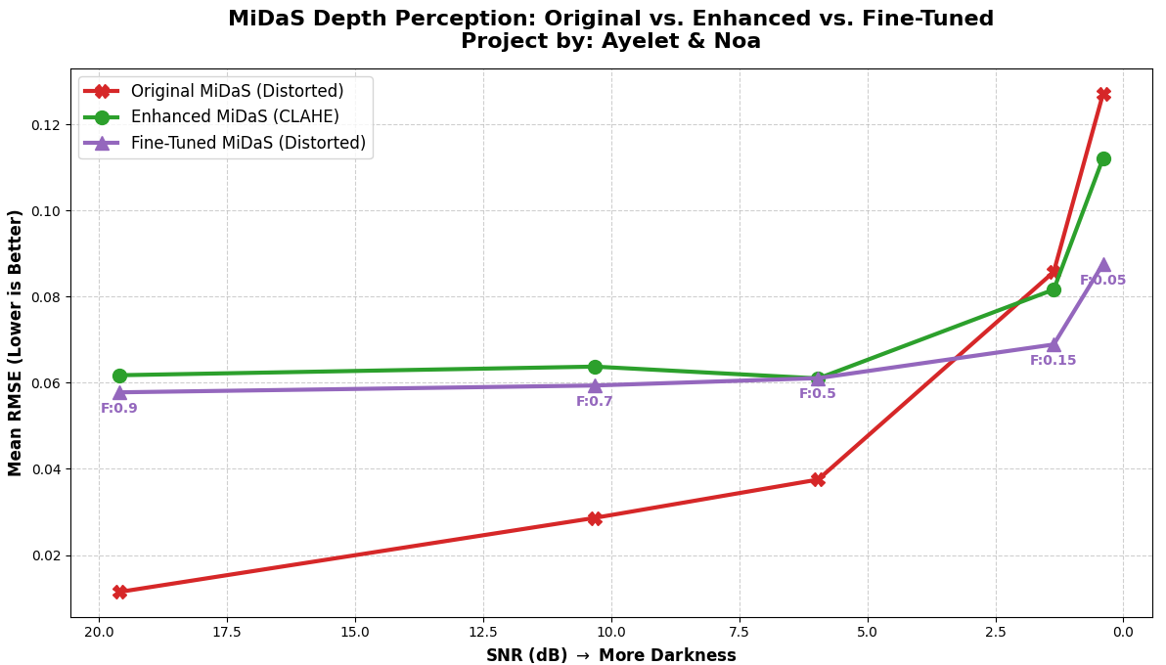
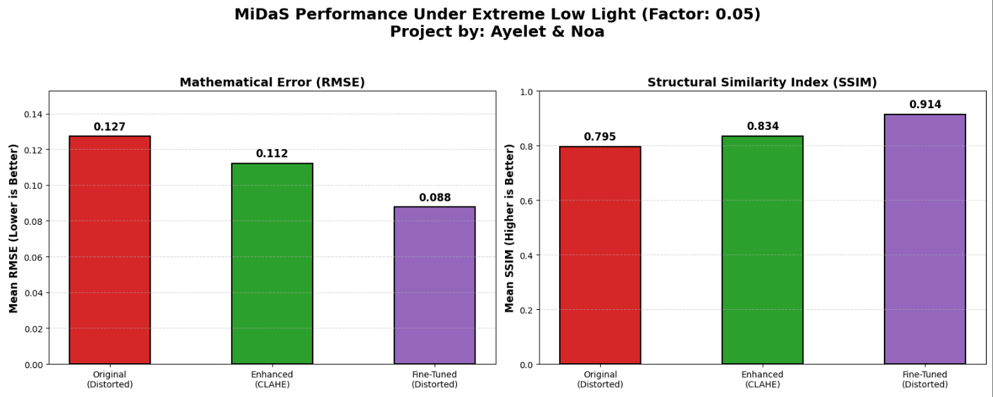
MiDaS under Low Light
Darkness weakens the visual signal used for depth estimation
RMSE increases as the image becomes darker
SSIM decreases because the depth structure changes
CLAHE helps mainly under strong darkness
Fine-tuning gives the most reliable recovery at extreme low light
Fine-tuned MiDaS improves both RMSE and SSIM at the darkest level
Ayelet & Noa | Computer Vision Robustness
20

Slide 15
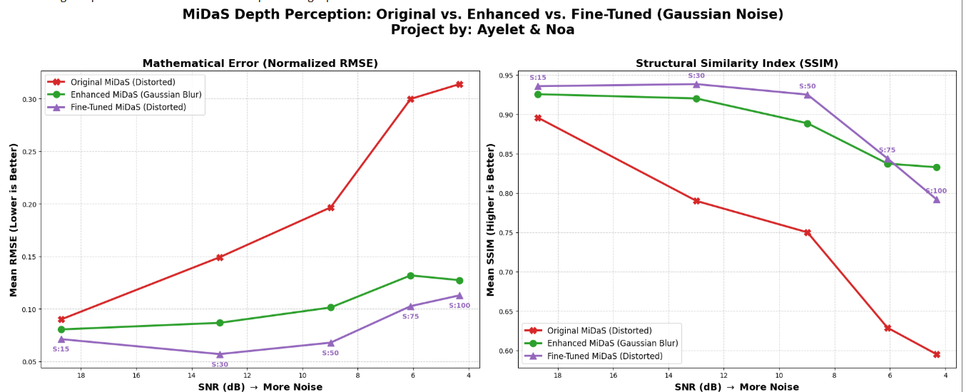
MiDaS under Gaussian Noise
The noisy baseline shows rising RMSE and falling SSIM
Gaussian Blur improves results at every noise level
Fine-tuning achieves the lowest RMSE across all tested noise levels
At very high noise, blur can retain slightly smoother structure
Gaussian Blur helps consistently; fine-tuning focuses on lowering numeric depth error
Ayelet & Noa | Computer Vision Robustness
21

Slide 16
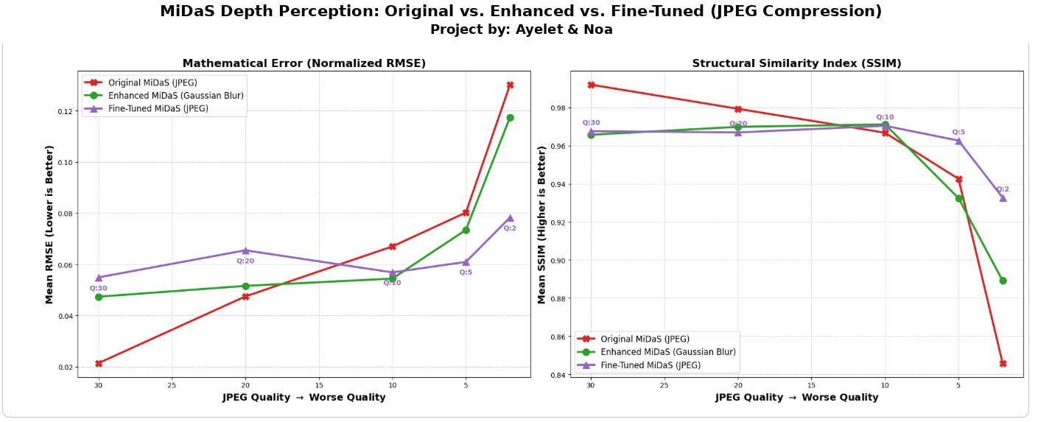
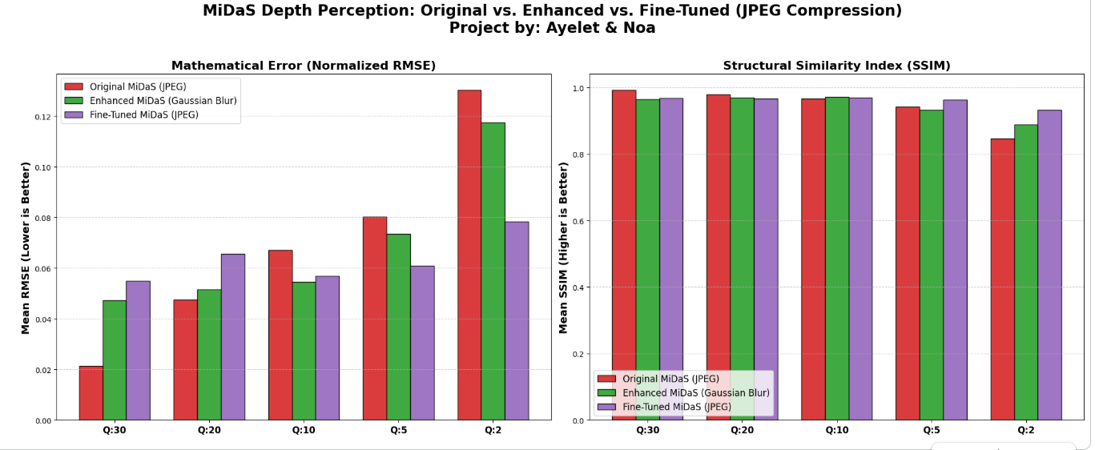
MiDaS under JPEG Compression
The original model is strongest when compression is mild
Gaussian Blur partially reduces blocking artifacts
Fine-tuning becomes clearly better at low quality factors
At Q=2, the fine-tuned model gives the lowest RMSE and highest SSIM
Fine-tuning trades a small loss at high quality for stronger robustness at severe compression
Ayelet & Noa | Computer Vision Robustness
22

Slide 17
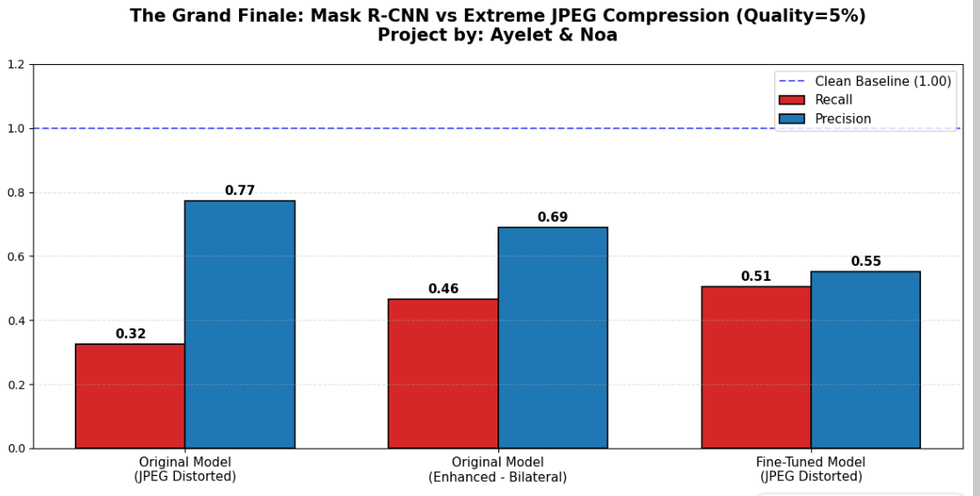
What We Learned
Model robustness depends strongly on the distortion type
Classical enhancement is useful when the distortion has a simple signal-processing structure
Fine-tuning is more reliable when distortions become severe or structural
A single metric is not enough: recall, precision, RMSE and SSIM can tell different stories
The best system should choose between original, enhanced and fine-tuned models according to image quality
Final results highlight the advantage of fine-tuning under severe degradation
Ayelet & Noa | Computer Vision Robustness
23

Slide 18
Conclusion
Computer vision models are reliable on clean images, but performance drops under realistic distortions
Classical enhancement is simple and useful, especially for Gaussian noise
Fine-tuning provides stronger robustness under severe low light, noise and JPEG compression
Robust real-world systems should combine quality assessment, preprocessing and model adaptation
This course was interesting and we really enjoyed,
Thank you ☺
Ayelet & Noa
24

