Slide 1



01 / 10
Your Final Year Companion
An AI-powered research companion that walks Nigerian final year students from a raw topic idea to a defense they're genuinely ready for.
● LIVE SINCE JUNE 2026
www.fypro.com.ng

Slide 2

THE PROBLEM
02 / 10
Final year projects break down
the same way, every year.
Talk to enough final year students and the same pattern shows up, semester after semester.
01
No clear starting point
02
Supervisor time is scarce
Students don't know how to move from a vague idea to a topic that's actually validated for scope and originality.
Feedback can take weeks to arrive, and guidance is inconsistent from one meeting to the next.
03
Each chapter is a different skill
04
Defense day has no rehearsal
Literature review, methodology, and instrument design are rarely taught step-by-step — students guess.
Most students face real examiner questions for the very first time, in the exam room itself.

Slide 3

03 / 10
WHY IT WAS BUILT
Built after watching
that pattern repeat.
FYPro started from a simple observation: students weren't struggling because their research was weak — they were struggling because the process around it was unclear, and support was hard to reach exactly when they needed it.
Not weak research.
An unclear process.
FYPro was built to put a structured, patient guide beside every student — from the first topic idea to the last question in the defense room.

Slide 4





WHAT FYPRO IS
04 / 10
A research companion — not a shortcut.
FYPro is an AI-powered companion for the final year research and writing process. It validates your topic, structures your chapters, sharpens your methodology, plans your writing schedule, reviews your drafts, and prepares you to defend your work.
Guides, step by step
Prepares you to defend
Built for Nigeria
A structured six-step workflow — never a blank page and a deadline.
A real examiner panel simulation, so the defense room holds no surprises.
Every prompt is written for the Nigerian university research context.
Not a plagiarism tool
Not an essay writer
Not a shortcut

Slide 5

THE JOURNEY
05 / 10
One structured path, six steps.
Topic Validator
Checks your research topic for feasibility, scope, and originality against your department and level.
01
Chapter Architect
Generates a complete five-chapter breakdown with section headings and key literature.
02
LITERATURE MAP
ABSTRACT GENERATOR
Methodology Advisor
Selects your research design, sampling strategy, and data approach — justified for Chapter 3.
03
INSTRUMENT BUILDER
Writing Planner
A week-by-week writing schedule, calculated from your submission deadline.
04
Project Reviewer
AI feedback on structure, argument, and academic writing quality — chapter by chapter.
05
Defense Prep
A full three-examiner defense simulation, with a readiness score and a certificate.
06

Slide 6

THE CORE DIFFERENTIATOR
06 / 10
The moment everything else
prepares you for.
01
The Methodologist — probes your research design and sampling choices.
Three AI examiner personas question your work the way a real panel would. Questions adapt to your answers, so gaps get found before the real thing does.
02
The Subject Expert — tests how deep your knowledge of the literature really goes.
3
3
7/10+
Examiner
personas
Free trial
questions
Unlocks your
certificate
03
The External Examiner — the hardest questions, saved for last.

Slide 7

07 / 10
WHO IT'S FOR
Built for one group:
Nigerian final year students.
Every workflow, every prompt, and every examiner question is written for the Nigerian university context — your department, your level, your defense format. Not a generic study tool adapted for the market. Built for it from the start.
300 level
400 level
500 level
Any faculty, any department

Slide 8

08 / 10
THE GOAL
To help students through their research, through their writing, and all the way to their defense — with nothing left to figure out alone.
— the goal behind FYPro

Slide 9


STATUS
09 / 10
● LIVE SINCE JUNE 2026
Live, and already carrying
students through their projects.
Full six-step workflow
Defense Simulator + certificates
Literature Map & Abstract Generator
Instrument Builder
Supervisor Meeting Prep
Multi-project dashboard

Slide 10

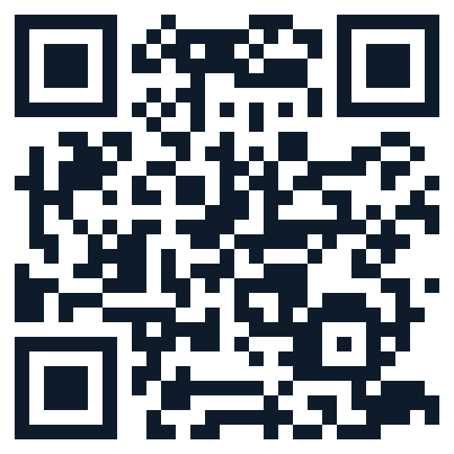
FYPro
10 / 10
Walk into your defense ready.
From your first topic idea, through every chapter, to the last question in the room — FYPro is with you the whole way.
SCAN TO START
Try FYPro
www.fypro.com.ng

