Slide 1
Model-Driven Design Method 01. Introduction
Dr. Bo Liu
liubocq@swu.edu.cn
Centre for Research and Innovation in Software Engineering
School of Computer and Information Science
Southwest University
Chongqing, China

Slide 2
Outline
About this module
Introduction to SE and MDD
The scope of the module
Ministerial matters
Aim: Motivation and Inspiration

Slide 3
About this unit
You are assessed according to
Course paper, not the final exam (50%)
Group project (30%)
Attendance at lectures (20%)
To perform well, you are suggested to
Attend the lectures
Actively contribute to your group project
Seek help in time when you have problems in your learning process
Continuously do your own assessment on your progress!

Slide 4
Teaching Method
Teach how to learn
fundamental concepts and ideas
development activities, artifacts and their relations
modelling notations, techniques and tool support to create artifacts, model them, and to analyse and manipulate them
Motivating through problems
Lab sessions for further illustration and practice
Group project for collaboration and practice

Slide 5
Hints on Learning Method
Impossible to learn software engineering or MDSE from lectures only
Not enough to know one or two modelling languages and programming languages
Need
Hands on practice
Accumulation of experience and domain knowledge
Collaboration
Enjoy your team project and collaboration with your project colleagues

Slide 6
Learning outcome
Understanding of fundamental concepts
Understanding of and doing fundamental activities
Use of UML to represent artifacts as models
Reasoning and checking relations among models
Collaborations and use of tool in the project
Guide your study by the above points

Slide 7
Manage Your Learning
Understand
Course description and learning outcome
Arrangement of assessments and policies
Lecture notes, slides and announcements
Learn to manage your learning well – an important part of quality of a university undergraduate or graduate

Slide 8
Exercises - Reading Materials
C.A.R. Hoare (1975): Software Engineering [provided as handout], and understand what the problems of software design are according to Hoare.
Zhiming Liu and Xiaohong Chen, Model-Driven Design of Object and Component Systems, Engineering Trustworthy Software Systems, Lecture Notes in Computer Science 9506: 156-263, 2016.
Zhiming Liu, et at,, Software abstractions and Human-Cyber-Physical Systems Architecture Modelling, Lecture Notes in Computer Science 12154, Springer, 159-219, 2020,
C. Larman and V.R. Basli, Interactive and incremental development: a brief history, Computer, IEEE Society, 2003.
Understand software complexity, evolution, and key features of MDA.

Slide 9
Introduction to Software Engineering
Points of Discussion
What is software
What is software engineering
software crisis
what is software engineering about
Notes:
We first understand what software is.
Then what software engineering is about, and when and how it came to becoming a discipline, and its relation to software crisis

Slide 10
What is Software?
A program?
Then what is a program?
A model of a process of a computation written in a language that a computer understands
A computer carries out a computation by executing a program
A program consists of a number of variables and a sequence of commands that tell the computer how to carry out the computation
Program Fool {
int x, y;
x:=1; y:=2;
x:=x+y}
Notes:
What is software? What its is not countable, and you cannot use plural?
You may say a piece of software is a a program. Then, what is a program?
I would define a program is a model of a process of a computation
A computer carries out a computation by executing a program
…..

Slide 11
Program in the Small
How to develop a program?
Specification of a computational problem, e.g. calculate the greatest common divisor of two integers
Design an algorithm: data and control structures
Verification
Refinement of the algorithm and data structure
Coding, testing, and installation

Slide 12
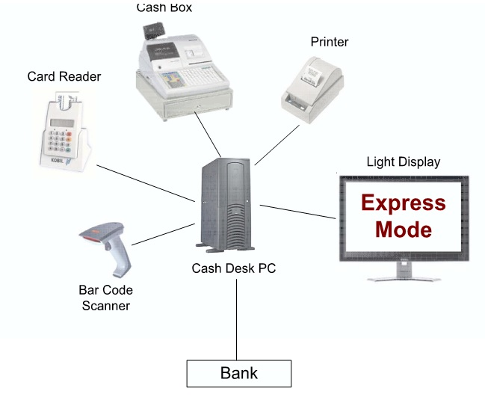
Develop a Not So Small Program
A point of Sale System Used in a Retail Store or Supermarket
Record sales and handle payments, such as
a computer
a barcode scanner
a printer, etc
Develop the software to run the system (POST)

Slide 13
The Aim is to Develop a Program
Class Payment
package post;
public class Payment {
private float amount;
public Payment (float CashTendered ) {
this.amount=CashTendered;
}
public float getAmount() { return amount; }
}

Slide 14
Class ProductCatalog
package post; import java.util.*;
public class ProductCatalog {
private Hashtable productSpecifications = new Hashtable();
public ProductCatalog() {
ProductSpecification ps = new ProductSpecification(100, 1,
"product 1");
productSpecifications.put(new Integer(100), ps);
ps = new ProductSpecification(200, 1, "product 2");
productSpecifications.put(new Integer(200), ps);
}
public int getUPC() {return upc;}
public float getPrice() {return price;}
public String getDescription {return description;}
}

Slide 15
Class Sale
package post;
import java.util.*;
class Sale {
private Vector lineItems = new Vector(); private Date date = new Date();
private boolean isComplete = false; private Payment payment;
public float getBalance() {
return payment.getAmount() - total(); }
public void becomeComplete() { isComplete = true; }
public boolean isComplete() { return isComplete; }
public void makeLineItem (ProductSpecification spec, int quantity) {
lineItems.addElement(
new SaleLineItem(spec, quantity))
}
public float total() {
flaot total = 0;
Enumeration e = lineItems.elements();
(to be continued)

Slide 16
Class Sale Continued
while ( e.hasMoreElments() ){
total += ( (SaleLineItem)
e. nextElement()).subtotal();
}
return total;
}
public void makePayment(float cashTendered)
{
payment = new Payment (cashTendered );
}
}

Slide 17
Class SaleLineItem
package post;
class SaleLineItem {
private int quantity;
private ProductSpecification productSpec;
public SaleLineItem (ProductSpecification spec, int quantity){
this.productSpec = spec;
this. quantity = quantity;
}
public float subtotal(){
return qauntity * productSpec.getPrice();
}
}

Slide 18
Class Store
package post;
class Store {
private ProductCatalog productCatalog;
private POST post;
public POST getPOST() {
productCatalog = new ProductCatalog();
post = new POST( productCatalog);
return post;
}
}

Slide 19
Software Engineering Answers Questions
What are the process steps or activities?
What artifacts to produce and how to represent them? (Models and modelling notation)
What and how to validate/verify the artifacts? (VV)
What techniques and tools can be used?
Ensure correctness, performance and maintainability (QoS)
One cannot go immediate to the desk and start programming

Slide 20
Program in the Large
A large application, such as Apollo Program, involves a large number of computational problems
Components and interfaces
Design of software architecture
Models/specifications static structure, functionality, dynamic behavior, interactions
Levels abstractions: models and model refinement/transformations
Testing/verification: at the component/unit level, composition/integration level, system level
Software: is not only a program but also documents such as requirements specifications, design, tests, etc.

Slide 21
Software in General
Computer software or software
a collection of computer programs and related data that provide the instructions for telling a computer what to do and how to do it
a set of computer programs, procedures, and associated documentation concerned with the operation of a data processing system
one or more computer programs and data held in the storage of the computer for some purposes

Slide 22
Software as Systems
Software [Zhiming Liu 2011]
A set of related (architected) programs and data that tells a set interrelated computers what to do and how to do it, with the associated documents
Computers include all devices with programmable processing capacity, all kinds of “smart devices” as well as “computers”
Software systems are running everywhere at anytime, affecting all aspects of our daily life.

Slide 23
Types of Software Systems
System software: provides the basic functions for computer usage and helps run the hardware systems
operating systems, device drives, network protocols, internet browsers, window systems ….
Programming software: provides tools to assist a programmer in writing programs
compilers, interpreters, IDE, debuggers, text editors, etc.
Application software: developed to perform any task of an application domain

Slide 24
Application Software
Business software, industrial automation, CAD, embedded control systems
Health information systems (eHealth), e-gov, defense software, telecommunications, educational software, e-science, smart cities, network of things
Image and video processing, games, social networks
Scientific computing, modeling and simulation (environment, policy, etc)
Tools for software development, validation and verification

Slide 25
Software Engineering
No authoritative account of when “software engineering” first appeared in the literature
Anthony Oettinger in his letter to the ACM membership [1966]
Margaret Hamilton used it while working on the Apollo guidance software [1969-1972]
NATO Software Engineering Conference motivated by the Software Crisis [1968]:
“The computer industry has a great deal of trouble in
producing large and complex software systems“
The Problem: late deployment, budget overflow, unreliable and unsatisfactory systems, systems never delivered …..

Slide 26
Software Engineering – Definition
Software Engineering: the application of a systematic, disciplined, quantifiable approach to the development, operation, and maintenance of software [IEEE]
Put software design and production on similar theoretical foundations and practical disciplines as for the traditional branches of engineering

Slide 27
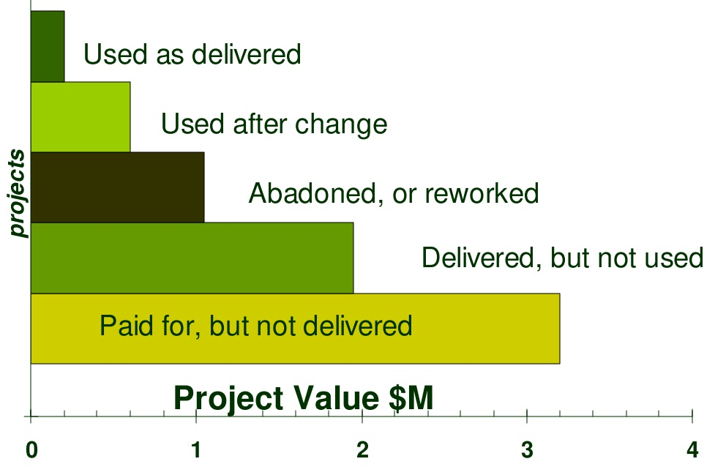
“Software’s Chronic Crisis”
“Software engineering… a term of aspiration” [Gibbs 94]
The fate of US
defense projects
according to US
government statistics.
(Connel & Shafer 1989)

Slide 28
“Software Hell”
Nicholas Carr (2005):“…software debacles [崩溃] are routine. And the more ambitious the project, the higher the odds of disappointment”
Only 34% of projects: timely & within budget
FBI
Since 2001: a database on suspected terrorists
Jan. 2005: $M170, “not even close to having a working system”
Ford Motors
Since 2000, project “Everest”: buying supplies, replacing legacy
Aug. 2004: $M200 over budget, abandoned (β-version slower than legacy)

Slide 29
Recent Case from “Software Hell”
NHS “Connecting for Health” (2005 – 2015)
Originally budgeted 2.3 Billion GBP
Total Expected cost: 20 Billion [2013]
“…... the central costs incurred by NHS are such that, so far, the value for money from the services deployed is poor [BCS]
Terminated in 2015 soon after the Tories got into power

Slide 30
Software Complexity [Brooks 87]
Complexity of application domain – challenges in Requirements Analysis
Flexibility possible to offer through software – difficulties in design
Difficulty of defining and managing a development processes – dealing with ever changing requirements
Problem of characterizing the behavior – challenges in V&V

Slide 31
Advances in Hardware Technology
Edsger Dijkstra : “The major cause of the software crisis is that the machines have become several orders of magnitude more powerful!”
Moore’s Law:
“The number of transistors in a dense integrated circuit doubles approximately every two years”

Slide 32
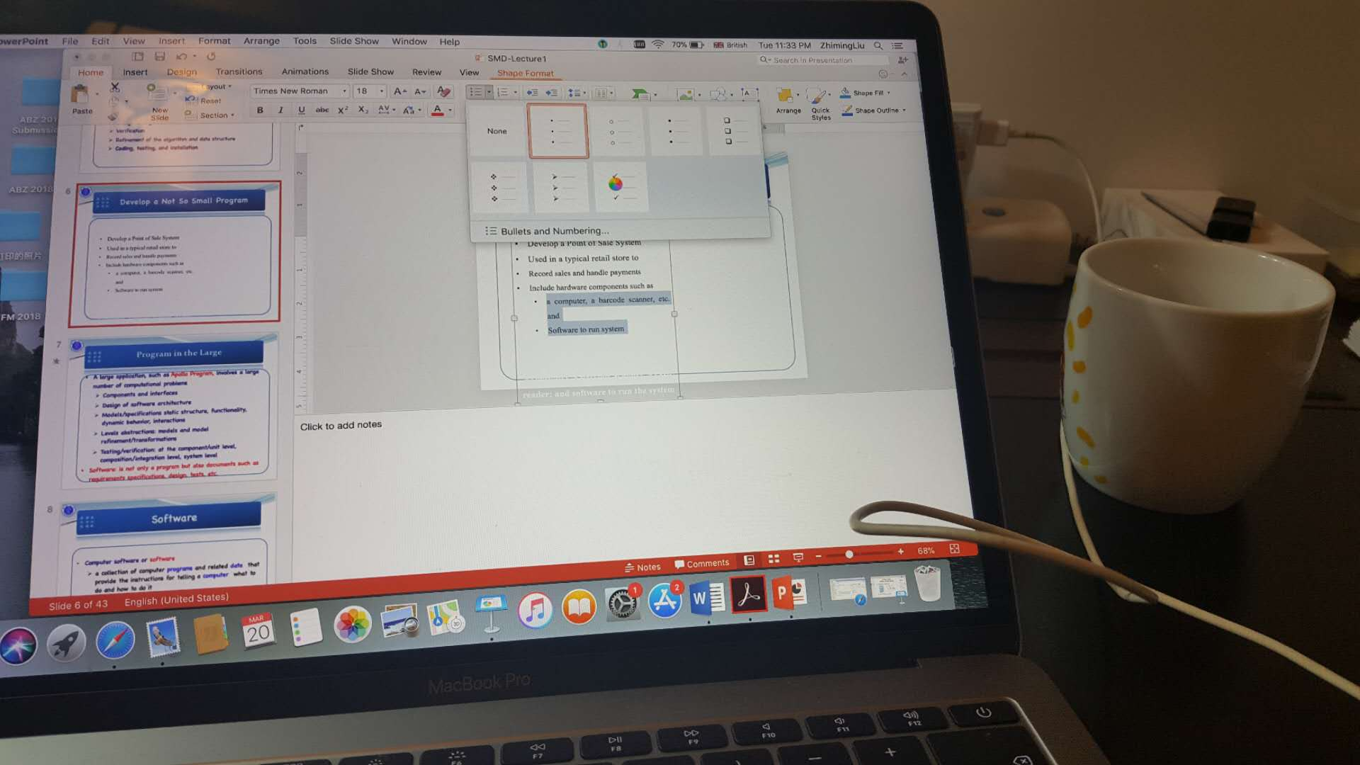
Complex Systems are Prone to Failures
Nuisances caused by bugs: lost a few unsaved slides

Slide 33
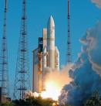
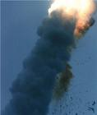
Ariane-5 Explosion in 1996
Caused by an exception in software
Cost about 300 million Euro

Slide 34
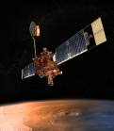
Mars Global Surveyor 2006 火星环球探测器
WASHINGTON
– “After studying Mars four times as long as originally planned, NASA's Mars Global Surveyor orbiter appears to have succumbed to battery failure caused by a complex sequence of events involving the onboard computer memory and ground commands. …..”

Slide 35
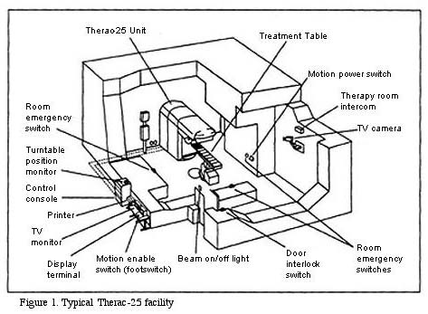
Therac – 25 Accident 1985-1987
Gave overdose of radiation, about 100 times
http://courses.cs.vt.edu/cs3604/lib/Therac_25/Therac_1.html

Slide 36
Economic Cost of Software Bugs
Software bugs costing the U.S. economy $59.5 billion each year
More than half borne by end users, the rest by the vendors and developers
Improvements in testing could reduce it by a third, or $22.5 billion
But testing won't eliminate all software errors
WASHINGTON (COMPUTERWORLD) , 2/2002
http://www.cse.lehigh.edu/~gtan/bug/softwarebug.html
“Program testing can be used to show the presence of bugs, but never to show their absence!”
--Edsger Dijkstra

Slide 37
Increasing Software Complexity
Software are running everywhere, at anytime, increasing connectivity [IoT, CPS]
Different views of different stakeholders of the same system [IoT, BigData, Cloud]
Integration of services to support collaborative workflows
Software for e-health, manufacture product and workflow management, maintenance of networked critical systems
Ever evolving, forming infrastructures & digital ecosystems
More and more software becomes safety & security critical
Safety/Security Criticalness: failures, system breakdowns or attacks sometimes are catastrophic and very costly.

Slide 38
Refreshing Points
Software: programs & data to be executed by computers, with documents； and software is complex
Software engineering: application of a systematic, disciplined, quantifiable approach to the development, operation, and maintenance of software system
Dealing with complexities
Produce correct, reliable, high quality software products in time and within budget
Healthy evolution
Processes, artifacts & models, Techniques & tools

Slide 39
Software Engineering Again
Study, research and practice methods and tools, and process for developing and maintaining software systems that are
delivered within their project budgets and in their planned time
dependable
A method includes a theory and set of techniques

Slide 40
The Focus of the Course
Requirements Modelling/Specification, Analysis and Design
Model-Driven Design Method (MDD) or Model-Driven Software Engineering (MDSE)
Use-case driven, incremental and iterative development process - Rational Unified Process
The modelling language we will use is UML
The tool we will use is Visual Paradigm for UML

Slide 41
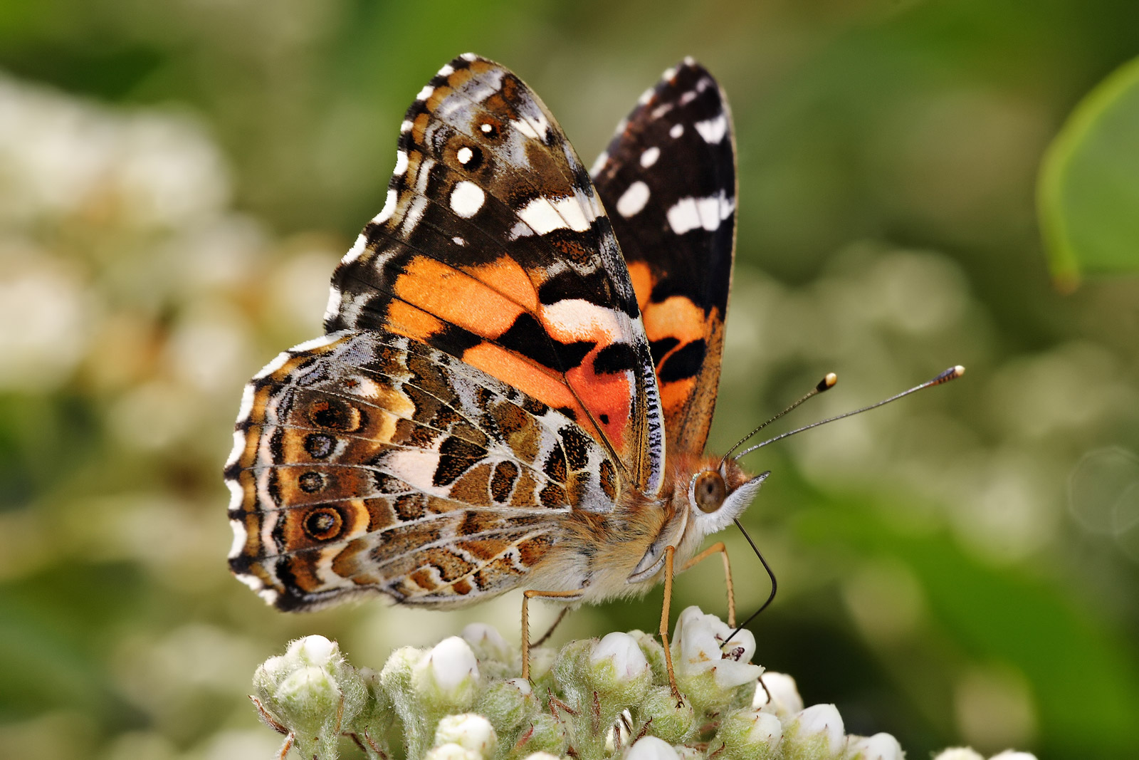
A Taste of Modelling

Slide 42
A Taste of Modelling
A Model of a Butterfly – copied from a book that my son read when he was five years old
A butterfly is an insect
It has six legs
It has three body parts
It has four wings
There were photos with labels in different parts
Can we create a diagram of a butterfly?

Slide 43
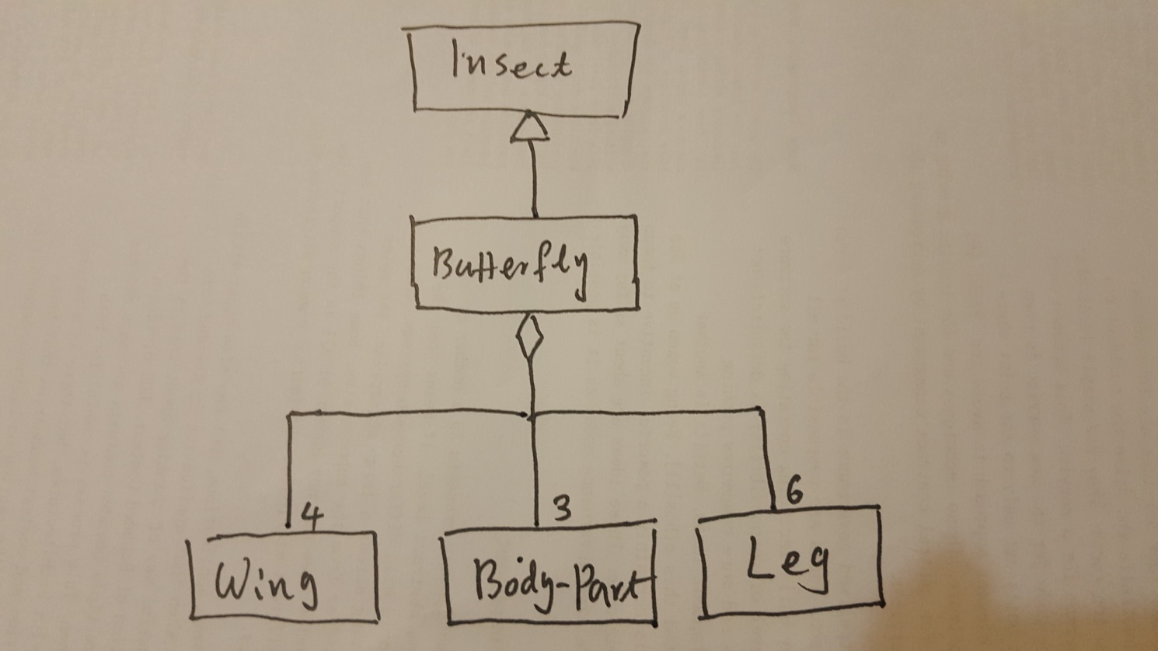
A Class Diagram for Butterfly
Think about classification, decomposition
Abstraction: nothing about size, color, antenna
Think about AI,, Machine Learning

Slide 44
Recall the models you have learned
From a perspective of OO, how to model software…
From a perspective of Structured Method , how to model software …

