Slide 1
SMART WATER MANAGEMENT
BY:S.AYESHA

Slide 2
ABSTRACT
Water resource management represents a fundamental aspect of a modern society. Urban areas present multiple challenges requiring complex solutions, which include multidomain approaches related to the integration of advanced technologies. Water consumption monitoring applications play a significant role in increasing awareness, while machine learning has been proven for the design of intelligent solutions in this field. This presentation presents an approach for monitoring and predicting water consumption from the most important water based on a proposed IoT solution.

Slide 3
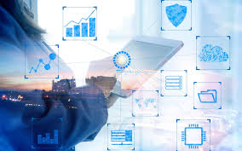
Contents
Introduction
Methodology
System Architecture
Data Processing Pipeline
Machine Learning Algorithms
Key Application Area
Smart City Water Management
Conclusion

Slide 4
Introduction
Machine learning has been proven for the design of intelligent solutions in this field. This paper presents an approach for monitoring and predicting water consumption from the most important water outlets in a household based on a proposed IoT solution. Data processing pipelines were defined, including K-means clustering and evaluation metrics, extracting consumption events, and training classification methods for predicting consumption sources. Continuous water consumption monitoring offers multiple benefits toward improving decision support by combining modern processing techniques, algorithms, and methods.

Slide 5
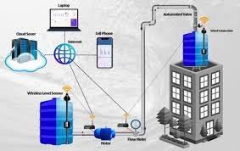

Slide 6
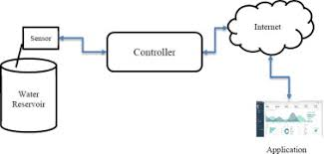
Methodology
This chapter describes the proposed methodology for the data collection and processing pipelines, which provide the context for the experimental results obtained. The system architecture describes the water consumption monitoring solution. The data processing pipeline presents the methodology for water consumption analysis, for which the clustering and classification methods are described.

Slide 7
System Architecture
An intelligent water network management system is most effective when several factors are considered simultaneously, i.e., water suppliers, decision makers, and the direct involvement of consumers.
Data acquisition is performed using a NodeMCU development board based on the ESP8266 microcontroller, with Wi-Fi communication. The platform has multiple GPIO pins connected to several YF-S201 flow meters and can be programmed using the Arduino environment [44] to monitor and collect the water flow through several pipes.

Slide 8
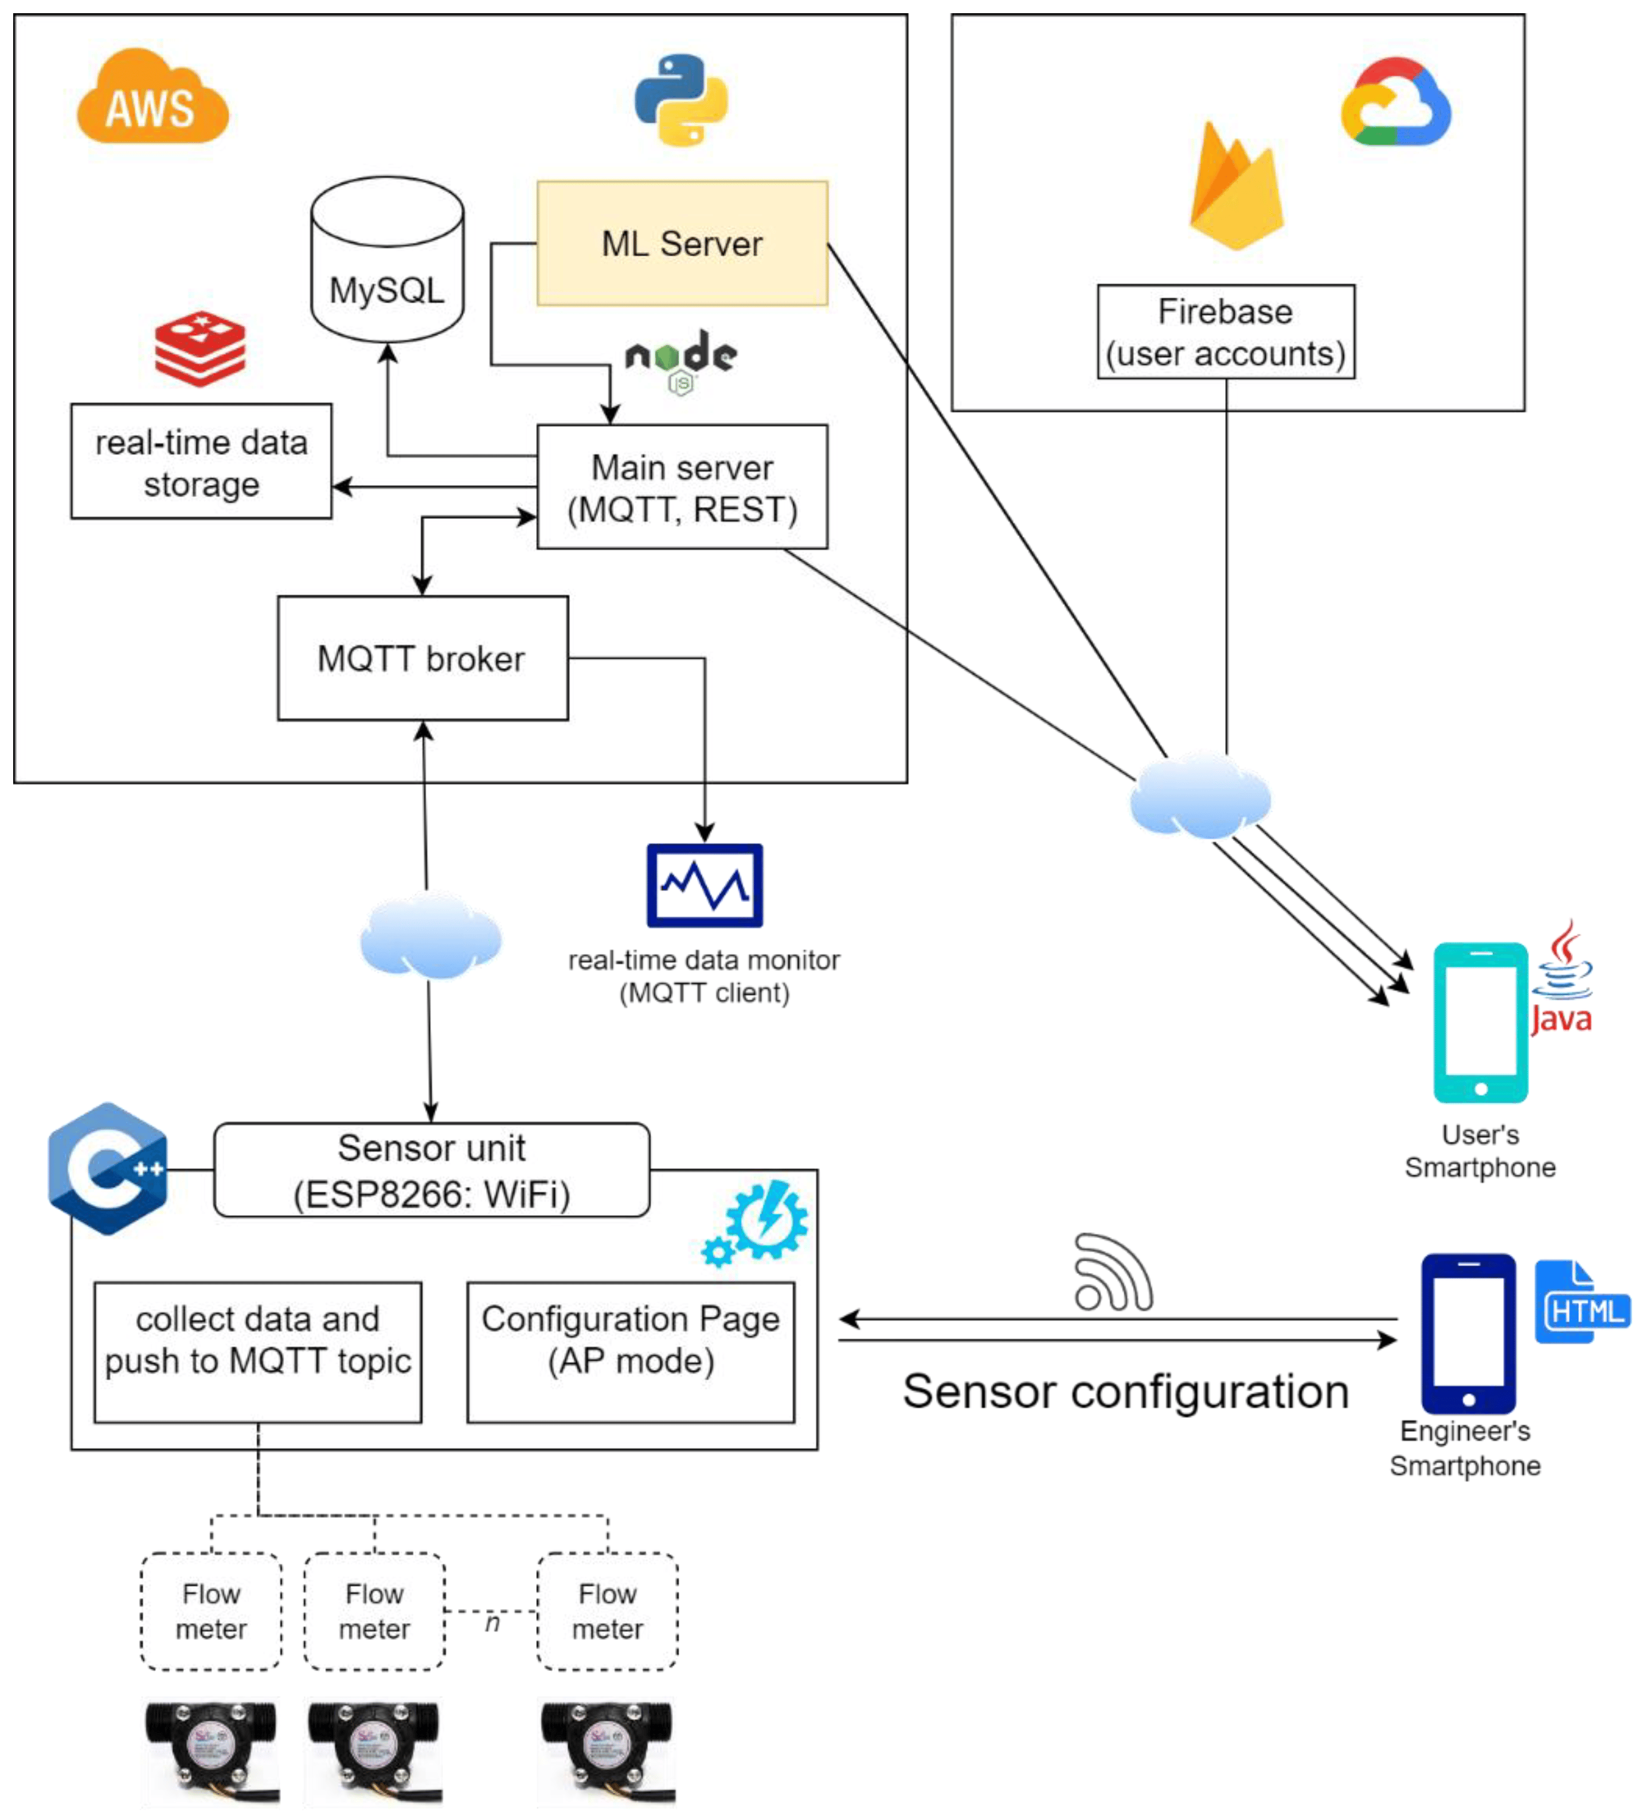
System Architecture

Slide 9
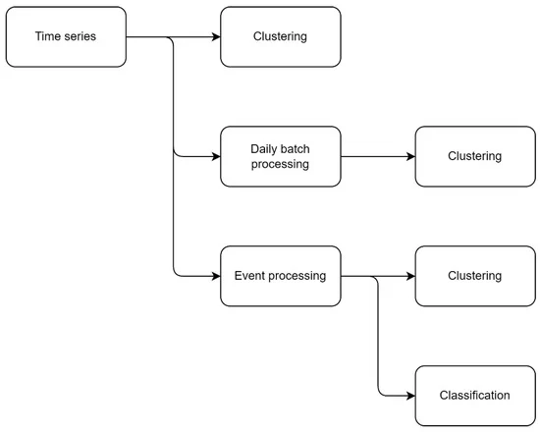
Data Processing Pipeline
For a better understanding, each step will be described below. The raw data set (time series) was generated by collecting data from sensors installed in multiple households. Four types of water outlets were considered, i.e., sink (cold and hot water measured separately), toilet, and shower. The raw data set were processed to be evaluated and tested by first eliminating nonrelevant data that could negatively impact the results.

Slide 10
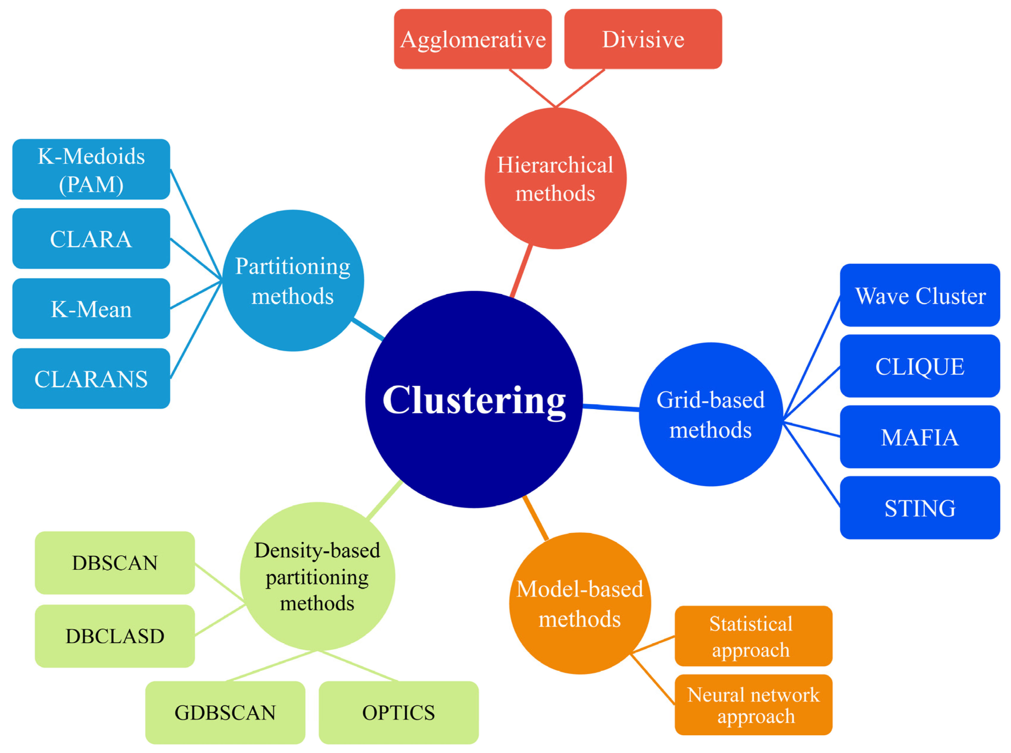
Machine Learning Algorithms
Calculating the WQI is time-consuming, but estimating WQI is inevitable for water resources management. For this purpose, three Machine Learning (ML) algorithms, namely, Gene Expression Programming (GEP), M5P Model tree, and Multivariate Adaptive Regression Splines (MARS), were employed to predict WQI.

Slide 11
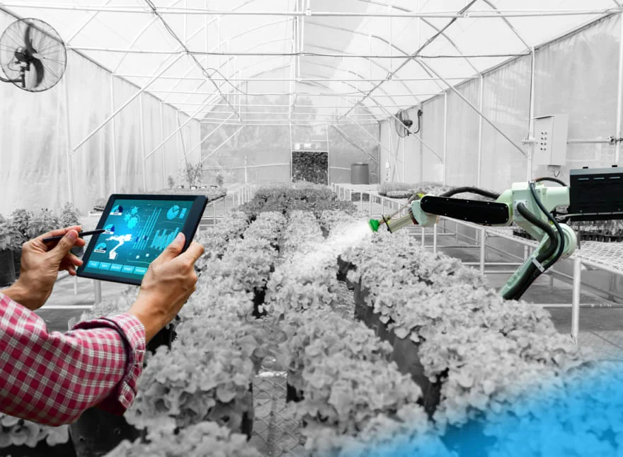
Key Application Area
It’s easier to understand climate change when you experience challenges yourself. Consider unpredictable water supply, worsening water scarcity, and water pollution. Whether you’re an agricultural firm or city administration, all these affect you. And if you’re looking to become more efficient and boost your green credentials, you might not know where to turn.

Slide 12
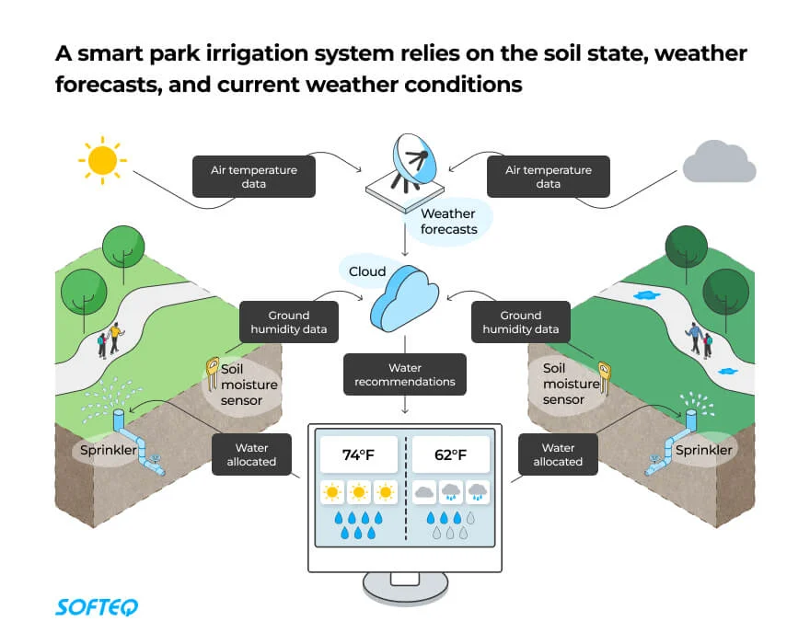
Smart City Water Management
City administrators need to keep a close eye on water supply, consumption, and equipment. With IoT, the whole water supply chain can become more transparent and easier to control.
With the help of sensors, a smart city water management system can enable you to collect real-time data—information that helps you visualize water distribution across the network. Residents with smart meters can make more informed decisions as a result, leading to a more sustainable city overall

Slide 13
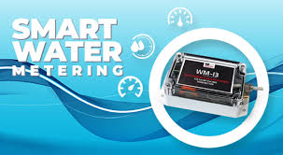
CREATING AWARENESS BY SMART METERS

Slide 14
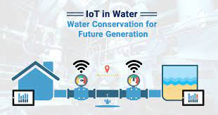
IOT in water conservation

Slide 15
Conclusion
IoT helps to collect data from different sources and water consumed at other places at different levels. Water data is collected from households, countries, communities, and the globe. This way, we can monitor the consumption of water everywhere.
The digital system identifies unusual water consumption, both, in open and concealed areas. The system alerts you immediately about water leaks and closes the main water supply itself, even when you are not at home. IoT sets a new standard for water technology worldwide.

Slide 16

Thank You

