Slide 1
SMART WATER MANAGEMENT
BY:S.AYESHA

Slide 2
IOT IN WATER MANAGEMENT
IoT water management systems leverage numerous sensors that collect real-time insights on how resources are used. These devices transmit the gathered data to the user's application online. This information empowers analysis of consumption patterns and encourages more rational water consumption.

Slide 3
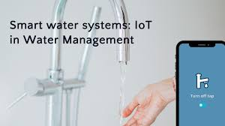

Slide 4
Use of Arduino
It proposes the design of smart water management system based on IoT application which helps controlling and monitoring of rain water with the help of Arduino UNO as a microcontroller which helps in processing information received from various sensors such as rain sensor, ultrasonic sensor, flow sensor, leak detectors ...

Slide 5
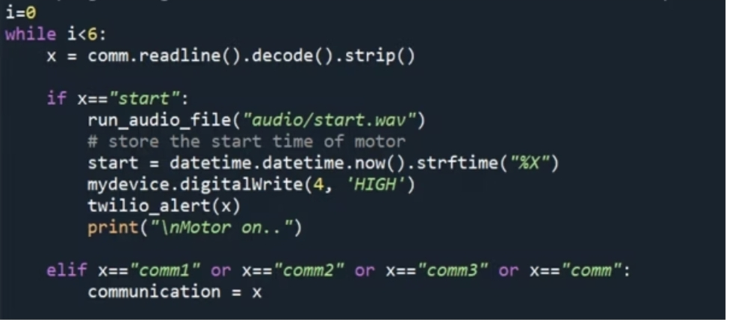
PythonScript for Arduino

Slide 6
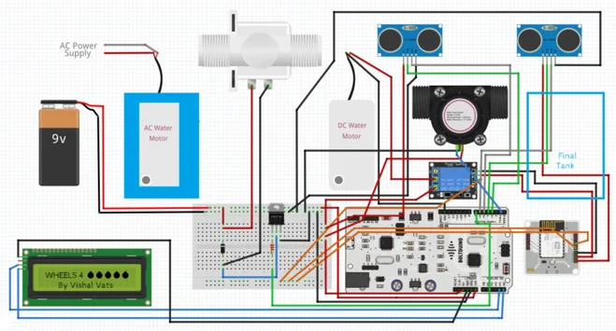
Sketch of the hardware connections for the static Arduino section.

Slide 7
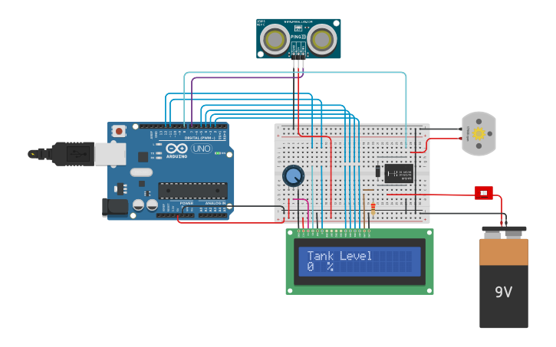
Tank level Monitoring

Slide 8
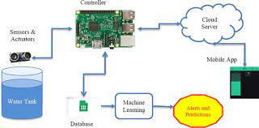
Representation of Final Output

Slide 9
Use of IOT
An IoT smart water meter tracks the quality, pressure, and consumed quantity of water in a household or industry. An IoT smart water sensor can be used to track the flow of water across the entire plant and over the distribution channels. Helping in leakage detection, to reduce water wastage.

Slide 10
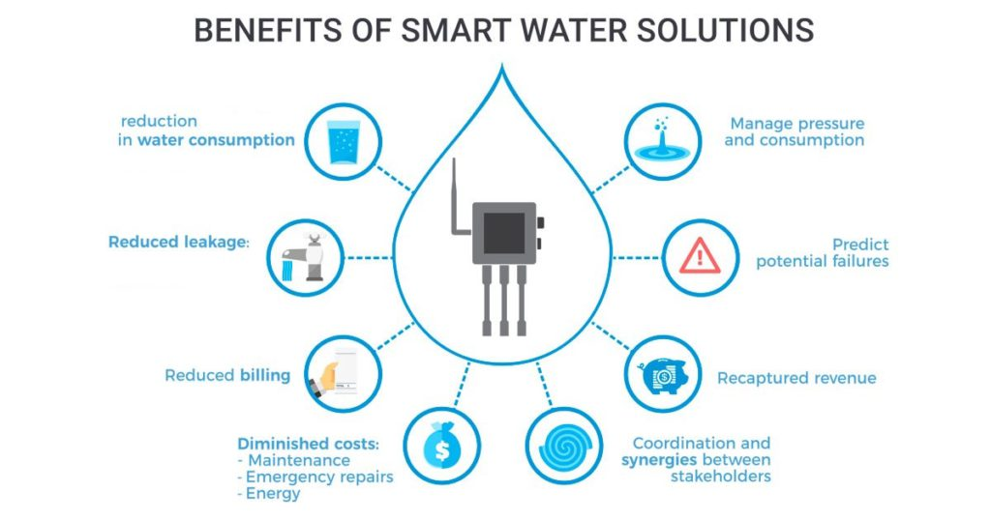
Benefits

Slide 11

THANK YOU

