Slide 1
بِسْمِ اللهِ الرَّحْمٰنِ الرَّحِيْمِ
اللَّهُمَّ إِنِّي أَسْأَلُكَ عِلْمًا نَافِعًا وَرِزْقًا طَيِّبًا وَعَمَلاً مُتَقَبَّلاً
O Allah, I ask You for beneficial knowledge, goodly provision, and acceptable deeds

Slide 2

CODING DREAM BLOG
Project CS619
The proposed project of Coding Dream Blog will be used by the Blogger (Admin) to post articles related to coding. Users can view the post and put comments or ask questions. The Blogger (Admin) will post articles about coding using the Coding Dream Blog project as recommended. Viewers of the post have the option to comment or ask questions.

Slide 3
Project Supervisor
Adnan Asif
Submitted By
F220778EAB (bc190408737)
Student Name Ayesha Nudrat
Software Projects & Research Section, Department of Computer Sciences, Virtual University of Pakistan

Slide 4

Introduction
Project Domain / Category
Web Application
Abstract / Introduction
A blog is an online informational website displaying information about anything with the latest information/posts appearing at the top. Bloggers are individuals who love sharing their knowledge with others.
They post on various topics from arts, home designs, Computer Hardware, Programming, carpentry, and finance articles etc. So, the main purpose of a blog is to connect you to the relevant audience.
The more frequent and better your blog posts are, the higher the chances for your website to get searched and visited by your target audience.

Slide 5
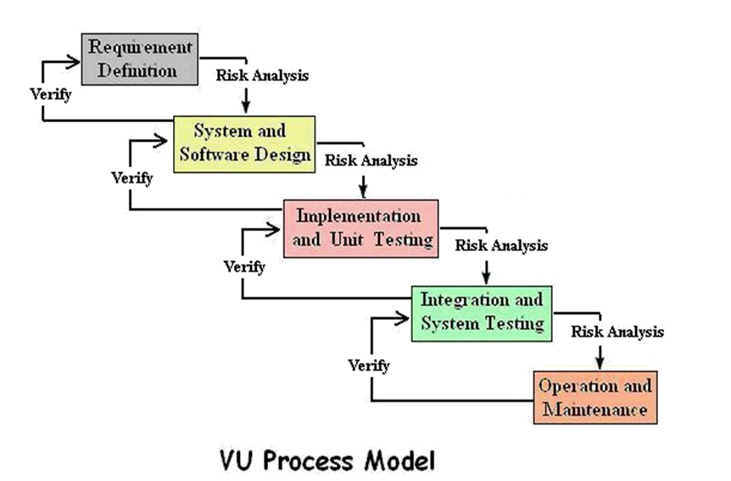
Diagram of Process Model
The VU Process Model combines the waterfall and spiral methodologies. The term "hybrid approach to system development" is often used.
It consists of five stages including:
Requirement Definition
System and Software Design
Implementation and Unit Testing
Integration and System Testing
Operation and Maintenance

Slide 6
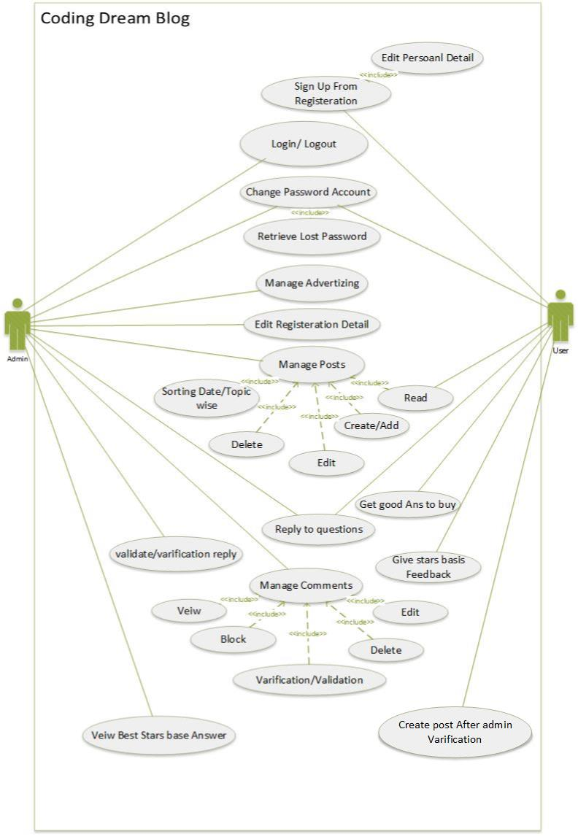
Use Case Diagram
The scope and high-level functions of a system are described in use-case diagrams. The interactions between the system and its actors are also depicted in these diagrams. Utilize-case diagrams show what the system does and how the actors use it, but they do not show how the system works within.
4 main components of a use case diagram
System.
Actors.
Use cases.
Relationships.

Slide 7
Business Rules Catalog
Functional Requirements:
Functional requirements define what a product must do, what its features and functions are.
Blogger (Admin):
Admin can Login/Logout
Change password/retrieve lost password
Edit Registration details
Admin will be able to Create/Delete and Update Posts
Admin will be able to sort in any order by date or topic etc.
Admin will be able to manage comments on post (View/Edit/Delete/block)
Search posts on the basis of different criteria
Mange any advertisement on the blog
Admin can reply user questions.
Admin can verify/validate the Register user’s reply on any post.
Admin can view the best answers on the basis of stars given.
Register User/Visitor:
User can use Sign Up page to register
Change Password/Retrieve lost password
View/Edit Registration Info (Personal Details)
Read posts
Registered users will be able to create Posts as well, which will be shown after Admin Verification.
Put comments on any post.
Reply to questions on any posts.
Can get best options to buy from the Admin.
User can be able to give feedback / stars to replies.

Slide 8
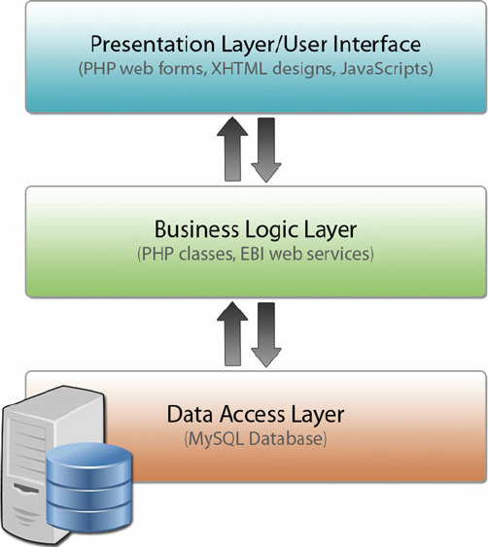
Architectural Design
An architectural diagram is a visual representation that maps out the physical implementation for components of a software system. It shows the general structure of the software system and the associations, limitations, and boundaries between each element.
Three-tier architecture
Three-tier architecture, which separates applications into three logical and physical computing tiers, is the predominant software architecture for traditional client-server applications.
In this coding Dream Blog Project, the tiers have different names but perform similar functions:
Web Sever
Application Sever
Database Sever

Slide 9
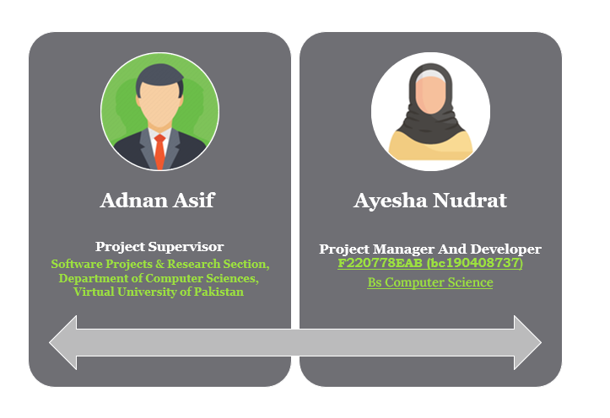
Team Structure

Slide 10
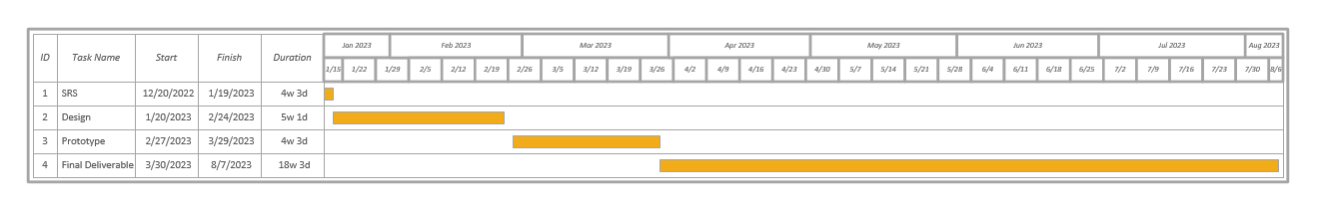
Project Schedule
A Gantt chart is a project management tool that illustrates work completed over a period of time in relation to the time planned for the work. It typically includes two sections: the left side outlines a list of tasks, while the right side has a timeline with schedule bars that visualize work.

Slide 11
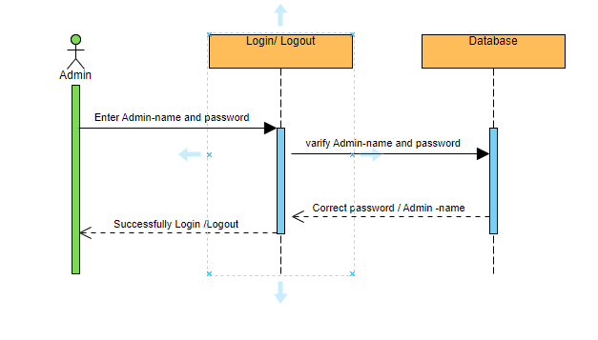
Sequence Diagrams
A sequence diagram is a Unified Modeling Language (UML) diagram that illustrates the sequence of messages between objects in an interaction. A sequence diagram consists of a group of objects that are represented by lifelines, and the messages that they exchange over time during the interaction.

Slide 12
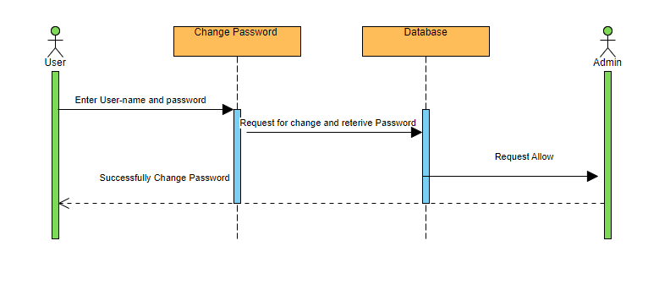
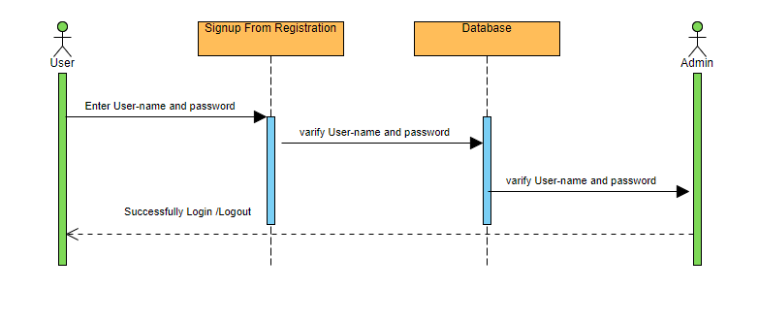
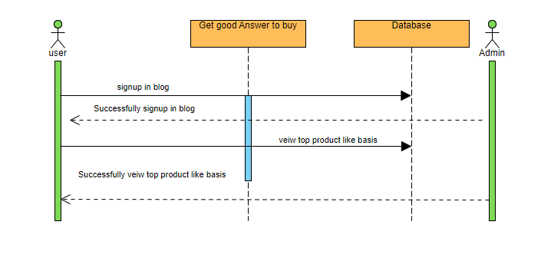
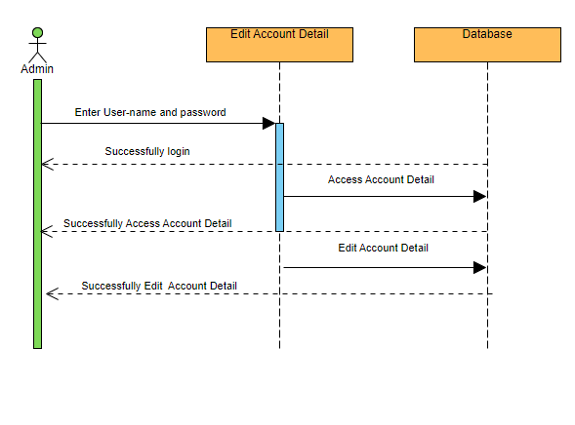
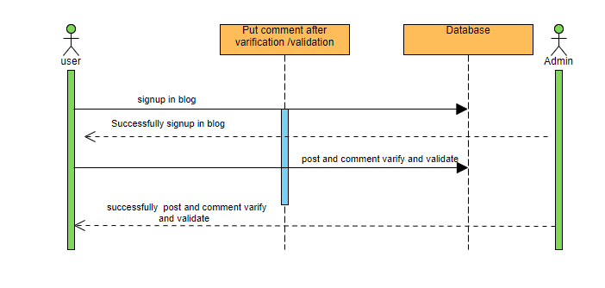

Slide 13
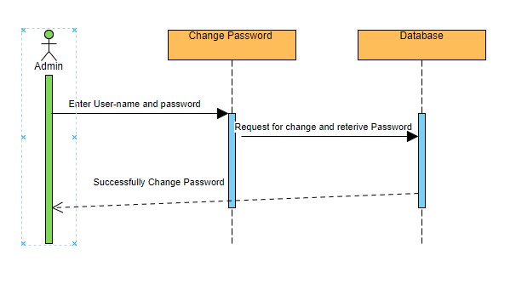

Slide 14
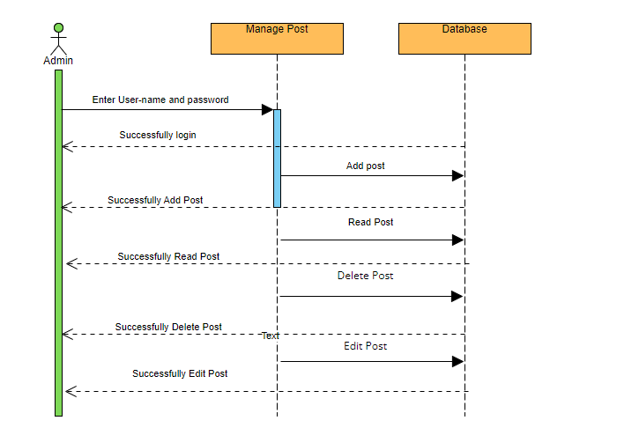
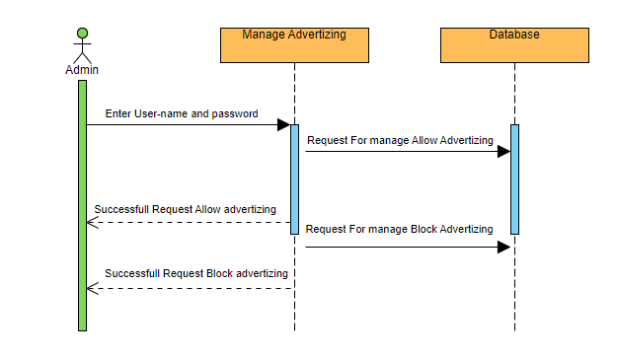

Slide 15
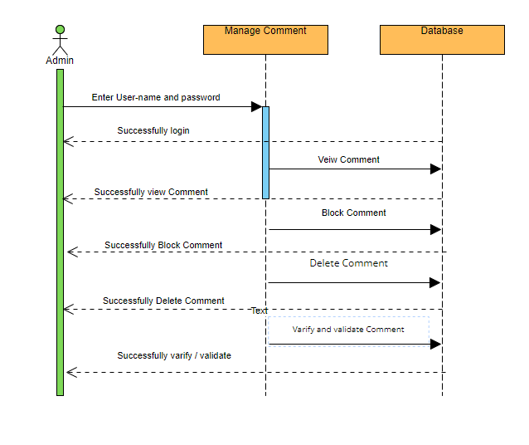
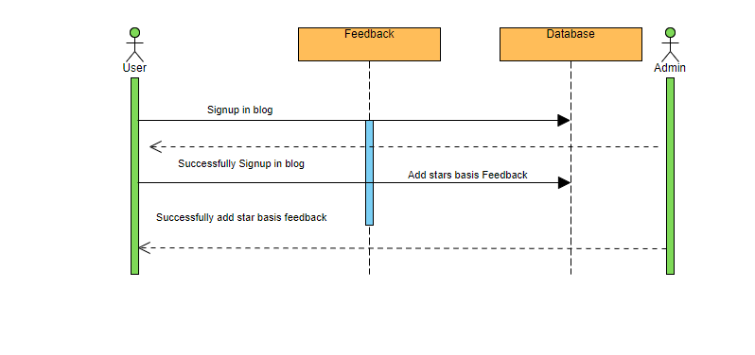

Slide 16
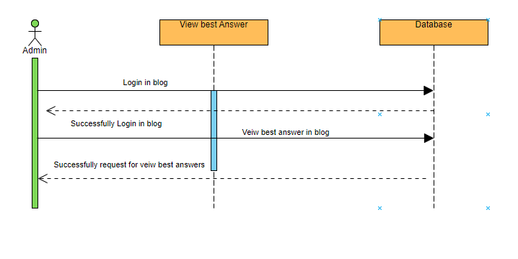
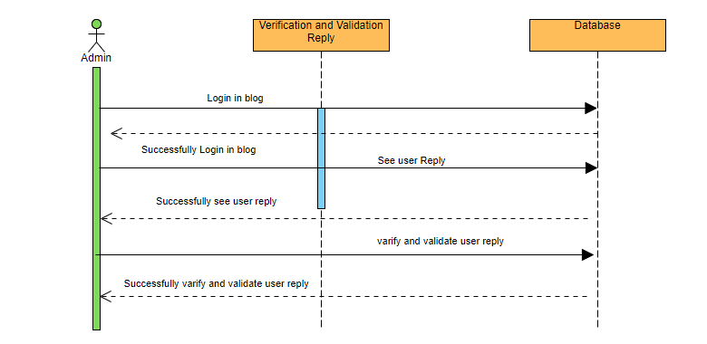

Slide 17
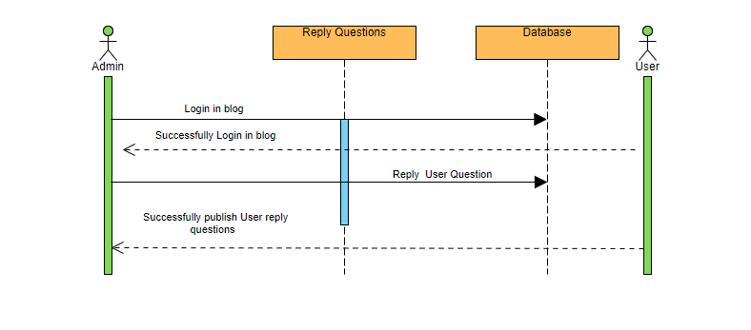

Slide 18
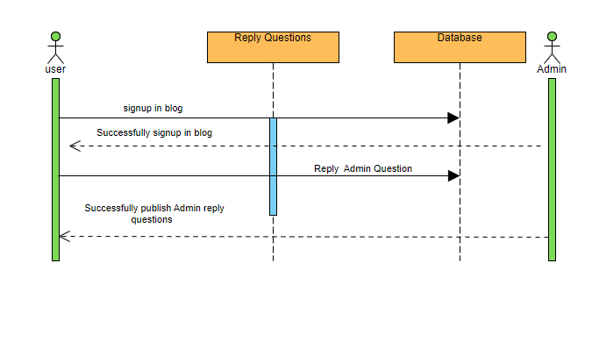

Slide 20
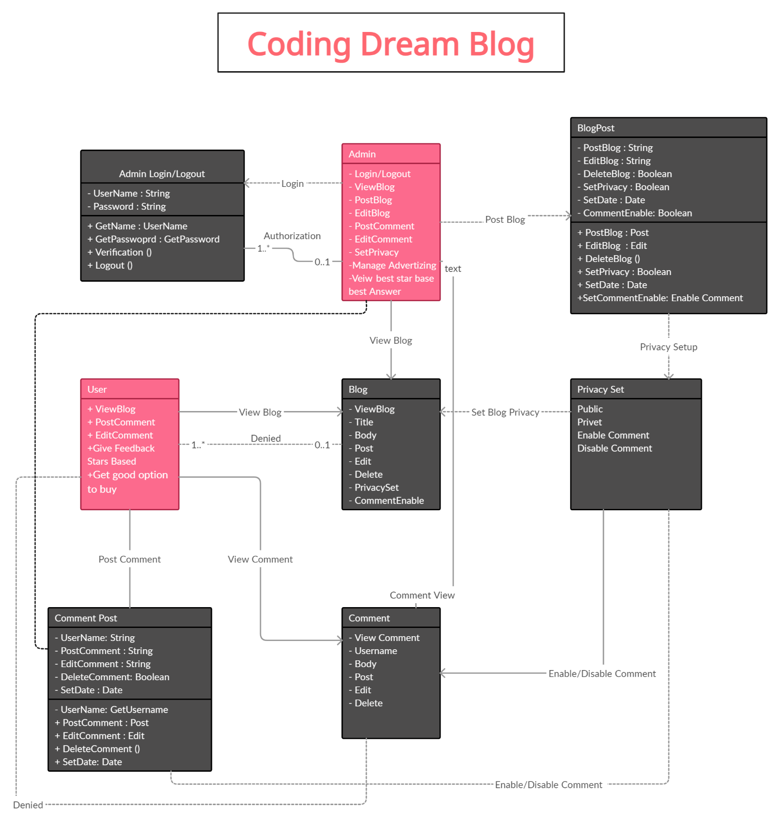
Logical Model/Class Diagram
A class diagram is a visual representation of class objects in a model system, categorized by class types. Each class type is represented as a rectangle with three compartments for the class name, attributes, and operations. Objects are represented as ovals that contain class names inside class name compartments.

Slide 21
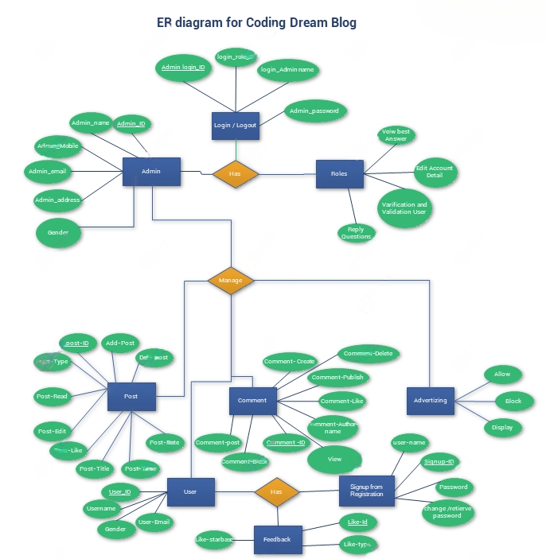
Entity-Relationship Diagram
A graphical representation that shows relationships between individuals, things, locations, concepts, or events within an information technology (IT) system is called an entity relationship diagram (ERD), also known as an entity relationship model.
Entity Relationship Diagram contains:
Entities (Tables)
Attributes
Relationship
Three common cardinal relationships are
one-to-one
one-to-many
many-to-many

Slide 22
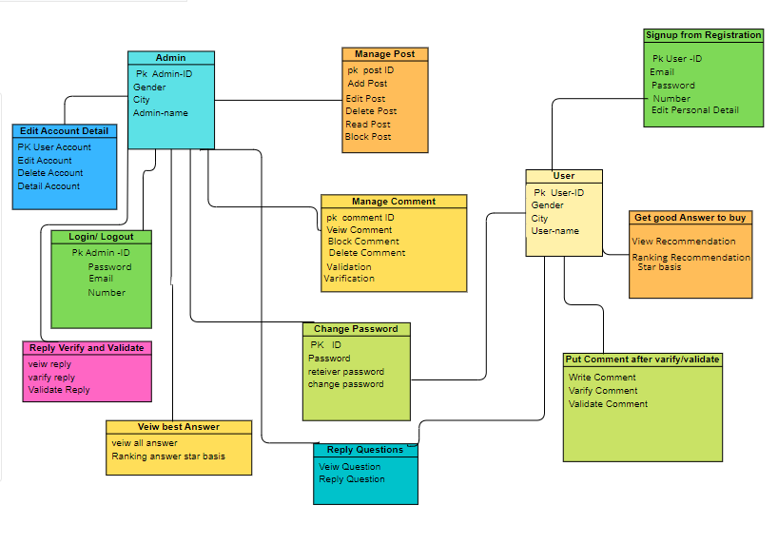
Database Diagram
Database diagrams graphically show the structure of the database and relations between database objects. To generate a diagram, we need a data source, a schema, or a table. To create relations between database objects, consider using primary and foreign keys. The five major components of a database are Hardware , Software , Data , Procedure , Database access language

Slide 23
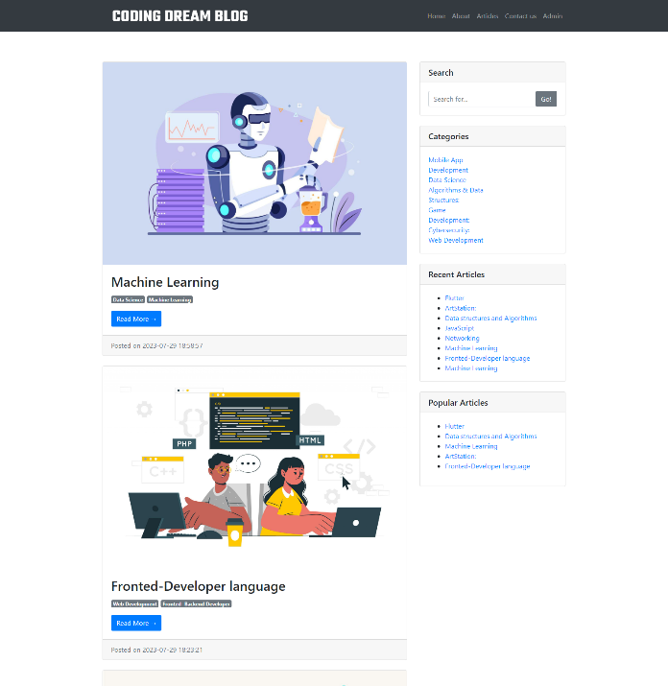
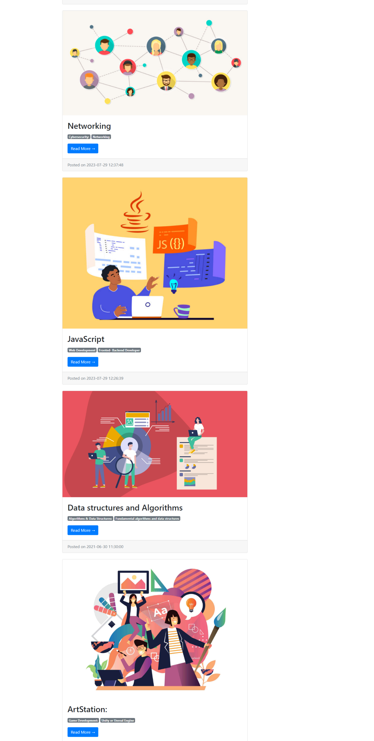
User Interfaces
User interface (UI) design is about building interfaces with a focus on styling and interactivity. UI brings together concepts from interaction design, visual design, and information architecture.

Slide 24
Project’s Tools
Tools:
HTML, CSS, Boot Strap Java Script, Python, PHP, MySQL
Editors (Visual Studio Code, Dream viewer, Notepad++) etc.
Note: (Word Press Not allowed)
Databases: Any DBMS

Slide 25
THANK YOU
Writer : Ayesha Nudrat

