Slide 1


Surveillance Car

Slide 2
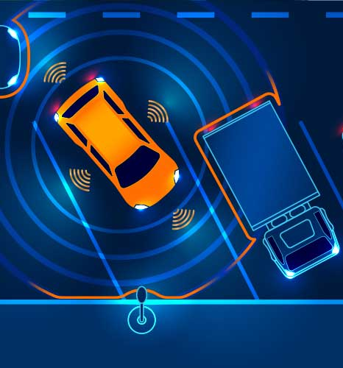
Contents
Introduction
Motivation
How it works?
Application
Bibliography

Slide 3
Introduction
Subject: CSE 250: Project Work II Submitted By: Reg. No.: 2019331049 Reg. No.: 2019331105 Name: Sifat Jahan Shorna Name: Ayesha Chowdhury Rimi

Slide 4
Motivation
We need surveillance cameras for a variety of purposes, so it would be great if they could travel from one location to another. Therefore, we came up with the concept of creating a monitoring vehicle that can be operated wirelessly by smartphones.
Instruments required:
Arduino UNO
ESP32 CAM module
L298N H-Bridge dual motor driver
4WD smart robot car chassis kit
Jumper wires
Mini breadboard
11.1V 3s 850mAh Lipo battery

Slide 5
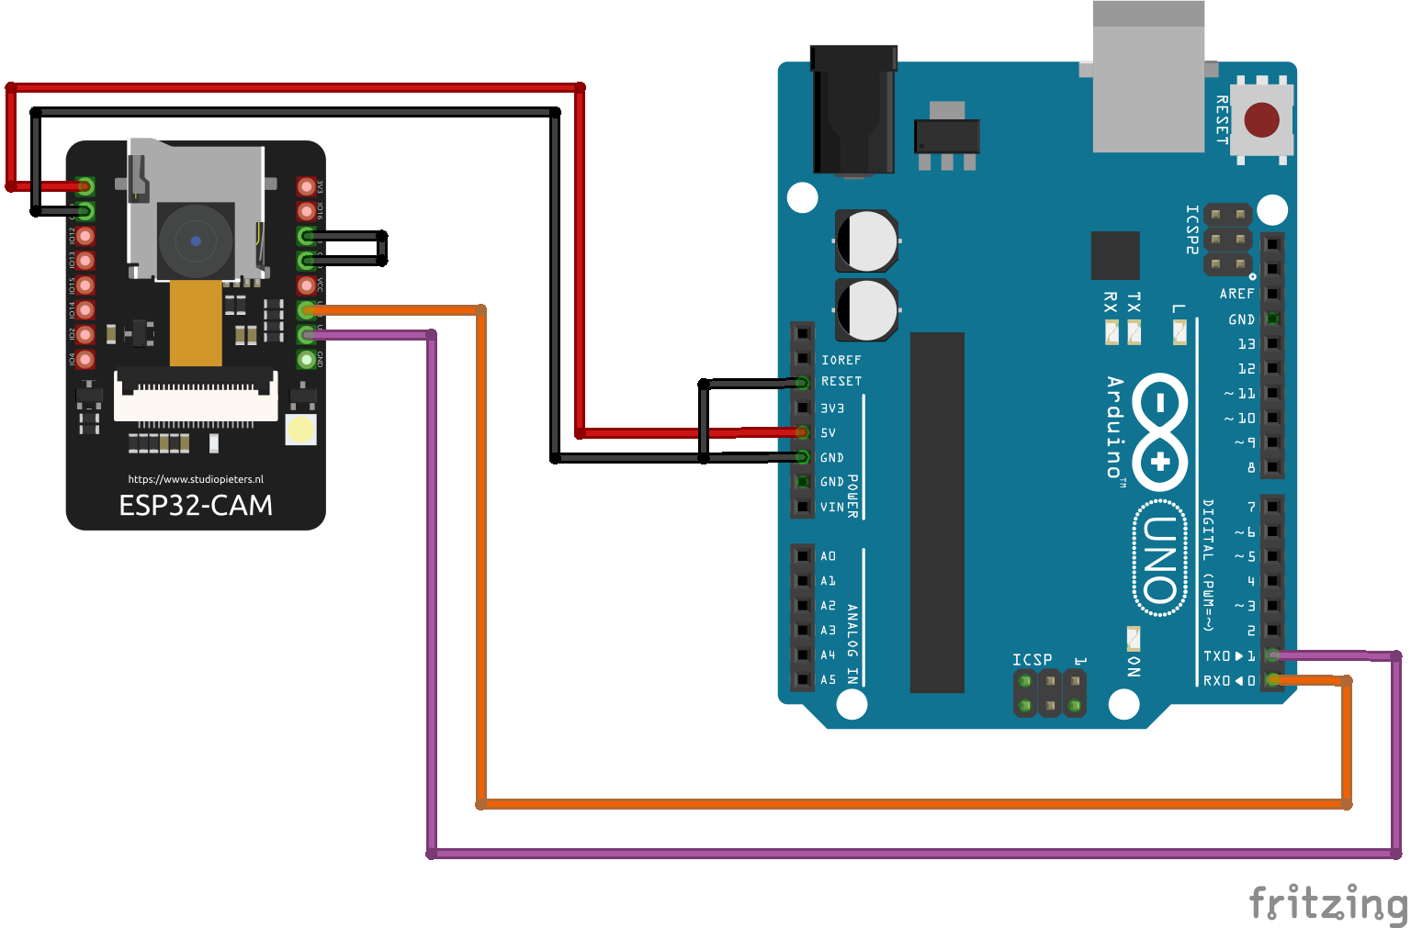
Code Upload

Slide 6
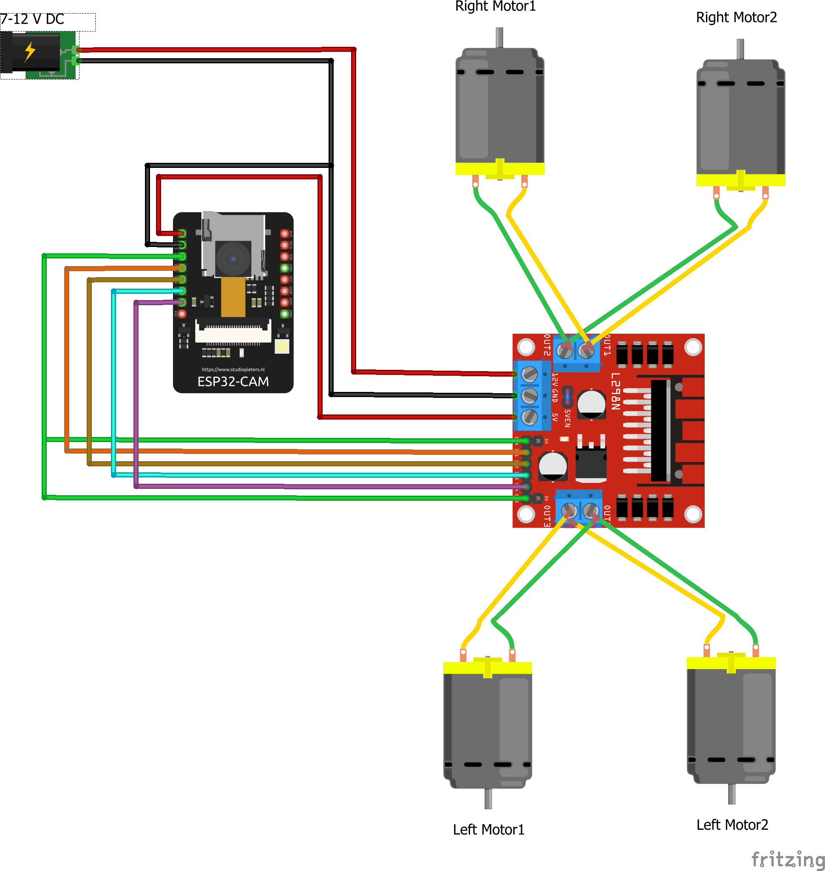
Car assembly

Slide 7
Applications:
Military purpose.
Spy car
Wild weather forecast
Remote traffic control

Slide 8
Bibliography
Hash include electronics (YouTube channel)
Hackster.io
Stackoverflow

