Slide 1
Python Programming

Slide 2
Dictionaries in Python

Slide 3
What is a Dictionary?
Python provides another composite data structure called a dictionary, which are used to store data values in key:value pairs.
A dictionary is a collection which is
Changeable
Does not allow duplicates (cannot have two items with the same key)

Slide 4
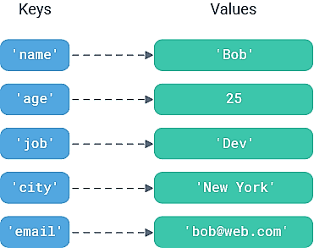

Slide 5
A dictionary in Python is a one to one mapping.
Dictionary holds a pair of values, one being the Key and the other corresponding pair element being its Value
Values in a dictionary can be of any data type and can be duplicated, whereas Keys of a Dictionary must be unique and can’t be repeated.
Dictionary keys are case sensitive, same name but different cases of Key will be treated distinctly.
Dictionaries are indexed using their keys.

Slide 6
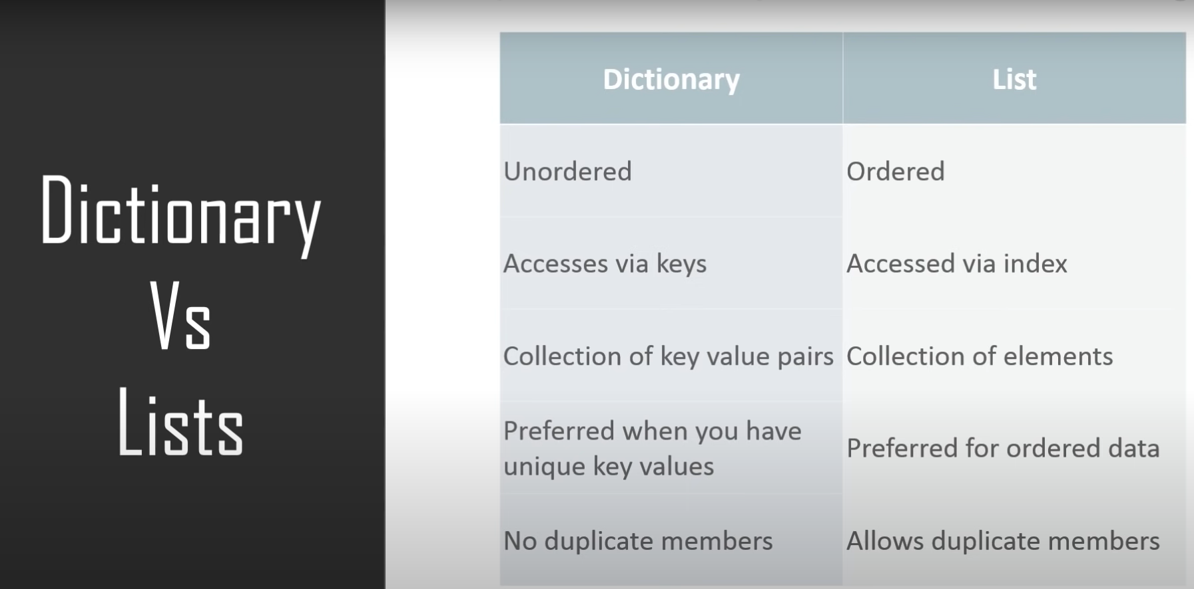

Slide 7
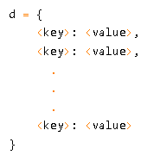
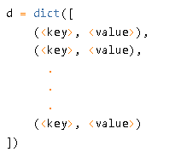
How to create a dictionary

Slide 8
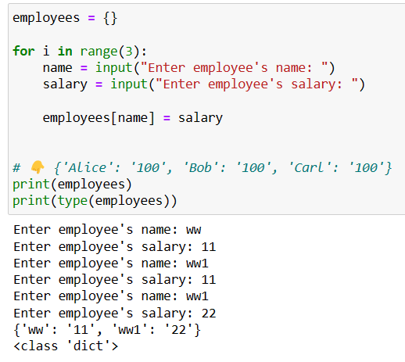
Dictionary with user input()

Slide 9
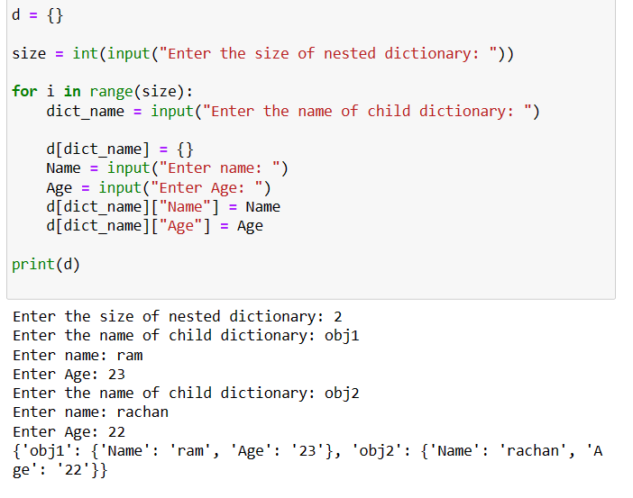
Nested dictionary

Slide 10
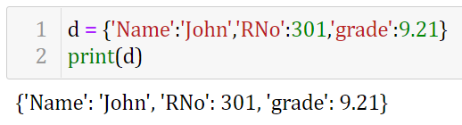
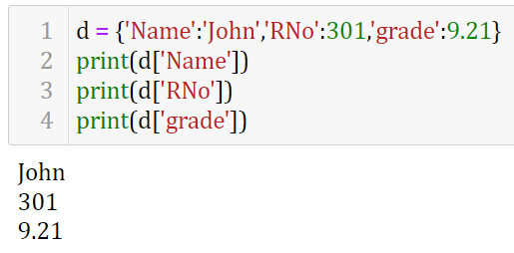

Slide 11
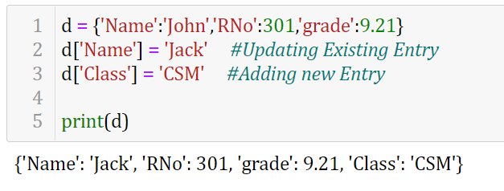
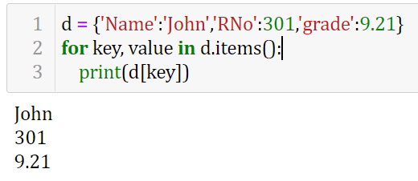

Slide 12
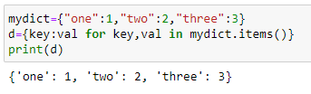
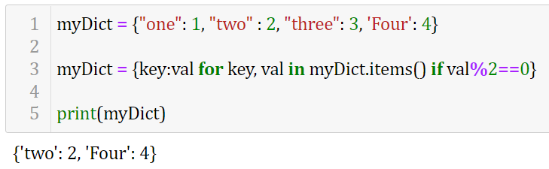

Slide 13
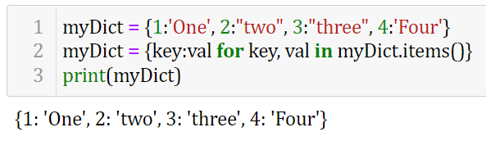
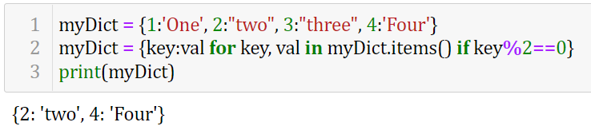

Slide 14
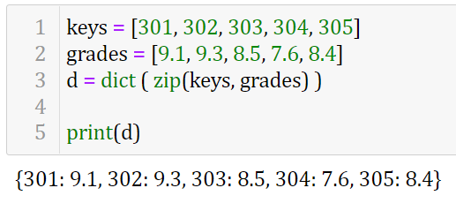

Slide 15
Python Dictionary Methods
Methods that are available with a dictionary are tabulated below. Some of them have already been used in the above examples.
Function | Description
all() | Return True if all keys of the dictionary are True (or if the dictionary is empty).
any() | Return True if any key of the dictionary is true. If the dictionary is empty, return False.
len() | Return the length (the number of items) in the dictionary.
sorted() | Return a new sorted list of keys in the dictionary.
clear() | Removes all items from the dictionary.
keys() | Returns a new object of the dictionary's keys.
values() | Returns a new object of the dictionary's values

Slide 16
Method | Description
clear() | Removes all the elements from the dictionary
copy() | Returns a copy of the dictionary
fromkeys() | Returns a dictionary with the specified keys and values
get() | Returns the value of the specified key
items() | Returns a list containing a tuple for each key value pair
keys() | Returns a list containing the dictionary's keys
pop() | Removes the element with the specified key
popitem() | Removes the last inserted key-value pair
setdefault() | Returns the value of the specified key. If the key does not exist: insert the key, with the specified value
update() | Updates the dictionary with the specified key-value pairs
values() | Returns a list of all the values in the dictionary

Slide 17
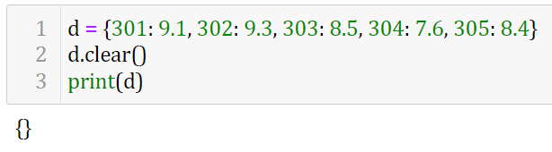
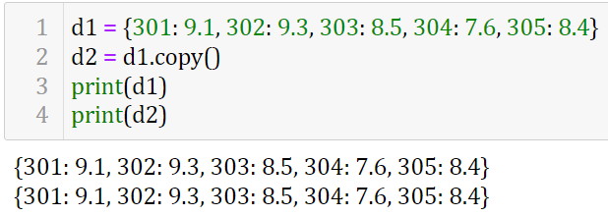
Clear()
Copy()

Slide 18
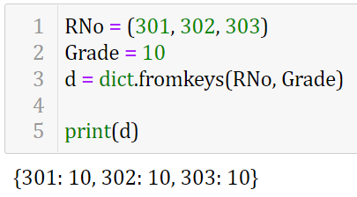
Syntax
fromkeys(seq[,val)

Slide 19
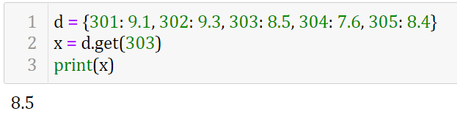
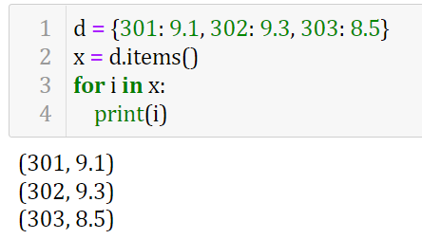
Dict.get(key) returns the value for the key passed
Dict.Items() returns list of tupless(key-value pair)

Slide 20
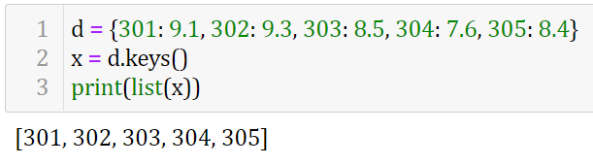
Dict.Keys() returns a list of keysin the dictionary

Slide 21
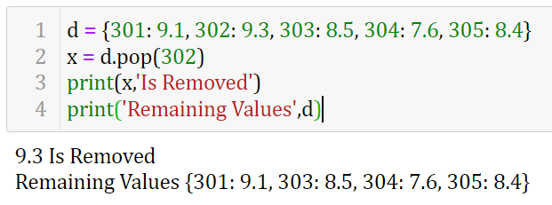
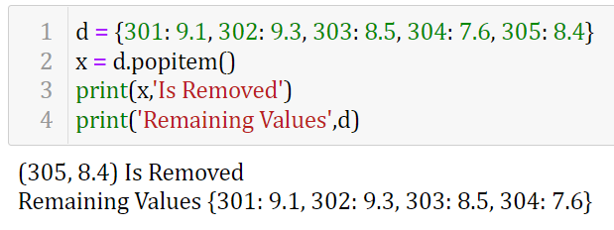
Syntax:
Dict.pop(key[,default])
popitem()

Slide 22
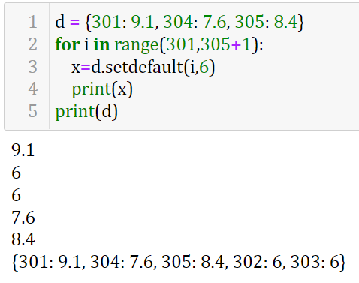
Syntax:
setdefault(key,value)

Slide 23
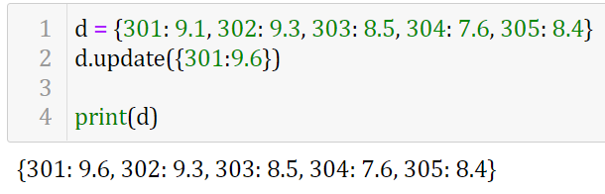
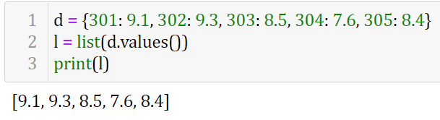
Syntax:
Dict1.update(Dict2)
values()

