Slide 1
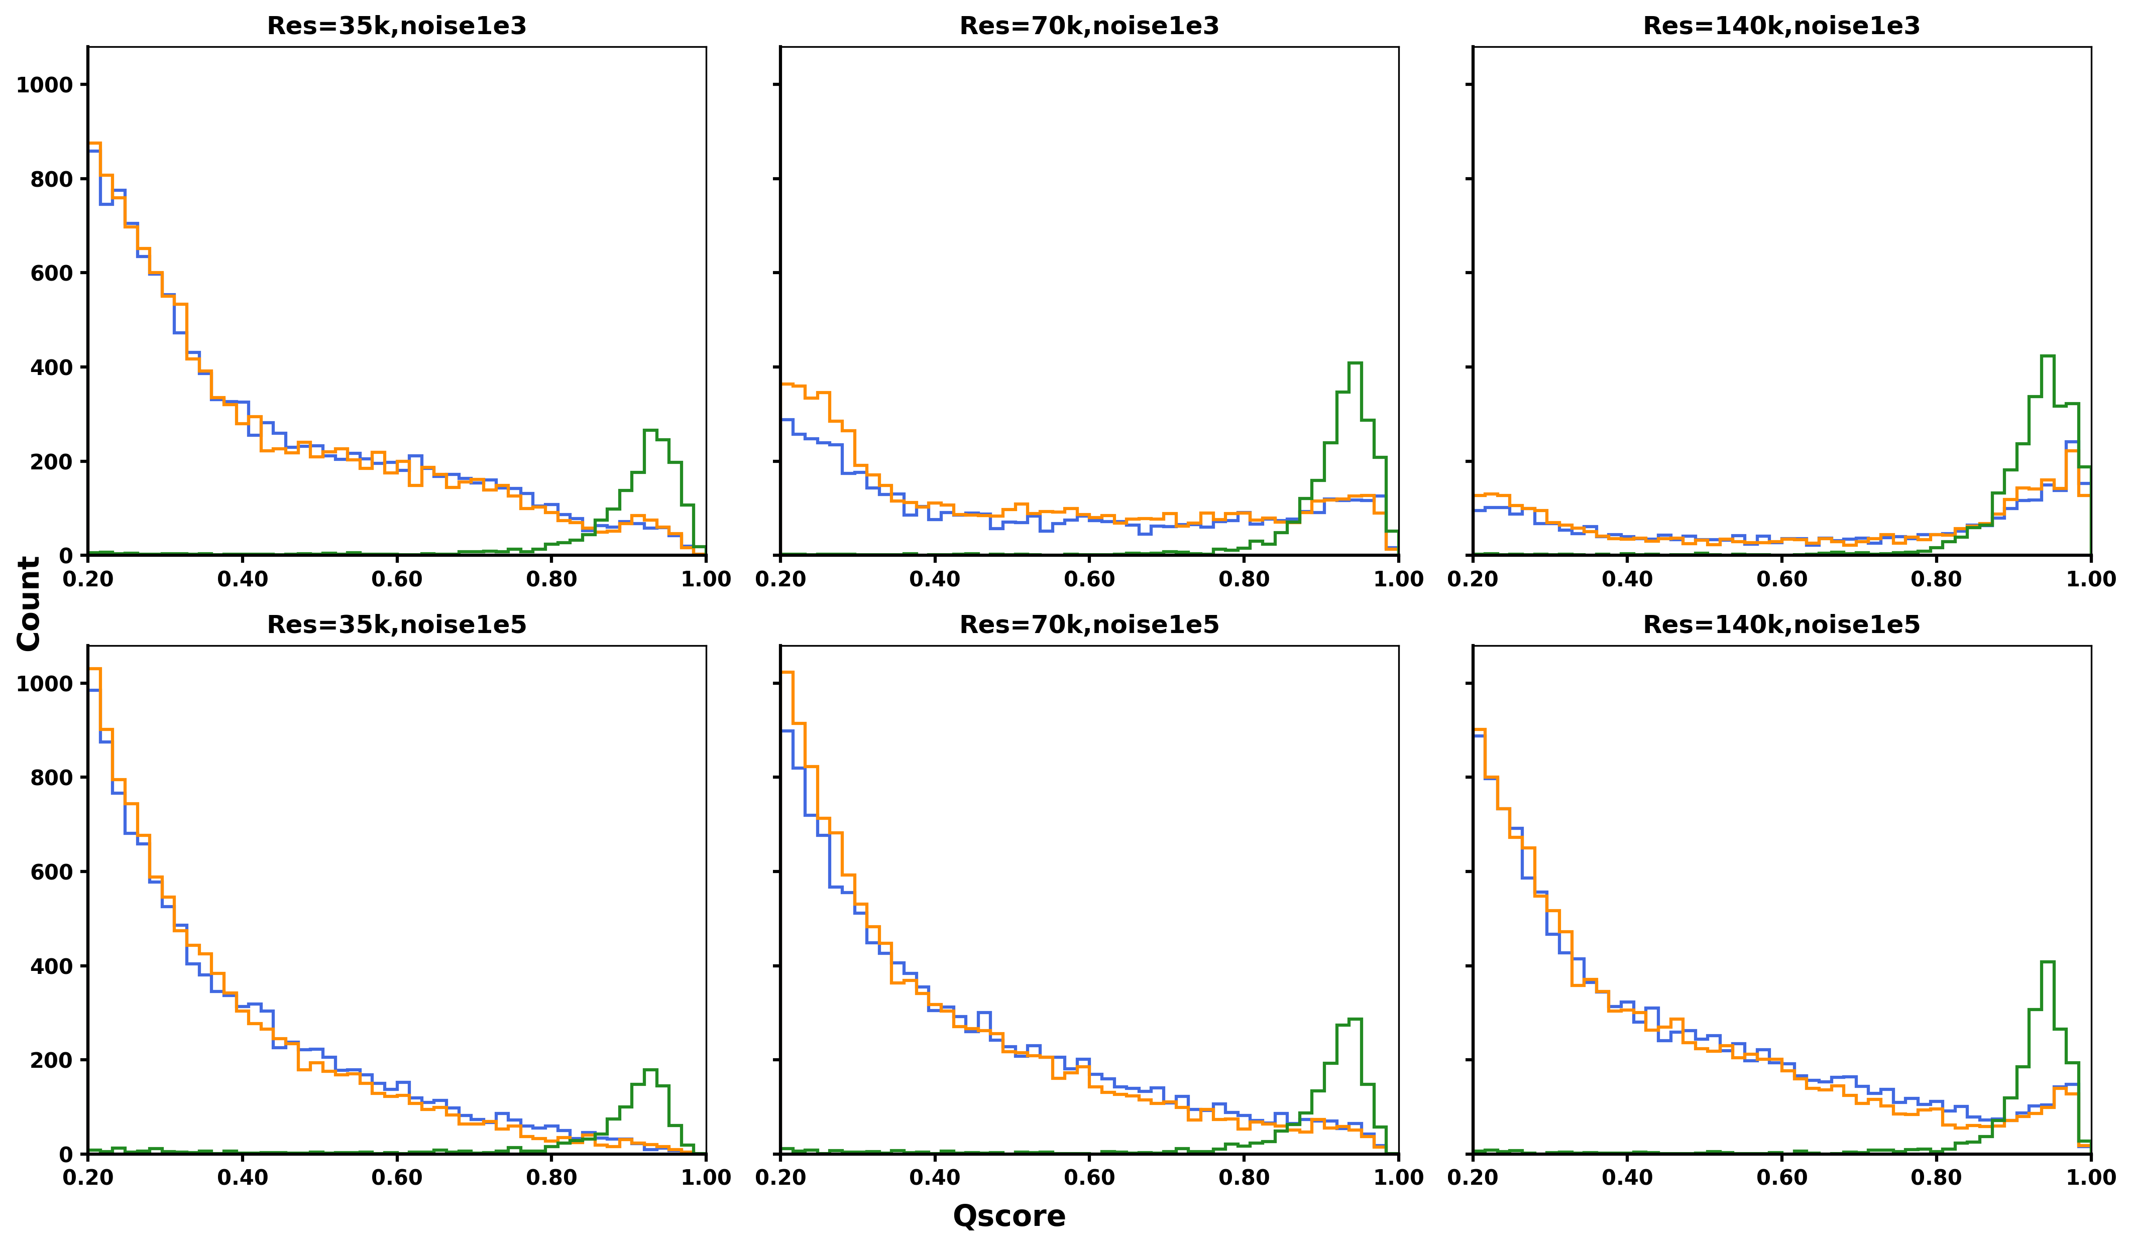
True Positives
Decoy Masses
False Positives
Notes:
iso0

