Slide 1
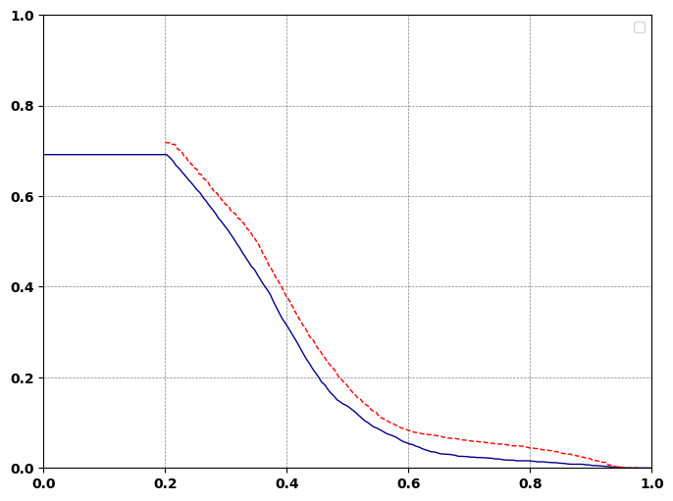

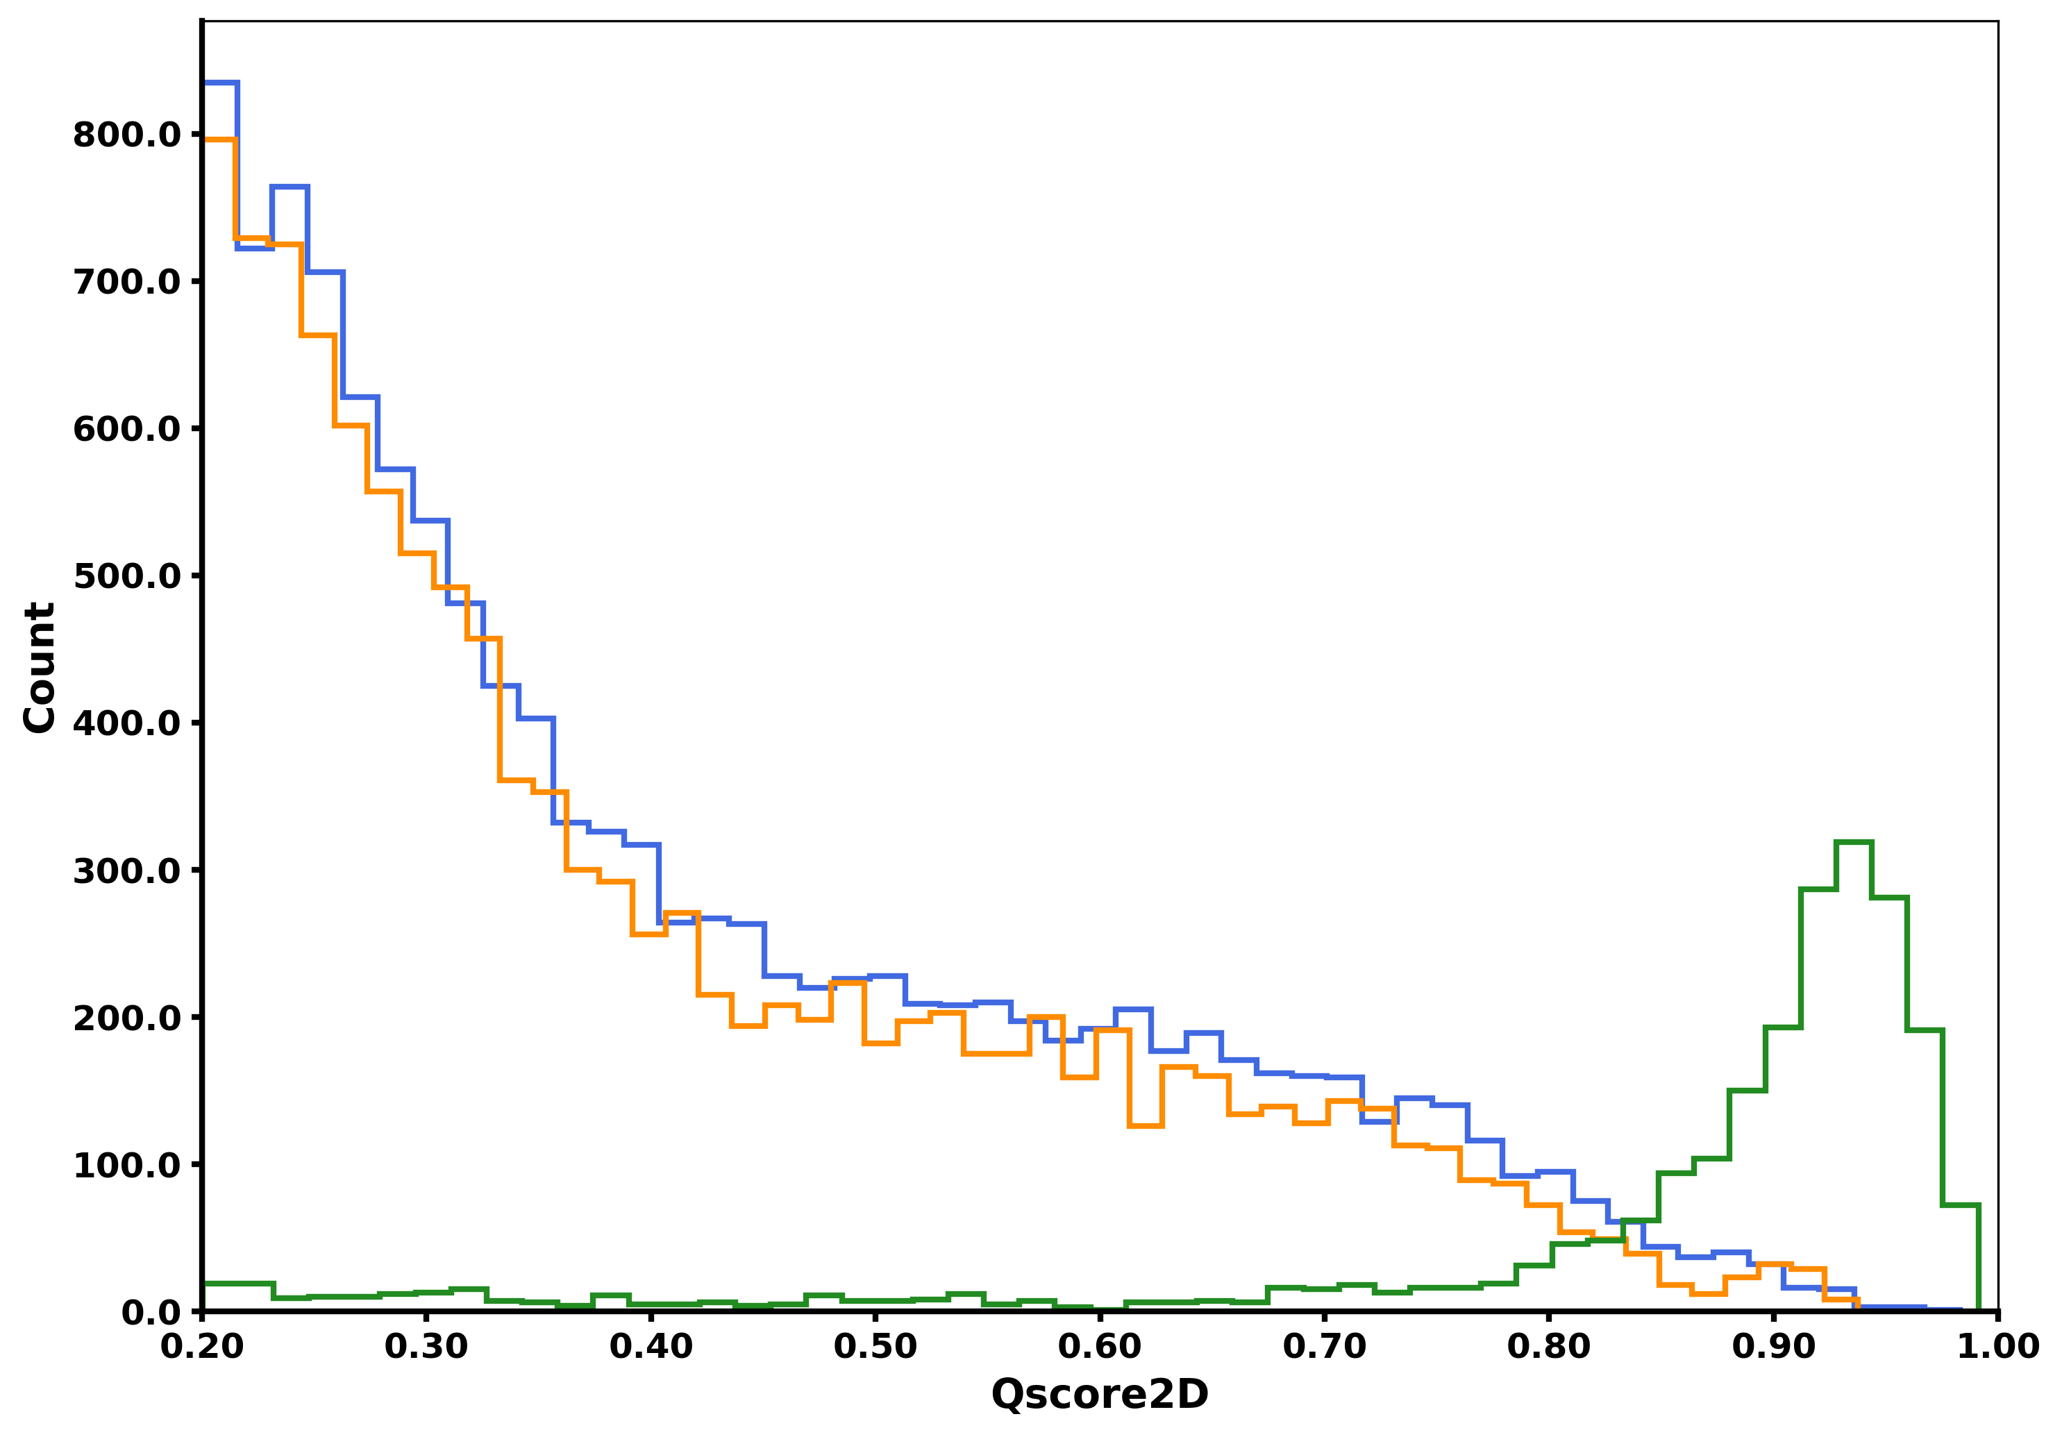

A.
Target masses
---- Estimated FDR
True FDR
Qvalue or FDR
Spectrum
FLASHDeconv
Run
2
FLASHDeconv Run
for D_signal
Decoy masses (D_signal)
Qscore
Total Decoys
3
1
Annoted spectrum
FLASHDeconv Run
for D_noise
Decoy masses (D_noise)
Weight
B.
Deconvolved File from FLASHDeconv
Theoretical mass list of sequences
Monoisotpic Mass
Target Decoy Type
Monoisotpic Mass
Configuration files
In silico datasets mzml
113.4
115
119
222
343
345
212
211
113.4
222
119
..
0
0
0
0
0
0
0
0
1
1
2
..
Matching
113
115
119
233
343
345
218
211
True Positives
TSV
Decoy Masses
SpectroSwiss
False Positives
FLASHDeconv
FDR estimation
Notes:
Latest consider this may

