Slide 1
FINE PRINT
PRIVACY POLICIES AND DATA PROTECTION LAWS
Group Members:
Tehreem Javed i16-0086
Ayesha Qamar i16-0104
Supervisor:
Dr. Mirza Omer Beg

Slide 2
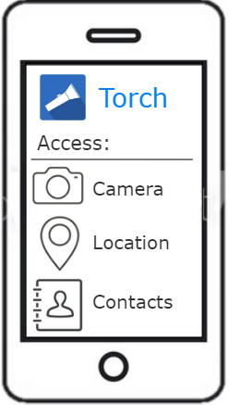
PROJECT OVERVIEW
To enable users to check privacy policies against data protection laws.

Slide 3
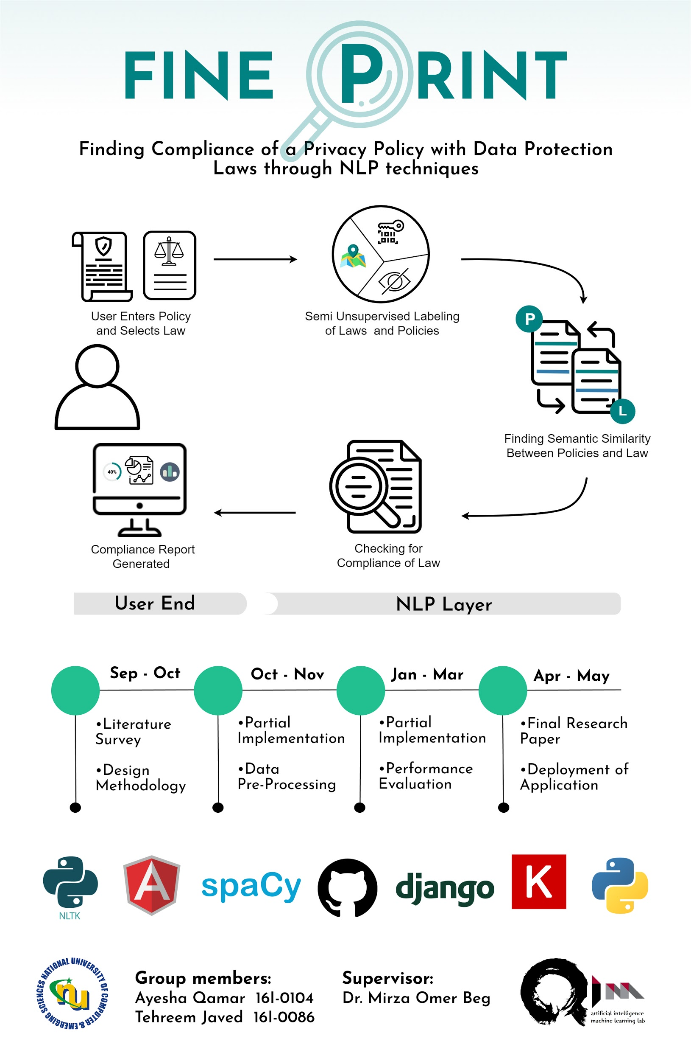
Poster

Slide 4
Unsupervised Alignment of Privacy Policies using Hidden Markov Models[1]
Year of Publication | 2014
Place of Publication | 52nd Annual Meeting of the Association for Computational Linguistics

Slide 5
Overview
Human QA
Privacy Policy Corpus
HMM Model
Direct Judgement
The privacy policy corpus is segmented and aligned using the hidden markov model. The model is evaluated through two techniques; by Human QA and by Direct Judgement.

Slide 6
Critical Analysis
Research Contributions:
  Dataset of privacy policies, unsupervised approach for alignment and evaluation techniques.
Research Direction:
  Evaluation techniques require datasets for out of domain implementation.
  Small number of policies used in ‘Evaluation by Human QA
Can be used to label the laws.

Slide 7
Leveraging Linguistic Structure For Open Domain Information Extraction[2]
Year of Publication | 2015
Place of Publication | 53rd Annual Meeting of the Association for Computational Linguistics

Slide 8
Overview
Sentence broken down into self-contained clauses.
  Sentence traversed using dependency tree.
Superfluous information removed
  Triples of subject-object-verb formed.

Slide 9
Critical Analysis
Research Contributions:
  Sub clause inherits subject from parent clause.
  Non-subsective adjectives are not removed.
  Better generalization through splitting sentences.
Research Direction:
  Complex assertions not interpreted correctly.
Can be used to extract information from the laws.

Slide 10
Multi-Perspective Sentence Similarity Modeling with Convolutional Neural Networks [3]
Year of Publication | 2015
Place of Publication | Conference on Empirical Methods in Natural Language Processing

Slide 11
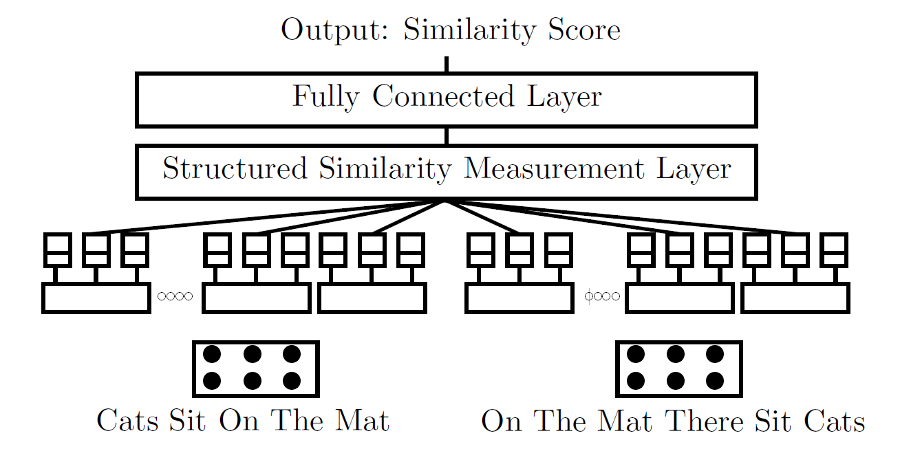
sample
sample.. make duplicate slides from this

Slide 12
Critical Analysis
Research Contributions:
  Doesn’t require external resources such as parsers and wordnet.
  Uses multiple filters for better information extraction.
  Doesn’t require hand-crafted features.
Research Direction:
  Architecture engineering is complex.
  Model may not compete with simple but deeper networks with large training data
Can be used to find similarity and compliance between laws and policies.

Slide 13
Unsupervised Topic Extraction from Privacy Policies[4]
Year of Publication | 2019
Place of Publication | Companion Proceedings of World Wide Web Conference, ACM.

Slide 14
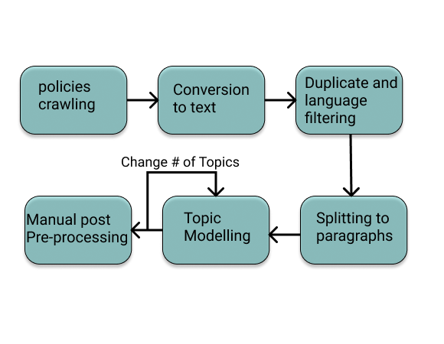
High Level overview

Slide 15
Critical Analysis
Research Contributions:
  Provides insight into fine-details of PPs
Research Direction:
  Privacy Policies analyzed at paragraph level only.
Provides an unsupervised technique to label policies.

Slide 16
Polisis: Automated Analysis and Presentation of Privacy Policies Using Deep Learning[5]
Year of Publication | 2018
Place of Publication | 27th USENIX Security Symposium

Slide 17
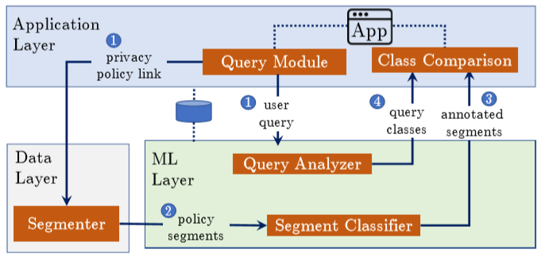
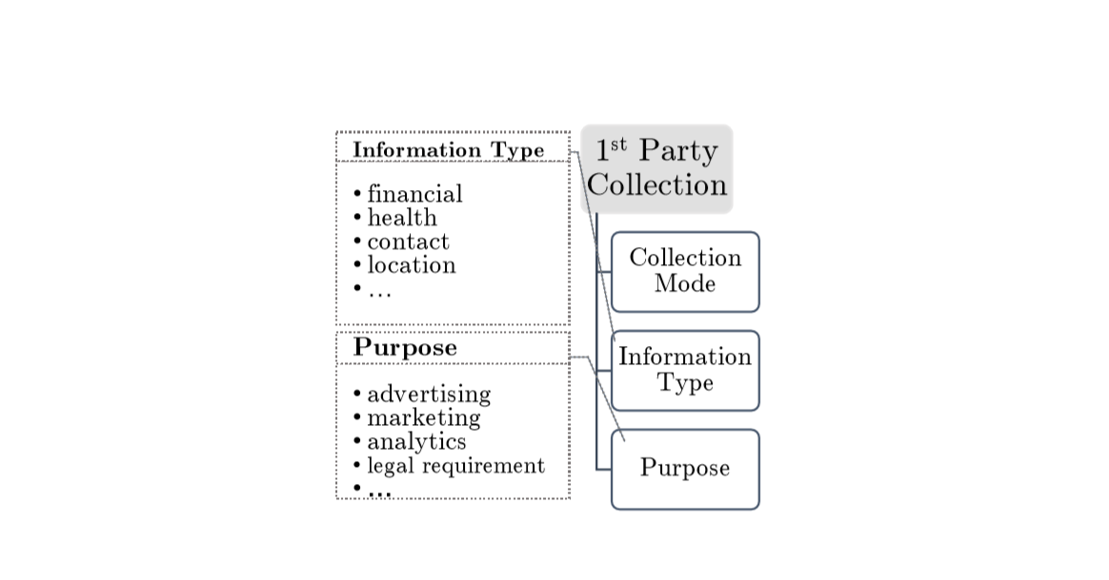
High Level overview

Slide 18
Critical Analysis
Research Contributions:
  QA system without any dataset available.
  Sub-word embeddings for robustness to unseen words.
Research Direction:
  Dependent on OPP-115 dataset
Provides an end-to-end overview on labelling policies

Slide 19
Comparison table of papers
Papers | Extrinsic Evaluation | Account for PP dynamics | Comparison with previous work
Polisis | ✔
LDA |  | ✔ | ✔
HMM |  |  | ✔
CNN |  |  | ✔

Slide 20
Research Gap
Privacy Policies analyzed from many angles:
  Usability [6]
  Content [7]
  Readability [8]
  Changes [9]
No work done yet to check compliance of privacy policies with laws.

Slide 21
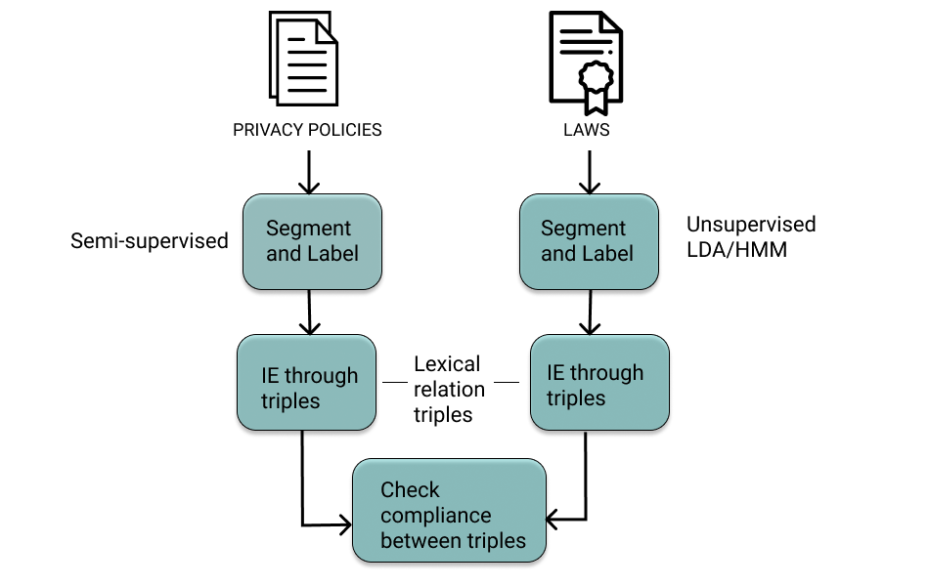
Proposed Methodology

Slide 22
REFERENCES
[1] Ramanath, Rohan, et al. "Unsupervised alignment of privacy policies using hidden markov models." Proceedings of the 52nd Annual Meeting of the Association for Computational Linguistics (Volume 2: Short Papers). 2014.
[2] Angeli, Gabor, Melvin Jose Johnson Premkumar, and Christopher D. Manning. "Leveraging linguistic structure for open domain information extraction." Proceedings of the 53rd Annual Meeting of the Association for Computational Linguistics and the 7th International Joint Conference on Natural Language Processing (Volume 1: Long Papers). 2015.
[3] He, Hua, Kevin Gimpel, and Jimmy Lin. "Multi-perspective sentence similarity modeling with convolutional neural networks." Proceedings of the 2015 Conference on Empirical Methods in Natural Language Processing. 2015.
[4] Sarne, David, et al. "Unsupervised Topic Extraction from Privacy Policies." Companion Proceedings of The 2019 World Wide Web Conference. ACM, 2019.

Slide 23
REFERENCES
[5] Harkous, Hamza, et al. "Polisis: Automated analysis and presentation of privacy policies using deep learning." 27th {USENIX} Security Symposium ({USENIX} Security 18). 2018.
[6] Jensen, Carlos, and Colin Potts. "Privacy policies as decision-making tools: an evaluation of online privacy notices." Proceedings of the SIGCHI conference on Human Factors in Computing Systems. ACM, 2004.
[7] Antón, Annie I., Julia Brande Earp, and Angela Reese. "Analyzing website privacy requirements using a privacy goal taxonomy." Proceedings IEEE Joint International Conference on Requirements Engineering. IEEE, 2002.
[8] M. Hochhauser (2001). Lost in the fine print: Readability of financial privacy notices. Retrieved September 30, 2019 from http://www.privacyrights.org/ar/GLB-Reading.htm.
[9] Linden, Thomas, et al. "The privacy policy landscape after the GDPR." arXiv preprint arXiv:1809.08396 (2018).

Slide 24
ANY QUESTIONS
Thank you

Slide 25
DATASET
465 labelled policies
Links to around 4 million unlabelled policies
Data Protection laws of Canada(PIPEDA), Singapore, Europe(GDPR), US-EU and US-Swiss(Privacy Shield Framework), China (The Personal Information Security Specification)

Slide 26
Privacy Policy Categorization
The annotation scheme according to OPP-115 dataset consists of ten data practice categories*:
1. First Party Collection/Use
2. Third Party Sharing/Collection
3. User Choice/Control
4. User Access, Edit, & Deletion
5. Data Retention
6. Data Security
7. Policy Change
8. Do Not Track
9. International & Specific Audiences
10. Other
*The creation and analysis of a website privacy policy corpus . Shomir Wilson, Florian Schaub and Aswarth Abhilash Dara. In Proceedings of the 54th Annual Meeting of the Association for Computational Linguistics, Berlin, Germany, August 2016.

