Slide 1
CYBER COMPLIANCE
PRIVACY POLICIES AND DATA PROTECTION LAWS
Supervisor:
Dr. Mirza Omer Beg
Group Members:
Ayesha Qamar i16-0104
Tehreem Javed i16-0086

Slide 2
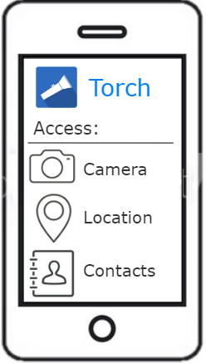
PROJECT OVERVIEW
To enable users to check privacy policies against data protection laws.

Slide 3
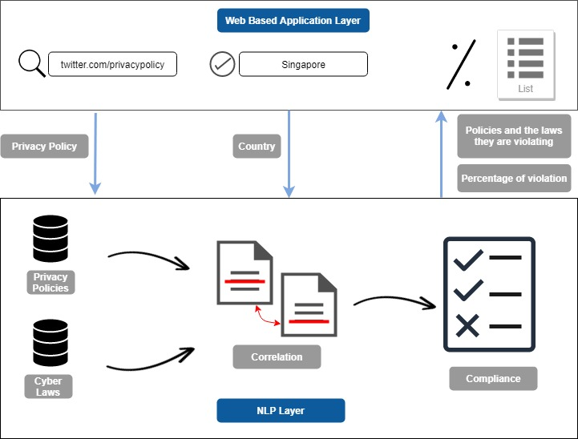
Web Based Application Layer
Twitter.com/privacy
Singapore
Policies and the laws being violated
Privacy Policy
Country
Percentage
Privacy Policies
Correlation
Data Laws
Compliance
NLP Layer

Slide 4
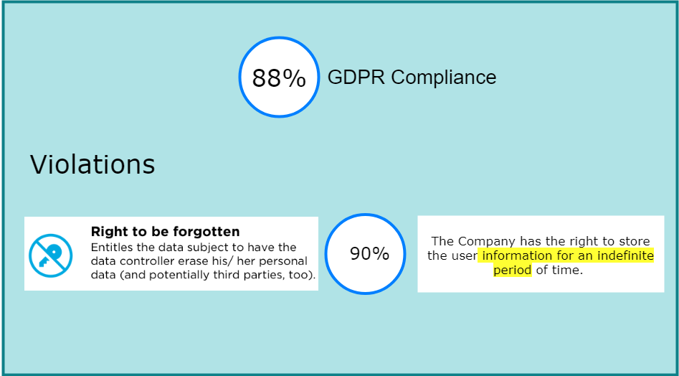

Slide 5
MOTIVATION
Google was Fined $57 million under Europe’s new Data Privacy Law in January 2019*.
The Federal Trade Commission (FTC) fined Facebook $5 Billion for privacy breaches**.
Around 201 hours are needed by any average user just to read all the privacy policies encountered in a year. [1]

Slide 6
MOTIVATION
Previous Work
  Polisis
    It is a privacy policy analysis tool which has the ability to find and present what information is being collected and why, using deep learning. [2].
  Automated Analysis of Privacy Requirements for Mobile Apps
    It checks the policies of an app against its practices to find conflicts using automated analysis [3].

Slide 7
CHALLENGES
Building correlations between laws and the corresponding policies.
Verifying if the policy is in accordance to its related law.
Identifying any discrepancies between laws and policies.
Implementing semi unsupervised learning.

Slide 8
PROJECT SCOPE
A web application where users can enter privacy policy and select a country to check if it follows the laws.
A research and development based approach.

Slide 9
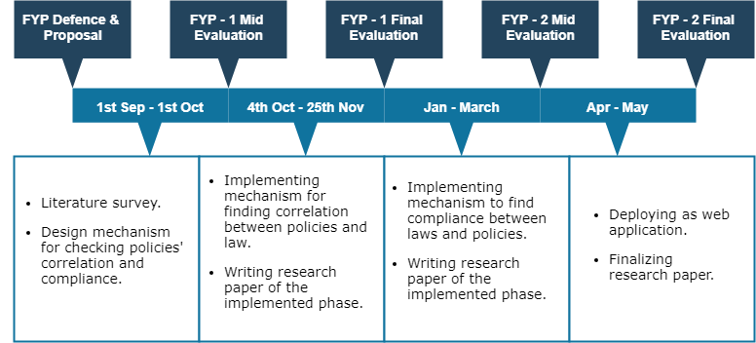
TIMELINE

Slide 10


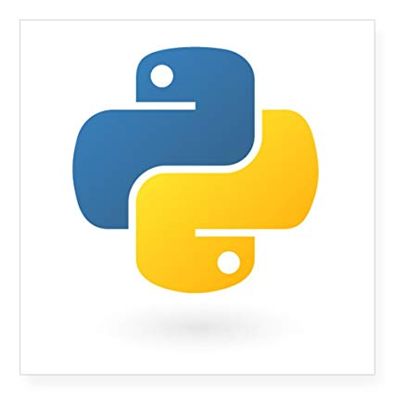


TOOLS AND TECHNOLOGIES

Slide 11
REFERENCES
[1] A. M. McDonald and L. F. Cranor, “The cost of reading privacy policies,” ISJLP, vol.4, p. 543, 2008.
[2] Harkous, H., Fawaz, K., Lebret, R., Schaub, F., Shin, K. G., & Aberer, K. (2018). Polisis: Automated analysis and presentation of privacy policies using deep learning. Computation and Language.
[3] S. Zimmeck, Z. Wang, L. Zou, R. Iyengar, B. Liu, F. Schaub, S. Wilson, N. Sadeh, S. M. Bellovin, and J. Reidenberg, “Automated analysis of privacy requirements for mobile apps,” in 24th Annual Network and Distributed System Security Symposium, NDSS 2017, 2017.

Slide 12
ANY QUESTIONS
Thank you

Slide 13
LIMITATIONS
Caters to privacy policies in English only.
Focuses on only data protection laws and regulations.
Can select law from a few countries.

Slide 14
DATASET
465 labelled policies
Around 1280 unlabelled policies
Data Protection laws of Canada(PIPEDA), Singapore, Europe(GDPR), US-EU and US-Swiss(Privacy Shield Framework), China (The Personal Information Security Specification)

Slide 15
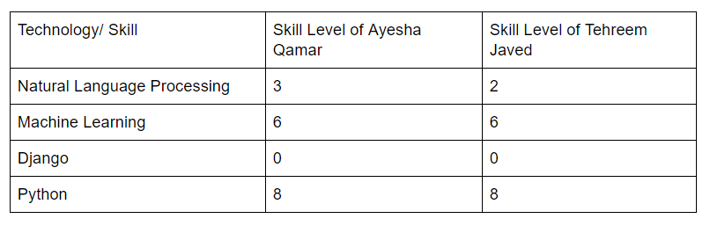
Skills Table

Slide 16
Privacy Policy Categorization
The final annotation scheme according to OPP-115 dataset consists of ten data practice categories*:
1. First Party Collection/Use
2. Third Party Sharing/Collection
3. User Choice/Control
4. User Access, Edit, & Deletion
5. Data Retention
6. Data Security
7. Policy Change
8. Do Not Track
9. International & Specific Audiences

