Slide 1

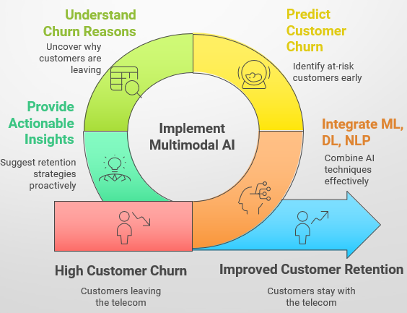


📡 Multimodal AI for Telecom Customer Churn & Sentiment Analysis
Production-ready ML, DL, and NLP pipeline combining tabular machine learning for churn prediction with deep learning for sentiment analysis. This end-to-end system delivers actionable insights through a deployable Streamlit application.
Predict Customer Churn
Understand Churn Reasons
Identify at-risk customers early using advanced ML algorithms
Uncover why customers are leaving through sentiment analysis
Provide Actionable Insights
Suggest retention strategies proactively based on AI predictions
By: Ayesha Banu
M.Sc. Gold Medalist
Open to roles in Data Science / Data Analyst / ML Engineering / AI Development
LinkedIn Profile
GitHub Repository

Slide 2
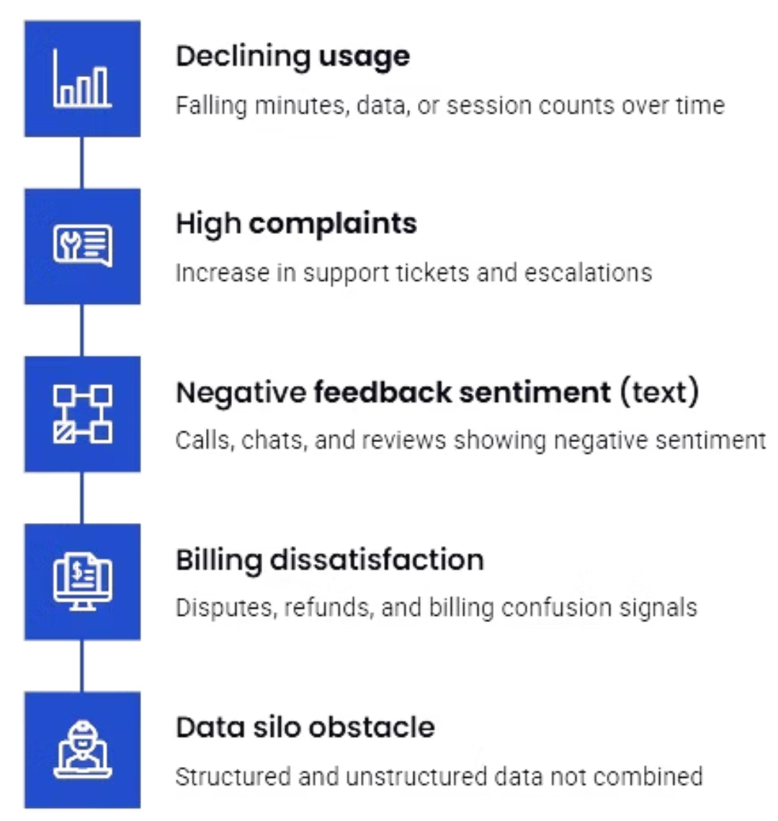
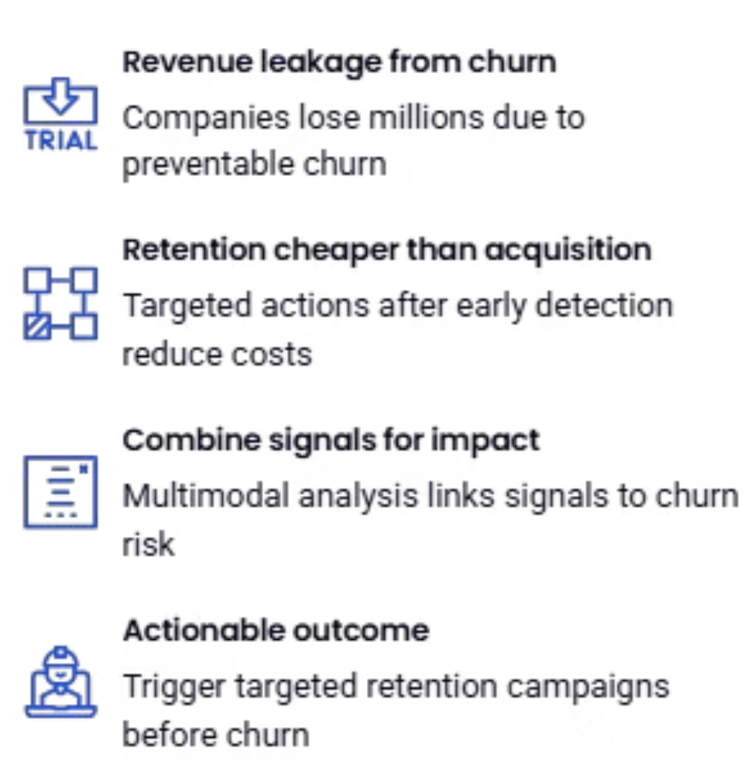

The Business Problem: Early Signals of Customer Churn
The Question: How can we leverage ALL available data—both structured metrics and unstructured feedback—to detect churn early and understand the underlying reasons?
Detect warning signs early to reduce revenue leakage
Telecom companies face significant revenue loss when customers churn. The critical challenge is identifying who will leave and understanding why they're leaving—early enough to implement effective retention strategies.
Goal: Detect WHO will churn and WHY—early enough to stop revenue loss and implement targeted retention campaigns.

Slide 3




Mult imodal AI Solution: Predict, Explain, Act
A unified ML and DL pipeline that transforms signals and sentiment into prioritized retention actions, delivering both predictive power and explainable insights.
Tabular ML: Churn Score
Predicting WHO will churn: XGBoost model leverages usage patterns, billing data, and engagement metrics to identify customers at high risk of churning.
Text DL: Sentiment and Triggers
Understanding WHY they churn: Deep learning NLP extracts sentiment, complaints, and specific churn triggers from unstructured customer feedback text.
Fusion: Prioritized Interventions
Providing actionable insights: Combine churn scores and sentiment signals to rank customers for targeted retention campaigns and interventions.
CRM-Ready Action Layer
Deployable pipeline: Produces real-time alerts, campaign rules, and prioritized intervention lists ready for CRM integration and business action.

Slide 4
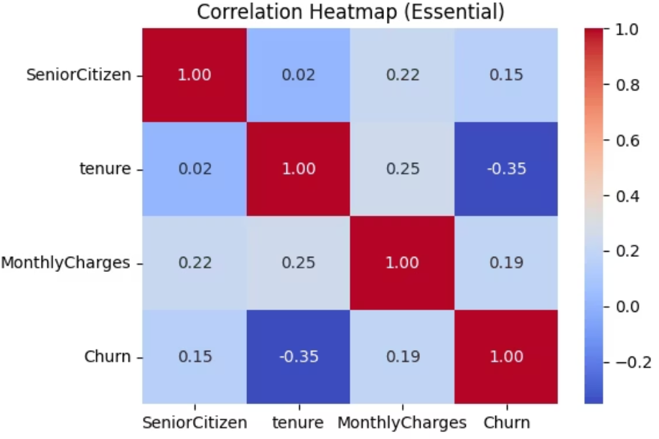
Dataset Overview & Key Patterns
Telecom Customer Records
Exploratory Data Analysis: Warning Signs Discovered
Comprehensive dataset combining structured and unstructured data for multimodal
analysis:
Contract Type Risk
7,043
23
Month-to-month customers churn at significantly higher rates—the highest risk segment requiring immediate attention.
Total Records
Total Features
Customer accounts analyzed
Data dimensions captured
Data Components:
Service Quality Issues
Structured: Tenure, monthly charges, contract type, services
Fiber optic users demonstrate higher churn rates compared to DSL users, indicating potential service quality concerns.
Unstructured: Customer feedback text
ML Target: Churn (Yes/No)
DL Target: Sentiment (Positive, Neutral, Negative)
Billing Pressure
High monthly charges correlate with churn decisions—price sensitivity is a critical factor.
Loyalty Timeline
Early-tenure customers face the highest risk of leaving during their initial months.
Sentiment Connection
Customer sentiment strongly aligns with churn behavior—negative feedback is a powerful predictor of departure.

Slide 5
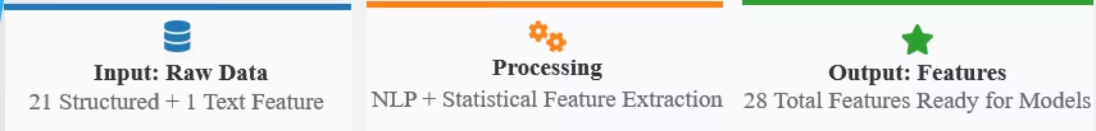

Feature Engineering: Bridging Structured & Text Data
Transforming raw telecom data into 28 powerful features that enable both machine learning and deep learning models to deliver actionable predictions.
Customer Features
Text-Based Features
Business Flags
Structured attributes:
NLP-derived metrics:
Derived indicators:
Tenure & contract details
Feedback length & word count
High-value customer flag
Monthly charges
Sentiment scores (positive, negative, neutral)
New customer indicator
Service portfolio count
Compound sentiment
Risk segment classification
Payment methods
Linguistic patterns
Service tier markers
Fiber optic indicator
Key Insight: The dual labeling strategy (Churn + Sentiment) enables a powerful multimodal AI model that provides both predictive accuracy and explanatory depth—transforming raw data into strategic business intelligence.

Slide 6
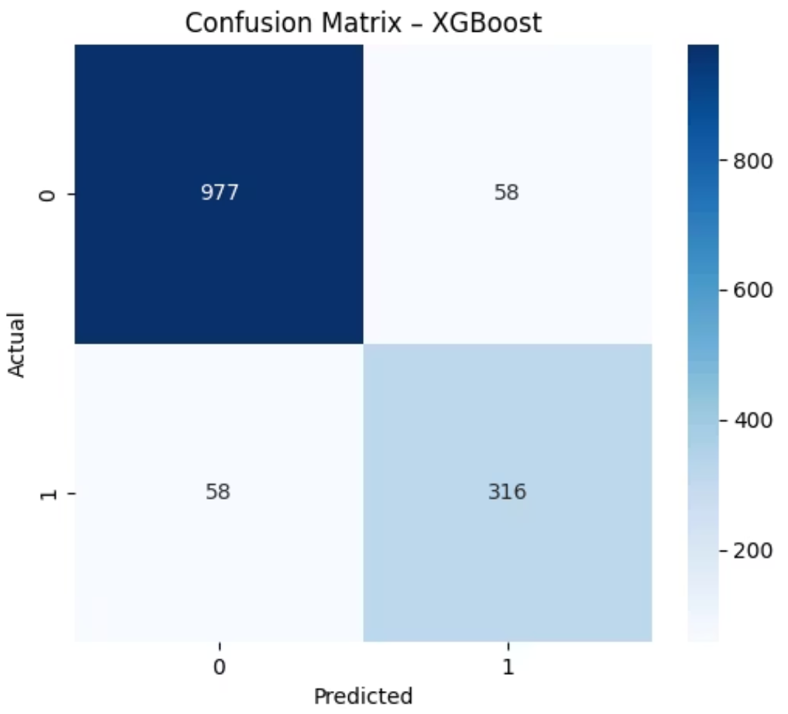
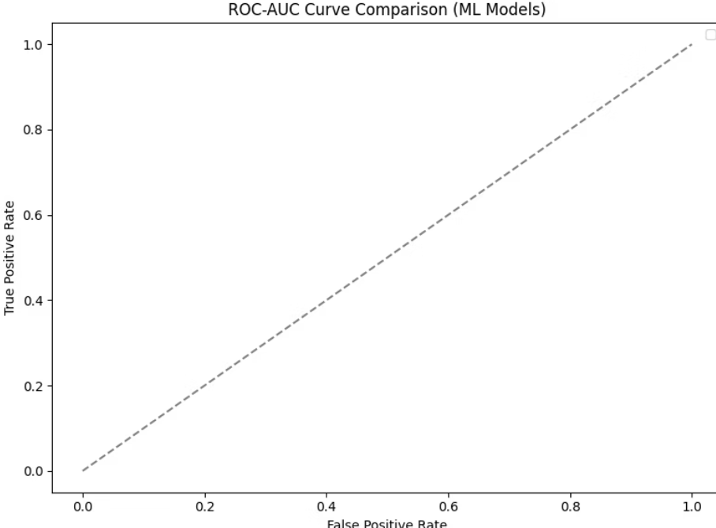
Machine Learning: Predicting Who Will Churn
XGBoost Delivers 96.77% ROC-AUC
Why XGBoost Wins
Gradient boosting outperforms baseline models for imbalanced telecom churn classification, delivering production-ready accuracy with interpretable feature importance.
Superior handling of feature interactions and non-linear relationships
Robust performance on imbalanced datasets with proper tuning
Model
Algorithm Type
ROC-AUC
Status
Production-ready with SHAP explainability integration
Logistic Regression
Linear Classifier
78.5%
Baseline
Significantly outperforms linear and tree-based alternatives
Random Forest
Ensemble (Bagging)
89.2%
Good
Top Predictive Features: Tenure, Contract Type, Monthly Charges, Sentiment Compound Score
XGBoost
Gradient Boosting
96.77%
BEST ⭐
Model Performance Visualization
SHAP summary plot revealing feature impact on churn predictions
Confusion matrix demonstrating classification accuracy

Slide 7
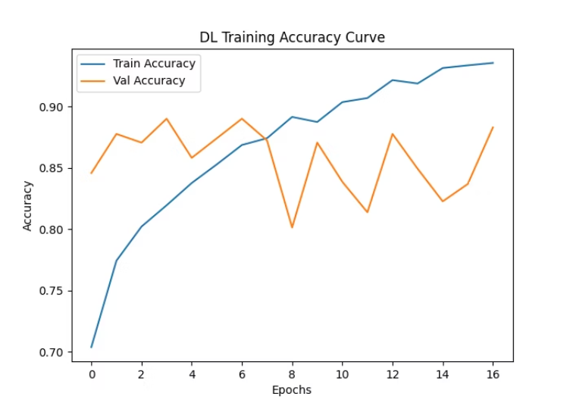
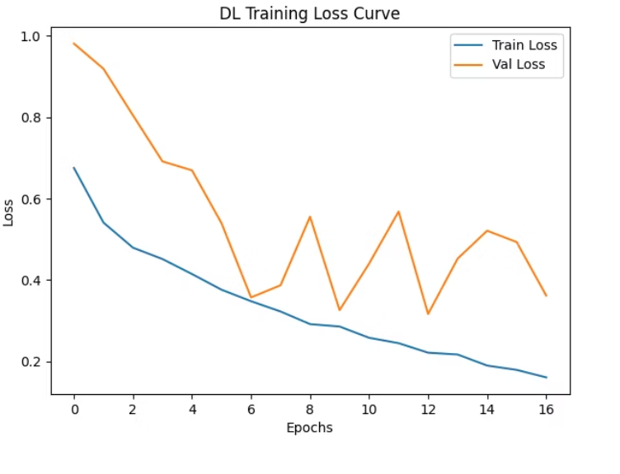
Deep Learning: Understanding Why They Churn
CNN + BiLSTM + Attention Architecture Achieves 88.15% Accuracy
Hybrid Neural Architecture
Key Capabilities & Insights
CNN Layer
1
Trigger Detection: Identifies specific complaint phrases like "slow internet" and "billing error" that correlate with negative sentiment
Captures local phrase patterns and linguistic features from feedback text
Validated Performance: Overall accuracy of 88.15% with balanced precision-recall across sentiment classes
2
BiLSTM Layer
Models sequential context and long-range dependencies in customer narratives
Explainability: Attention weights reveal which feedback segments most influence predictions, enabling human validation
3
Attention Mechanism
Highlights which words and phrases drive sentiment classification decisions
Production Monitoring: Validation curves and class balance checks prevent overfitting and ensure reliability
4
Classification Output
Multi-class sentiment: Positive, Neutral, Negative with confidence scores
Quality Assurance: Regular audits of class distribution and attention patterns maintain model trustworthiness

Slide 8

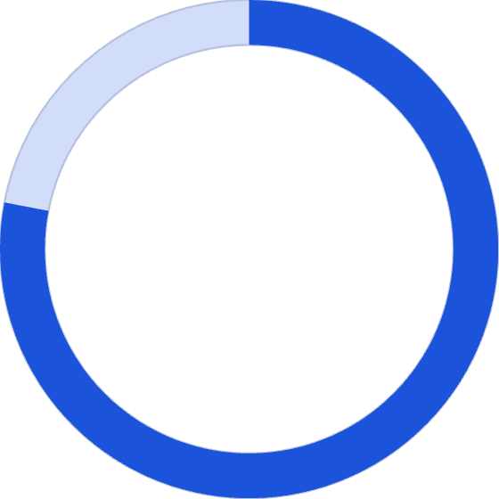

Multimodal Fusion: ML + DL Driving Retention Action
Combining churn probabilities, sentiment analysis, and trigger detection into a unified intelligence layer that prioritizes customer interventions with precision and context.
ML Output
DL Output
Fusion Layer
Churn Probability: High-risk customer identification with confidence scores
Sentiment + Triggers: Negative feedback severity and specific complaint themes
Actionable Intelligence: Prioritized intervention list with root causes and suggested actions
Key Insights from Multimodal Analysis
4x
78%
Churn Rate Multiplier
Billing Correlation
Fusion Intelligence Delivers
Low-tenure customers show 4x higher churn rates than long-term subscribers
Billing dissatisfaction appears in 78% of negative sentiment feedback from churners
WHO: High-risk customers ranked by churn probability
WHY: Specific complaint triggers and sentiment drivers
ACTION: Tailored retention strategies based on root causes
PRIORITY: Combined score enabling resource optimization

Slide 9






Streamlit App: Real-Time Deployment
Production-Ready Telecom Churn AI System
Interactive web application demonstrating end-to-end ML/DL pipeline with real-time predictions, batch processing capabilities, and comprehensive business intelligence dashboard.
Single Customer Prediction
Sentiment Analysis Engine
Real-time churn probability and sentiment analysis with feature input validation and instant results display
Live feedback processing using trained DL model to extract sentiment scores and identify churn triggers
Batch CSV Scoring
SQLite History Tracking
Upload customer datasets for bulk predictions with exportable results and priority rankings
Persistent storage of all predictions enabling trend analysis and audit trail maintenance
Business Dashboard
SHAP Explainability
Executive metrics visualization showing churn trends, segment analysis, and intervention effectiveness
Model interpretation layer displaying feature contributions for transparency and trust-building
Streamlit interface components: Input form, Prediction output, and Analytics dashboard

Slide 10
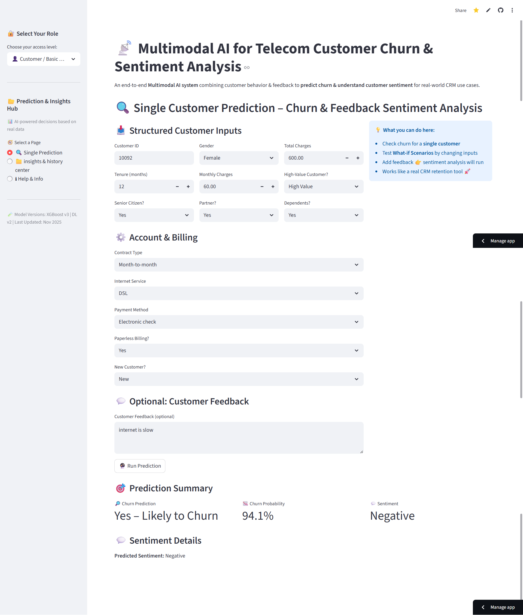
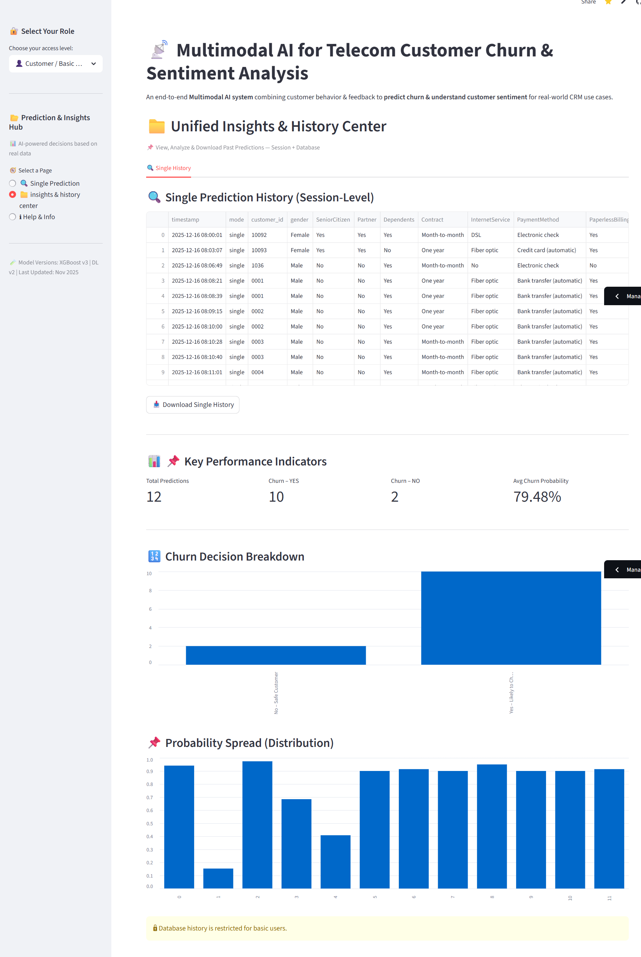
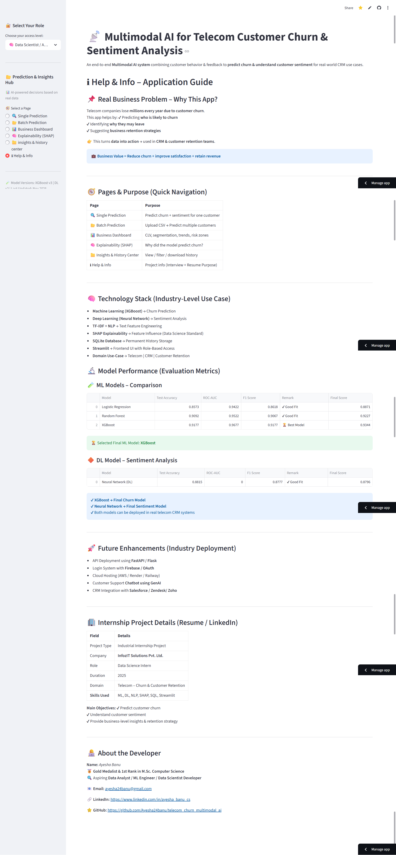
Streamlit App Output: Customer / Basic User Role
Single Prediction Page:
Single Prediction History Page:
Help & Info Page:

Slide 11
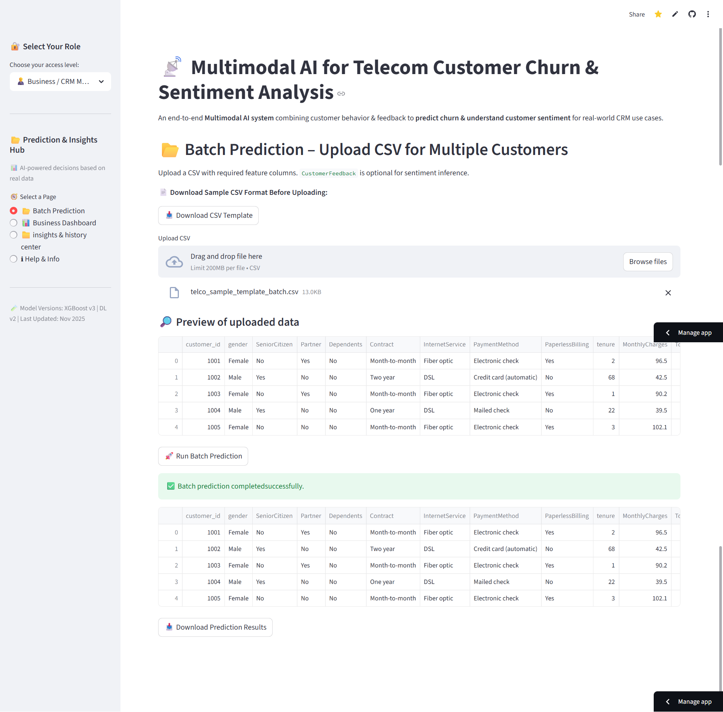
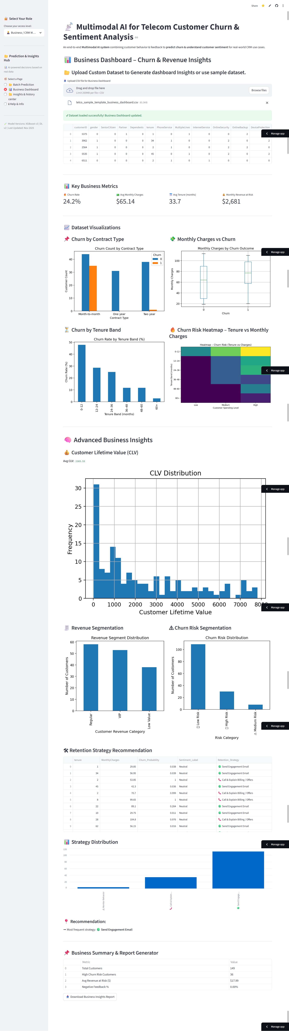
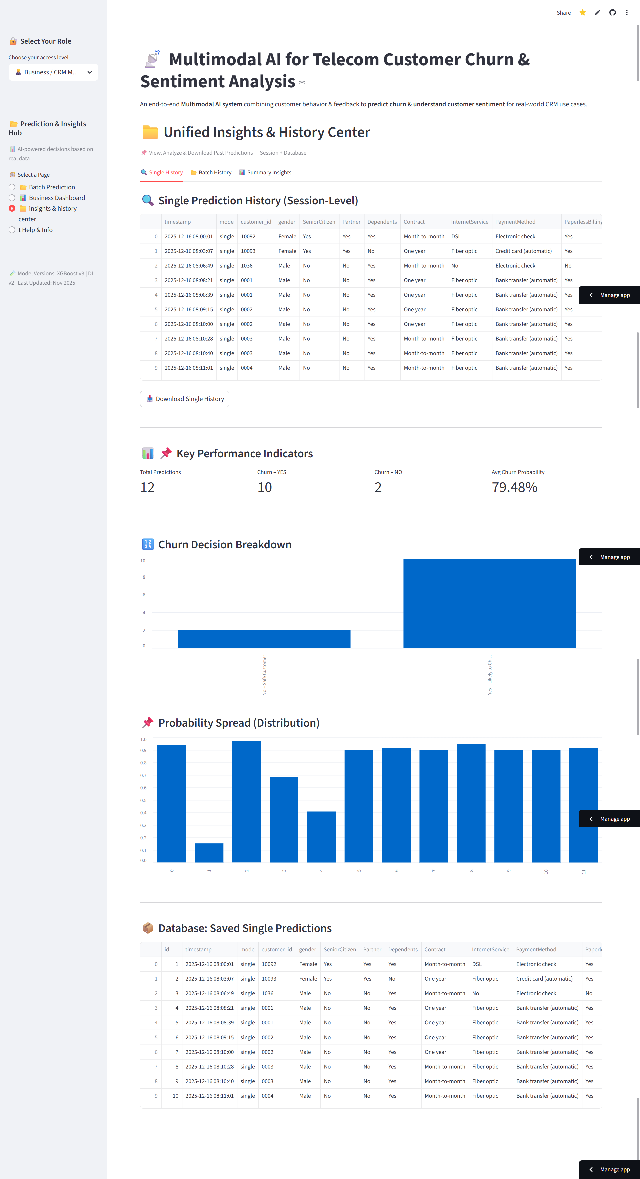
Streamlit App Output: Business / CRM Manager Role
Batch Prediction Page:
Business Dashboard Page:
Single Prediction History Page:

Slide 12
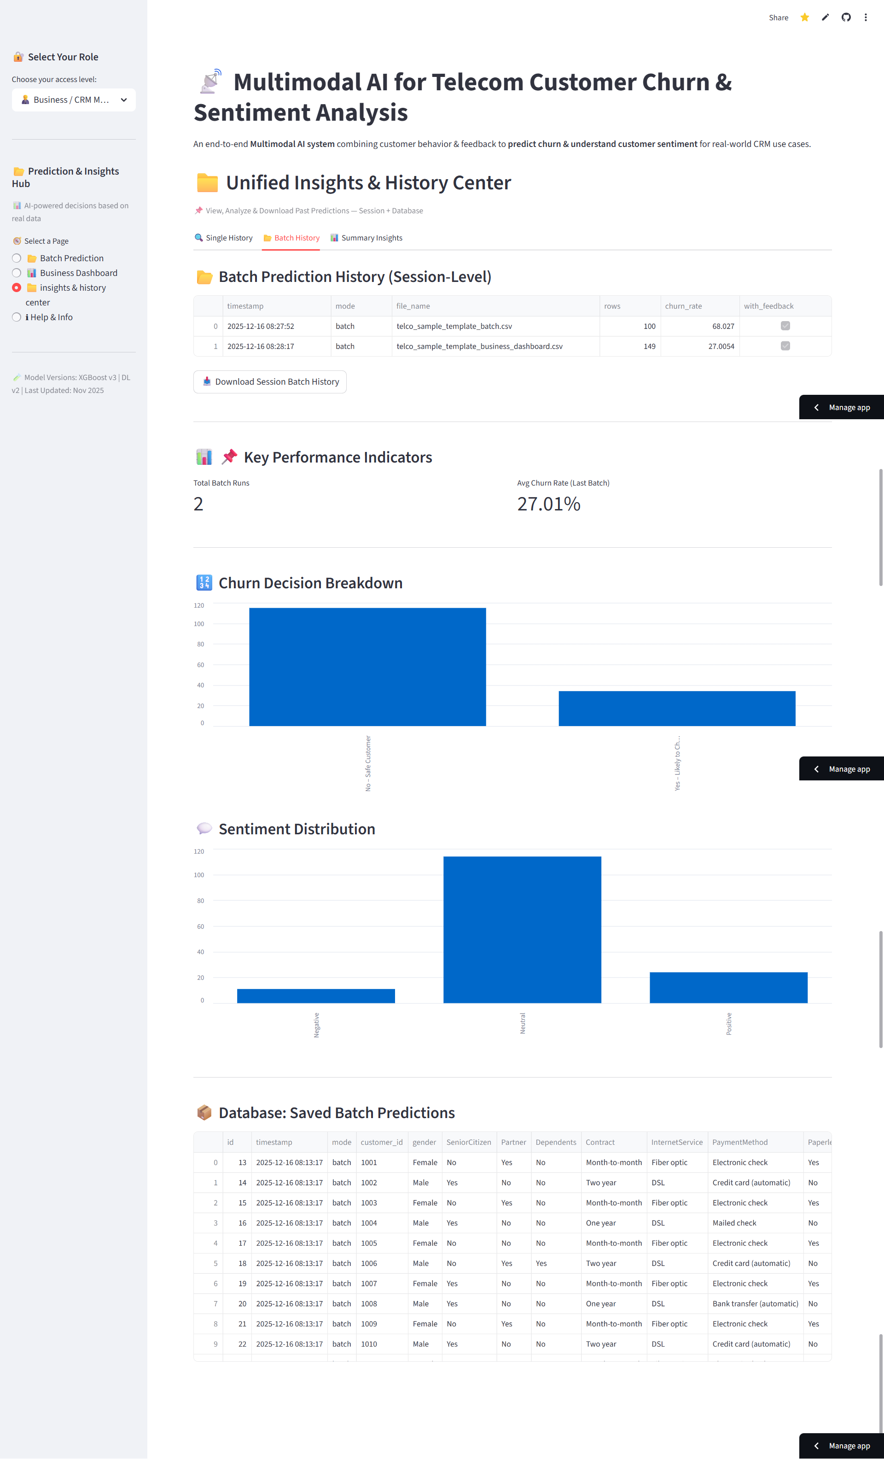
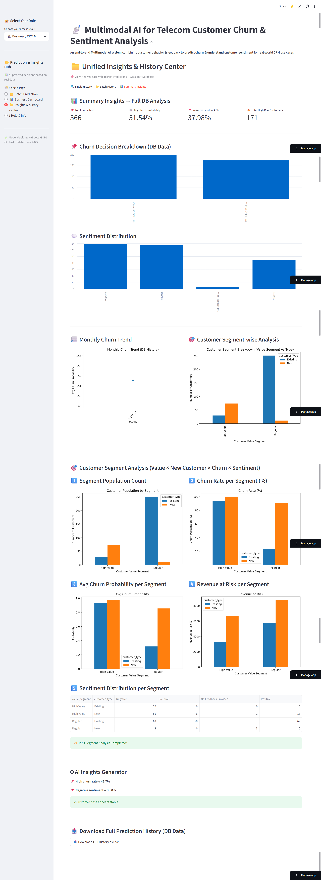
Batch Prediction History Page:
Summary Insights Page:
Help & Info Page:

Slide 13
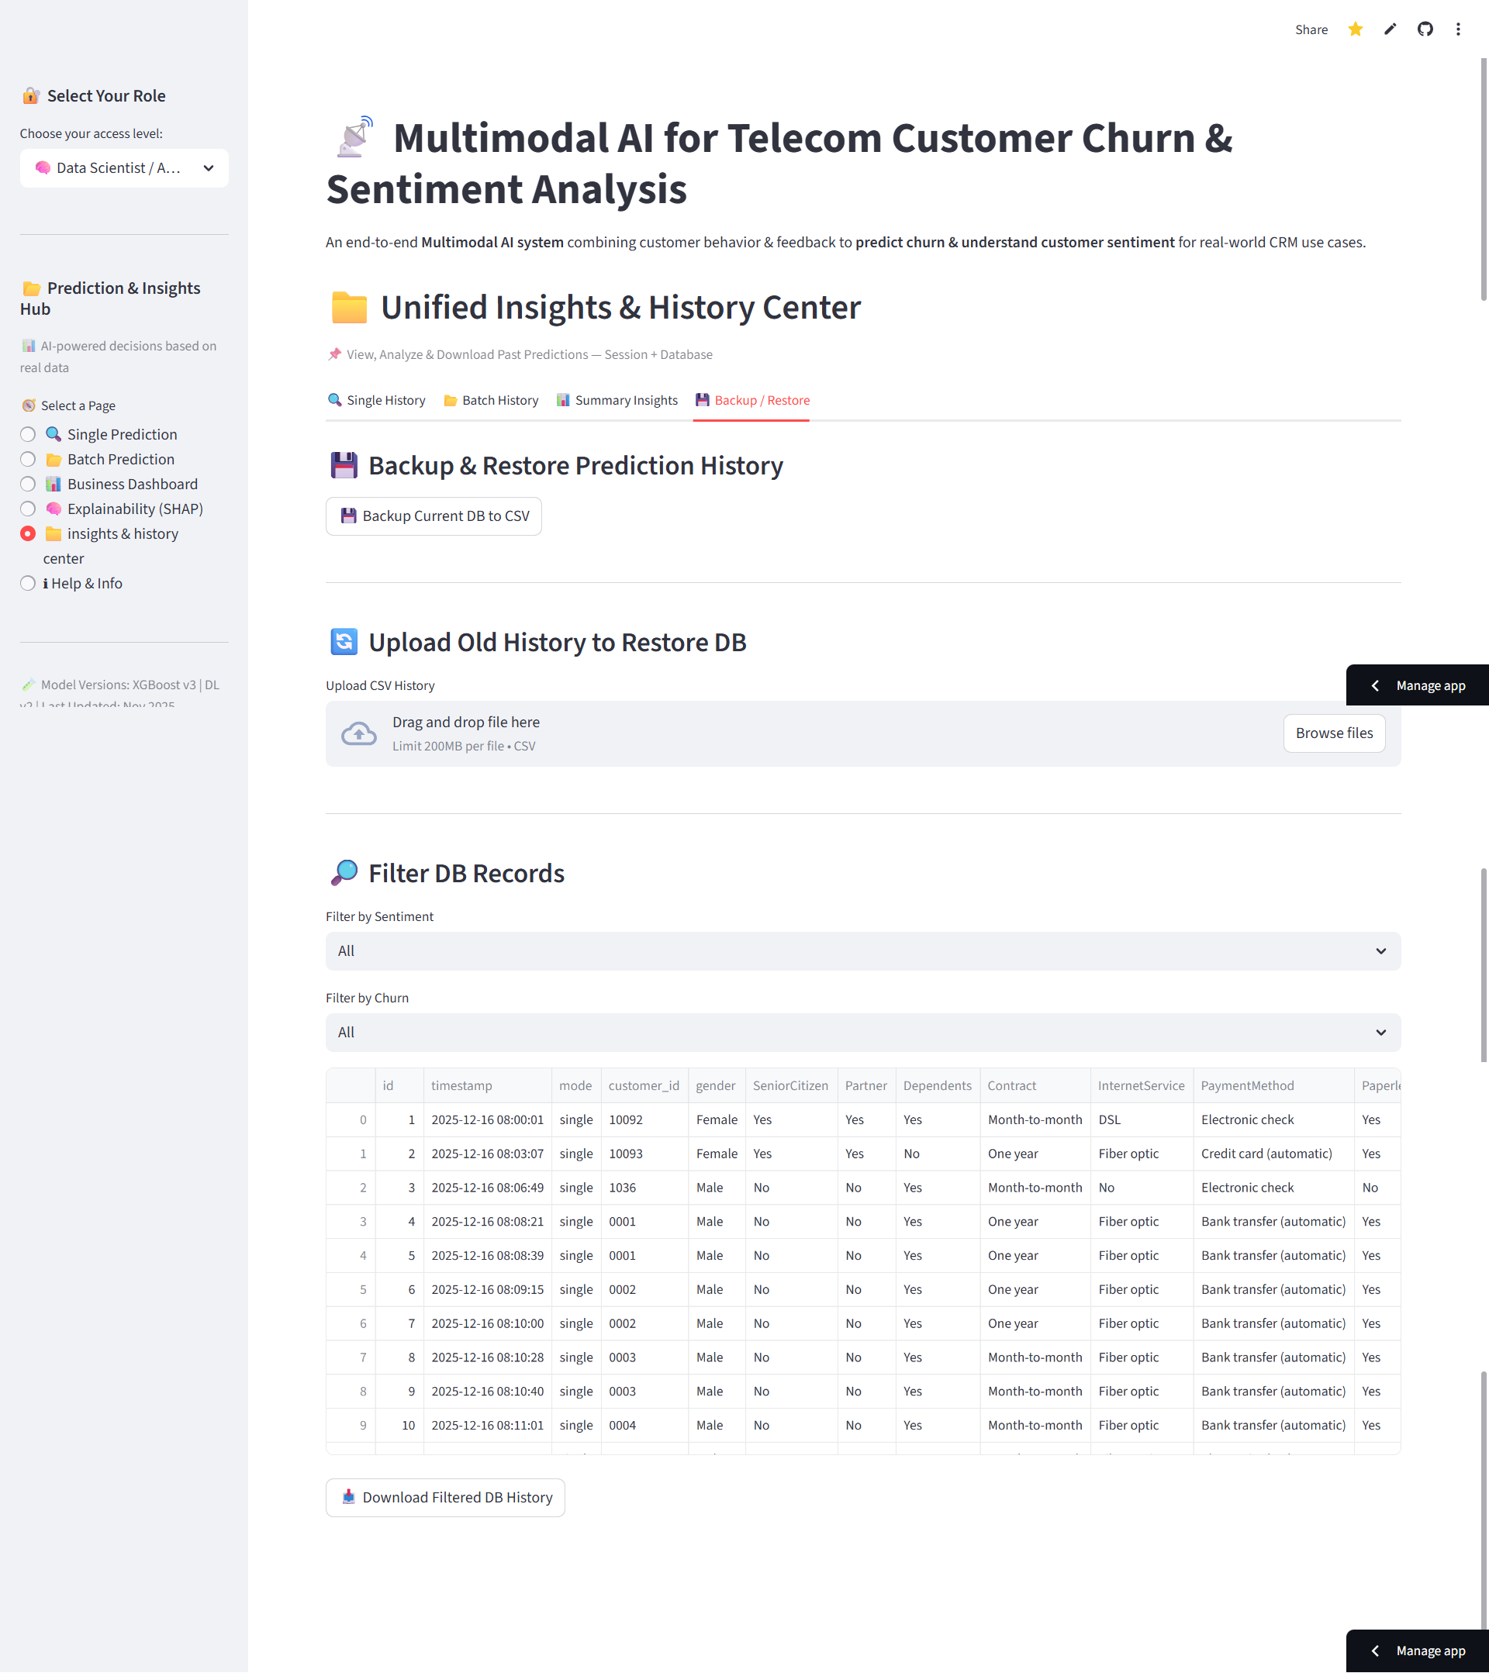
Streamlit App Output: Data Scientist / Analyst Role
Backup / Restore Prediction History Page:
Streamlit App Output Images
This Pages are same as Business / CRM Manager Role pages :
Single Prediction Page
Batch Prediction Page
Business Dashboard Page
Insights & history Page
Single History Tab
Batch History Tab
Summary Insights Tab
Help & Info page

Slide 14
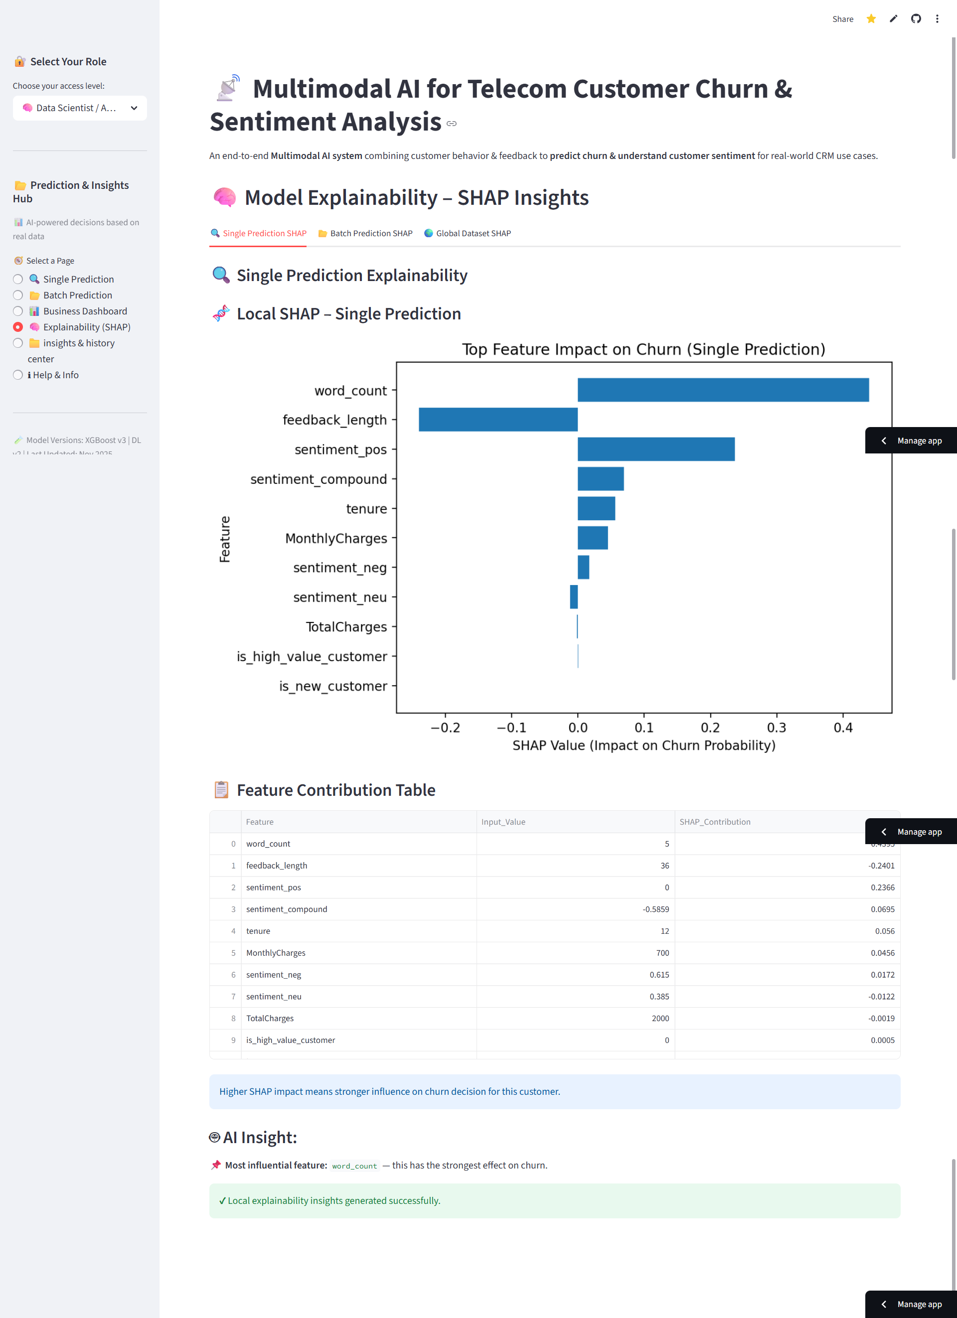
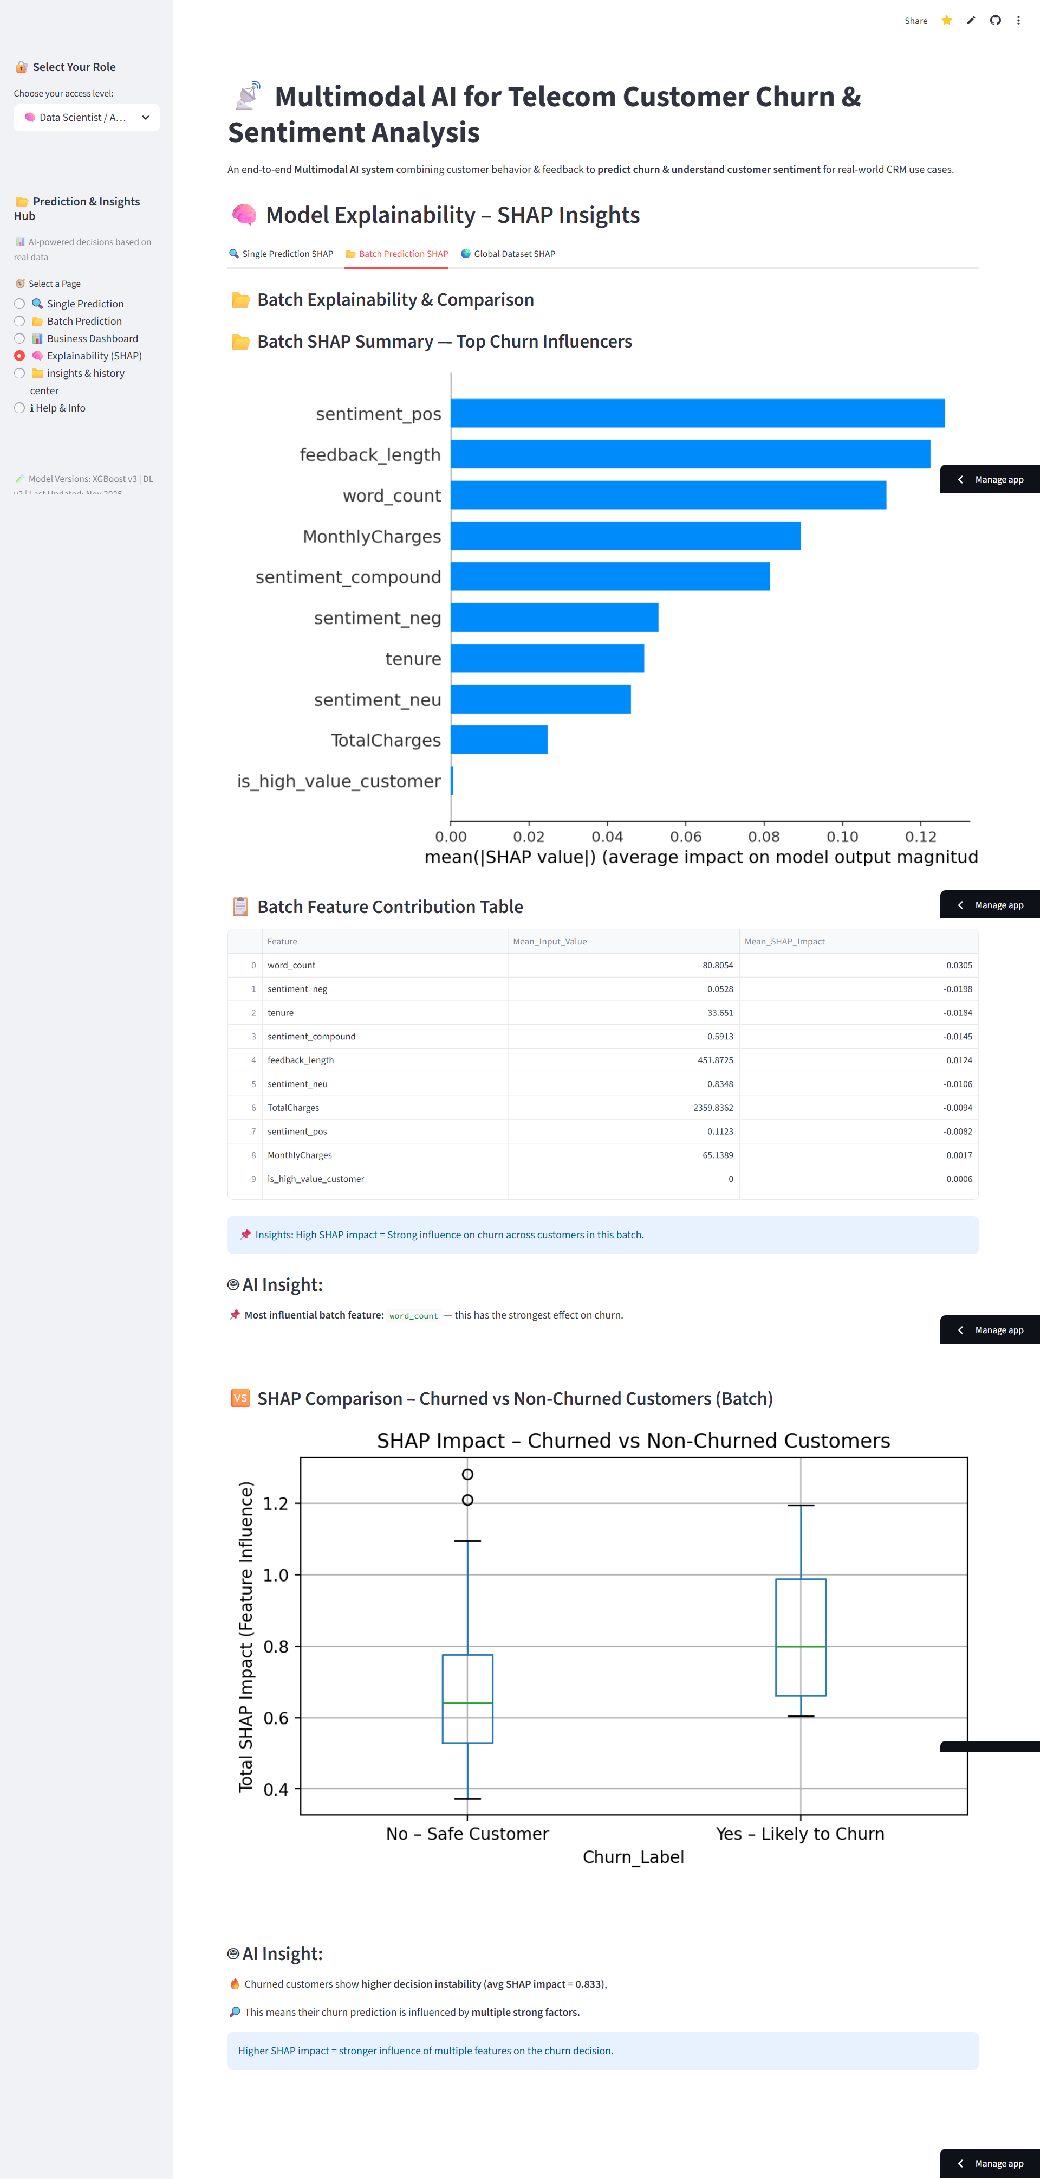
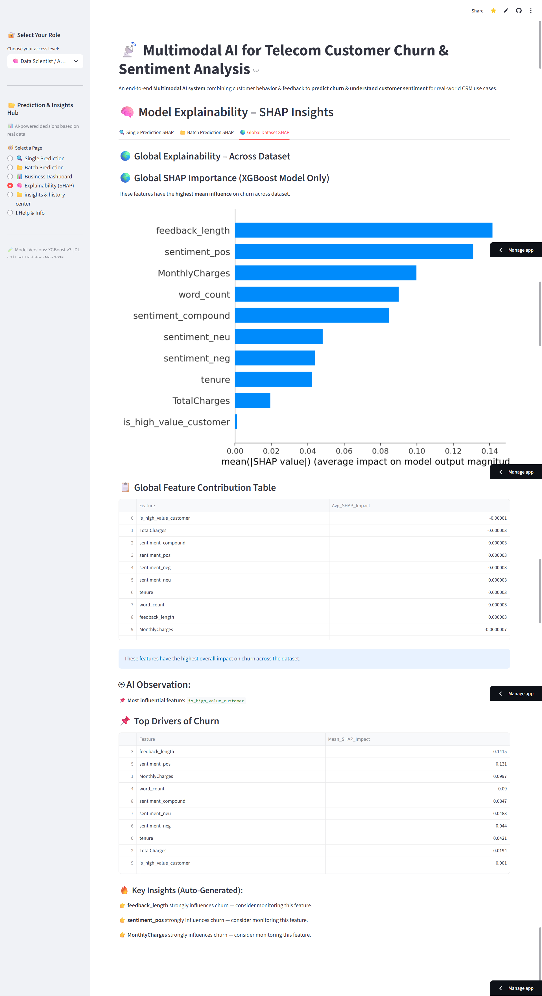
Model Explainability - Shap Insights Page
Single Prediction Explainability Tab:
Batch Prediction Explainability Tab :
Global Explainability Tab :

Slide 15
Results, Impact & What This Demonstrates
Industry-Grade AI for Telecom
Technical Skills Demonstrated
1
2
End-to-End ML/DL Pipeline
Production Deployment
Predict WHO Will Leave
Understand WHY They Leave
Rare multimodal AI skill combining tabular ML, text DL, and intelligent fusion
Real-time Streamlit app with SQLite backend, batch processing, and dashboard
XGBoost model with 96.77% ROC-AUC identifies high-risk customers before they churn
Deep learning sentiment analysis with 88.15% accuracy reveals specific complaint triggers
Explainable AI
Business Impact
3
SHAP integration and attention mechanisms for model transparency and trust
CRM-ready outputs with actionable insights and measurable ROI potential
Enable Proactive Retention
Fusion intelligence prioritizes interventions and suggests targeted retention strategies
Technology Stack
Key Takeaway
Languages & Frameworks: Python, TensorFlow, XGBoost, VADER, SHAP
Multimodal AI = Powerful Customer Intelligence
Deployment: Streamlit, SQLite
This deployment-ready pipeline transforms raw telecom data into strategic retention actions, demonstrating production-grade data science capabilities.
Techniques: ML, Deep Learning, NLP, Feature Engineering, Model Explainability
Thank You

