Slide 1



Telecommunications Analytics Project
Telco Customer Churn & Sentiment Analysis
A comprehensive data-driven analysis examining customer churn patterns and sentiment indicators within the telecommunications industry. This project combines advanced analytics with customer feedback to identify critical retention opportunities and revenue protection strategies.
POWER BI
PYTHON
NLP
Author: Ayesha Banu | MSc. Computer Science
Role: Data Analyst / Data Science Fresher

Slide 2
Business Problem, Data & Analytical Approach
🧩 Business Problem
📊 Data Used
Telecom companies face high customer churn, leading to significant revenue loss
Traditional reports explain who churned, but not why customers churn.
Business needs early churn signals to retain high-value customers
Customer Demographics: gender, senior citizen, partner, dependents
Service Details: internet type, contract, payment method, service count
Financial Metrics: monthly charges, total charges, tenure
Customer Feedback (Text): used for sentiment analysis
🧠 Analytical Approach
🛠 Tools & Technologies
Data cleaning & feature engineering (tenure groups, service count, value flags)
Sentiment analysis (NLP) on customer feedback to detect emotional signals
Integrated behavioral + sentiment insights in Power BI dashboards
Focus on churn risk, revenue impact, and retention opportunities
POWER BI
PYTHON
NLP
Machine Learning

Slide 3
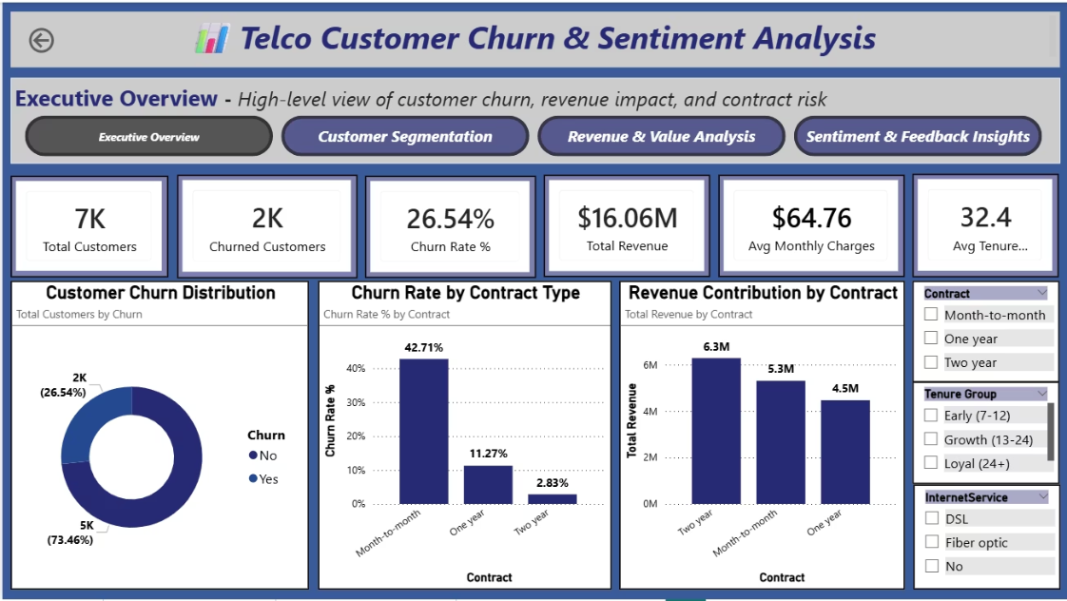
Executive Insights: Churn Impact Overview
26.5%
42%
89%
Overall Churn Rate
Month-to-Month Risk
Two-Year Stability
Significant portion of customer base at risk
Highest churn among flexible contracts
Long-term contracts drive retention
Key Findings from Executive Analysis
The overall churn rate is 26.5%, indicating a clear risk to revenue stability. Contract type plays a key role in customer retention.
Month-to-month customers churn the most, creating higher revenue volatility, while two-year contracts show strong customer loyalty and stable revenue.
Churn has a high financial impact, as customers who leave often contribute significant revenue, making targeted retention efforts essential.
Executive Takeaway
Improving contract strategy and targeting high-risk customers can significantly reduce churn and protect long-term revenue.

Slide 4
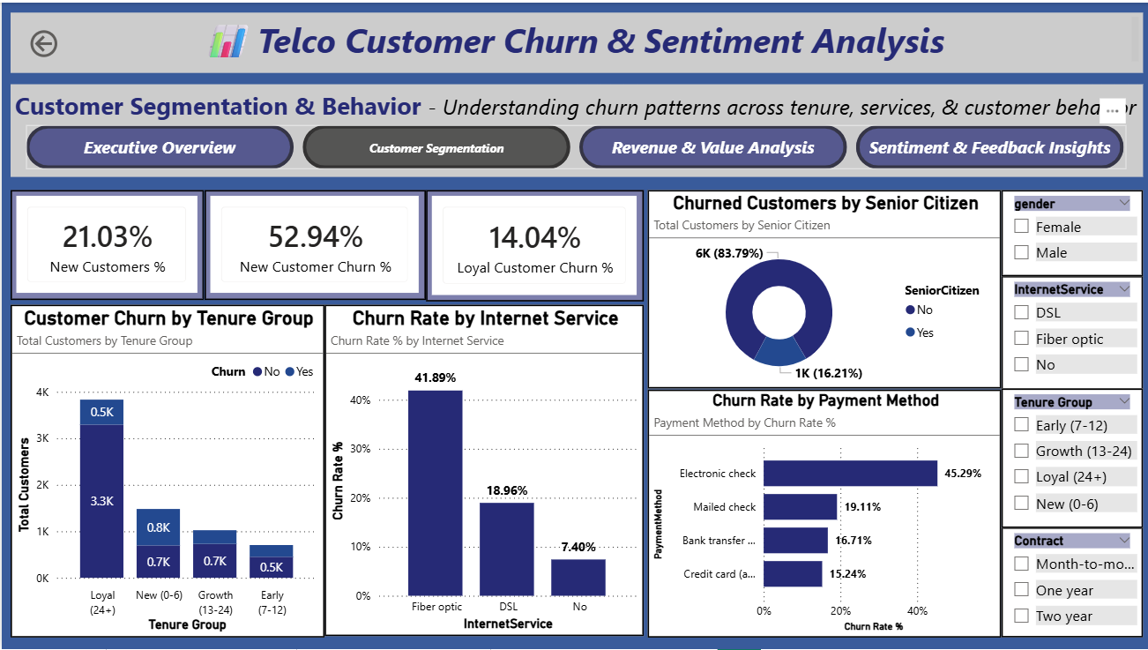
Customer Segmentation: Identifying High-Risk Profiles
Early-Stage Customers
1
New customers in their first 0–6 months show the highest churn risk during the first few months. This early onboarding phase is critical and requires stronger engagement and support to build long-term loyalty.
Fiber Optic Subscribers
2
Despite being a premium service, fiber optic customers experience higher churn. This suggests potential gaps in service expectations, pricing perception, or competitive alternatives.
Electronic Check Users
3
Customers using electronic check payments exhibit elevated churn risk. Payment friction or billing experience may contribute to dissatisfaction and eventual churn.
Senior Citizen Segment
4
Although a smaller customer group, senior citizens show distinct churn patterns. This segment benefits from targeted retention strategies tailored to their specific needs.

Slide 5
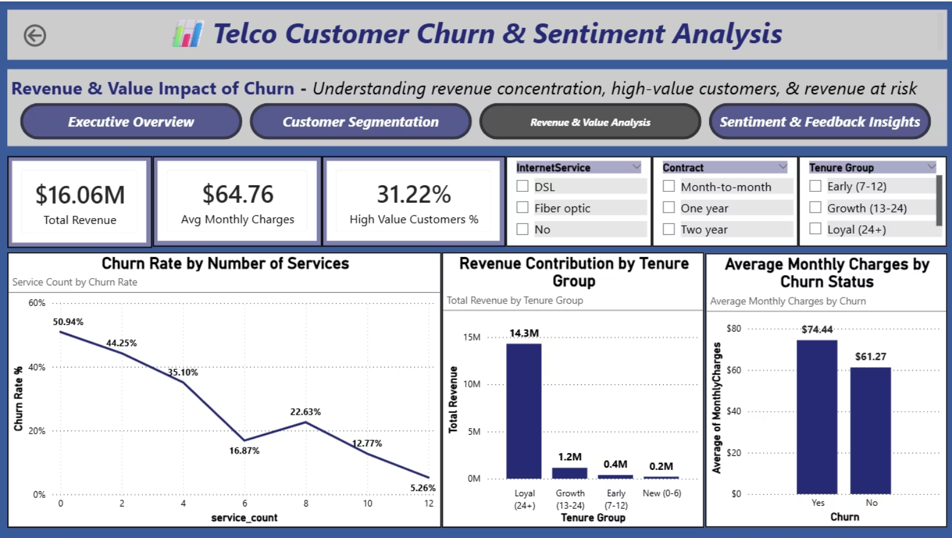




Revenue Impact: Understanding Value Distribution
Strategic Value Insights
High-value customers form a smaller share (~31%) of the customer base but contribute a disproportionately large portion of total revenue, making them critical for revenue protection.
Loyal customers are the backbone of stable revenue, with long-term relationships delivering predictable cash flow and higher lifetime value.
Month-to-month churn causes significant revenue loss, highlighting the financial risk of short-term contracts.
68%
31%
47%
Revenue from Loyal Customers
High-Value Customer Share
Revenue Loss from M2M
Majority revenue contribution
from stable base
Critical segment for
revenue protection
Month-to-month churn impact
Key Revenue Takeaways
Retaining high-value and long-tenure customers has the greatest impact on revenue stability.
Customers using multiple services churn less, indicating strong cross-sell and bundling opportunities.
Revenue-focused retention strategies should prioritize contract upgrades and service expansion.
Business Intelligence Highlight: Customers with multiple services show lower churn rates, suggesting that bundling increases customer stickiness and reduces switching behavior.

Slide 6

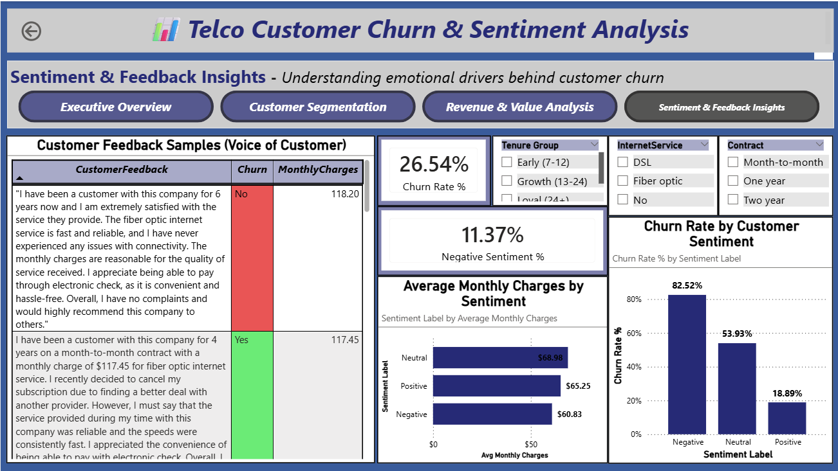



KEY DIFFERENTIATOR
Sentiment Analysis: The Early Warning System
Customer feedback reveals early signs of dissatisfaction that often appear before churn happens. By analyzing sentiment, we can identify at-risk customers and act proactively.
Negative Sentiment
= High Churn Risk
High Charges +
Negative Sentiment
= Critical Risk
Customer Feedback
Validation
Customers expressing negative sentiment show significantly higher churn rates, making sentiment a strong early warning signal.
Text feedback clearly highlights service issues and dissatisfaction, validating the churn patterns seen in quantitative metrics.
Many unhappy customers are also high-paying, increasing the financial impact if they churn.
Strategic Advantage
Sentiment analysis enables early warning mechanism, allowing businesses to address customer issues before churn occurs—shifting retention strategies from reactive to proactive.

Slide 7
Business Recommendations: Strategic Action Framework
Based on comprehensive data analysis and sentiment insights, we propose a focused retention
strategy addressing the most critical churn drivers and value protection opportunities.
Enhanced Onboarding Programme
First 6 months (highest churn risk)
Contract Migration Strategy
Month-to-month customers
Structured onboarding for new customers
Proactive check-ins during early tenure
Educational guidance to improve service usage
Incentives to move customers to yearly / two-year plans
Value-based discounts for long-term commitments
Simplified upgrade options
1
2
📌 Goal: Reduce early-stage churn and build long-term loyalty.
📌 Goal: Improve retention and stabilize revenue streams.
Sentiment-Driven Interventions
Customers showing negative sentiment
High-Value Customer Focus
Top revenue-contributing customers (~31%)
Monitor sentiment from customer feedback
Early alerts for dissatisfaction signals
Priority support for at-risk customers
Dedicated support and faster resolution
Loyalty benefits for premium customers
Proactive relationship management
3
4
📌 Goal: Prevent churn before customers decide to leave.
📌 Goal: Protect high-revenue customers and reduce financial loss.

Slide 8



Thank You
Driving Customer Retention Through Data Intelligence
Project Contact
Key Takeaway
Ayesha Banu
MSc. Computer Science
Telecommunications Analytics | Power BI | ML | NLP
Combining sentiment analysis with customer behavior data enables early churn detection and supports proactive retention strategies, helping protect revenue and strengthen long-term customer relationships.
QUESTIONS WELCOME
CONTACT FOR DETAILS

