Slide 1


Slide 2
TITLE:
DIGITAL PORTFOLIO

Slide 3
STUDENT NAME : AYESHA SIDDIQUA REGISTER NO : 31224U18004 NMID :3837D334254389B0B4BC6172C815F7 DEPARTMENT:B.SC.COMPUTER SCIENCE COLLEGE NAME:ISLAMIAH WOMEN’S ARTS AND SCIENCE COLLEGE, THIRUVALLUVAR UNIVERSITY.

Slide 4
AGENDA:
1.Problem statement.
2.project overview.
3.End Users.
4.Tools and Technologies.
5.portfolio design and layout.
6.Features and Functionality.
7.Results and Screenshots.
8.conclusion.
9.Github link.

Slide 5
Problem Statement
Lack of a centralized platform to organize their projects, certificates, and skills.
Limited interactivity in traditional resumes (cannot include multimedia, code, designs, etc.).
Difficulty in maintaining and updating physical or PDF-based portfolios.
Accessibility issues, as recruiters, teachers, or clients cannot easily access or evaluate their work online.

Slide 6
Project Overview
A web/digital platform to showcase achievements & skills.
Supports multimedia: images, videos, documents, project links.
Easy to create, update & share with one link.
Enhances visibility for career & academic opportunities.
Highlights practical skills, creativity & growth over time.

Slide 7
End Users
Students – to present academic work, projects & skills.
Job Seekers – to showcase resumes with multimedia proof.
Teachers / Mentors – to evaluate students’ achievements.
Freelancers / Professionals – to display portfolio for clients.
Recruiters / Employers – to easily review candidate profiles.

Slide 8
Tools and Technologies
Frontend: HTML, CSS, JavaScript (for design & interactivity)
Frameworks: Bootstrap / React (for responsive UI)
Backend: PHP / Node.js / Python (for server-side logic)
Database: MySQL / MongoDB (for storing user data & projects)
Hosting: GitHub Pages / Firebase / AWS (for deployment)
Design Tools: Canva / Figma (for UI & graphics)

Slide 9
Portfolio Design and Layout
Homepage – Introduction, profile photo & tagline.
About Section – Personal info, education & background.
Skills Section – Technical & soft skills in visual format.
Projects Section – Showcase academic & professional work.
Certificates / Achievements – Upload documents & awards.
Contact Section – Email, phone, social media links.
Design Style – Clean, responsive, user-friendly, with simple navigation.

Slide 10
Features and Functionality
User Registration & Login – Secure access for portfolio owners.
Profile Management – Add/update personal details.
Skill Showcase – Visual representation of technical & soft skills.
Project Upload – Attach images, documents, videos & links.
Certificate Storage – Upload and organize achievements.
Customization – Choose themes, colors, and layouts.
Sharing Option – Shareable link for recruiters & teachers.
Responsive Design – Works on desktop, tablet & mobile.

Slide 11
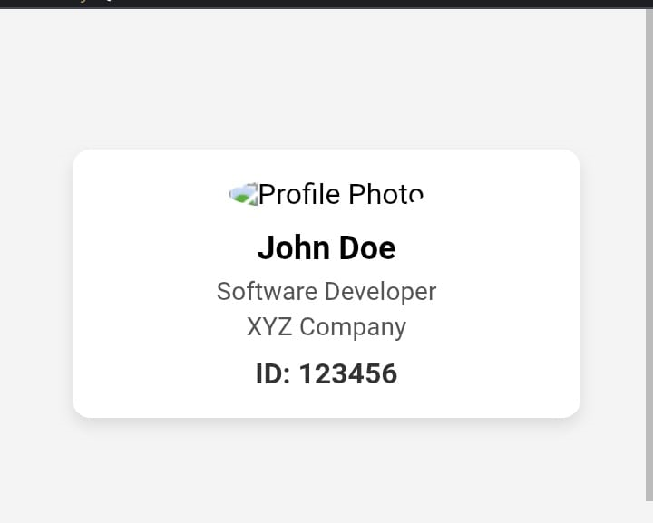
SIMPLE STUDENT ID CARD:

Slide 12
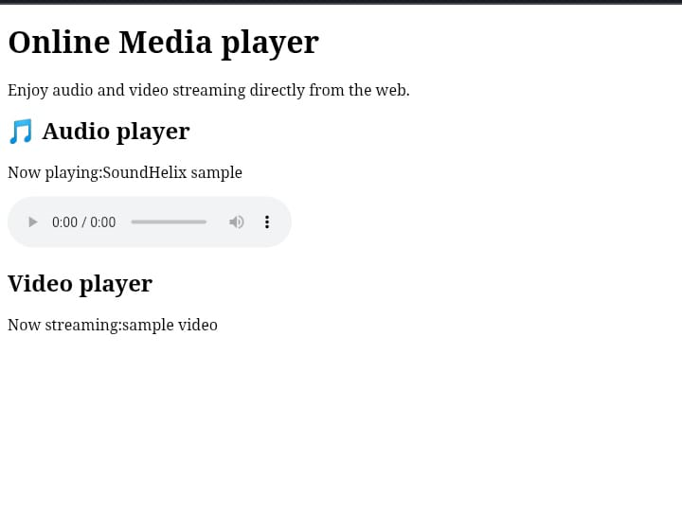

Slide 13
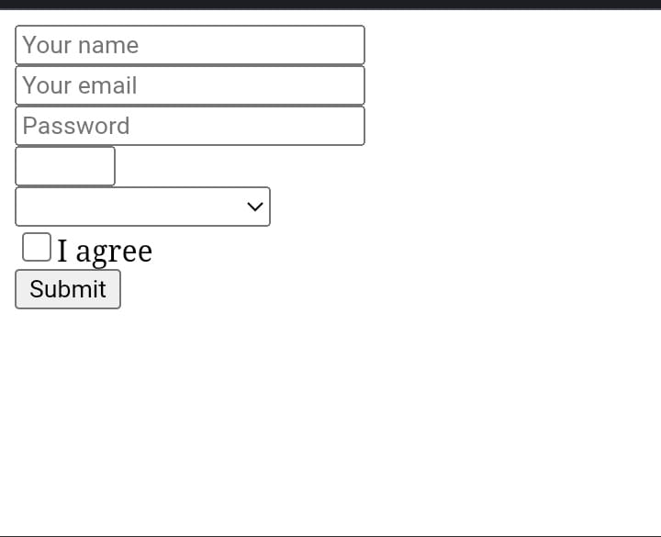
SIMPLE FORM:

Slide 14
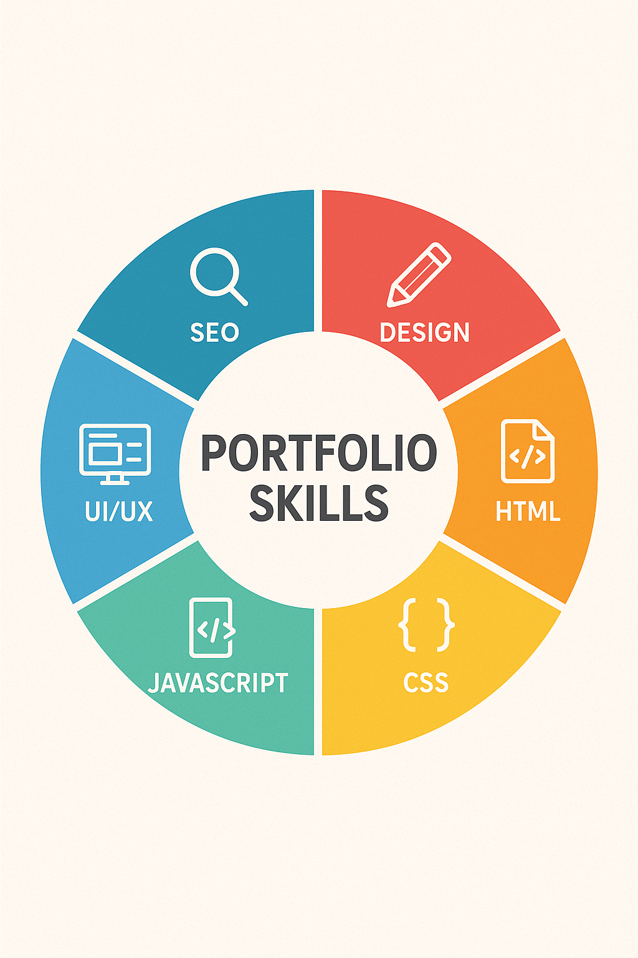
SKILLS

Slide 15
Result and Screenshots
Successfully developed a digital portfolio platform.
Users can create, update & share their portfolio easily.
Showcases academic, professional, and creative work in one place.

Slide 16
Conclusion
Digital Portfolio provides a modern way to showcase skills & achievements.
More interactive and dynamic compared to traditional resumes.
Easy to update, maintain, and share with recruiters/teachers.
Enhances career & academic opportunities.
Acts as a complete reflection of personal and professional growth.

Slide 17


