Slide 1




Smart meal plan
Group Name: TechIT
Xiyuan Liu
Farnaz Rezaei
Girish Rentaha
Phanindra Gowrishetty
Huali Ye
Ayesha Akter
Date: Nov 06, 2017
Louisiana Tech University

Slide 2
Overview
Objective
The main purpose of this system is to assist the application users to live their lives in a smarter and healthier way. Moreover, SMP will collaborate with social media, hence it will be very useful to create health awareness across media platform..
Product Features
Create meal plan to track daily nutrition content.
Meal plan recommendation based on age, gender, health conditions etc.
Connect the app to another health app such as Fitbit.
Calculate the nutrition content of the recipes.
Collaborate with social media like Facebook.

Slide 3
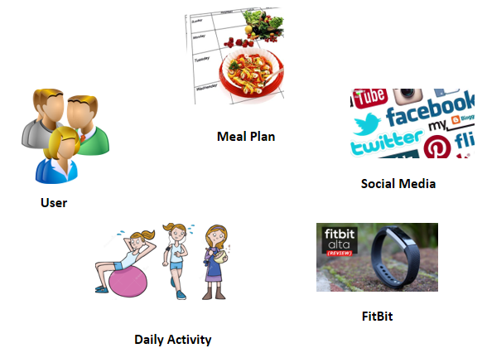
Domain Model
Abstraction

Slide 4
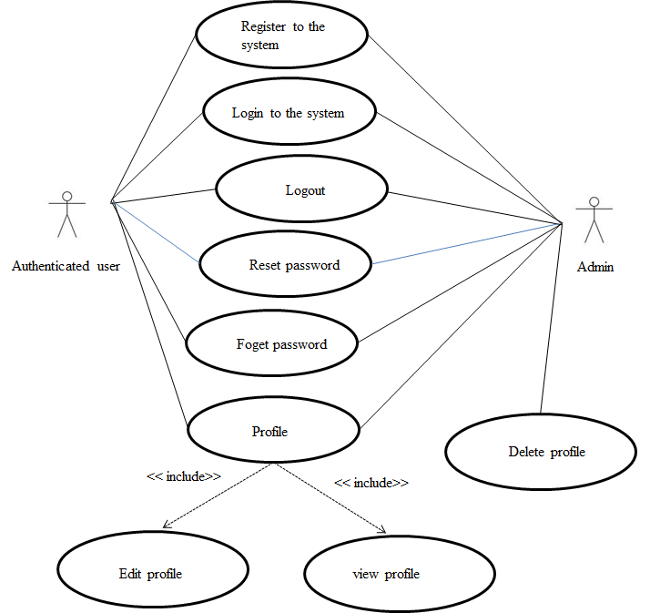
Use Cases
Use case Name: : User management

Slide 5
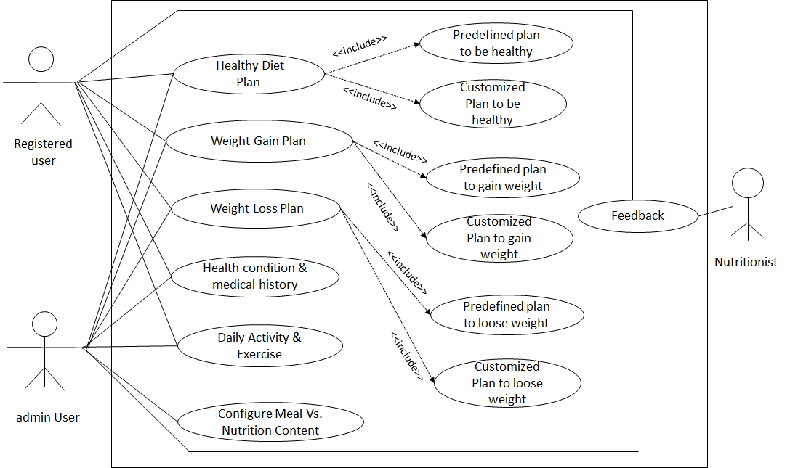
Use Cases Continue..
Use case Name: : Integrated meal plan generation

Slide 6
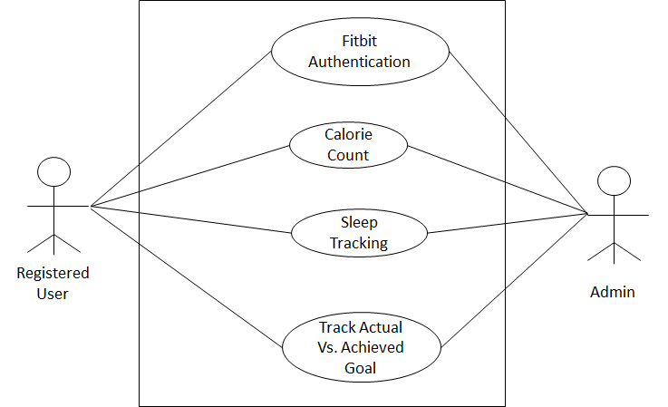
Use Cases Continue..
Use case Name: : Nutrition tracking using Fitbit

Slide 7
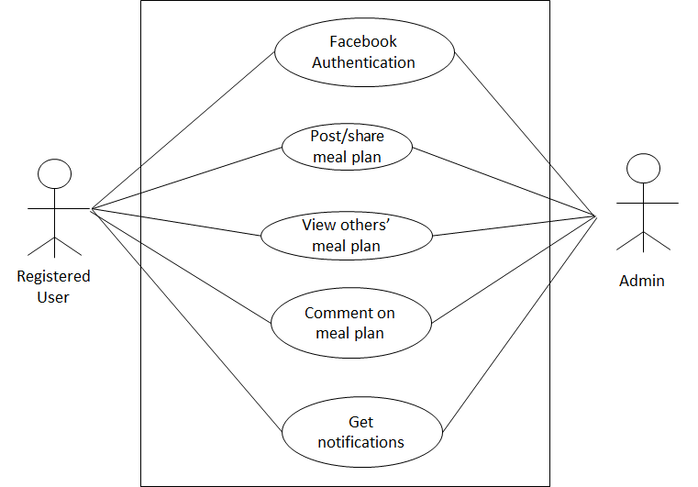
Use Cases Continue..
Use case Name: : Meal plan sharing using social media

Slide 8
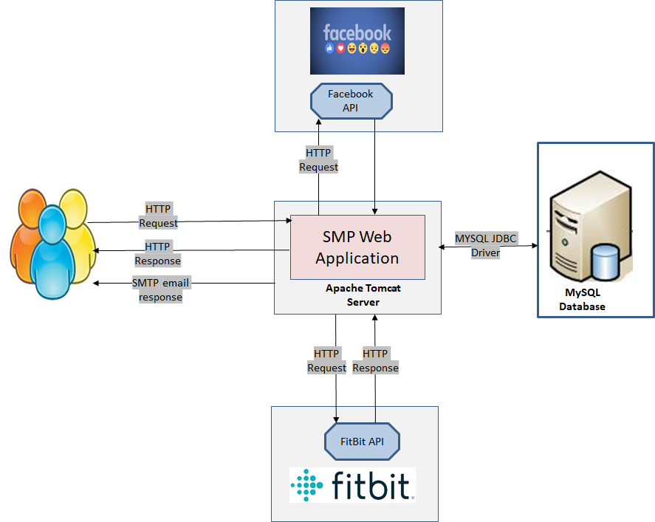
Architecture Overview

Slide 9
Class Diagram
Inventory
Shopping List
-User ID
-ItemID
-User ID
-Item Name
-Item Quantity
Fitbit
-User ID
-Steps
User Profile
Track Meal Activity
-User ID
-Password
-email
-Item ID
--Nutrient Count
Meal Plan
-Plan ID
-User ID
-Purpose
User Medical History
Nutrition Database
-Record ID
-Type
-description
-AppKey
-UPC Code
-Nutrition Content
Social Media
-userID
-Plan ID
-datetime

Slide 10
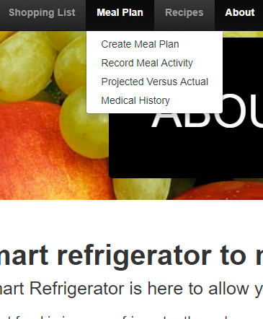
New Features Developed
4 new features developed
Create new meal plane
Record daily meal activity
Projected vs. actual meal activity
Medical history

Slide 11
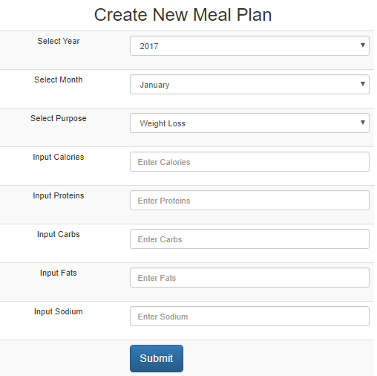
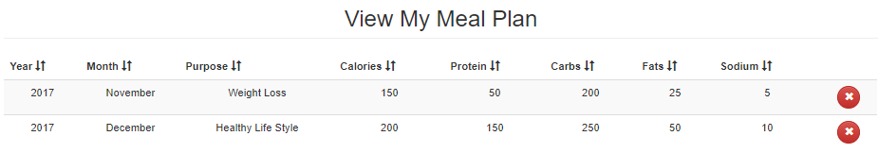
Create new meal plane
Functions
Create new meal plan
Delete existing meal plan
Only one meal plan for a particular year and month
View all meal plans

Slide 12

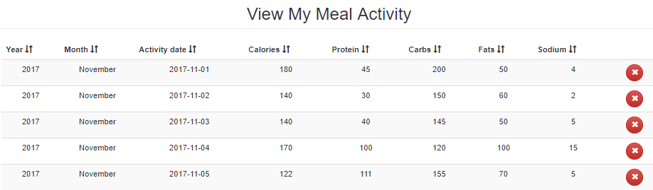
Record Meal Activity
Functions
Create new meal activity for each single day
Delete existing meal activity record
View all meal activity records

Slide 13
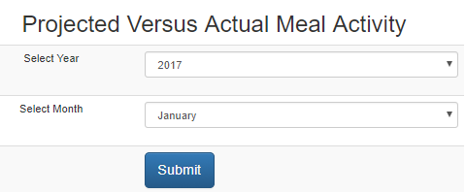
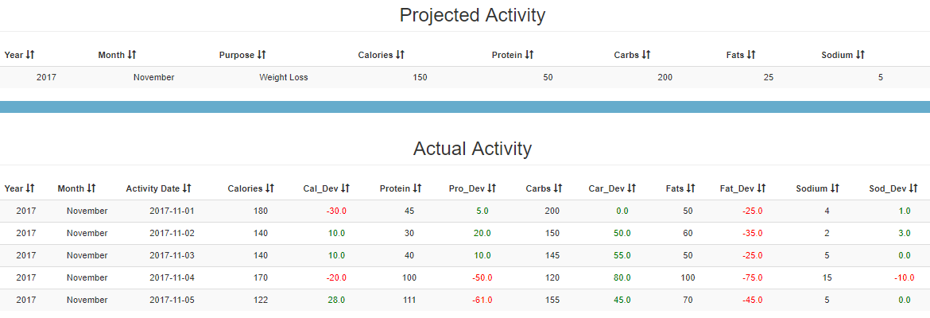
Projected Vs. Actual Activity
Functions
Monitor projected versus actual meal activity year and month wise
Red color to refer over consumption
Green color to refer under consumption

Slide 14
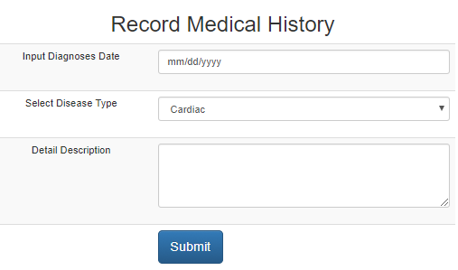
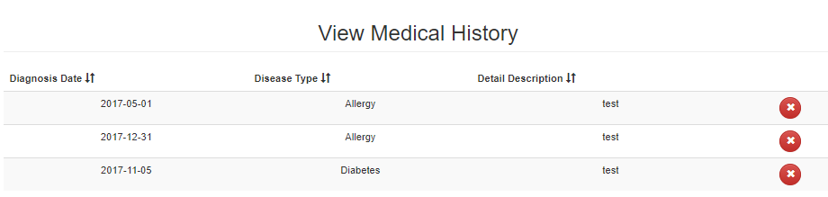
Medical History
Functions
Create new medical history
Delete existing medical history
View all medical history

Slide 15

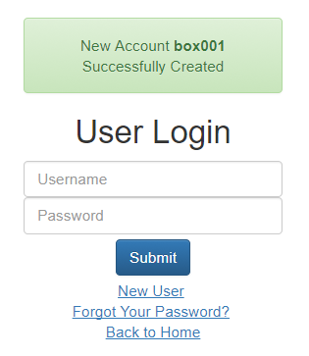
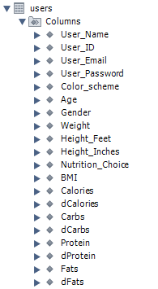
Challenges
Difficulties to Up Existing Application
Setup development environment(Apache Tomcat Vs. Xampp)
MySQL database file was not up-to-date
Debug code to find missing data column, data type, default values etc.

Slide 16
Fitbit Integration
1. Register at Fitbit.com （done）
2. Apply our api （not yet）
3. Use Oauth 2.0 （download the core）
4. Use mysql to do relation (not yet)
5 Use MongoDB to deploy APP (not yet)

Slide 17
Works We have Done
Final Week
Previous Week contd.
Completed project plan
Meeting with clients clarify requirement.
Collected supporting material.
Completed SRS(software requirement specification)
Signed off SRS
Completed SDD(software design document)
Completed test plan and test cases.
Ran existing application
Code reengineering to recreate database to align with front end.
Developed 4 new features
Performed actual testing and recorded test results
Prepared final presentation
Previous Week
Formed group
Identified project roles : Project management, Requirement collection, system design, implementation, testing, documentation
Assigned roles to group members

Slide 18
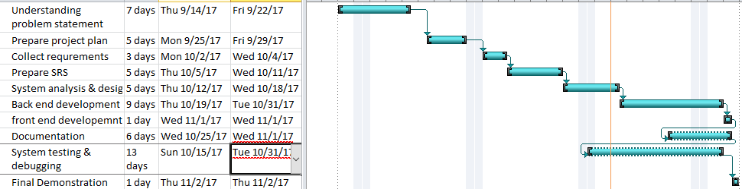
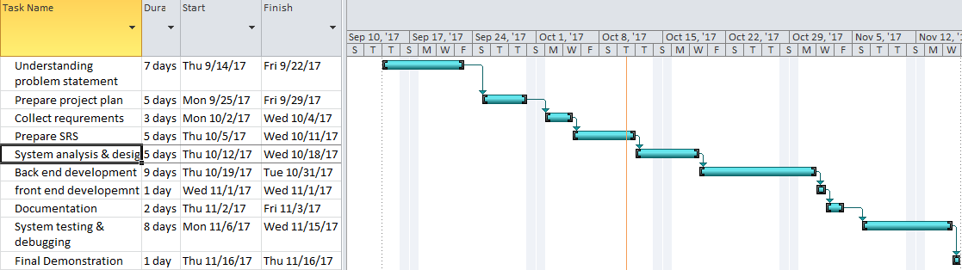
Timeline

Slide 19
Recourses Distribution
Name | Email | Contact | Role
Xiyuan Liu | lxy038639@gmail.com | 318-514-8177 | Requirement collection, system design, implementation, documentation
Farnaz Rezaei | Fnaz.rezaei@gmail.com | 318-243-0337 | Requirement collection, implementation, testing, documentation
Girish Rentaha | Girishsrivatsa787@gmail.com | 318-243-9496 | Requirement collection, system design, testing, documentation
Phanindra Gowrishetty | Phanindra0517@gmail.com | 425-283-2458 | Requirement collection, implementation, Testing, documentation
Huali Ye | hualipro@gmail.com | 318-497-5673 | Requirement collection, testing, documentation
Ayesha Akter | ayesha.latech15@gmail.com | 318-243-5409 | Project management, Requirement collection, system design, implementation, documentation

Slide 20

THANK YOU

