Slide 1
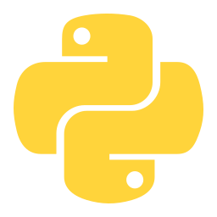
A COMPLETE OVERVIEW
Python
The language behind modern AI, data and the web

Slide 2
Content
01
Introduction
02
Why Python Dominates
What Python is and its history
Strengths and design philosophy
03
Core Syntax
04
Key Features
How Python code actually looks
Data types, OOP, libraries
05
Real-World Use
06
Future & Resources
Where Python powers the world
Where to go from here
Python: Overview & Insights
2 / 22

Slide 3
01
Introduction
Where Python comes from and what makes it different

Slide 4
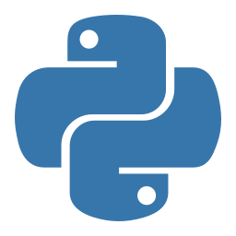
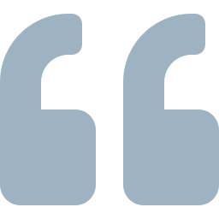
What is Python?
Python is a high-level, general-purpose programming language designed for readability and rapid development.
Interpreted
Runs line by line — no compile step
Dynamically typed
No need to declare variable types
Code is read more often than it is written.
Multi-paradigm
OOP, functional, procedural — your choice
— Python's design philosophy
Python: Overview & Insights
4 / 22

Slide 5
A brief history
1989
1991
2000
2008
2020
Today
Christmas project
Python 0.9.0
Python 2.0
Python 3.0
Python 2 retired
World's #1
Guido van Rossum starts Python at CWI in the Netherlands
First public release with classes, exceptions, functions
List comprehensions, garbage collection, Unicode
Major redesign — broke backward compatibility for the better
Official end-of-life — Python 3 becomes the standard
Top-ranked language on TIOBE, GitHub, and Stack Overflow
Python: Overview & Insights
5 / 22

Slide 6
02
Why Python Dominates
The features that made it the world's #1 language

Slide 7






Six reasons Python wins
Readable
Fast to write
Versatile
Almost reads like English
Less code than C++ or Java
Web, AI, data, scripting, automation
Huge ecosystem
Community
Cross-platform
400,000+ packages on PyPI
Massive support, great docs
Runs on Windows, Mac, Linux
Python: Overview & Insights
7 / 22

Slide 8
Python vs other major languages
Approximate GitHub repositories using each language (millions)
KEY INSIGHT
Python leads in scientific computing, data science, and AI — fields driving the next decade of tech.
Sources: GitHub, TIOBE Index, Stack Overflow Survey 2024
Python: Overview & Insights
8 / 22

Slide 9
The Zen of Python
19 guiding principles that shape every Python program
Beautiful is better than ugly.
Simple is better than complex.
Readability counts.
There should be one obvious way to do it.
Errors should never pass silently.
If the implementation is hard to explain, it's a bad idea.
Try it yourself: type import this in any Python shell
Python: Overview & Insights
9 / 22

Slide 10
03
Core Syntax
How Python code actually looks

Slide 11
Why Python feels different
The same program — "Hello, World!" — in three languages
Java
C++
Python
public class Main {
public static void
main(String[] args) {
System.out.println(
"Hello!");
}
}
#include <iostream>
using namespace std;
int main() {
cout << "Hello!";
return 0;
}
print("Hello!")
5 lines
6 lines
1 line
Python: Overview & Insights
11 / 22

Slide 12
Core syntax in one slide
Variables
Conditionals
name = 'Ali'
age = 25
score = 95.5
if score >= 90:
print('A')
elif score >= 80:
print('B')
Loops
Functions
for i in range(5):
print(i)
while x < 10:
x += 1
def greet(name):
return f'Hi, {name}!'
greet('Sara')
Python: Overview & Insights
12 / 22

Slide 13
Python's signature feature: indentation
No curly braces. No begin/end keywords. The whitespace IS the structure.
Other languages
Python
if (score > 50) {
if (attendance > 75) {
print("Pass");
} else {
print("Fail");
}
}
if score > 50:
if attendance > 75:
print("Pass")
else:
print("Fail")
Python: Overview & Insights
13 / 22

Slide 14
04
Key Features
Data types, OOP, and the package ecosystem

Slide 15
Built-in data types
int
float
str
bool
age = 25
pi = 3.14159
name = 'Python'
is_open = True
Whole numbers
Decimal numbers
Text strings
True or False
list
tuple
dict
set
nums = [1, 2, 3]
pt = (4, 5)
user = {'id': 1}
tags = {'py', 'js'}
Ordered, mutable
Ordered, immutable
Key-value pairs
Unique items
Python: Overview & Insights
15 / 22

Slide 16
Object-Oriented Programming
Python supports all four OOP pillars natively
CODE EXAMPLE
THE FOUR PILLARS
class Student:
def __init__(self, name, gpa):
self.name = name
self.gpa = gpa
def is_topper(self):
return self.gpa >= 3.7
sara = Student("Sara", 3.85)
print(sara.is_topper()) # True
1
Encapsulation
Bundle data with behavior
2
Inheritance
Build new classes from existing ones
3
Polymorphism
Same interface, many forms
4
Abstraction
Hide complexity behind simple APIs
Python: Overview & Insights
16 / 22

Slide 17




The library ecosystem
400,000+ packages on PyPI. Here are the giants.
TensorFlow / PyTorch
NumPy / Pandas
Deep learning & neural networks
Numerical & data analysis
Django / Flask
scikit-learn
Web frameworks
Classical machine learning
FastAPI
Selenium / Requests
Modern API development
Automation & web scraping
Python: Overview & Insights
17 / 22

Slide 18
05
Real-World Use
Where Python actually powers the modern world

Slide 19


Where Python is used
AI & Machine Learning
Data Science
Web Development
OpenAI, Google, Meta — all train models in Python
From finance to healthcare analytics
Instagram, Reddit, Dropbox built on Python
Cybersecurity
Scientific Research
Automation & Scripting
Automation, malware analysis, pentesting tools
NASA, CERN, drug discovery, genomics
DevOps, scraping, system administration
Python: Overview & Insights
19 / 22

Slide 20
Python in numbers
The scale of Python's influence
#1
8M+
Most popular language on the TIOBE Index
Active Python developers worldwide
400K+
70%
Packages available on PyPI
Of machine learning research uses Python
Python: Overview & Insights
20 / 22

Slide 21
Where to go from here
A learning path for someone serious about Python
BEGINNER
INTERMEDIATE
ADVANCED
01
Install Python
01
Master OOP
01
Frameworks (Django, FastAPI)
02
Learn syntax basics
02
Build a real project
02
Data science / ML libraries
03
Build small scripts
03
Learn Git & GitHub
03
Contribute to open source
Python: Overview & Insights
21 / 22

Slide 22
THANK YOU
Questions?
"The journey of a thousand miles begins with a single step."
RESOURCES
python.org · docs.python.org · realpython.com · pypi.org

