Slide 1
Transformation from Real to Cartoon Images

Slide 2
Group Information
Supervised By :
Nibir Chandra Mandal
Md. Tanvir Rouf Shawon
Department of Computer Science and Engineering
Ahsanullah University of Science and Technology
Presented By : 01/09/2022
180104106 Rumana Akter
180104107 Ashif Reza
180104109 Asifur Rahim
180104118 Ayesha Afroze

Slide 3
Project Statement:
Cartoon occupies a large part of entertainment.
Lot of work to recreate real-world scenes in cartoon forms.
Significant amount of time can be saved for artists by using specially created processes

Slide 4
Literature Review :
Paper 01: CartoonGAN: Generative Adversarial Networks for Photo Cartoonization
Author : Yang Chen Tsinghua University, China, Yu-Kun Lai Cardiff University, UK, Yong-Jin Liu Tsinghua University, China
The solution belongs to learning based methods
GAN framework was proposed
Unpaired photos and cartoon images were used

Slide 5
Literature Review :
Two losses are proposed:
a semantic content loss
an edge-promoting adversarial loss
An initialization phase was introduced

Slide 6
Literature Review
Paper 02: Learning to Cartoonize Using White-box Cartoon Representations
Author : Xinrui Wang, Jinze Yu, The University of Tokyo.
Three white-box representations was proposed from images:
The surface representation
The structure representation
The texture representation

Slide 7
Literature Review
A Generative Adversarial Network (GAN) framework is used
An unpaired image-to-image translation framework was adopted
VGG network is used

Slide 8
Literature Review :
Paper 03 : Toon2real: Translating Cartoon Images to Realistic Images
Author : K. M. Arefeen Sultan, Mohammad Imrul Jubair, MD. Nahidul Islam, Sayed Hossain Khan, Ahsanullah University of Science and Technology, Bangladesh
Cartoon images to photo-realistic images were generated
CycleGAN building approach was taken
Spectral normalization technique was implemented
Two losses are proposed :
Adversarial loss
Reconstruction loss

Slide 9
Dataset
Unpaired Dataset
Real-World Images
Cartoon Images

Slide 10
Dataset Acquisition: Real-World Images
For real world images we have used MS COCO dataset (Microsoft Common Objects in Context) which is a large-scale image dataset containing 328,000 images of everyday objects and humans.
We have used 1000 images from it to train our model.
The images are in jpg format.

Slide 11
Dataset Acquisition: Cartoon Images
For cartoon images we have used the Safebooru dataset which contains 10 lac cartoon images.
We have used 1000from it.
The images are in png format.

Slide 12
Generated Dataset
Cartoons with smoothed edges have been created from the Safebooru dataset.
1000 such images have been generated.

Slide 13
Implementation & Methodologies
Our model contains Generative Adversarial Network.
Generative Adversarial Networks (GANs) have achieved great success even when it is used in the unsupervised dataset.
The loss function is a simple sum of adversarial loss and content loss.
Feature extracted by VGG-16 network.

Slide 14
Implementation & Methodologies
CARTOON
IMAGES
SMOOTH EDGED
CARTOON
IMAGES
GENERATED
CARTOON
IMAGES
REAL-WORLD IMAGES
Generator
Discriminator

Slide 15
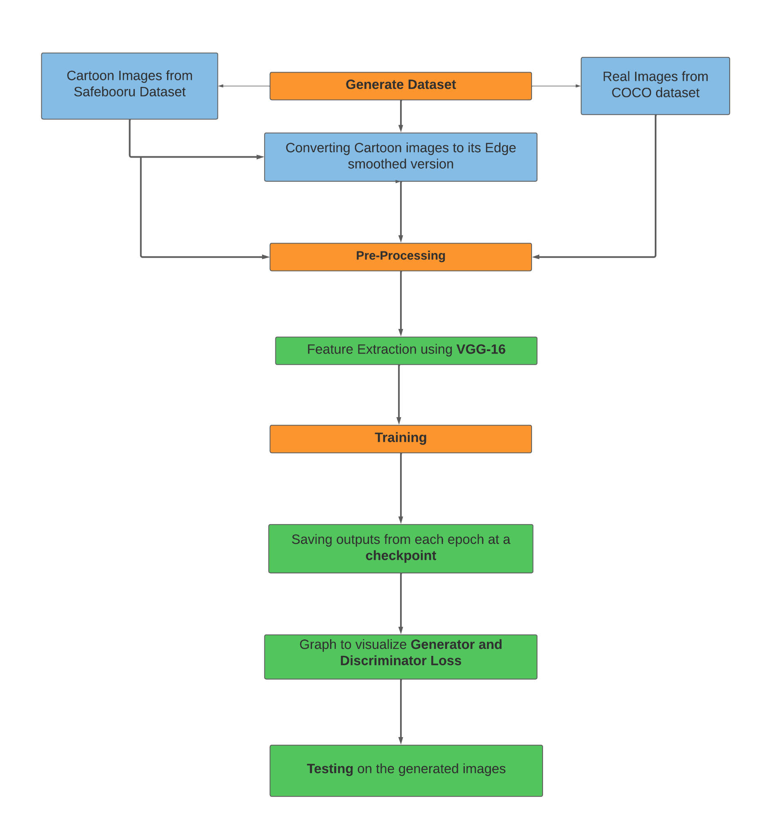
Workflow Diagram

Slide 16
Workflow Diagram
Dataset have been generated from safebooru(Cartoon) and Coco(real)
Converting the cartoon images to smoothed -edges images using canny edge and gaussian blur.
Data-Preprocessing of three input images(Resize,normalizes etc) using dataloader
Vgg-16 for Feature Extraction and to calculate content loss
Training the the generator and discriminator
Save the output after some epochs in a folder

Slide 17
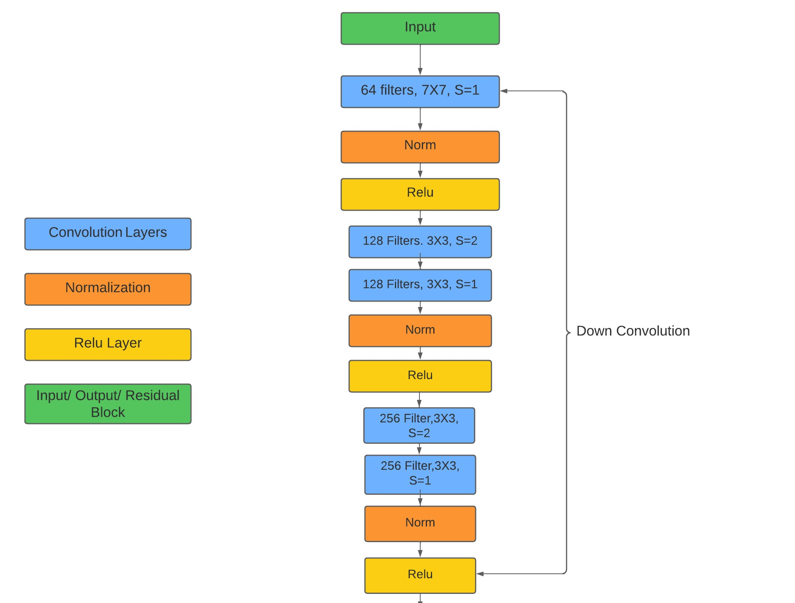
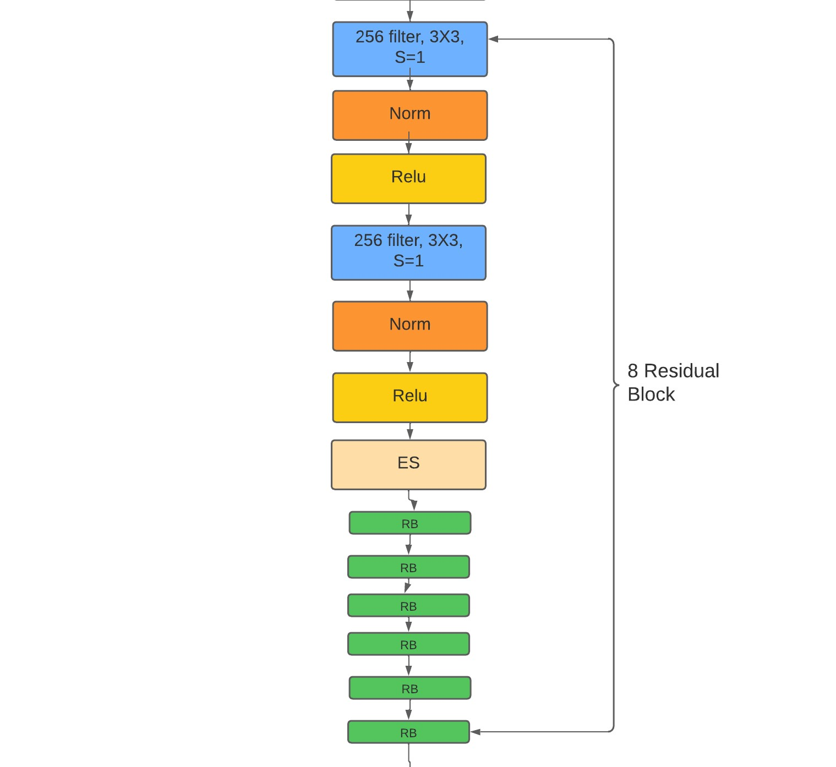
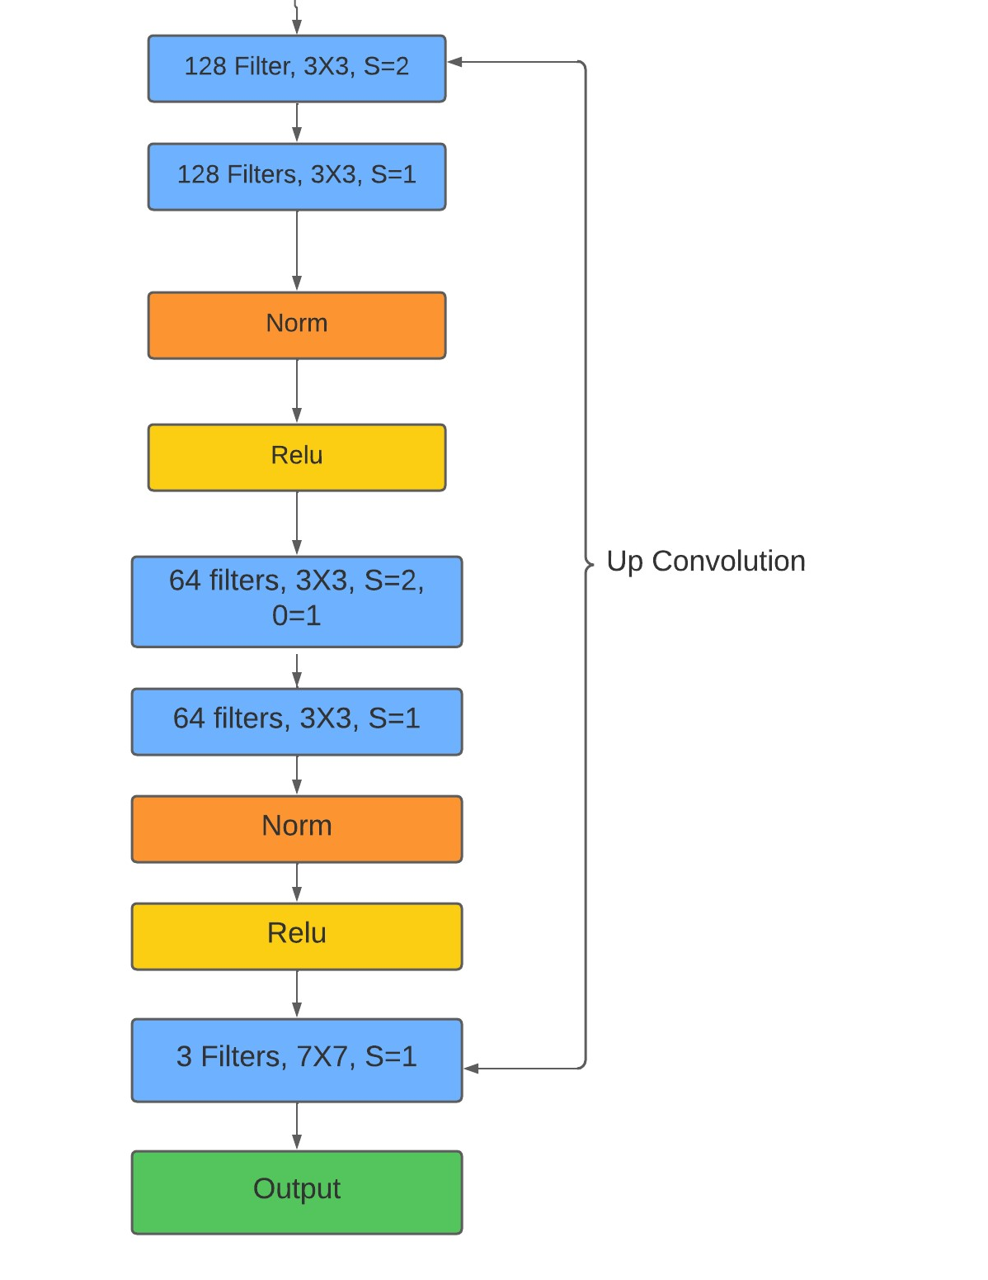
Generator Network Architecture

Slide 18
Network Architecture
The G begins with flat convolution followed by 2 down convolution
Eight Residual blocks with identical layout to construct the content and manifold feature
Two up-convolution with a stride of 2 and outer padding of 1 to reconstruct the output images
A final convolution with 7*7 kernels and with stride of 1
For the Discriminator the model has been used from the paper GAN for Photo Cartoonization authored by Yang Chen.
Consists of flat conv followed by a Leaky Relu then two strided conv

Slide 19
Result Analysis
Training for 210 epochs
Changing the value for ω ( Weight value for content preservation from the real images to the comic style of the cartoon images)
Real Vs Cartoon images for different points in the training
Graph for Training Vs Validation Loss

Slide 20
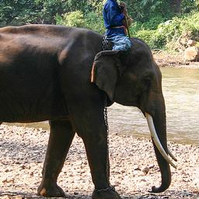
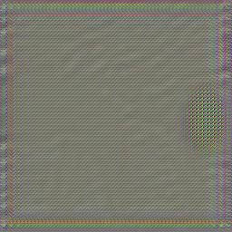
Directly After First Epoch
Value for ω is set to 10
Fig : Real Image
Fig : Cartoon Image

Slide 21
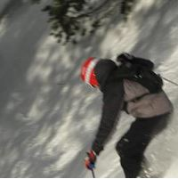
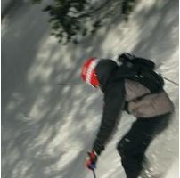
After 210 Epochs
Value for ω is set to 10
Fig: Real Image
Fig: Cartoon Image

Slide 22
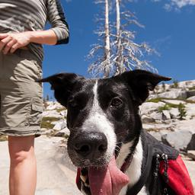
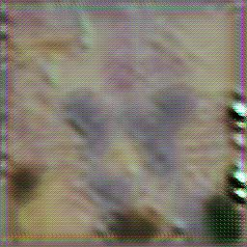
Around 100 Epochs
Value for ω is set to 0.000005
Fig: Real Image
Fig: Cartoon Image

Slide 23
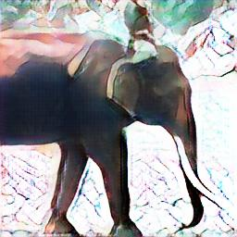
After 210 Epochs
Value for ω is set to 0.000005
Fig: Real Image
Fig: Cartoon Images

Slide 24
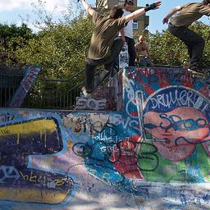
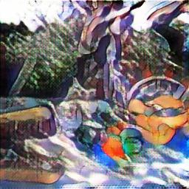
After 210 Epochs
Value for ω is set to 0.000005
Fig: Real Image
Fig: Cartoon Image

Slide 25
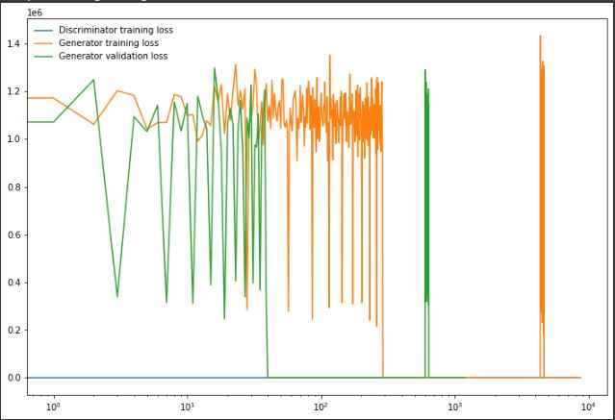
Result Analysis
Value for ω is set to 0.000005
Fig: Training vs Validation Loss

Slide 26
Future Work
We would like to look into how to better stylize cartoons of human faces by utilizing local facial traits.
We would employ Conditional-GAN to accomplish this.

Slide 27
References :
[1] “J.-Y. Zhu, T. Park, P. Isola, and A. A. Efros. Unpaired imageto-image translation using cycle-consistent adversarial networks. In International Conference on Computer Vision, 2017.
[2] “J. Clerk Maxwell, A Treatise on Electricity and Magnetism, 3rd ed., vol. 2. Oxford: Clarendon, 1892, pp.68--73.
[3] “Chen, Yang, Yu-Kun Lai, and Yong-Jin Liu. "Cartoongan: Generative adversarial networks for photo cartoonization." Proceedings of the IEEE conference on computer vision and pattern recognition. 2018.
[4] “Y. Chen, Y. -K. Lai and Y. -J. Liu, "Transforming photos to comics using convolutional neural networks," 2017 IEEE International Conference on Image Processing (ICIP), 2017

Slide 28
References :
[5] ”Sultan, KM Arefeen, et al. "toon2real: Translating Cartoon Images to Realistic Images." 2020 IEEE 32nd International Conference on Tools with Artificial Intelligence (ICTAI). IEEE, 2020.
[6] “Wang, Xinrui, and Jinze Yu. "Learning to cartoonize using white-box cartoon representations." Proceedings of the IEEE/CVF conference on computer vision and pattern recognition. 2020.
[7]”Black Mamba " Generating fake faces using GAN”
[8]”Forrester Cole. " Cartoon Set”
[9]” Goodfellow, Ian, Jean Pouget-Abadie, Mehdi Mirza, Bing Xu, David Warde-Farley, Sherjil Ozair, Aaron Courville, and Yoshua Bengio. "Generative adversarial nets." Advances in neural information processing systems 27 (2014).”

Slide 29
Thank you

