Slide 1
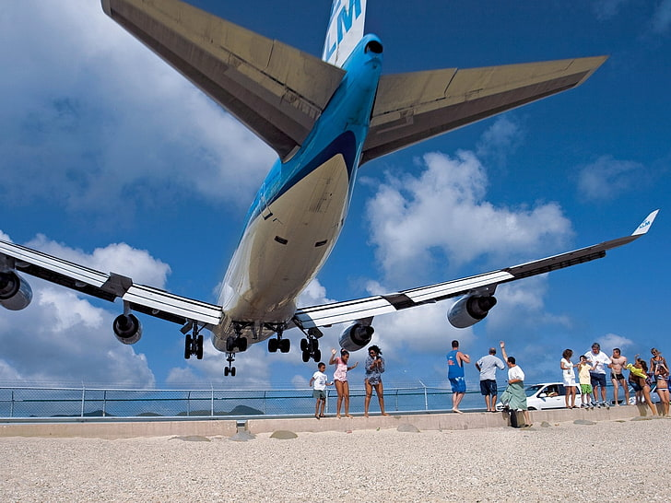
A Data-Driven Overview of Flight Departures Delay Flight Take Off Data - JFK Airport
Presented by: Ayesha Ahmad Sumi
Date : 13/06/2025

Slide 2
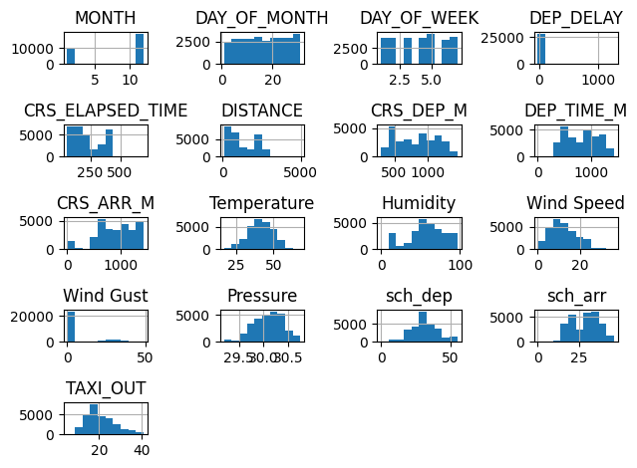
Source
This data was published under an Academic Paper under Review by IEEE transportation. This file contains data about flights leaving from JKF airport between Nov 2019-Dec-2020. Taxi-Out prediction has been an important concept as it helps in calculating Runway time and directly impact the cost of the flight.

Slide 3
Project Overview
We will predict the TAXI_OUT time based on Wind Speed, Wind Gust and Pressure.
We will perform Exploratory Data Analysis (EDA), clean the data if need, then implement a linear regression model to predict the data. We will also use the lasso and Ridge to balance the new data.

Slide 4
Value proposition
Stakeholder | Value
Airlines | Reduce fuel costs, optimize schedules, and minimize delays
Airports | Improve runway utilization, predict congestion, and manage ground traffic
Passengers | More reliable flight times, fewer delays
Air Traffic Controllers | Enable proactive rerouting and sequencing of departures
Environmental Bodies | Less idle engine time → reduced emissions

Slide 5
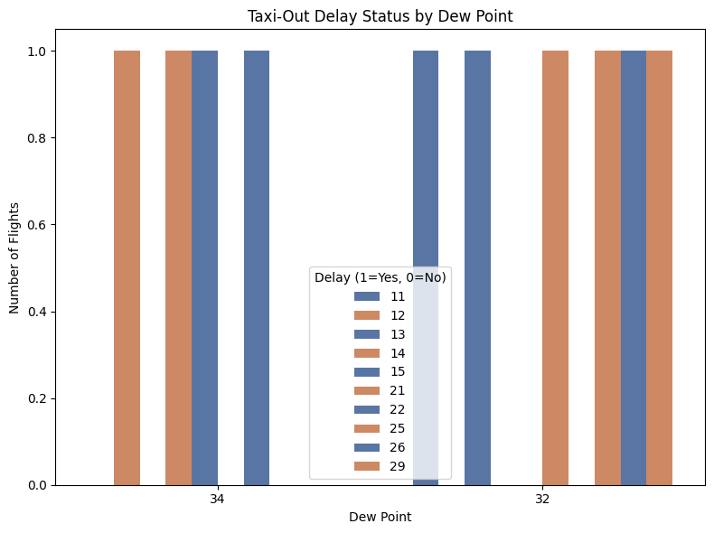
Taxi out delay by dew point

Slide 6
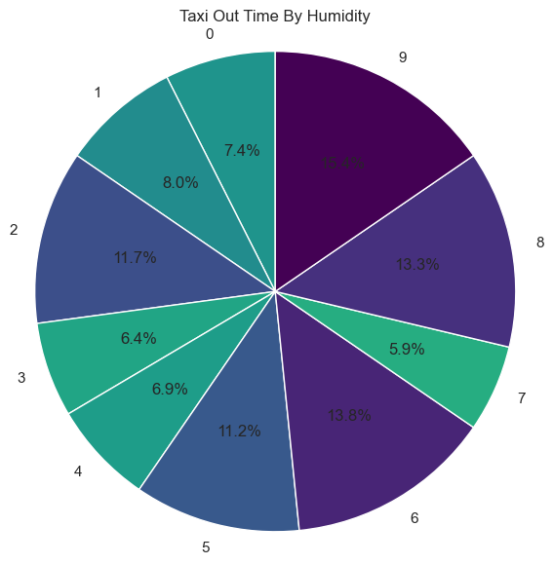
Taxi out time by Humidity

Slide 7
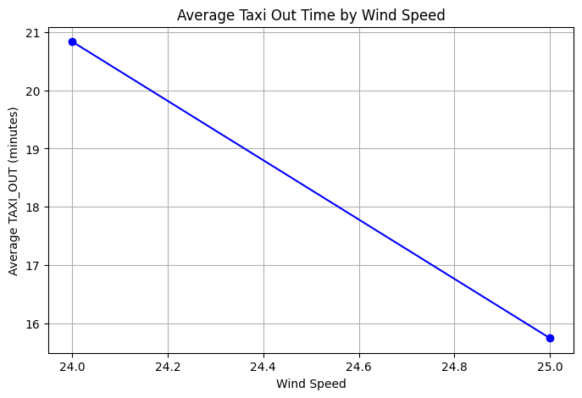
Average taxi out time by Wind speed

Slide 8
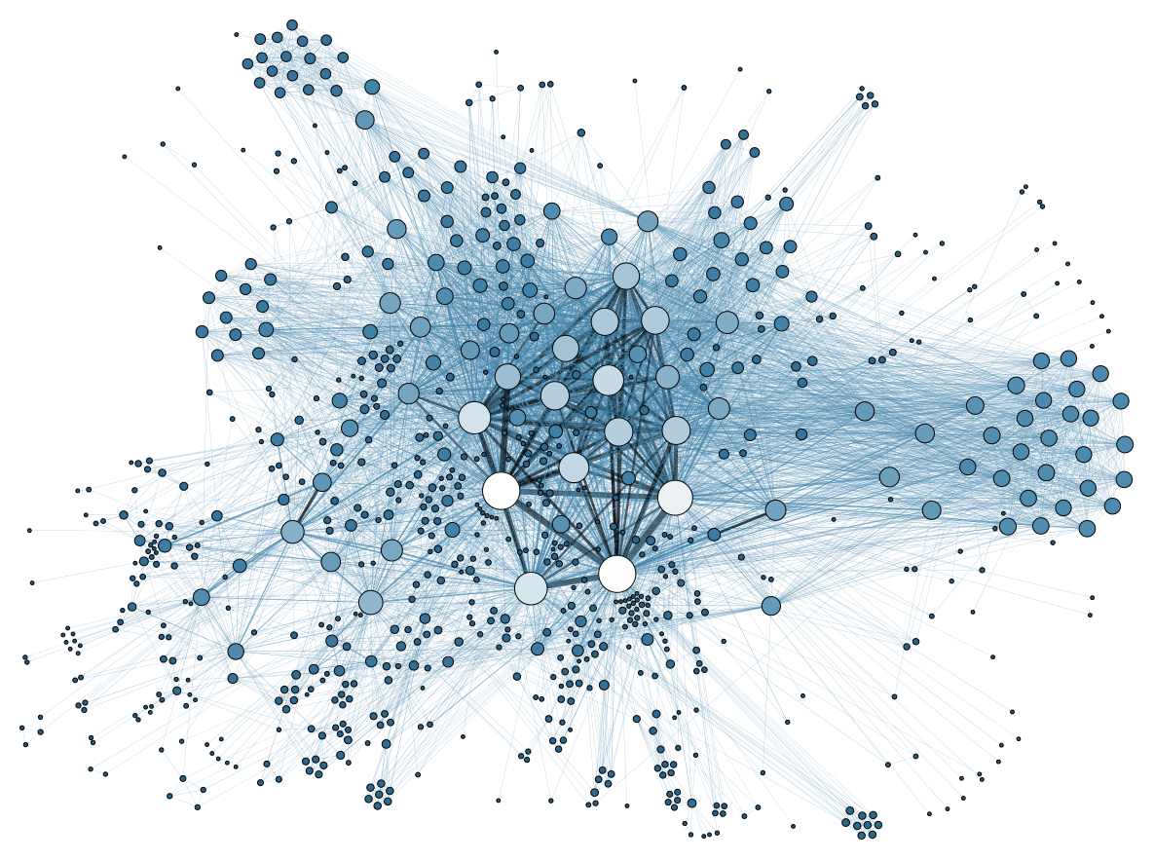
Some more visualization

Slide 9
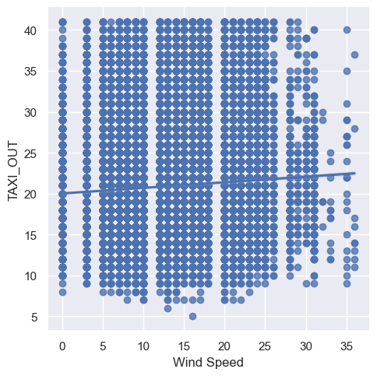
Taxi out based on wind speed

Slide 10
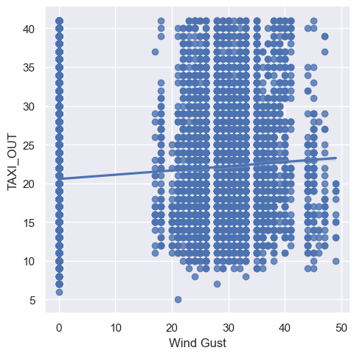
Taxi out delay based on wind Gust

Slide 11
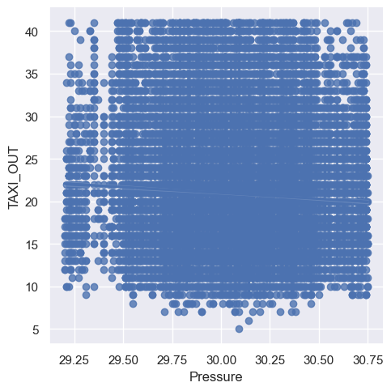
Taxi out delay based on pressure

Slide 12
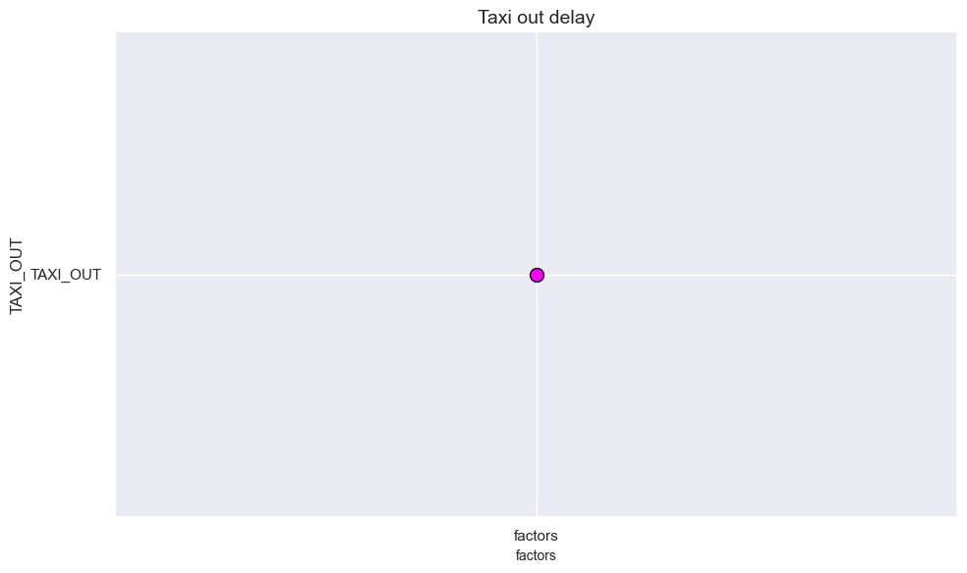
Linear Regression
Linear regression shows the taxi out delay based on factors ("Actual", "Predicted"
The data shows
Actual = [14, 15, 22, 12, 13, ..., 19, 22, 21, 13, 15]
Predicted = [22.642122, 22.642122, 22.642122, 22.642122, 22.475764, ..., 20.593345]

Slide 13
Evaluating the model
A linear regression model for taxi out delay can:
Quantify key influences on taxi time
Estimate congestion-free taxi time
Feed real‑time tools (pilots, ATC, dispatchers)
Benchmark performances and flag process deviations
Balance interpretability and sufficient accuracy compared to complex models

