Slide 1
Problem Statement:
The development of the hospital Management system was initiated to address the inefficiencies and challenges present in the manual management of :
Medical records,
Patient information,
Diagnosis updates.
The existing paper-based system posed significant hurdles in terms of :-
Accessibility
Accuracy,
ii) Timely retrieval of important healthcare data.
The primary Goal for this project included:
Streamlining the patient information management
process,
Improving the accuracy of diagnose , iii)Ensuring the security
iv) Confidentiality of sensitive medical records.
The hospital system aims to provide a comprehensive
and efficient solution to these challenges,

Slide 2
Bussiness requirements:
Patient Information Management:
•
The system should allow efficient capture, storage, and retrieval of patient information, medical history, and contact details.
It must support the creation of unique patient identifiers to avoid data duplication and ensure accuracy.
Diagnosis and Treatment Records:
Enable healthcare professionals to input, update, and retrieve diagnosis and treatment records for each patient.
Ensure the system that is supports accurate and detailed documentation of medical procedures.
Permissions:
Implement secure login mechanisms to protect sensitive patient information.
Training and Support:
Provide training materials and sessions for hospital staff to effectively use the system
Scalability:
Design the system to accommodate the potential growth of the hospital, supporting an increasing

Slide 3
number of patients.
The aim of these business requirements is to enhance operational efficiency,
Functional Requiremnt:
FUNCTIONAL REQUIREMENTS:
System will add a patient record System will save doctor's record
System will update doctor's record System will update patient's record
System will add Diagnose information of The Patient System will update the diagnose information of the Patient. System will Assign a ward to the patients.
System will add a doctor record System will save patient's record System will delete doctor's record
It will provide authorized access to the admin by the secure login process.
System will delete patient's record
System will save bed and room's record System will retrieve any record which we want
NON-FUNCTIONAL REQUIREMENTS

Slide 4
System's interface will be user friendly System will provide acceptable performance System will provide the protection of stored data
1. | Performance:
 |  | • | Requirements: |  |  |  |  | System will respond promptly to
 |  | user requests, with efficient data retrieval.(bec.ause we have used abstraction here)
2. | Reliability:
 |  | • | Requirements: |  |  |  |  | The system is reliable, ensuring
 |  | data accuracy and availability at all times.
3. | Usability:
 |  | • | Requirements: |  |  |  |  | The user interface is like to make it
 |  | easy for healthcare professionals to navigate and use the system.
4. | Scalability:
 |  | • | Requirements: |  |  |  |  | The system should be scalable to
 |  | accommodate the growth of the hospital and increased data volume.
5. | Maintainability:
 |  | • | Requirements: |  |  |  |  | The system is easy to maintain
 |  | with updates .
6. | Reliability:
 |  | • | Requirements: |  |  |  |  | The system will operate reliably
 |  | without unexpected errors

Slide 5
Insert password and user name
Login
Add Patient Record
Add diagnose Record Of Patient
Update patients personal record
Update patient’s
Delete patient’s record
Retrieve patient’s history
Retrieve staff information
Manage and upload the

Slide 6
Activity Diagram:
Enter admin info
Valid?
Add Docto r
Add Patient
Add Diagnose Information
Update Patient
Update Diangnose
Delete Patien t
Show patient history
Show staff infrom
Show hospital history
Enter details
Enter Details
Enter Id of the existing patient
Enter Id of the existing patient
Enter Id of the existing patient
Enter Id of the existing patient
Vali
Valid
Valid
Valid?
Valid
?
Valid
Save doctor
Save Patient Informa tion
Save diagnose Information
Update Patient record
Update diagnose record
Delete record

Slide 7
Sequence Diagram:
System
Enter email and password
Valid _Yes
Add doctor info()
Not valid please re_enter() Re_enter valid information()
Doctor data saved()
Add Patient() Add diagnose()
Update Patient record() Update diagnose record() Delete record()
Show patient complete history()
show staff history() show hospital history()

Slide 8
Use Cases Description:
ELABORATED USE-CASES
Login
Implementation Priority | 1
Actors | Admin
Summary | Admin will enter password if that password is valid then admin can use the software
Pre-condition | Admin must be authorized.
Post-Condition | Admin can make changes, add or retrieve any data
Extend | None
Uses | None
Normal Course of Events | Admin will enter password. If password is correct. Admin will be logged in
Alternative Path | None
Exception | None
Assumption | Admin can use any functionality of software

Slide 9
Add Patient
Implementation Priority | 2
Actors | Admin
Summary | Admin will enter the details of the patient if the details will be valid then the patient will be added.
Pre-condition | That data should not be already saved in the data base of patient.
Post-Condition | New data will be saved in the data base of the patient.
Extend | None
Uses | None
Normal Course of Events | Admin will enter the data. If data is valid. New data will be saved in the system .
Alternative Path | None
Exception | None
Assumption | A new doctor will be saved in the data base of the patient

Slide 10
Add diagnose information
Implementation Priority | 3
Actors | Admin
Summary | Admin will enter the diagnose details of the patient if the details will be valid then the patient will be added.
Pre-condition | That data should not be already saved in the data base of patient.
Post-Condition | Diagnose data will be saved in the data base of the patient.
Extend | None
Uses | None
Normal Course of Events | Admin will enter the data. If data is valid. Diagnose data will be saved at the respective id of the patient .
Alternative Path | None
Exception | None
Assumption | A new doctor will be saved in the data base of the patient

Slide 11
Edit/Update Patient record
Implementation Priority | 4
Actors | Admin
Summary | The data of the patient will be added after entering the new data by admin
Pre-condition | Admin will enter the updated data.
Post-Condition | The updated data will be saved in the system.
Extend | None
Uses | None
Normal Course of Events | Admin will enter the data. If data is valid. Updated data will be saved at the respective id of the patient .
Alternative Path | None
Exception | None
Assumption | New data will be saved in the system and while retrieving this data the updated data will be retrieved

Slide 12
Retrieve Patients Data
Implementation Priority | 5
Actors | Admin
Summary | The admin will enter the id of the patient if that id is present in the system then it will show the complete data of the patient.
Pre-condition | Patient data is saved in the system .
Post-Condition | There will be no change in the system .
Extend | None
Uses | None
Normal Course of Events | Admin will enter the id of the patient. If id is valid. System will show the data.
Alternative Path | None
Exception | None
Assumption | System will show all the details of the patient.

Slide 13
Retrieve Staff Data
Implementation Priority | 6
Actors | Admin
Summary | The admin will enter the id of the Staff if that id is present in the system then it will show the complete data of the Staff ‘s memeber.
Pre-condition | Staff data is already saved in the system .
Post-Condition | There will be no change in the system .
Extend | None
Uses | None
Normal Course of Events | Admin will enter the id of the Staff memeber. If id is valid. System will show the data.
Alternative Path | None
Exception | None
Assumption | System will show all the details of the Staff member.

Slide 14
Person
-id
-name
-Address
-Contact
-Age
-Geneder
______________
+Person()
Patient
-Blood Group
-Disease
-Symptoms
-Ward requirement
-ward type
_________________
+Patient()
Doctor
-Qualification
__________
+Doctor()

Slide 15
Design Document:
Type of Architecture: I used 3-Layer architecture in my project for the following reasons: Scalability.
Maintainability.
Easy to handle.
Easy to work with.
Easy to understand.
Diagram:

Slide 16
Presentation layer: Desktop interference(
1)Login form
2)Dashboard form
(
Add patient pannel
Add diagnose pannel
Update pannel
)
3) Deleting form 4) Patient show history form. 5) Show staff history form 6) Show Hospital history form.
Bussiness Layer(
.Person class
Patient class
Doctor Class
)
Database layer: (
Connection class(
Connection manger();
DataAccess Objects();
Entity framework();
Database();
)
)

Slide 17
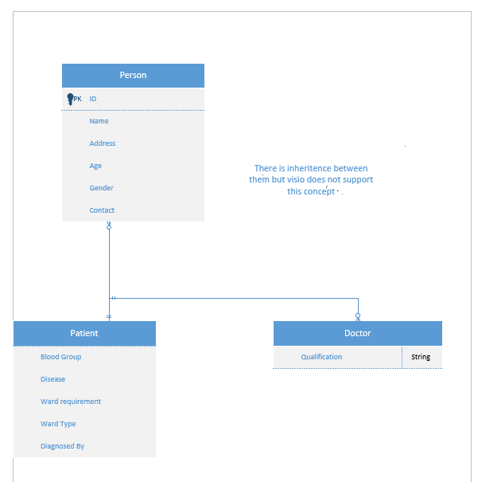
ERD:
Testing:
Types: There are 2 types of testing:
Black box testing.
White Box testing.

