Slide 1
Case study: How does a bike-share navigate speedy success?
Bike Rental Data Analysis Understanding Casual vs. Membership Riders

Slide 2
Introduction
Context:
The bike rental industry is split between casual riders and membership riders. Understanding the differences between these groups is crucial for growing the membership base.
Purpose:
To analyze the behavior of casual and membership riders, identify key differences, and provide recommendations to convert casual riders into full-time members.
Agenda:
Introduction
Methodology
Key Findings
Recommendations

Slide 3
Methodology
Approach:
Comparative analysis was performed between casual and membership riders using metrics such as ride frequency, duration, and peak usage times.
Behavioral segmentation was used to identify patterns in rider preferences and habits. Data was explored to uncover potential incentives that could encourage casual riders to convert to membership.
Data Sources:
The dataset includes ride details, customer types (casual or member), and additional variables like ride duration, time of day, and day of the week.

Slide 4
Key Findings
As we move into the visualization segment, the charts and graphs will provide a clear visual breakdown of the data, highlighting key differences between casual and membership riders which will help us draw actionable insights and inform our recommendations.

Slide 5
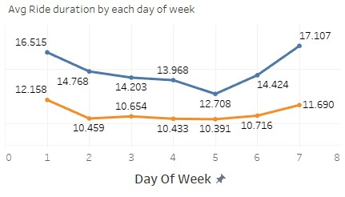
Casual Riders: Tend to have longer ride durations, particularly on weekends, indicating more leisurely use.
Member Riders: Exhibit consistent ride durations throughout the week, likely reflecting routine commuting patterns.

Slide 6
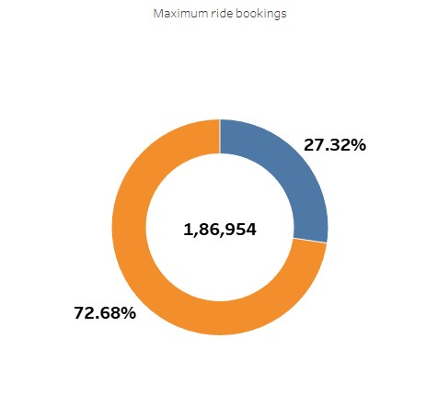
Casual Riders: Represent a smaller portion of total ride bookings, indicating less frequent use of the service.
Member Riders: Account for the majority of ride bookings, reflecting their higher engagement and regular usage.

Slide 7
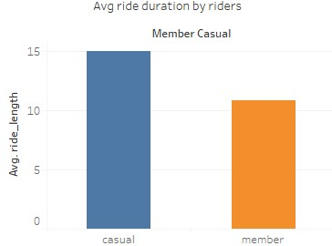
Casual Riders: Have significantly longer average ride durations, suggesting more leisurely or exploratory trips.
Member Riders: Show shorter average ride durations, likely due to routine or purpose-driven usage.

Slide 8
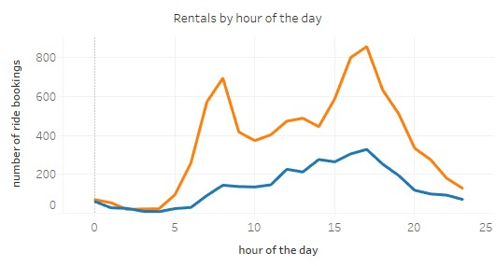
Casual Riders: Peak in the evening hours, indicating preference for late-day or leisure activities.
Member Riders: Show two peak periods 8 AM and 5 PM aligning with typical commute times, highlighting more consistent daily usage.

Slide 9
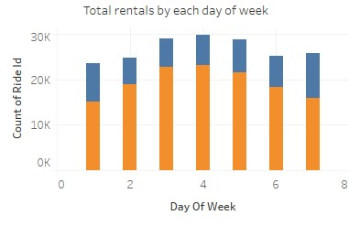
Casual Riders: Bookings are highest in the middle of the week, suggesting a peak in mid-week demand."
Member Riders: For member riders, the data similarly shows a peak in rentals during the mid-week, reflecting consistent high demand throughout this period.

Slide 10
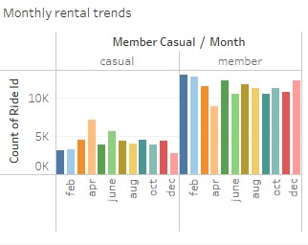
Casual Riders: Bookings for casual riders peak specifically in April and June, with fewer rentals in other months.
Member Riders: Member rider bookings are highest from January to July, with the peak occurring at the start of this period.

Slide 11
Recommendations
Weekend Promotions: Consider offering special deals or promotions for casual riders on weekends to capitalize on their longer ride durations and potentially encourage them to become members.
Encourage Regular Use: To increase the number of bookings from casual riders, implement strategies to promote more frequent use, such as offering incentives for repeat rentals or a loyalty program
Leisure Promotions: For casual riders, target promotions or incentives for evening rides, particularly around the 5 PM peak, to potentially convert this usage pattern into a regular membership.

Slide 12
Improve services or features that cater to the high usage period at the start of the year. This could include optimizing bike availability during peak months or adding new features that enhance convenience.
Use feedback from casual riders during their peak months to understand their needs and preferences better, allowing to tailor services and features that might encourage them to become full-time members.

Slide 13
Thank you for your time and attention.

