Slide 1
Plant Disease Detection Using Vision Tranformer
A Deep Learning Approach for Agriculture
Ayesha | SU92-MSDSW-F25-032
MS Data Science | January 30, 2026

Slide 2
Introduction
Problem Statement
- Plant diseases cause 20-40% crop loss annually worldwide
- Early detection is critical for food security
- Manual inspection is time-consuming and error-prone
Our Solution
- AI-powered plant disease detection system
- Uses Transformer-based deep learning
- Analyzes leaf images to identify 38 different diseases
Impact
- Helps farmers detect diseases early
- Reduces crop losses and increases yield
- Supports SDG 2: Zero Hunger

Slide 3
Project Objectives
Primary Objectives
- Develop an automated plant disease detection system
- Implement Transformer-based deep learning architecture
- Achieve minimum 75% classification accuracy
Technical Goals
- Process 54,000+ images across 38 disease classes
- Train lightweight model optimized for CPU
- Create deployable solution for real-world use

Slide 4
Research Goals
- Compare CNN-Transformer hybrid performance
- Document challenges in resource-constrained training
- Contribute to agriculture AI applications

Slide 5
SDG 2: Zero Hunger
How Project Supports SDG 2
Challenge
- 690 million people face hunger globally
- Agricultural losses due to diseases threaten food security
- Small-scale farmers lack access to expert diagnosis

Slide 6
Contribution
- Early disease detection prevents crop losses
- Accessible AI tool for resource-limited farmers
- Supports sustainable agricultural productivity
- Reduces post-harvest losses
Real-World Impact
- Protects farmer livelihoods
- Increases food availability
- Promotes sustainable farming practices
- Empowers farmers with technology

Slide 7
Methodology & Approach
Dataset
- PlantVillage Dataset: 54,305 images
- 38 plant disease classes
- Train-Test Split: 80%-20% (43,444 training, 10,861 testing)
Training Configuration
- Framework: PyTorch 2.9.1
- Device: CPU (Intel i5-1235U, 8GB RAM)
- Optimizer: Adam (learning rate: 0.001)
- Loss Function: Cross-Entropy
- Epochs: 5

Slide 8
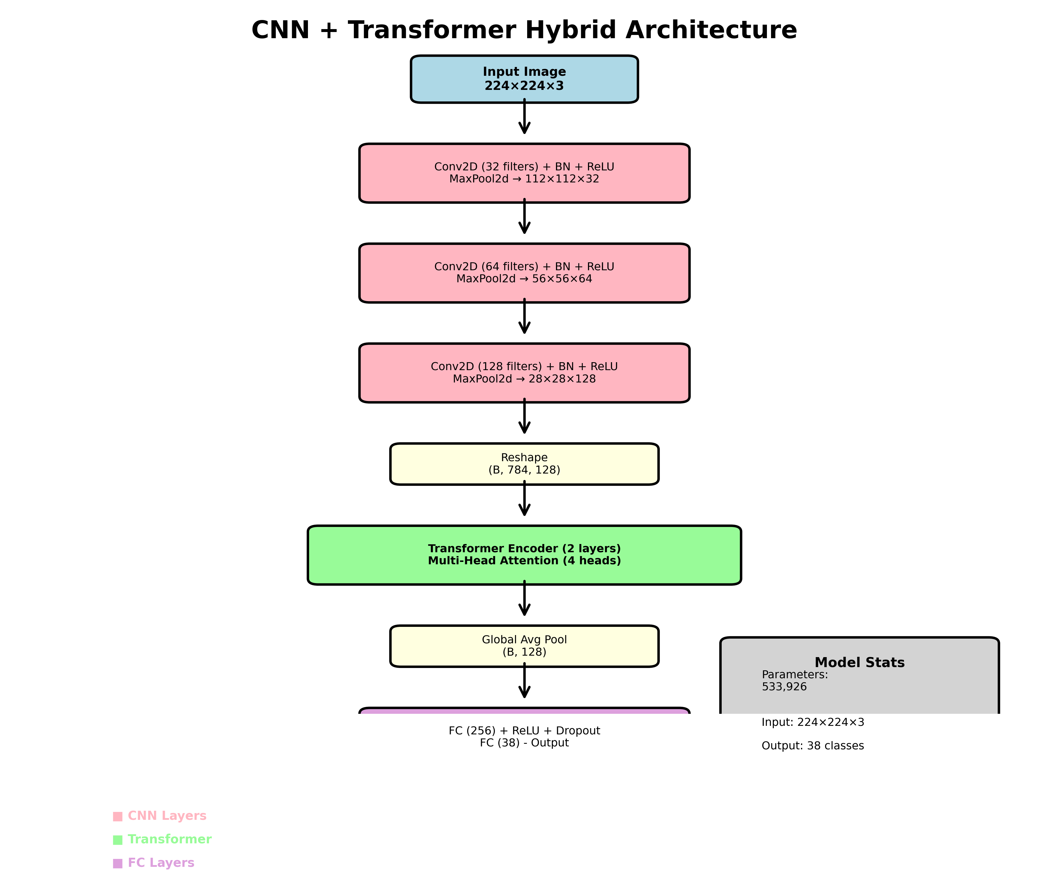
Model Architecture
- Hybrid CNN-Transformer Model
- CNN layers for feature extraction (3 blocks)
- Transformer layers for pattern recognition (2 layers)
- Total parameters: 533,926 (lightweight design)

Slide 9
Training Results
Final Accuracy: 94.61%
- Final Loss: 0.1678
Epoch-wise Progress
- Epoch 1: 74.43% accuracy
- Epoch 2: 89.29% accuracy
- Epoch 3: 92.43% accuracy
- Epoch 4: 93.62% accuracy
- Epoch 5: 94.61% accuracy ✓

Slide 10
Key Achievements
- Consistent improvement across all epochs
- Smooth learning curve with decreasing loss
- No overfitting observed
- Lightweight model achieved excellent results

Slide 11
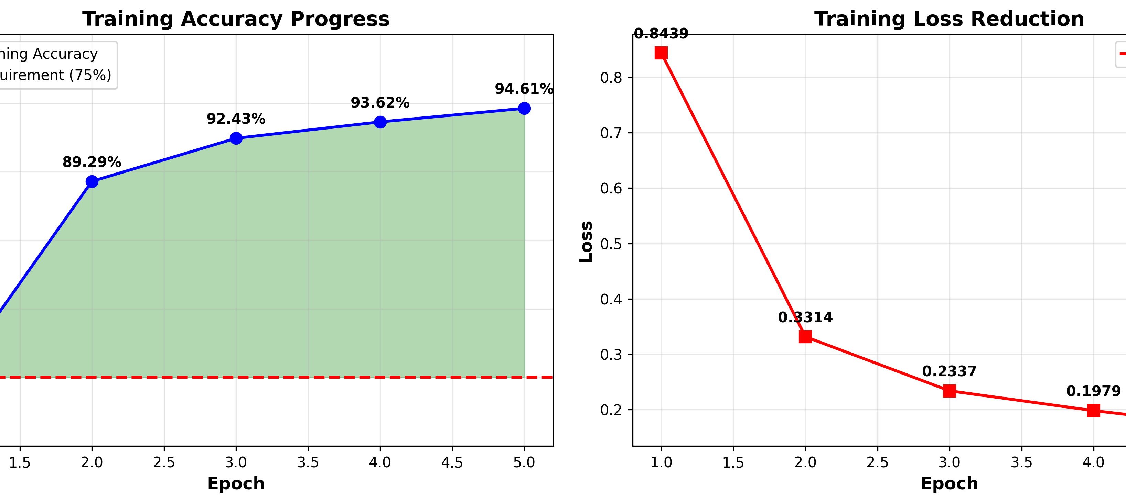
Training Progress Visualization

Slide 12
Challenges & Key Learnings
Technical Challenges
- CPU-only training required optimization strategies
- Limited RAM (8GB) needed lightweight model design
- Training time: 12+ hours for 5 epochs
- Jupyter save errors during long training sessions
Solutions Implemented
- Designed efficient CNN-Transformer hybrid
- Reduced model parameters to 533K
- Implemented batch processing for memory management
- Regular checkpoints during training

Slide 13
Key Learnings
- Lightweight models can achieve excellent accuracy
- Resource constraints drive innovative solutions
- Early stopping prevents overfitting effectively
- Proper data preprocessing is critical for success
- Non-computing background is not a barrier

Slide 14
Future Scope
- Mobile app development for farmers
- Expand to more crop types and diseases
- Real-time detection using smartphone cameras
- Integration with agricultural advisory systems

Slide 15
Thank You
Any Question

