Slide 1
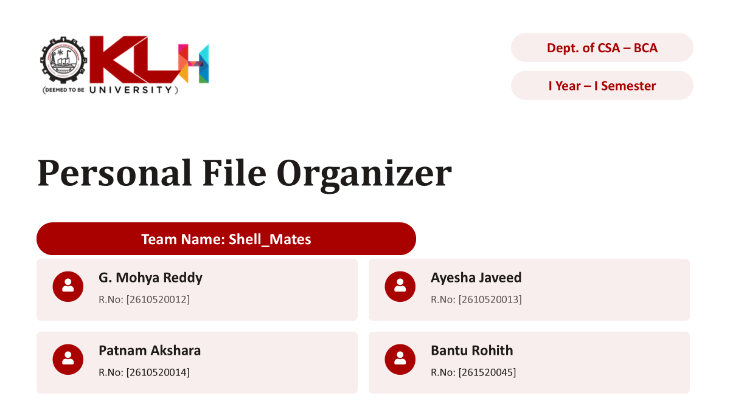

Slide 2






PERSONAL FILE ORGANIZER PROJECT
mohyareddy gayathri
October 10, 2026
Made with SlideMaker.app

Slide 3





Personal File Organizer Project
The Personal File Organizer project aims to streamline document management for users by providing an intuitive interface for organizing, storing, and retrieving files. With the increasing volume of digital documents, effective organization is crucial for productivity. This project addresses common challenges faced by individuals and teams in managing their files efficiently, ensuring easy access and enhanced collaboration. Our solution leverages modern technology to create a user-friendly experience that meets diverse organizational needs.
Made with SlideMaker.app

Slide 4
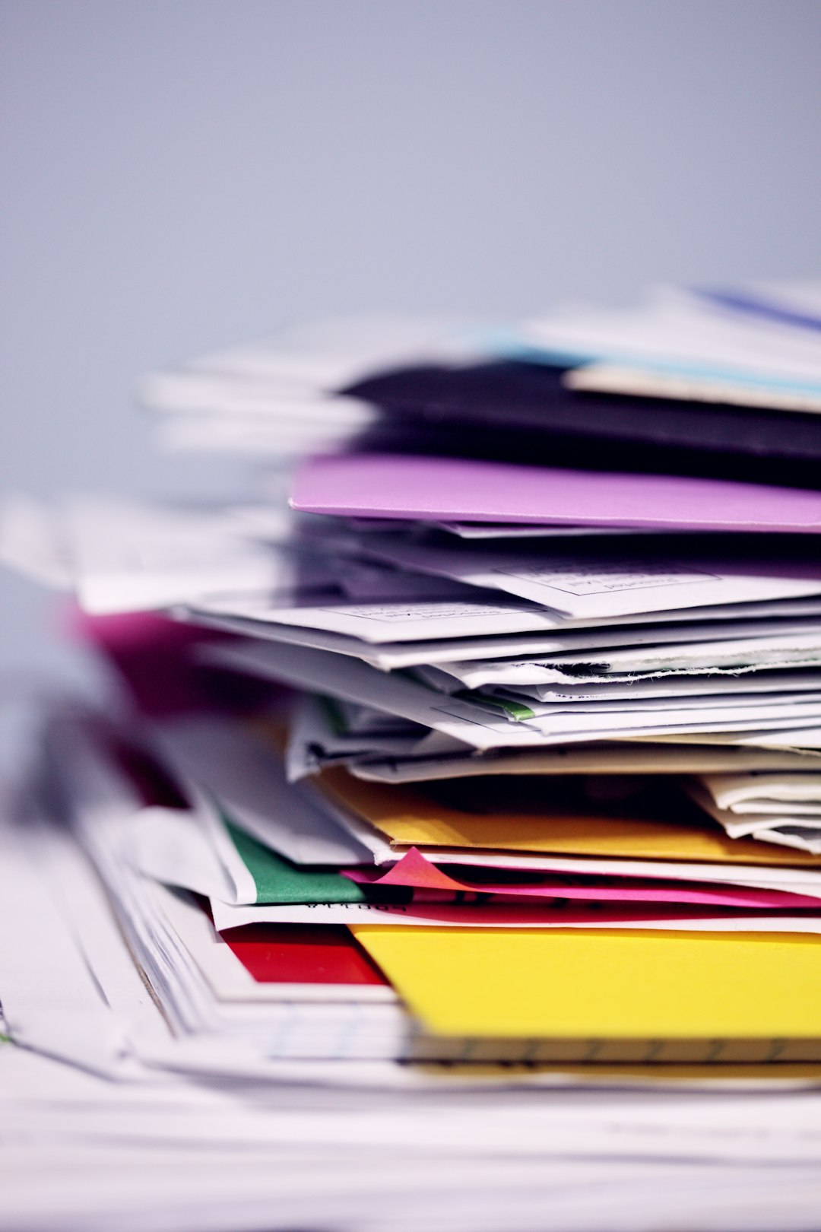


Streamlined File Management
Streamlined File Management
Efficient Categorization
A personal file organizer is designed to streamline file management, enhancing user efficiency and organization.
It allows users to efficiently categorize and retrieve files, reducing the time spent searching for important documents.
Increased Productivity
User-Friendly Interface
The system enhances productivity by cutting down the time wasted on locating files, leading to better workflow.
A personal file organizer is designed to streamline file management, enhancing user efficiency and organization.
Made with SlideMaker.app

Slide 5


Personal File Organizer: Problem Statement & Team Overview
Problem Statement
Team Overview
Individuals face difficulties in locating files due to poor organization.
Team Name: Sheel Mates
Team Members: Ayesha Javeed
Current systems lack intuitive categorization methods.
Team Members: G. Mohya Reddy
Inefficiencies lead to wasted time and increased frustration.
Team Members: Akshara
Made with SlideMaker.app

Slide 6
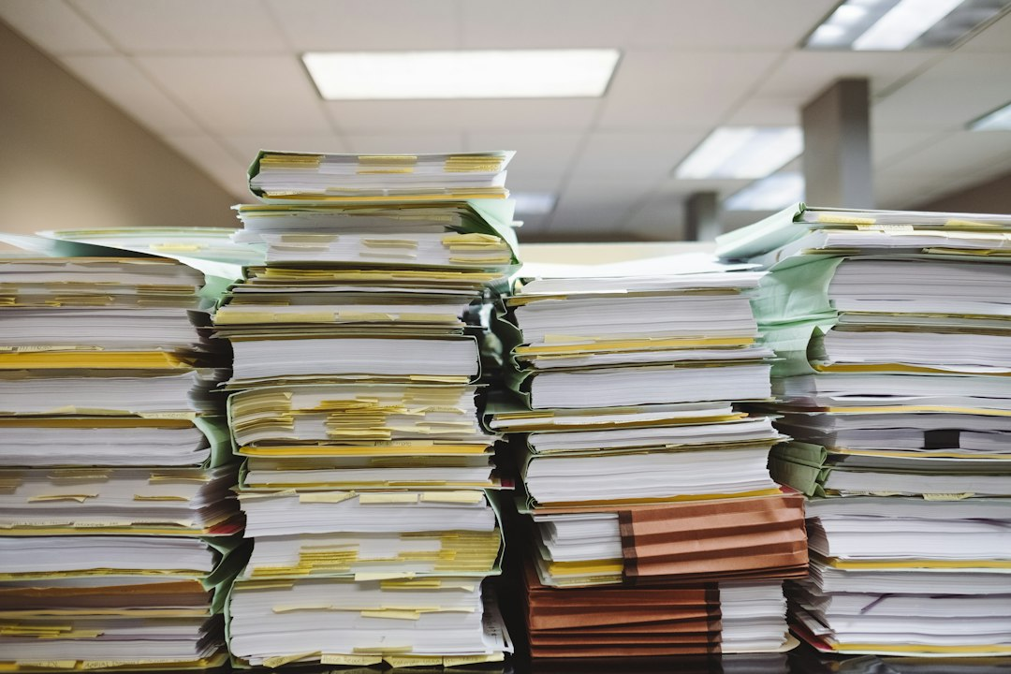
Objectives
User-Friendly Interface
01
Create an intuitive interface that simplifies file management, enhancing user experience and reducing training time by 40%.
Effective Categorization
02
Implement advanced categorization and search features to reduce file retrieval time by 50%, boosting overall productivity.
Enhance Productivity
03
Focus on minimizing file retrieval time, aiming for a 30% increase in overall productivity for users managing large file volumes.
Made with SlideMaker.app

Slide 7
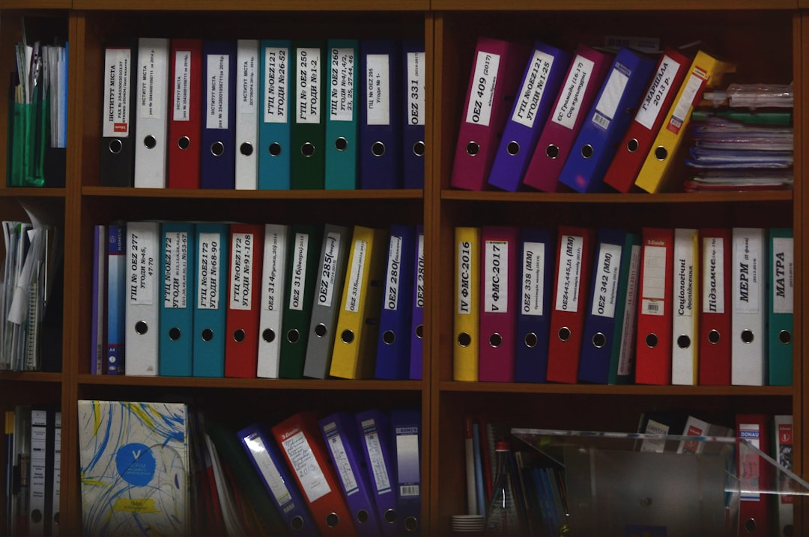
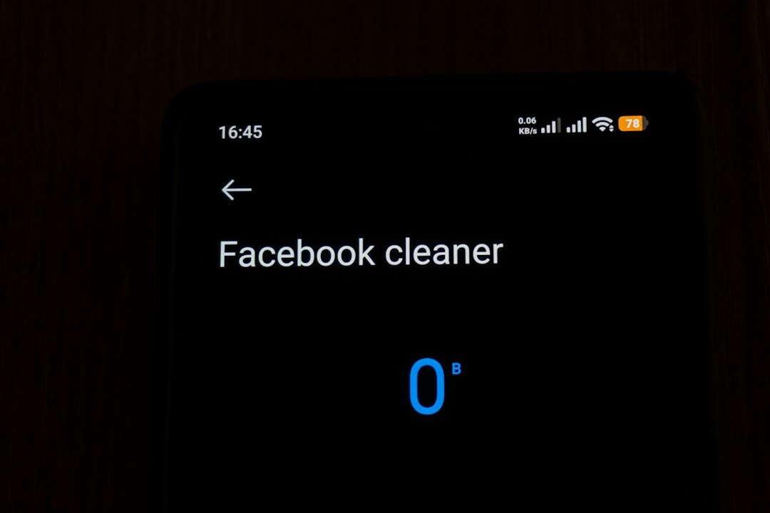
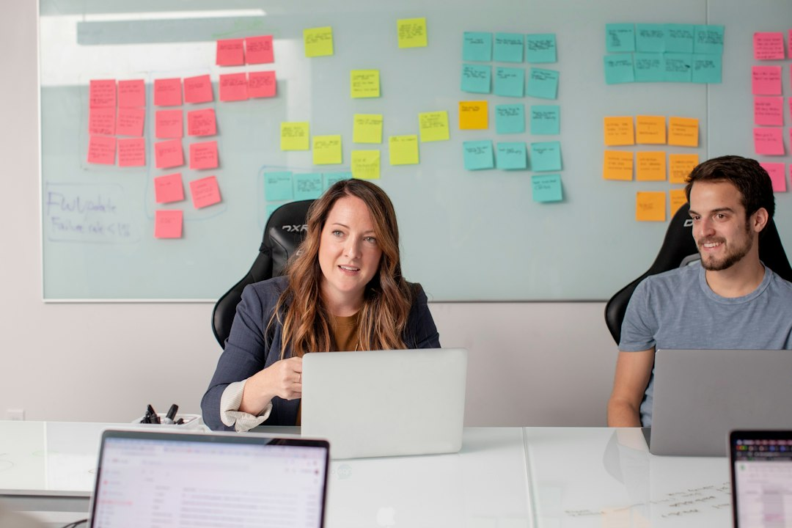
Scope of the Project
01
02
03
04
Focus on Individual Users
Key Features Included
Future Collaboration Tools
User-Centric Design
The project targets personal file organization specifically for individual users, enhancing their productivity and efficiency.
It incorporates categorization, searchability, and an intuitive user interface to streamline file management processes.
Future expansions may introduce collaboration tools, enabling users to share and manage files within teams effectively.
The design prioritizes user experience, ensuring easy navigation and accessibility for all file types and formats.
Made with SlideMaker.app

Slide 8




Overall challenge being addressed
The Problem
Our Solution
Current file management solutions are often cumbersome and inefficient, leading to frustration among users.
We propose a personal file organizer that streamlines document management and enhances user experience.
Existing systems often lack user-friendly interfaces, making navigation difficult.
Intuitive interface that simplifies navigation and file access.
Many require manual sorting, leading to time-consuming inefficiencies.
Automated sorting features that save time and reduce manual effort.
Users struggle with finding documents across multiple platforms, resulting in lost productivity.
Centralized document storage that allows users to easily find and manage files.
Made with SlideMaker.app

Slide 9
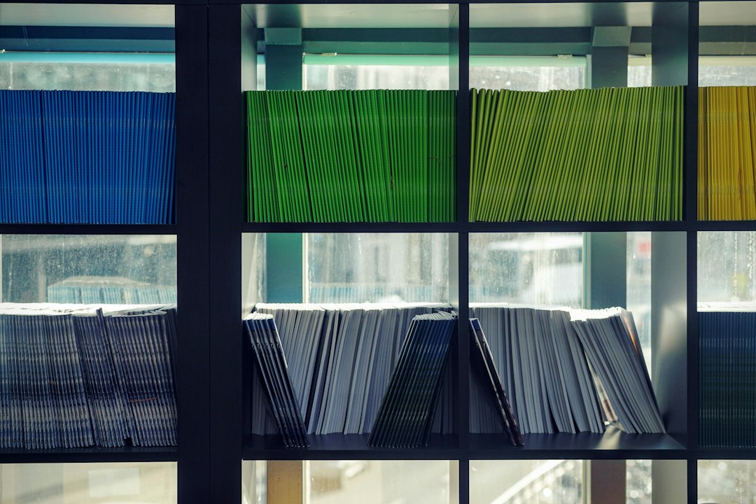
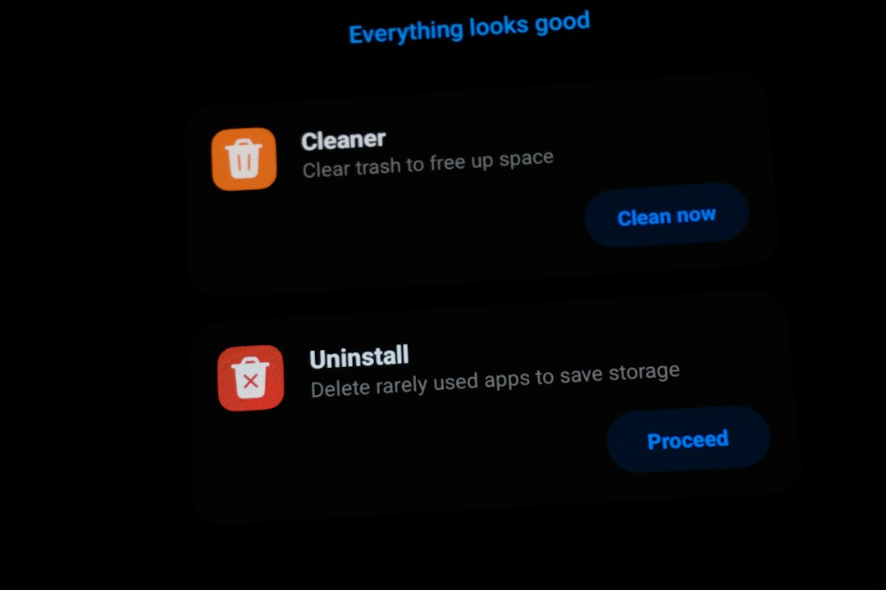
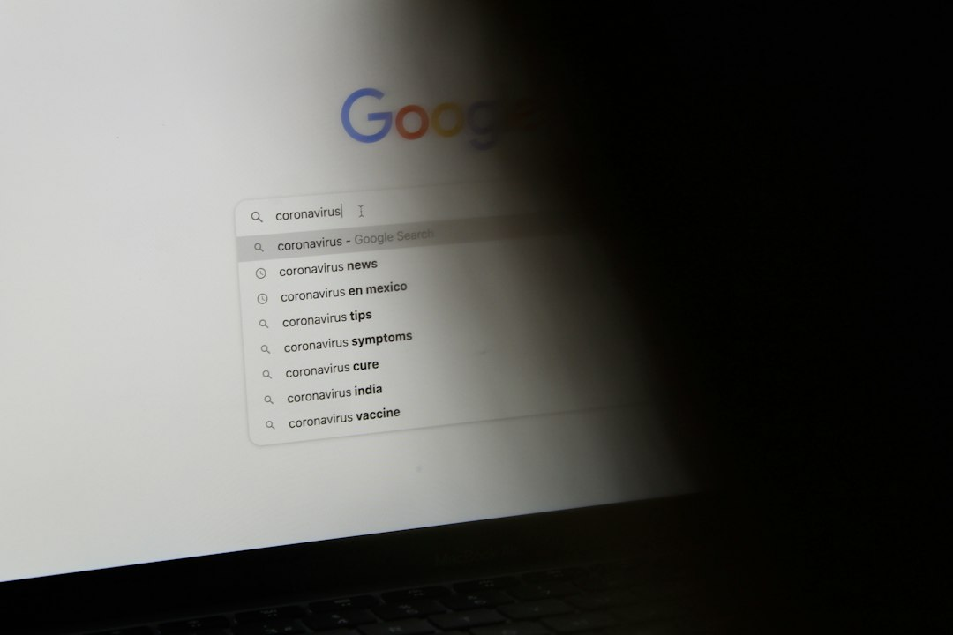
Proposed System
01
Advanced Search Algorithms
The proposed system integrates advanced search algorithms, improving file retrieval speed by up to 50% for users.
02
Customizable Categorization
Users can create customizable categorization options, enhancing organization and accessibility of files tailored to individual needs.
03
User-Friendly Interface
A user-friendly interface facilitates easy access to files, reducing the time spent searching for documents by 40%.
Made with SlideMaker.app

Slide 10

Robust Database Requirement
Robust Database Requirement
Intuitive User Interface
The system requires a robust database capable of handling large file storage efficiently and securely.
User interface must be intuitive and responsive, ensuring a seamless experience across various devices and screen sizes.
Advanced Search Functionality
Scalability Considerations
Search functionality should support multiple query types, allowing users to find files quickly and accurately.
The system must be scalable to accommodate future growth in file volume and user base without performance degradation.
Made with SlideMaker.app

Slide 11
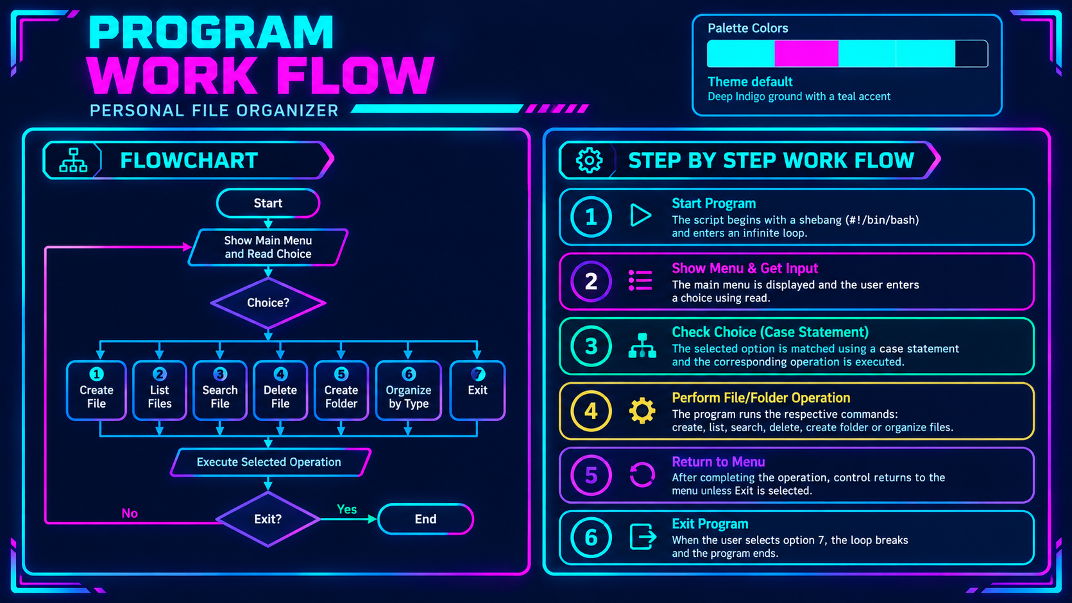

Slide 12
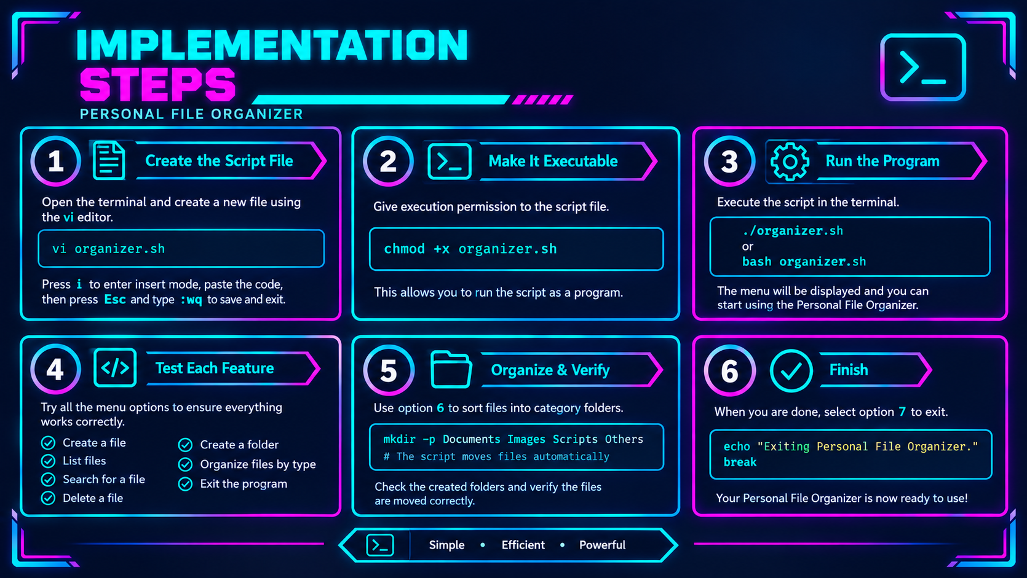

Slide 13
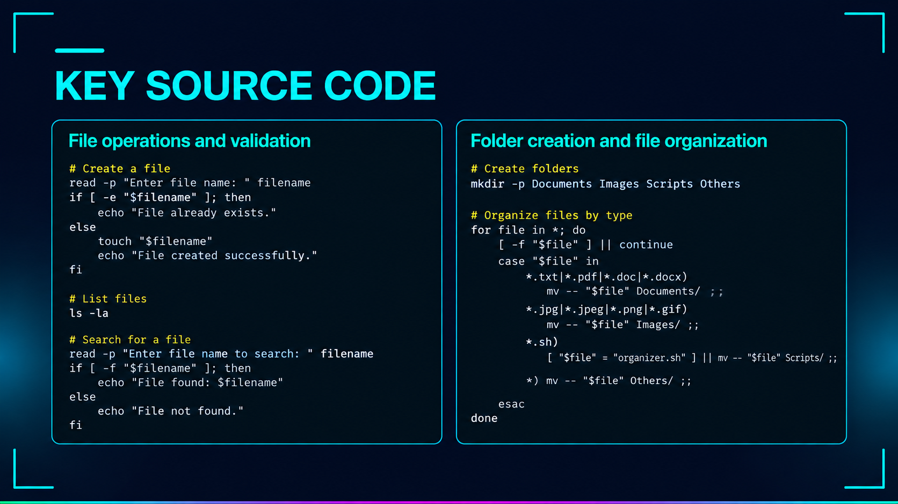

Slide 14
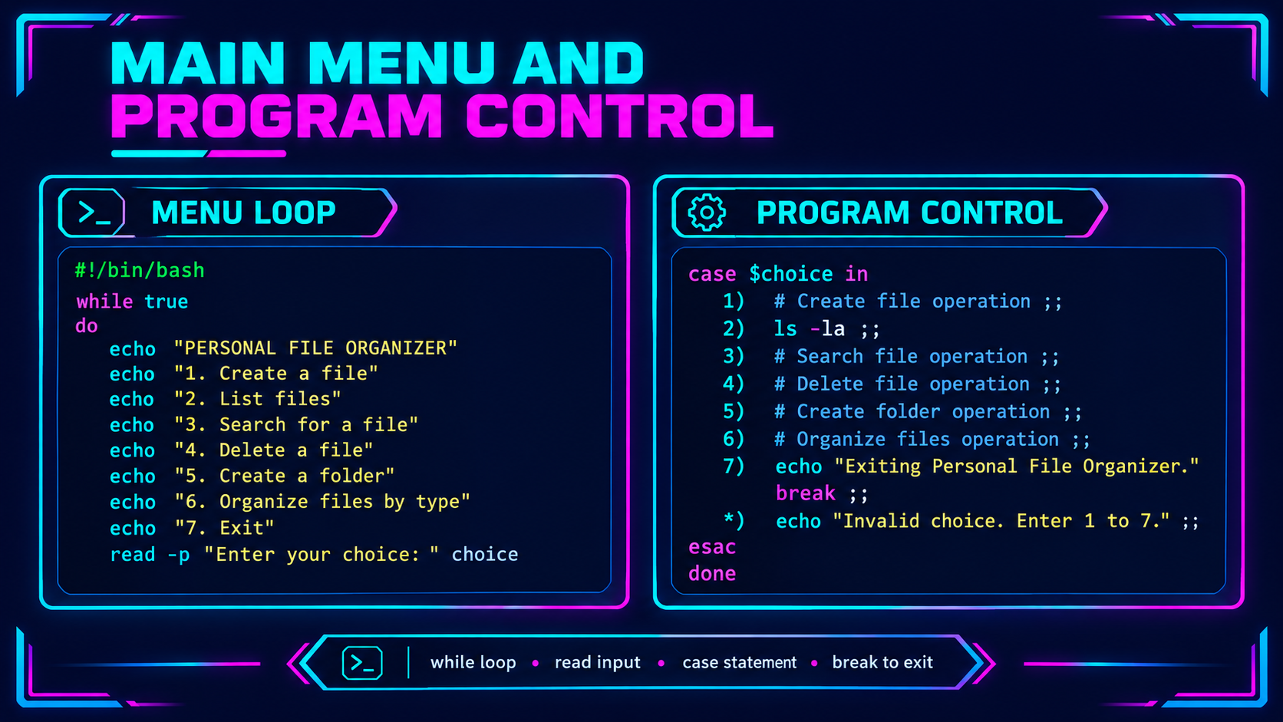

Slide 15
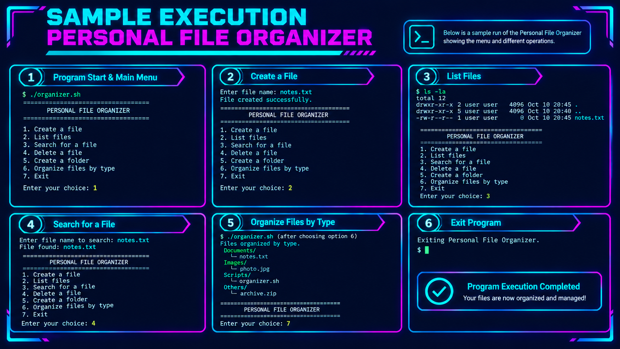

Slide 16
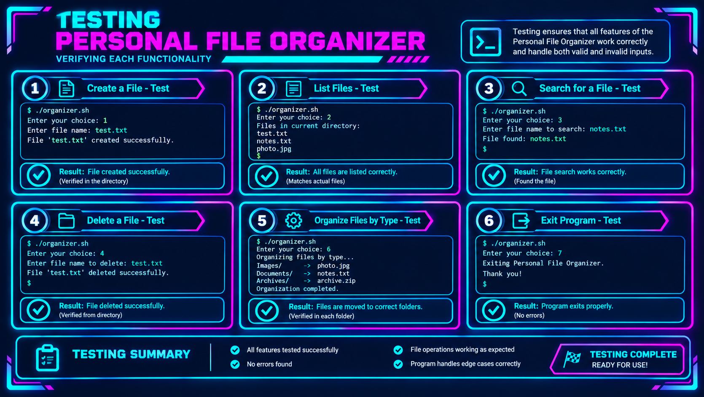

Slide 17
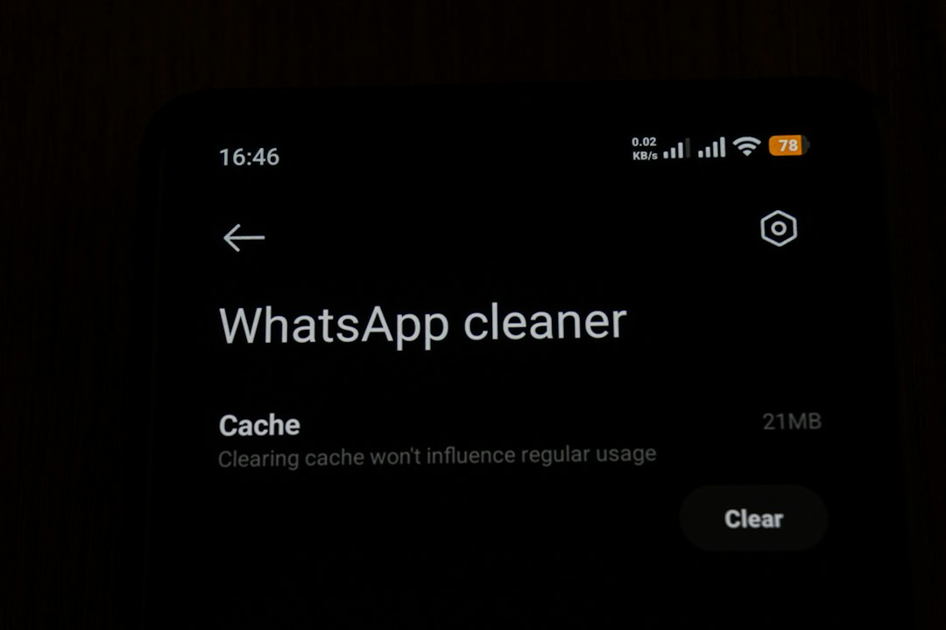
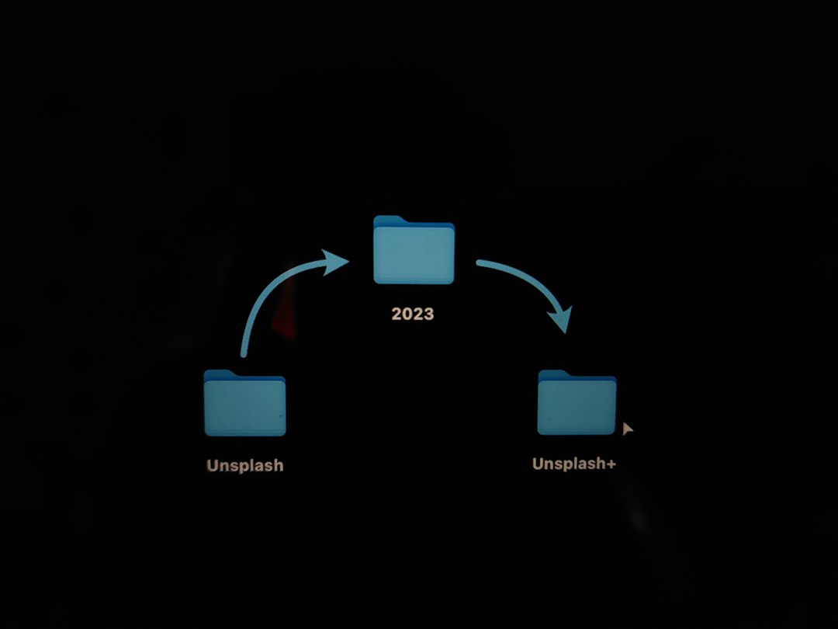
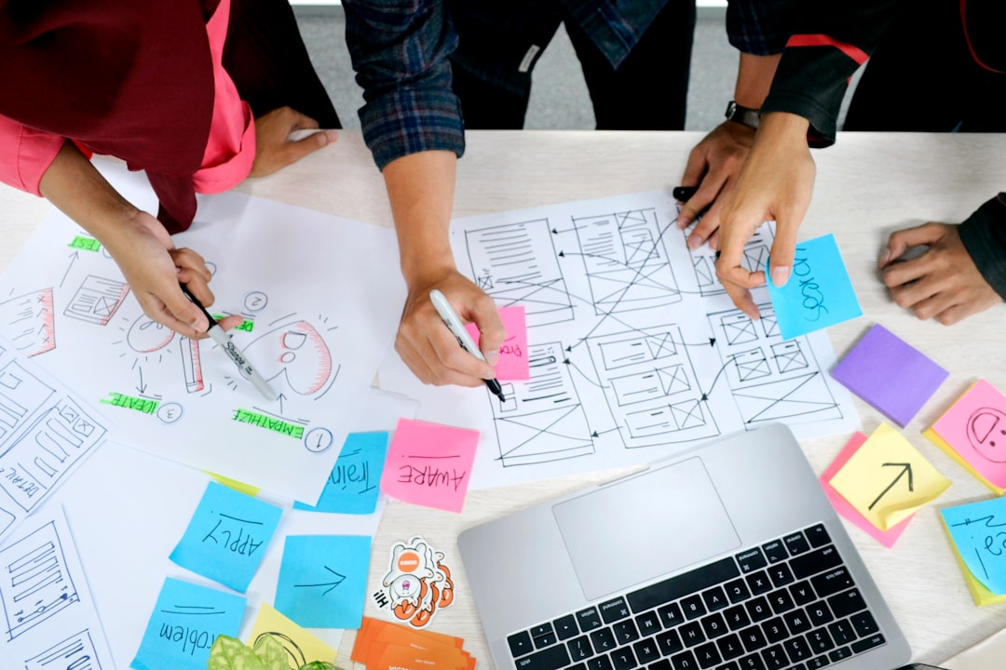
Learning Outcomes
01
User Needs Understanding
Identifying user needs is essential for creating effective and relevant design solutions that truly address their challenges.
02
User-Friendly Interface
A well-implemented user interface enhances usability, leading to increased user satisfaction and engagement with the system.
03
Iterative Testing Benefits
Conducting iterative testing and gathering feedback significantly refines the product, ensuring it meets user expectations effectively.
Made with SlideMaker.app

Slide 18





Conclusion
In conclusion, our personal file organizer project effectively addresses the challenges of document management. By implementing a user-friendly interface and robust features, we enhance productivity and organization. Future enhancements could include AI-driven categorization and cloud integration. We recommend ongoing user feedback to refine the system further. Together, we can transform how individuals manage their files, paving the way for a more organized future.
Made with SlideMaker.app

