Slide 1




Protecting Yourself from Phishing Attacks
Think before you click: Phishing hooks more than just fish.
Designed By: Ayesha khan

Slide 2
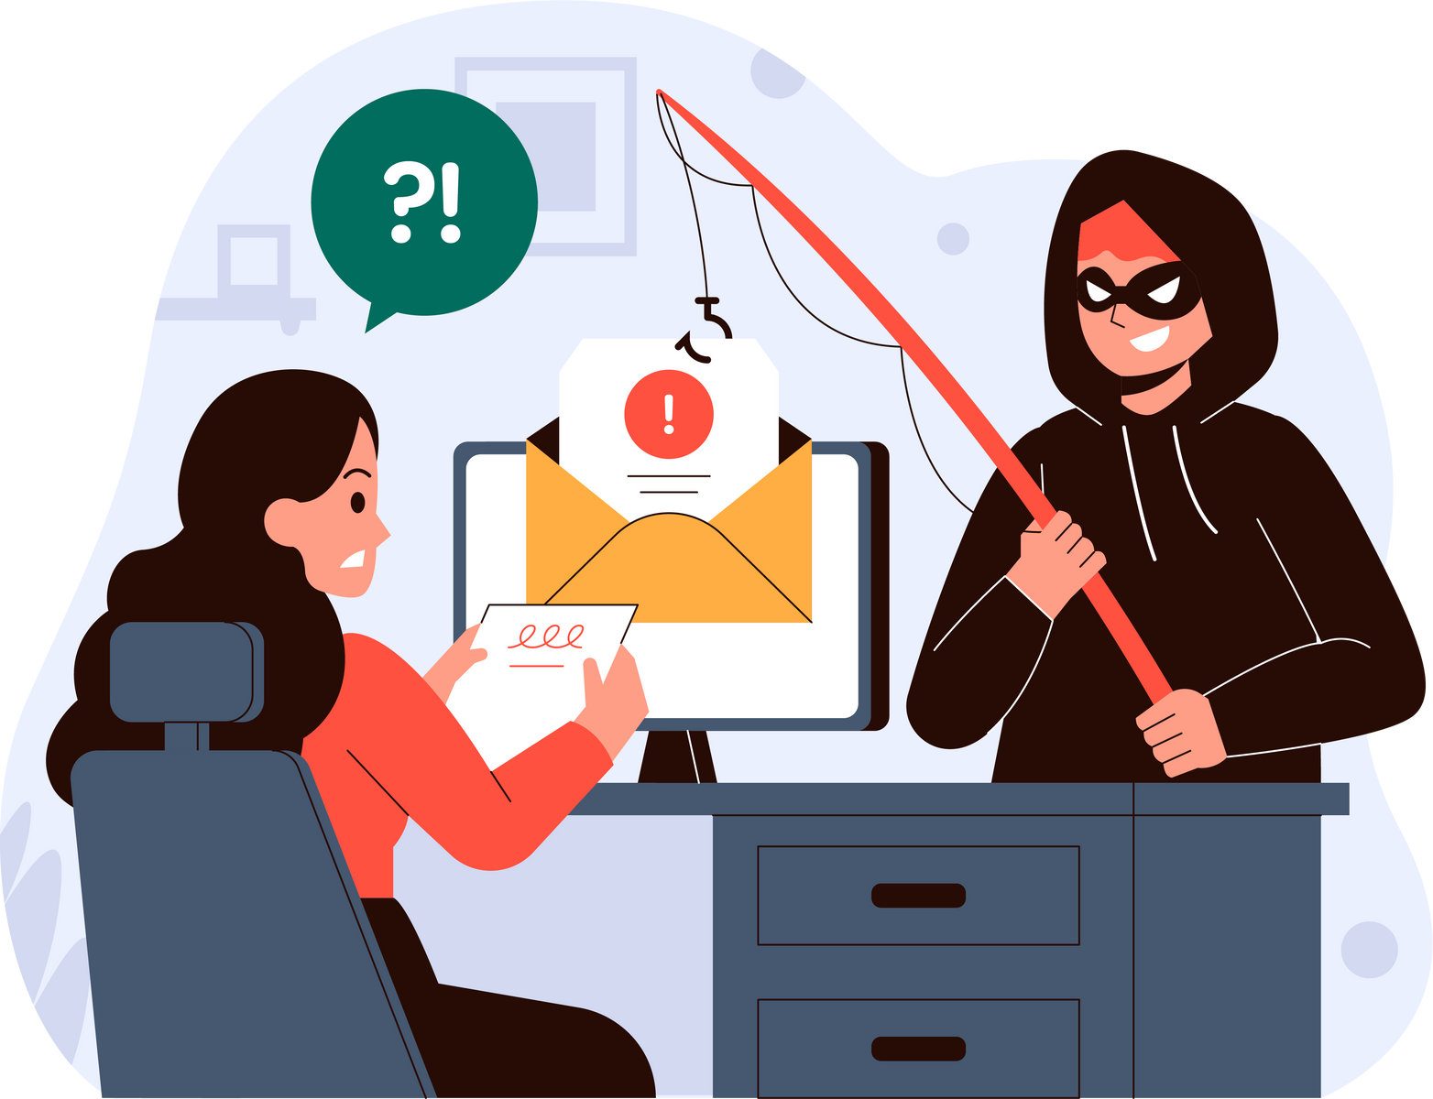
Introduction
- Welcome to my presentation on protecting yourself from phishing attacks.
- Phishing attacks are one of the most common and dangerous forms of cyber threats today.
- In this presentation, I'll discuss what phishing attacks are, how they work, and most importantly, how to recognize and avoid falling victim to them.
1996
2022
Term was first used in the context of online fraud.
800,944 reports of phishing
10% to 30%
90%
Success rate of phishing attacks
Key concern of IT Professional

Slide 3



What is Phishing?
Phishing is a cyber-attack where attackers impersonate legitimate entities (like banks, companies, or government agencies) to deceive individuals into divulging sensitive information such as usernames, passwords, credit card numbers, or other personal data.
Phishing attacks can occur via email, text messages, social media, or even phone calls
Attackers use various techniques to make their messages appear authentic and convincing.
Phishing emails often contain links that, when hovered over, reveal URLs that do not match the purported destination.

Slide 4
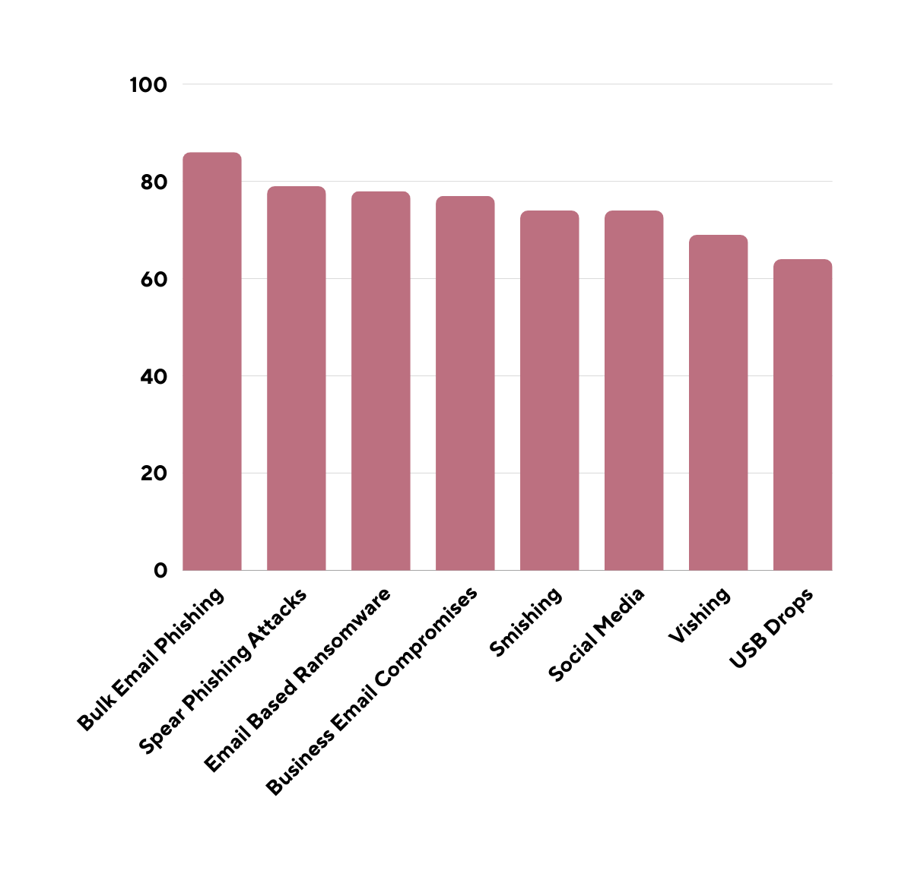
Types of Phishing attacks on Organizations 2021
Source via:
https://www.findmysoft.com/cybersecurity/phishing-statistics/

Slide 5
Delivery
Research
Exploitation
How Phishing Works....
Creation
Covering Tracks
Deception
Hooked by deception: Beware the phishing line

Slide 6






Creation
Delivery
Research
Attackers craft phishing emails or messages that mimic legitimate communication from trusted sources
Phishing emails are sent to targets, often with urgent or enticing subject lines to prompt action
Attackers research their targets to personalize their messages and make them more convincing
Deception
Exploitation
Covering Tracks
Victims are tricked into clicking on malicious links, downloading attachments, or providing sensitive information
Attackers use the stolen information for financial gain, identity theft, or further cyber attacks
attackers may attempt to cover their tracks to avoid detection and attribution. This may involve deleting traces of their activity.

Slide 7

Recognizing Phishing Emails
03.
Verify Links
Tips for recognizing phishing emails
Hover over links before clicking to see the actual URL. Be cautious of shortened URLs or links that don't match the purported destination.
01.
Check the Sender
04.
Verify the sender's email address. Beware of emails from unfamiliar or suspicious addresses.
Examine Attachments
Don't download attachments from unknown senders. Malicious attachments can contain malware or ransomware
02.
Look for Red Flags
Watch out for spelling and grammar mistakes, generic greetings, urgent requests, and offers that seem too good to be true.

Slide 8
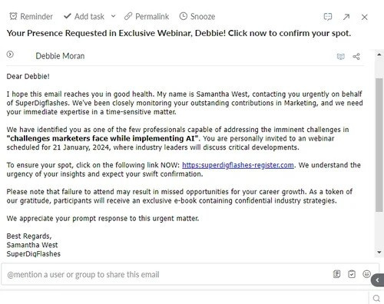
Sample Example of how phishing email may look like
ADVANCED SECURITY

Slide 9








Avoiding Phishing Websites
Check the URL
Verify Security Indicators
Look for HTTPS and verify the website's domain. Phishing websites may have misspelled or slightly altered URLs
Look for security icons like padlocks or trust seals. However, be cautious as these can be spoofed
Phishing websites: where trust is just a facade, and danger lurks behind every link.
Be Wary of Pop-ups
Use Security Software
Avoid clicking on pop-up windows, especially those requesting personal information or login credentials
Install and regularly update antivirus and anti-phishing software to help detect and block malicious websites

Slide 10

Social Engineering Tactics
URGENCY
AUTHORITY
PERSONALIZATION
Attackers create a sense of urgency to prompt immediate action, such as threatening to suspend accounts or claiming a limited-time offer
Attackers impersonate trusted sources like banks, government agencies, or company executives to gain credibility
Attackers gather personal information to customize messages and make them more convincing
FEAR OR GREED
BAITING
WATER-HOLING
Attackers exploit emotions like fear or greed to manipulate victims into disclosing sensitive information or clicking on malicious links
Baiting attacks use a false promise to pique a victim’s greed or curiosity. They lure users into a trap that steals their personal information or inflicts their systems with malware.
This attack uses advanced social engineering techniques to infect a website and its visitors with malware. The infection is usually spread through a website specific to the victims' industry, like a popular website that’s visited regularly.

Slide 11
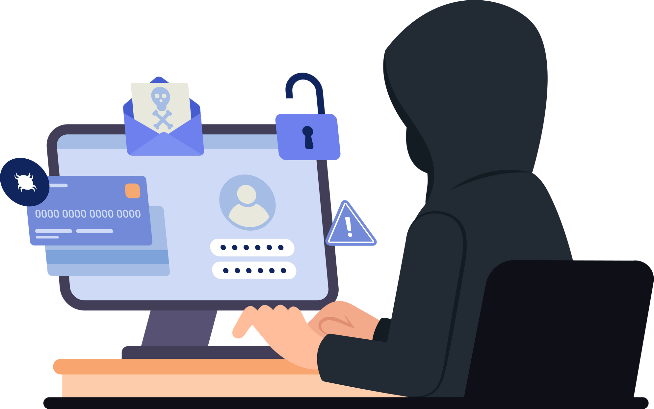

Best Practices for Protection
Stay Informed
Educate yourself and your employees about phishing techniques and how to recognize them
Think Before Clicking
Educate yourself and your employees about phishing techniques and how to recognize them
Keep Software Updated
Regularly update your operating system, web browsers, and security software to patch known vulnerabilities
Verify Requests
If in doubt, contact the sender or organization directly using verified contact information to confirm the authenticity of requests
Enable Multi-Factor Authentication (MFA)
Use MFA whenever possible to add an extra layer of security to your accounts.

Slide 12

Encouraging individuals to report phishing attempts is crucial for enhancing cybersecurity awareness and protecting against potential threats. Here are steps you can take to encourage reporting:
Reporting Phishing Attempts
Promote Awareness
Provide Clear Instructions
Ensure Accessibility
Assure Confidentiality
Offer Incentives
Conduct Regular Training
Foster Responsibility
Monitor and Respond
Continuous Improvement

Slide 13


Conclusion
- Phishing attacks continue to pose a significant threat to individuals and organizations worldwide.
- By staying vigilant, following best practices, and educating others, we can better protect ourselves and our communities from falling prey to phishing scams.
Thank you for watching. Stay safe online!

