Slide 1


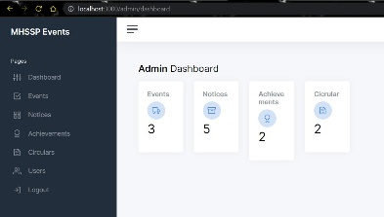
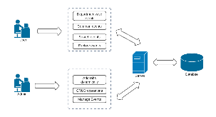
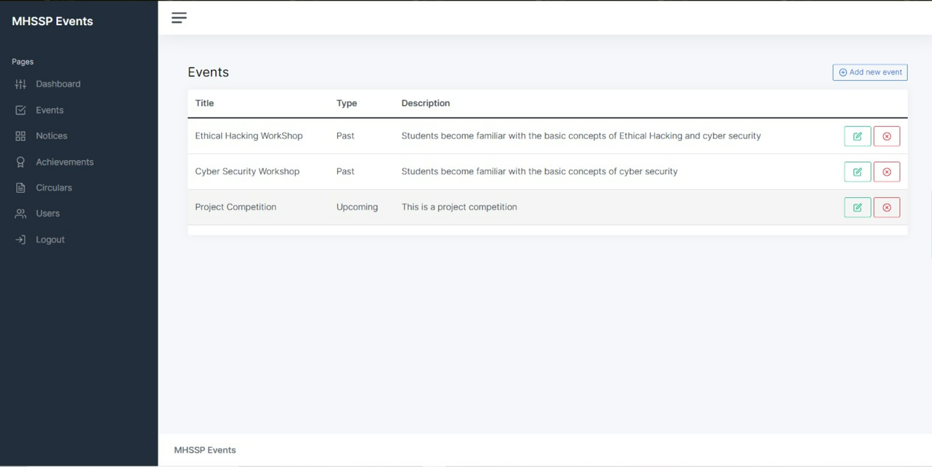
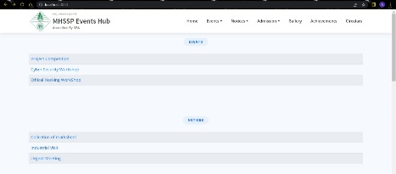
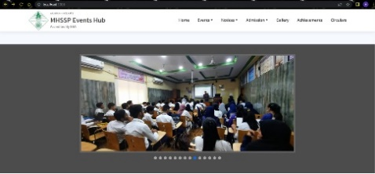
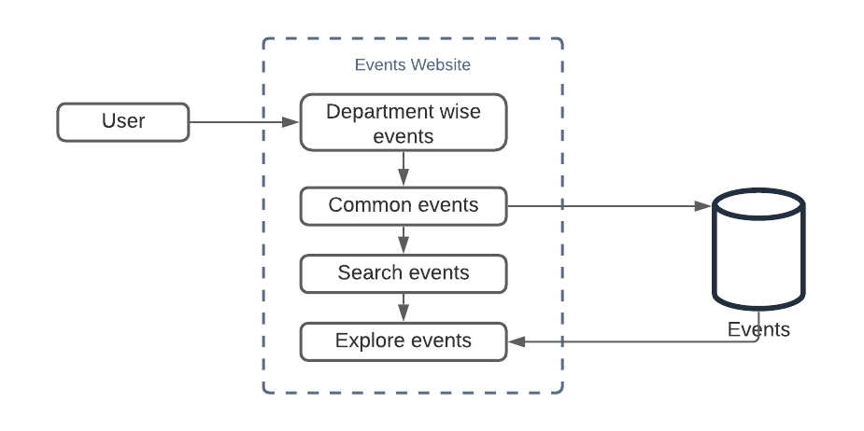
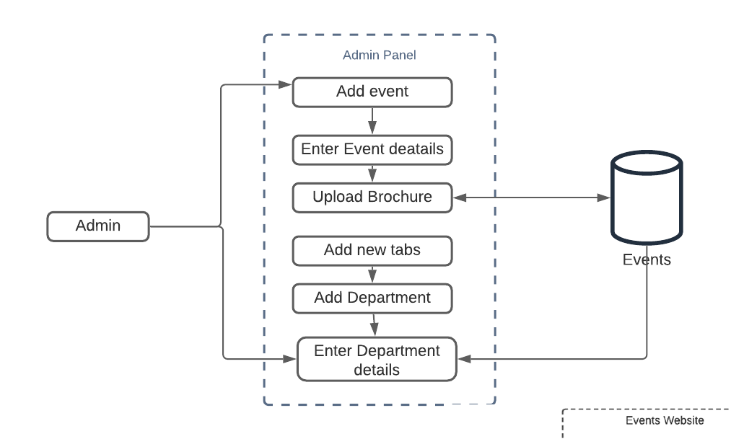
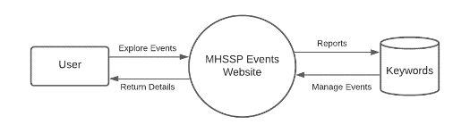



Project Title: MHSSP Events Hub Domain: Web application
STATE LEVEL PROJECT COMPETITION
Abstract:
The existing system uses WordPress Technology to showcase events and notices for M. H. Saboo Siddik Polytechnic, the process followed currently is indeed tedious and time-consuming, the administrator has to redesign the website every time a change is required. There is a major chance of the design getting ruined while applying the changes. Other than that, File Management is difficult and can worsen if not handled properly. Every WordPress Website has issues with response time, the user has to wait to perform actions. Lastly, performing analytical calculations, dashboard, and customize approach is not possible with WordPress. The Website cannot be scaled to a higher version using such technologies and lack the ability to handle huge traffic and can crash at peak time. So, to avoid such troublesome situations the current project is proposed.
The Event Management System has been developed to override the problems prevailing in the practicing manual system. This software is supported to eliminate and, in some case, reduce the hardships faced by this existing system. Moreover, this system is designed for the particular need of the institute to carry out operations in a smooth and effective manner. The application is reduced as much as possible to avoid errors while entering the data. It also provides error message while entering invalid data. No formal knowledge is needed for the user to use this system. Thus, by this all it proves it is user-friendly.
Proposed methodology:
The proposed website an effective replacement of the current website with improvement in overall site appearance. This will give a better outlook of the college to the site visitor. It contains all the information in the structured manner, by that the visitor can access the site easily. There is also an admin login in the website so that the admin can easily add the necessary data to the website without coding but by just using the interface and data that was added by the admin will be efficiently seen on the main website.
Admin Panel:
Introduction:
The Event Management System has been developed to override the problems prevailing in the practicing manual system. This software is supported to eliminate and, in some case, reduce the hardships faced by this existing system. Moreover, this system is designed for the particular need of the institute to carry out operations in a smooth and effective manner. The application is reduced as much as possible to avoid errors while entering the data. It also provides error message while entering invalid data. No formal knowledge is needed for the user to use this system. Thus, by this all it proves it is user-friendly. Event Management System, as described above, can lead to error free, secure, reliable and fast management system. It can assist the user to concentrate on their other activities rather to concentrate on the record keeping. Thus, it will help organization in better utilization of resources. Every organization whether big or small, has challenges to overcome and managing the information of Activity, Event, Attendees, Payment, Conductors. Every Event Management System has different Event needs; therefore, we design exclusive employee management systems that are adapted to your managerial requirements. This is designed to assist in strategic planning, and will help you ensure that your future goals.
Experimental results:
User Panel
Motivation:
We saw many other websites of other colleges dedicated to events. Those websites seemed to be much better than the website created by the students of our college. Being a computer department student, we decided we should re-develop this website for our college. Hence our group came up with an idea that we should develop a website as a replacement for the existing events website. We thought of considering the newest technology and came up with CMS (content management system). CMS is a trending technology. Learning and using this technology in our project will hugely benefit us.
Objectives:
1. To study current events management system and learn from their flaws and bugs.
2. To make the website responsive and dynamic using bootstrap, so that the website is accessible from any device with stable internet connection
3. To allow content management by providing an admin panel, which allows the administrator to manage the website according to their needs.
4. To classify events into categories (Upcoming, Ongoing and Archived) for better management of events
5. To allow students to access events for their choice and participate in it.
5. To provide an environment to promote events.
Background:
The existing system uses WordPress Technology to showcase events and notices for M. H. Saboo Siddik Polytechnic, the process followed currently is indeed tedious and time-consuming, the administrator has to redesign the website every time a change is required. There is a major chance of the design getting ruined while applying the changes. Other than that, File Management is difficult and can worsen if not handled properly. Every WordPress Website has issues with response time, the user has to wait to perform actions. Lastly, performing analytical calculations, dashboard, and customize approach is not possible with WordPress. The Website cannot be scaled to a higher version using such technologies and lack the ability to handle huge traffic and can crash at peak time. So, to avoid such troublesome situations the current project is proposed.
Conclusion:
The Website is developed for M. H. Saboo Siddik Polytechnic is an effort to make it as attractive and dynamic as possible. This working of the project includes several links on first page and several information about the site like about us, staff, completed events, ongoing events, upcoming events, gallery, etc on home page. The proposed website an effective replacement of the current website with improvement In overall site appearance. This will give a better outlook of the company to the site visitor. It contains all the information in the structured manner, by that the visitor can access the site easily
Students Name:
Loladia Ayesha (19416)
Department: Computer College: M.H Saboo Siddik Guide: Ms. Zebunnisa Malik

