Slide 1
SALES PERFORMANCE
& REVENUE INSIGHTS DASHBOARD
An interactive Power BI dashboard for business stakeholders — built to track revenue, profit, and growth across regions, categories, and time.
Task 3 — Dashboard Design | DataX Labs Internship
Prepared by Ayesha Muskan A

Slide 2
Objective
Design an interactive dashboard that helps business stakeholders make faster, better-informed decisions.
1
Track Performance
2
Identify Growth
Monitor revenue, profit, and order volume across regions, categories, and products.
Spot top-performing products, high-value customers, and seasonal revenue patterns.
3
Enable Interactivity
4
Support Forecasting
Let stakeholders filter by region, category, year, month, and quarter on demand.
Use trend analysis and a regression model to anticipate future revenue.
Sales Performance & Revenue Insights Dashboard | DataX Labs — Task 3
2

Slide 3
Tools & Data Pipeline
An end-to-end analytics workflow — from raw data to an interactive stakeholder dashboard.
SQL
Python
Power BI
Data cleaning, transformation & querying (MySQL)
→
Analysis, visualization & ML forecasting
(Pandas, NumPy, Matplotlib, Seaborn, Scikit-learn)
→
Interactive dashboard, KPI cards, slicers & visuals
Dataset: Sales & Financial performance data (Superstore-style), analyzed across region, category, product, customer, and time dimensions.
Sales Performance & Revenue Insights Dashboard | DataX Labs — Task 3
3

Slide 4
Key Performance Indicators
Four headline KPI cards give stakeholders an instant read on business health.
Total Revenue
Total Profit
Total Orders
Avg. Order Value
Overall sales value across all orders
Net profitability after cost of sales
Order volume across the full period
Revenue per order — a growth lever
Interactivity
Region
Category
Year
Month
Quarter
Slicers let stakeholders drill into any region, product line, or time period without leaving the page.
Sales Performance & Revenue Insights Dashboard | DataX Labs — Task 3
4

Slide 5
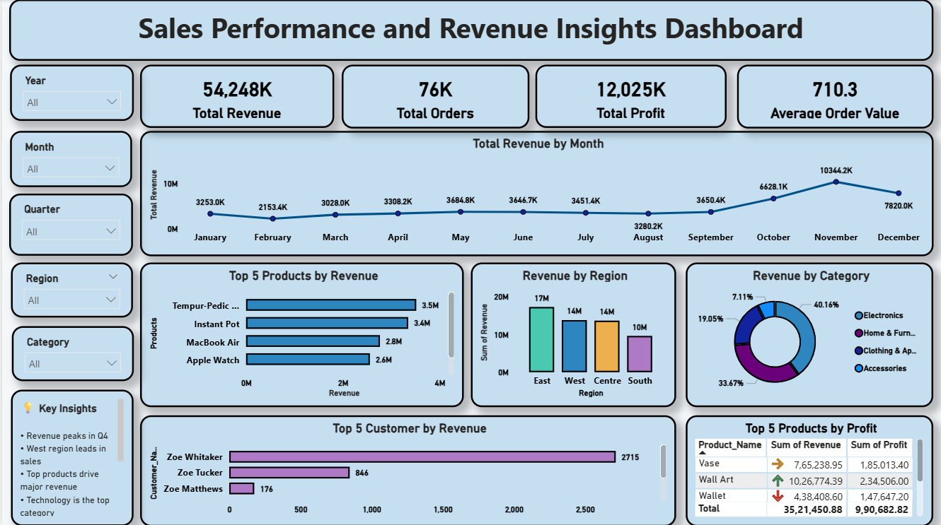
Dashboard Preview
Live view — revenue trend, regional split, top products & customers, all on one page.
Sales Performance & Revenue Insights Dashboard | DataX Labs — Task 3
5

Slide 6
Key Insights
1
Revenue shows strong growth, peaking in Q4 — a clear seasonal pattern.
2
The West region generates the highest revenue of all regions.
3
A small group of products drives a disproportionate share of total sales.
4
The Technology category dominates overall revenue contribution.
5
Customer revenue is skewed — a few key customers generate most sales.
Sales Performance & Revenue Insights Dashboard | DataX Labs — Task 3
6

Slide 7
Business Impact & Forecasting
How this supports decisions
Forecasting model
Improve decision-making with a single source of truth for sales performance
Identify growth opportunities by region, category, and product
Optimize strategy for underperforming segments
Forecast future sales trends to guide planning
Linear Regression model trained on historical revenue
Seasonality captured via sine/cosine transformations
Generates forward-looking monthly revenue forecasts
Roadmap: ARIMA/Prophet models, RFM customer segmentation, and an automated data pipeline
Sales Performance & Revenue Insights Dashboard | DataX Labs — Task 3
7

Slide 8
Thank You
Full project — SQL scripts, Python analysis, and the Power BI dashboard file:
github.com/AyeshaMuskan-a/task3-sales-dashboard/tree/main

