Slide 1
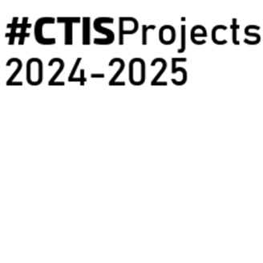
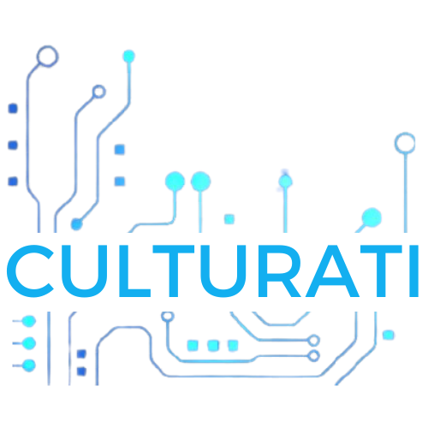
Culturati
Content Management System

Slide 2
The Culturati project focuses on enhancing the visitor experience at cultural heritage sites through personalized content and real-time visitor flow management.
Our team is responsible for developing the Content Management System (CMS), which enables administrators and content creators to manage and update educational content, routes, and interactive games with ease.
The CMS will include functionalities such as user account and role management, content creation, and content categorization.
By empowering admins, Super admins, editors, Data entry operators and creators, the CMS ensures efficient content management and aligns with the overall goals of the Culturati platform.

Slide 3
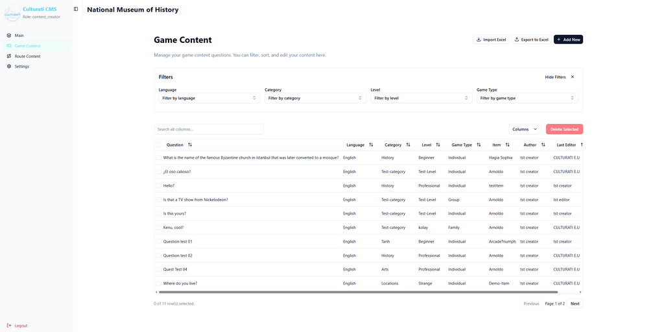
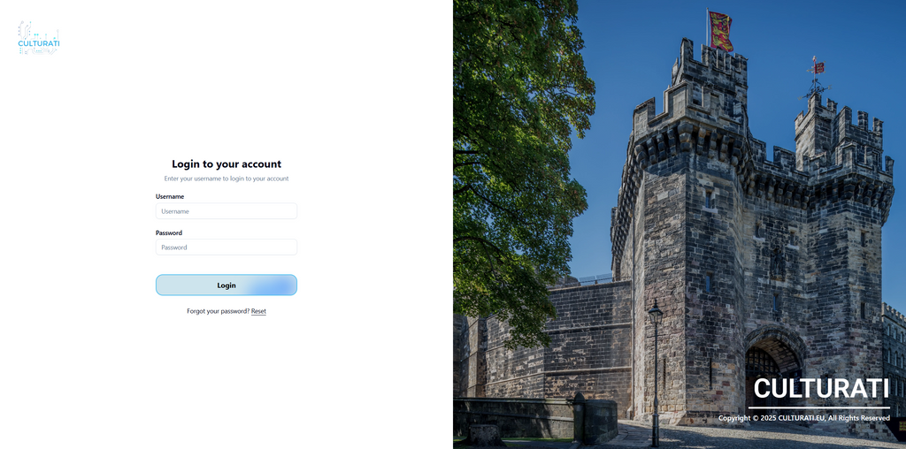


Slide 4
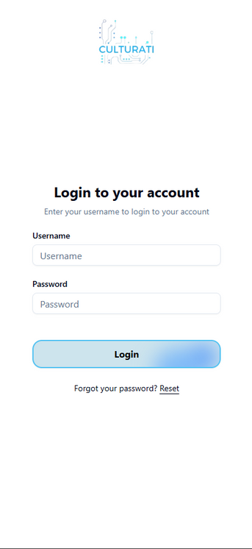
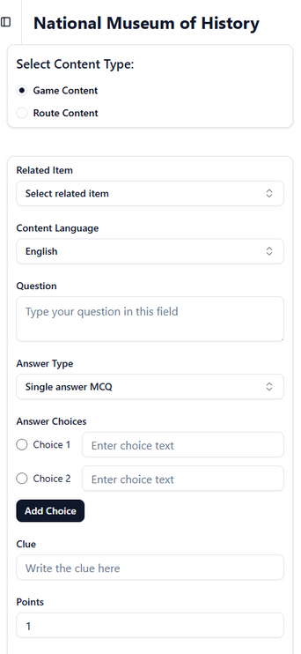

Slide 5
Developers
Ayesha Nizam
Göktuğ Şenkoyun
Talal Salman Zafeer
Tarık Ebubekir Koca
Enes Memigüven
Project Advisor: Neşe Şahin Özçelik

