Slide 1
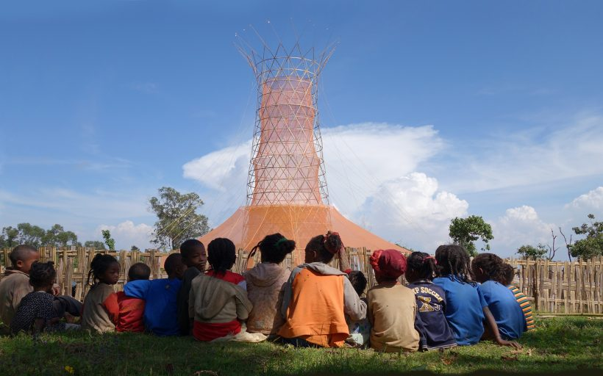
“ WaAir ” A DRINKABLE WATER FROM AIR

Slide 2
Problem
WaAir
Poverty
Diseases
Migration
Lack of Drinking Water

Slide 3
Water Scarcity on the Globe
Alternative Sources
Industrialization
Harvested rain water
Urbanization
Harvested storm water
Pollution
Water Scarcity
Harvested waste water
Cutting of Trees
Less rain fall
Global Warming
Greywater
Another source is to save water
Climate Change

Slide 4
WaAir
WaAir is an alternative water source to rural population that faces challenges in accessing drinkable water.
It's a vertical structure that collects water from the atmosphere and stores it for later use (it collects rain, harvests fog and dew).
Our goal is to deliver 100 litres of drinking water per day to women and children, freeing up time for care, education, and other socially constructive activities.

Slide 5
WaAir :
It gathers rainwater, as well as fog and dew.
It provides a social space for the community, where people can gather beneath the shade of its canopy for education and public gatherings, in addition to providing water.
It can also be outfitted with solar panels that give energy to the community, allowing them to charge their electronics and have a lit gathering area at night.
We have connected it with the IBM cloud to get reading of Humidity, Temperature and other air qualities.

Slide 6
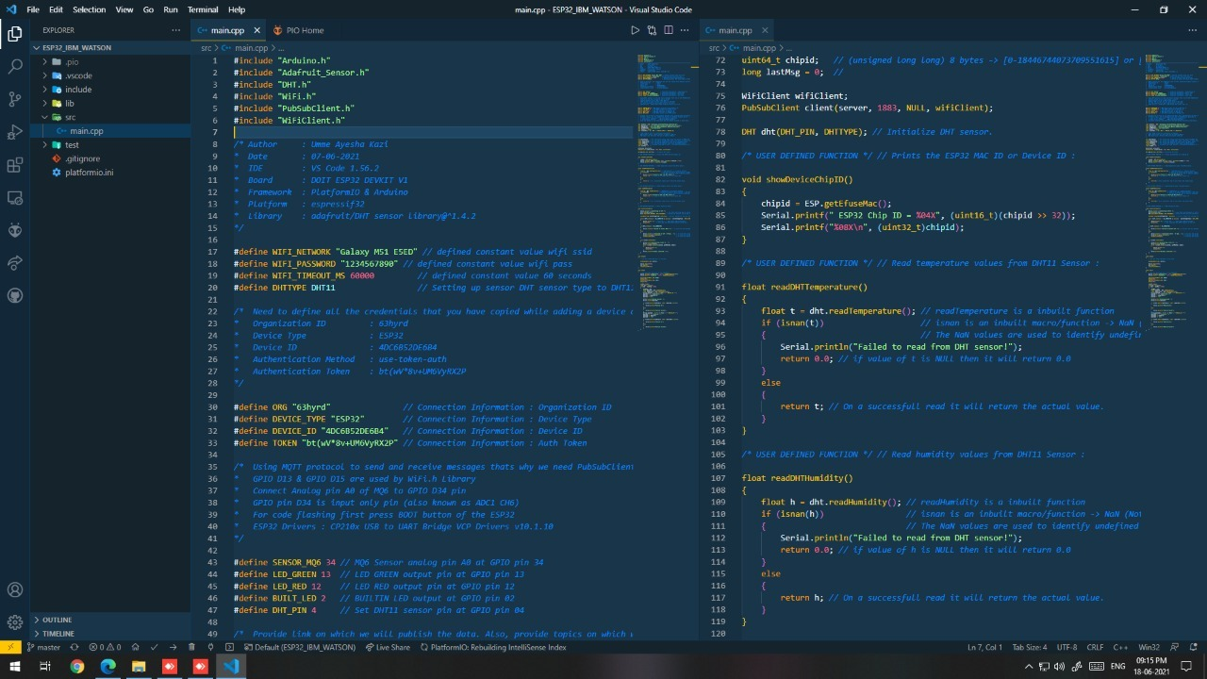
Methodology:
The inside of the tower is made up of a bamboo frame that supports a mesh polyester material. Rain, fog, and dew condensate on the mesh and run down a funnel into a reservoir at the structure's base. To keep the collected water from evaporating, the lower sections of the tower are shaded by a fabric canopy.
We use following IBM services for connecting WaAir to IBM cloud to monitor and analyse the data.
Cloud Provider : IBM Cloud
Cloud Type: PaaS
Cloud Service : IBM Blumix+Watson
Subscription : 30days trial
Service Limit : 250MB up/down
Fig. 1 connectivity with IBM cloud

Slide 7
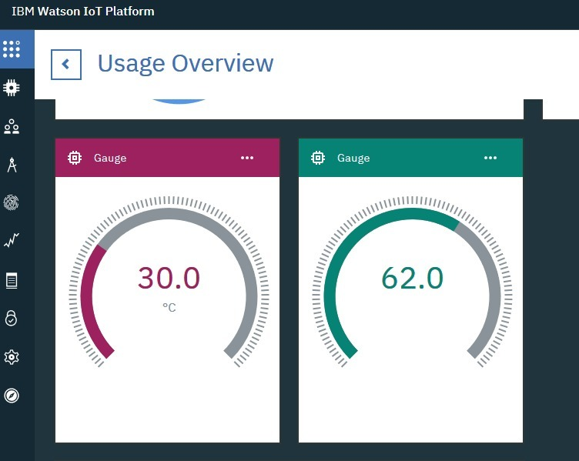
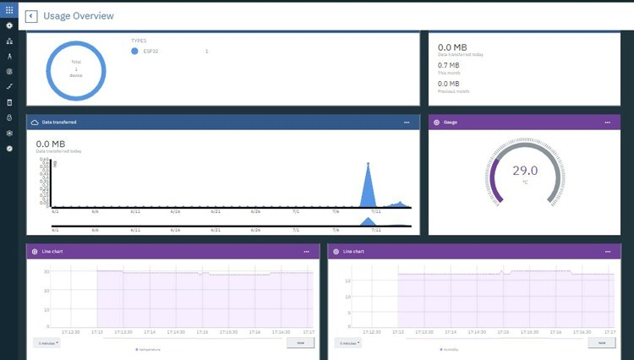
We are reading the temperature value in the unit of Celsius format from a range 0 to 100 on Guage meter and humidity value in the unit of percentage format from a range 0 to 100 on Guage meter
Fig. 2 Temperature and Humidity results of WaAir on IBM cloud
Fig. 3 Details temperature reading results of WaAir on IBM cloud

Slide 8
ADVANTAGES
WaAir is intended to offer safe drinking water while also ensuring long-term environmental, financial, and social sustainability.
These structures collect water generated by moisture in drastic temperature changes, making up for the lack of rainfall.
Due to lightweight and self-constructible structures allow for increased water gathering capability and also serve as a landscape landmark, which multiplicands in the area generate infrastructure needed in many places.
Allow to continuously monitor temperature, humidity and other air qualities from IBM cloud services

Slide 9
Testing
We created pilot model that supports a mesh polyester material inside
Rain, fog, or dew condenses on the mesh's cool surface, generating droplets of liquid water that trickle down into a reservoir at the structure's bottom.
We also tested IBM cloud connectivity which shows humidity level in the air and current temperature.
We collect and store this data on IBM cloud to perform analysis of suitable conditions for WaAir.
On the basis of analysis we shall decide most suitable places for WaAir.

Slide 10
THANK YOU!

