Slide 1
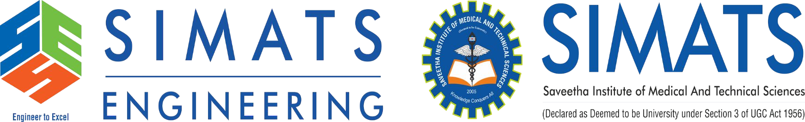
The Role of Artificial Intelligence and Machine Learning in Cloud Platforms
Presented By:
Ayesha Siddiqa S (192324305)
CSA1511-CLOUD COMPUTING AND BIG DATA ANALYTICS FOR ENGINEERS
DATE:- 17/07/26

Slide 2
INTRODUCTION
What is Cloud Computing?
Cloud computing is the delivery of computing services—like servers, storage, databases, networking, software, and analytics—over the internet (“the cloud”) instead of using your own local computer or physical servers.
What is AI?
AI enables machines to mimic human intelligence
What is ML?
ML allows systems to learn from data
What is AI/ML in Cloud?
Artificial Intelligence (AI) enables machines to simulate human intelligence.
Machine Learning (ML) allows systems to learn from data and improve performance.
Cloud platforms provide on-demand access to AI/ML tools and infrastructure.

Slide 3
CORE TECHNICAL PRESENTATION
Integration of AI/ML and Cloud
AI/ML requires large datasets and high computing power
Cloud provides:
Storage
Processing power (GPU/TPU)
Scalability
Real-time access
Working Process:
Data → Cloud Storage → Model Training → Deployment → Prediction

Slide 4
AI/ML Cloud Architecture
Components of AI/ML Cloud Architecture
Data Sources (IoT, Apps, Databases)
Data Storage (Cloud Storage, Data Lakes)
Data Processing (ETL, Preprocessing)
Model Training (ML frameworks)
Model Deployment (API endpoints)
Monitoring & Logging

Slide 5
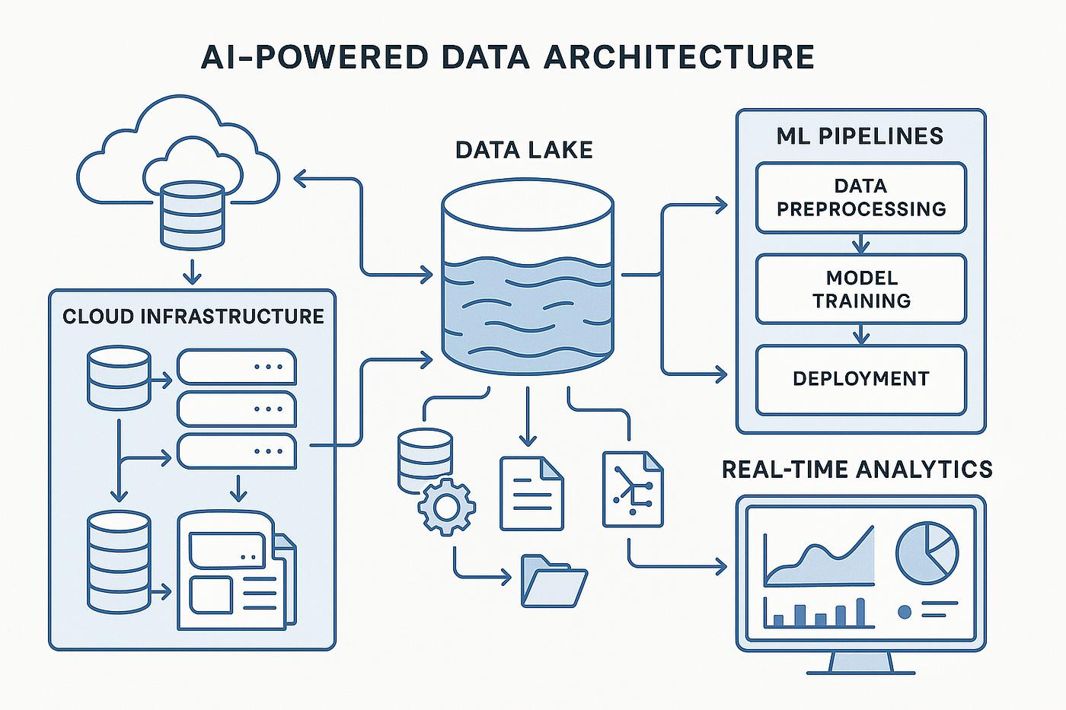

Slide 6
Components of Architecture
Data Sources
Apps, sensors, databases
Cloud Storage
Stores large datasets
Processing Layer
Data cleaning & transformation
ML Model Training
Algorithms learn patterns
Deployment Layer
APIs for predictions
Application Layer
User interface/dashboard

Slide 7
Benefits of AI/ML CLOUD
Scalability → handles large data
Cost Efficiency → pay-as-you-use
Faster Processing
Automation
Real-time insights

Slide 8
Real-World Applications
Healthcare → disease prediction
Finance → fraud detection
E-commerce → recommendation systems
Transportation → traffic prediction
Social media → content filtering

Slide 9
Example Use Case
AI-Based Patent Classification System
Input: Patent documents
Process: NLP + ML model
Output: CPC classification
Cloud Role:
Stores patent data
Trains model
Provides API for prediction

Slide 10
Conclusion & Key Takeaways
Conclusion:
AI/ML + Cloud enables intelligent systems
Supports automation and decision-making
Key Takeaways:
✔ Cloud provides scalability ✔ AI improves intelligence ✔ Used across industries ✔ Future technology depends on this integration

Slide 11
Limitations and Future Scope
Limitations:
Data privacy issues
High cost for large models
Bias in AI models
Internet dependency
Future Scope:
AutoML growth
Edge AI integration
Better security
Real-time AI systems

