Slide 1

WELCOME

Slide 2
Smart Voting System
Presented By:
Ayesha Zahid 03-134251-014
Adeeba Ali 03-134251-007
Instructor:
Mam Mehreen Tariq

Slide 3
Smart Voting System
OBJECTIVE:
To create a digital platform for polls, surveys, and group decision-making.
To ensure fast, error-free, and user-friendly voting experience for all users.
WHY WE CHOOSE THIS TOPIC:
Voting is widely used in schools, colleges, events, and daily decision-making
— not just elections.
This project enhances my problem-solving and programming skills.
It promotes fairness and transparency in decision-making through technology.

Slide 4
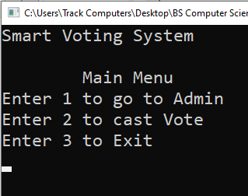
Smart Voting System
First display main menu
Take input from user to select an option:
Admin
Vote
Exit
If user enter 1 Display admin menu
If user enter 2 Display a list of entities to vote
If user enter 3 Exit application

Slide 5
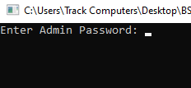
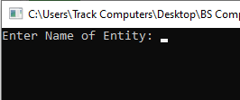
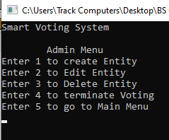
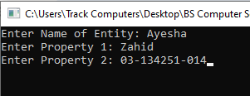
Smart Voting System
For admin menu a password is required
If a wrong password enter display an error message
In case of correct password display admin menu
Take input again from user to select:
Create entity
Edit entity
Delete entity
Terminate voting
Go to main menu

Slide 6
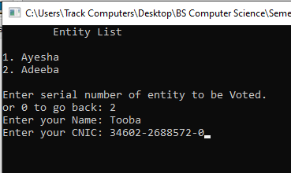
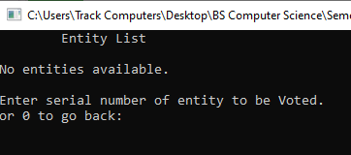
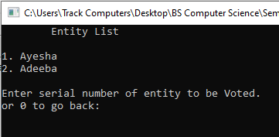
Smart Voting System
For vote first display a list of candidates
Select serial no. to vote
Take Name and CNIC as input
Now selected candidate voted

Slide 7

THANK YOU

