Slide 1
Lost and found portal
This is a full-featured web application built for an educational institution (college/university). It provides a centralized, digital platform for students to report and find lost or found items replacing informal, paper-based processes.
Scale: 3,445 lines of Python (Flask), 30+ HTML templates, advanced AI integration, multilingual support, and a full admin control center.

Slide 2
Tech Stack
layer | technology
Backend | Python 3.10, Flask 2.3.3
ORM/database | Flask-SQLAlchemy, SQLite (dev) / PostgreSQL (prod)
authentication | Flask-Login, Passlib (Argon2 + PBKDF2 hashing)
Forms and validation | Flask-WTF, WTForms
AI — Object Detection | YOLOv8 (Ultralytics), Faster-RCNN (torchvision)
AI — Image-Text Match | OpenAI CLIP (via HuggingFace Transformers)
AI — OCR | EasyOCR (Optical Character Recognition)
Frontend | Jinja2 HTML Templates, Bootstrap/Custom CSS, JS
PDF/CSV Export | ReportLab, Pandas
Multilanguage | Flask-Babel (English, Hindi, Gujarati)
Production Server | Gunicorn + Nginx (deployment-ready)

Slide 3
Role | access
Student | Register, Login, Report Lost/Found, View Items, Chat, Profile
Admin/HOD | All student access + soft-delete items, admin dashboard, analytics, user management
Core Features (Detailed)
1. Authentication & Security
Registration with unique Registration Number (student ID), full name, optional email/phone
Argon2 password hashing (industry-standard, GDPR-compliant)
Role-based access control (RBAC) — students, admins, HODs
Session management via Flask-Login
Auth logging — every login/logout tracked in
AuthLog table with IP address and timestamp
Input validation (client-side + server-side) — prevents SQL injection, XSS
Secure file uploads — extension whitelist (png/jpg/jpeg/gif), filename sanitization, 2MB limit

Slide 4
Item reporting
Report Lost Item
Fields: Item Name, Description, Date Lost, Location Lost
Auto-links to the logged-in student's account
Timestamp auto-captured
On submission → smart match search runs automatically (finds potential found-item matches)
Report Found Item
Fields: Item Name, Description, Date Found, Location Found, Image Upload
AI-powered image verification runs before submission (see AI section)
If the reported item name matches a PROTECTED keyword (phone, laptop, wallet, etc.), extra verification is required
Image preview shown in browser before upload

Slide 5
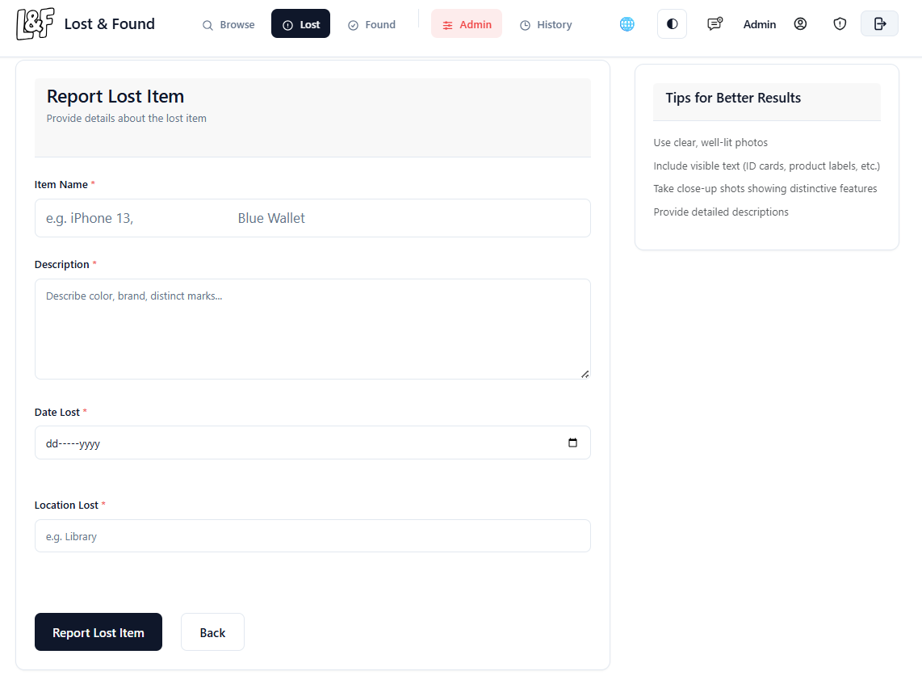

Slide 6
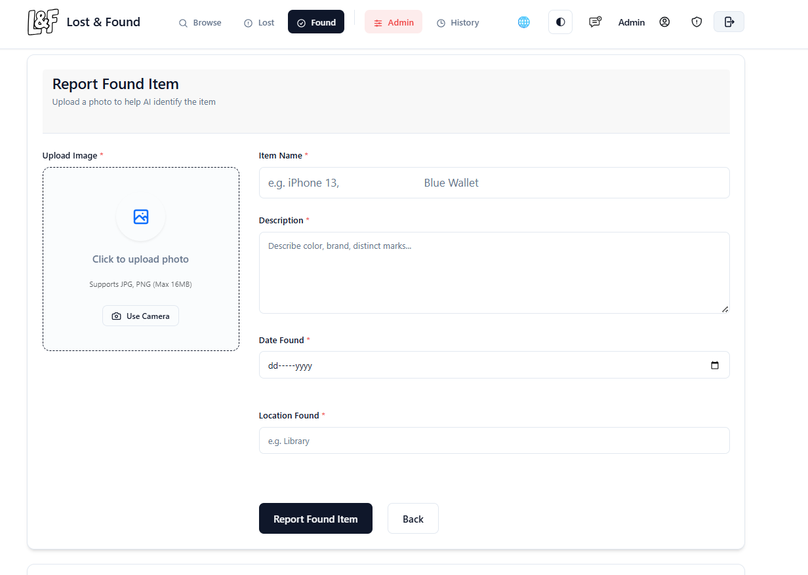

Slide 7
AI Features (The Standout Innovation)
A. CLIP — Zero-Shot Image-Text Matching (OpenAI)
Compares the uploaded image against the claimed item name using semantic similarity
Example: User says "Samsung Phone" → CLIP checks if the image visually matches a phone
Threshold: 0.22 confidence score minimum (configurable)
Returns: match result, best matching label, and confidence score
B. EasyOCR — Text Extraction from Images
Reads text visible in photos (brand names, college ID text, book titles, etc.)
Used to auto-suggest item names from ID cards, books, phone screens
Supports English (extensible to Hindi, Marathi, Tamil, etc.)

Slide 8
C. YOLOv8 — Real-Time Object Detection
Uses the YOLOv8n model (pretrained, 80 COCO categories)
Detects objects in the uploaded image with bounding boxes
Confidence threshold: 0.3 (relaxed for small/cropped photos)
Filters out person class to reduce false positives
D. Cross-Verification Engine (cross_verify_item)
Combines all three AI signals (OCR + YOLO + CLIP) into a single confidence score
Only items failing all three checks are rejected
Lenient mode for general items, strict mode for high-value/protected items
Prints detailed debug output for diagnostics

Slide 9
E. AI Smart Matching (find_smart_matches)
When a Lost item is reported, it searches all Found items for likely matches
Scoring is based on: name similarity, description keywords, location, date proximity
Sends automatic notifications to the reporter if a match is found
F. Live Image Analysis API (/api/analyze_image)
Runs YOLO → then CLIP → returns best detected object label and confidence
Used on the report form for real-time feedback before form submission
Auto-fills the item name field based on what AI detects in the photo

Slide 10
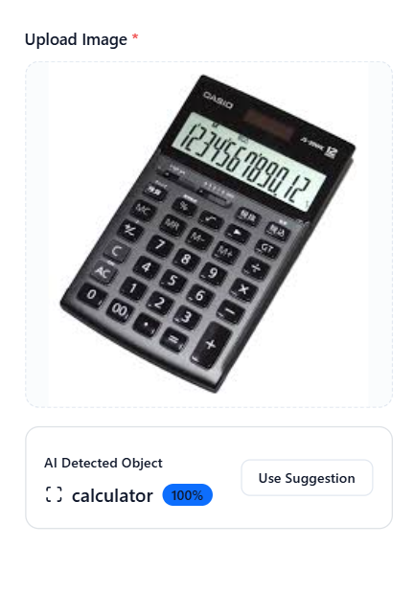

Slide 11
Admin dashboard & Analytics
Admin Dashboard (/admin)
Full user management table — view all registered users, their roles, activity
Change user roles (student ↔ admin ↔ HOD)
View all items (active + deleted)
Soft-delete items with confirmation — item is archived (not permanently deleted)
View detailed info about any user: items reported, messages, activity history
Analytics Dashboard (/analytics)
Daily analytics auto-generated: items reported per day (lost vs found)
Charts: items over time, popular locations, popular item types, peak hours
30-day summary view
Accessible to Admin/HOD only

Slide 12
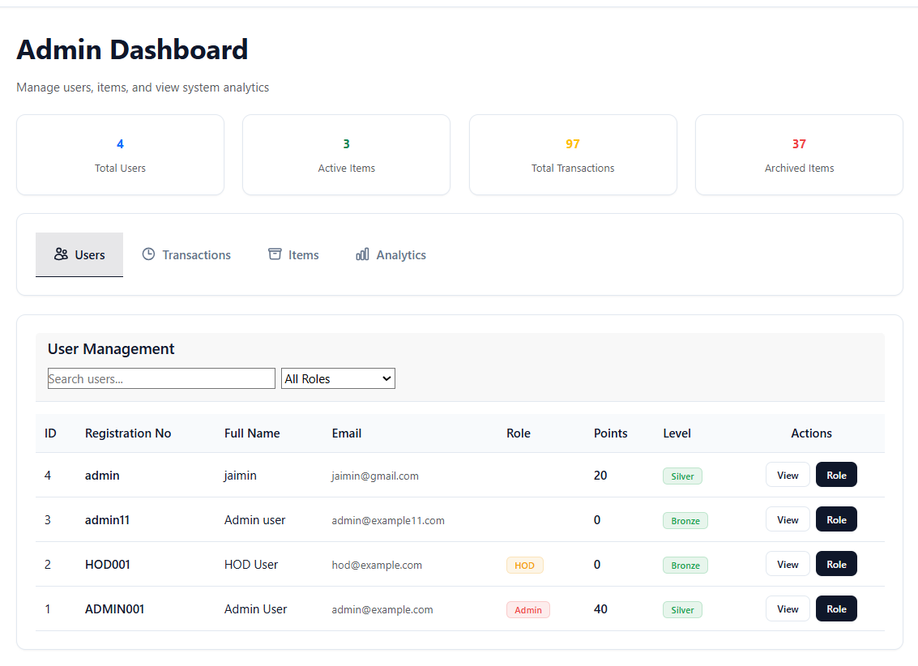

Slide 13
Secure Chat / Message System
Per-item chat thread — users can message each other about a specific item
Messages stored in
Message model with sender ID, item ID, and timestamp
Form-based (no WebSockets needed), rendered on Item Detail page
Real-time notifications when a message is received

Slide 14
Notification System
Notification model stores user-specific alerts
Notification types:
info, success, warning,
error
Optional link to redirect the user to the relevant item/page
Notification bell in the navbar (base.html) with live unread count polling
/notifications page lists all alerts; /api/notifications/unread_count for AJAX polling

Slide 15
User Profile & Gamification
Profile page — view/edit personal info, upload profile photo
Privacy settings — GDPR-compliant data masking for email/phone
GDPR data export — user can download all their data as JSON (/export_my_data)
Levels & XP system — users earn points for reporting items; levels updated on each action
Leaderboard — top contributors ranked by XP

Slide 16
Multilingual Support
Flask-Babel integration with ”gettext and lazy_gettext ”
Supported languages: English, Hindi (हिंदी),
Gujarati (ગુજરાતી)
Language auto-detected from browser Accept-Language header
Users can manually switch language; preference saved in session and user profile
/set_language/<lang> route for language switching

Slide 17
Database Design (Models)
model | purpose
Item | Core item record — name, description, status, location, image, timestamps, blockchain hash, AI verification score
User | Student/admin accounts — registration no, password hash, role, XP, level, preferred language, privacy settings
ReportLog | Audit trail — who reported/deleted what and when
AuthLog | Auth audit — login/logout events with IP addresses
Message | Per-item chat messages
Notification | User alerts and notifications
Analytics | Daily aggregated analytics snapshots

Slide 18
Non-Functional Features
features | Detail
Performance | SQLite WAL mode, foreign keys ON, lazy-loaded AI models
Reliability | Graceful error handling, 500/403 error pages, rollback on DB errors
Scalability | Designed for 5000+ students, 10,000+ items
Portability | Runs on Windows/Linux/macOS; SQLite → PostgreSQL migration-ready
Maintainability | 3445-line app.py with full docstrings, modular functions, config separation

Slide 19
Thank you

