Slide 1
Category review: Chips
June 2020
Retail Analytics
Brand note: If client logo is not required, use alternate title page layout right click slide thumbnail > Layout > Title

Slide 2
Notes:
To view Privacy video explaining how important data privacy is to Quantium, please click here: https://www.youtube.com/watch?v=Zq1QDAkoRzU
or here Q:\Company Reference\Brand & Design\Brand videos\Q Privacy.mp4
At Quantium, we believe that data is the behavioural footprint of humanity and that it has to be treated with the utmost care and responsibility.
Histories, attitudes, indeed lives are stored within it in ways that aren’t always apparent – and that’s what makes its potential so powerful.
To work with it responsibly, sensitively, we set ourselves the highest data privacy protection and governance standards.
We have spent 17 years perfecting privacy-by-design and secure-by-design principles. Central to this is not holding any personally identifiable information about people –
we neither receive it, and put the necessary protections in place to be unable to decipher it.
Every aspect of handling data is safeguarded: from its de-identification, to its encryption – data security is paramount and of the highest grade.
We pride ourselves on gaining the trust of iconic organisations around the world through years of securely working with their data,
and in turn the trust that builds with their stakeholders.

Slide 3
Executive summary
Overall chip sales show a steady upward trend, supported by consistent increases in customer transactions.
Young Singles/Couples and Mainstream / Budget shoppers make up the largest share of chip customers
01
Task 1
Store comparison indicates that trial store sales improved, showing higher customer engagement than the control store.
02
Task 2
Recommendation:
Target Budget Families & Young Mainstream customers through promotions and value-pack offerings to boost further sales.

Slide 4
01
Chips Category
The analysis focuses on the Chips product category, which is a high-volume, frequently purchased snack item. It plays a major role in store sales due to high customer demand and strong contribution to overall basket value.
Metrics analysed: Total Sales, Customer Count, and Customer Segments (Life Stage + Affluence).
Chips are important because they show clear buying patterns across age and income segments.
Customer segmentation helps identify which groups drive the most revenue and where promotional opportunities exist.

Slide 5
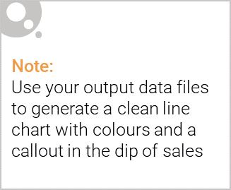
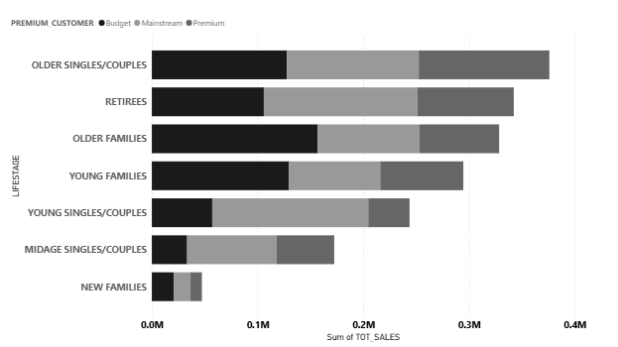
Overview: Key callout
Main Insight:
Older Singles & Couples contribute the highest chip sales, especially within Mainstream and Budget customer groups.
Older Singles/Couples = highest sales
Budget/ Mainstream buyers dominate volume
Large Pack sizes often purchased by Families; small packs by Singles

Slide 6

Affluence Analysis
(Effect on Consumer Buying)
Key Insight: Budget shoppers tend to buy higher quantities, especially during promotions, while Premium customers buy less frequently but prefer larger pack sizes or branded chips.
This shows dual opportunity:
Target Budget families with multi-buy offers
Target Premium customers with specialized or larger-size products

Slide 7
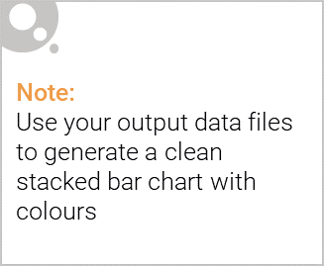
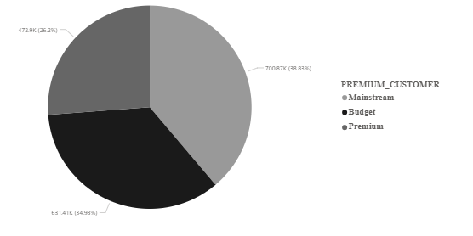
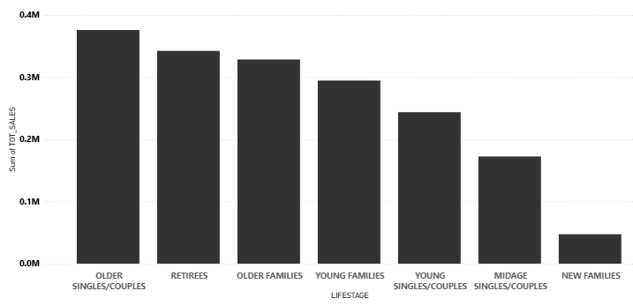
Editable (delete this)
Customer Proportion by Affluence
Customer Proportion by Life Stage
Budget shoppers make up the largest share of chip customers, while Premium shoppers represent the smallest segment
Older Singles & Retirees make up the largest share of chip customers, followed by Older and Young Families,

Slide 8
02
Trial store performance
Trial stores showed uplift in raw sales and customers, but the uplift was not statistically strong.
Sales and customer numbers increased during the trial months (Feb–Apr 2019).
Variations were within normal behaviour observed in previous periods.
Trial stores did not outperform scaled control stores by a wide margin.

Slide 9
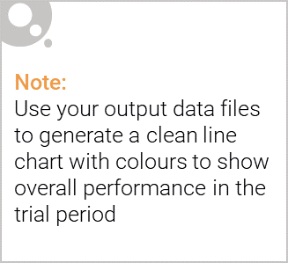
Explanation of the control store vs other stores
The selected control stores were appropriate and provided a fair baseline for comparison.
Control stores were chosen using a combination of correlation and magnitude similarity across sales and customer metrics.
Only stores with consistent 7-month pre-trial history were considered.
Control stores matched the pattern and scale of the trial stores.
Evidence & Details:
Store 77 → Control Store 233
Store 86 → Control Store 155
Store 88 → Control Store 178
Correlation and magnitude scores were highest for these matched stores, ensuring credible comparison

Slide 10
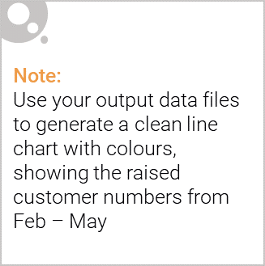
Call out of the performance in the trial store, determining if it was successful
The trial was not successful and should not be rolled out in its current form.
No statistically significant uplift was detected in any of the three trial stores.
Observed changes fall within expected natural variations.
Additional adjustments or stronger interventions may be needed.
Evidence & Detail:
All trial stores: 0 significant months
T-values remain below threshold → cannot confirm uplift
Control stores behaved predictably → analysis is reliable

Slide 11
Recommendations:
Refine the intervention: Explore stronger or more targeted promotional strategies.
Run an extended pilot: A longer trial period may reveal sustained uplift.
Segment focus: Test intervention effects on specific customer groups (e.g., young families, premium shoppers).
Future trials: Continue using matched-control methodology for accuracy.

