Slide 1




Mental stress detection in social media comments by
Applying Machine learning.

Slide 2
Submitted to:
Mr. Farzad Ahmed
Lecturer
Department of CSE
Aust
Mr. Sajib Kumar Saha Joy
Lecturer
Department of CSE
Aust
Submitted by:
Jesmsin Akter 180104052
Aysha Shiddika 180104054
MD Shafique 180104059

Slide 3
Introduction
Expressed opinion in a document whether it’s positive or negation according to the level of the document or feature aspect.
Emotion recognition helps people who have been suffering from physical or mental illness for a long time .
It is used to describe a highly complex state that is associated with a wide range of mental, physiological, and physical events.

Slide 4
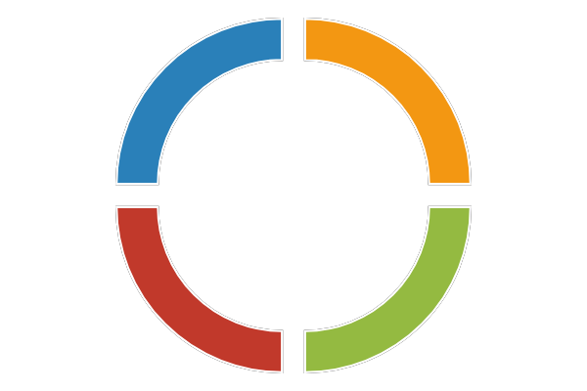



Objectives
Reliably detect positive and negative emotions from the texts.
Analyze tweets on Twitter and comments or posts on Facebook.
Generating ML model to classify the sentiment or emotions.
From the collected dataset, explore the texts.

Slide 5

Motivation
Sentiment analysis is the process of computationally identifying and categorizing opinions expressed in a piece of text, especially in order to determine whether the writer's attitude towards a particular topic, product, etc. is positive or negative. To recognize emotions, facial
Detecting the texts which are expressed as stressful texts on social media which can be helpful to social media users to understand their mental situation.
Analyzing mental health is an important part of this modern civilization as mental health contains great value in day to day social life.

Slide 6
Related Works
Serial no. | Paper Tittle | Author | Getting Idea
1. | A review on sentiment analysis and emotion detection from text, Social Network Analysis and Mining | P. Nandwani and R. Verma | The lexicon-based technique works well for sentiment and emotion analysis. The lexicon-based approach and machine learning approach were both evolving and producing better results in a specific way.
2. | Speech emotion recognition based on feature selection and extreme learning machine decision tree. | Zhen Tao Liu, Min Wu, Wei-Hua Cao, Jun-Wei Mao, Jian-Ping Xu & Guan-Zheng Tan. | An emotion recognition method based on an extreme learning machine (ELM) decision tree is proposed based on the confusion degree among different basic emotions to improve the recognition performance of the feature subset after proposal feature selection. Their proposal achieved an average recognition rate of 89.6% .
3. | Predicting anxiety, depression and stress in modern life using machine learning algorithms | A. Priya, S. Garg, and N. P. Tigga | A basic survey evaluating the common signs of stress, sadness, and anxiety was used to gather the data (DASS-21). The best-model selection was made on the basis of the f1 score, which is used for cases of imbalanced partitioning.

Slide 7
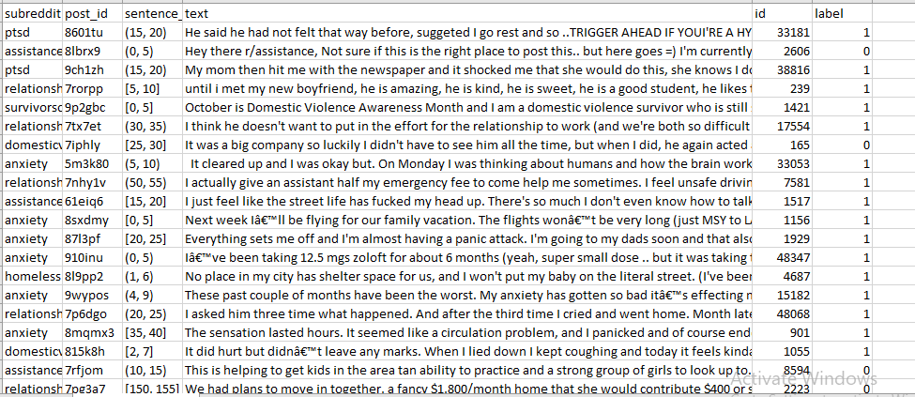
Sample Labeled Data set

Slide 8

Types Of Labeled Classes
1
Stress
CLASSES
2
Not Stress
3
6

Slide 9
Work Flow
Logistic
Regression
Support Vector Machine
Random
Forest
Sample Text
Pre-Processing
Feature Extraction
Gradient Boosting Classifier
Extreme
Gradient Boosting Classifier
AdaBoost Classifier

Slide 10

Methodology
Pre-Processing
Removing , @, URL
Lower Case
Remove Punctuations
Remove Stop words
Removing emoji
Lemmatization
Stemming

Slide 11
Methodology
Feature Extraction
TF-IDF
Bag of Words

Slide 12
Methodology
Machine Learning Models
Random Forest
Support Vector Machine
Logistic Regression
Boosting Models
Ada Boost
XG Boost
Gradient Boost
Learning Model
27

Slide 13

Evaluation Matrices
F1 Score
Precision
Accuracy
Recall

Slide 14
Result
Model | Accuracy | Precession | Recall | F1-Score
TF-IDF + LR | 76% | 76% | 76% | 76%
BOW + LR | 75% | 75% | 74% | 75%
TF-IDF + LinearSVC | 74% | 74% | 74% | 76%
BOW + LinearSVC | 75% | 75% | 78% | 77%
TF-IDF + RF | 72% | 75% | 84% | 72%
BOW + RF | 73% | 74% | 73% | 73%
TF-IDF + GBC | 73% | 73% | 73% | 75%
BOW + GBC | 72% | 75% | 74% | 74%
TF-IDF + XGBC | 73% | 73% | 73% | 75%
BOW + XGBC | 75% | 74% | 74% | 74%
TF-IDF + AdaBoostC | 67% | 69% | 67% | 67%
BOW + AdaBoostC | 67% | 67% | 67% | 70%

Slide 15
Future Works
Increment Our Dataset
1
Apply Deep learning models to compare with Machine learning models.
2
Different social media English or Bangla text or text from different blogs can be used to observe how the models will work on these.
3
4
Apply these models to classify multi-class.
4

Slide 16
Conclusion
People can experience their mental health issues time to time.
1
2
Focusing on presenting an approach to detect emotions based on Natural Language Processing..
3
Compare between the performance gained through popular machine learning and ensemble learning.
4

Slide 17
References
Ali H, Hariharan M, Yaacob S, Adom AH. “Facial emotion recognition using empirical mode decomposition. Expert Systems with Applications.” 2015;42(3):1261-1277
1
Nandwani, P., Verma, R.”A review on sentiment analysis and emotion detection from text”, 2021,Social Network Analysis and Mining 11(1),81
2
J.Camacho-Collados and M.T. Pilehvar, ”On the role of text preprocessing in neural network architectures: An evaluation study on text categorization and sentiment analysis.” arXiv preprint arXiv:1707.01780,2017.
3
4
Liu ZT, Wu M, Cao WH, Mao JW, Xu JP, Tan GZ. “Speech emotion recognition based on feature selection and extreme learning machine decision tree.” Neurocomputing. 2018;273:271-280”
4

Slide 18
Thank you

