Slide 1
Heart disease prediction
USING MACHINE LEARNING
PROJECT BY:
Ayesha Raza
Naviotech solutions Pvt.Ltd.

Slide 2
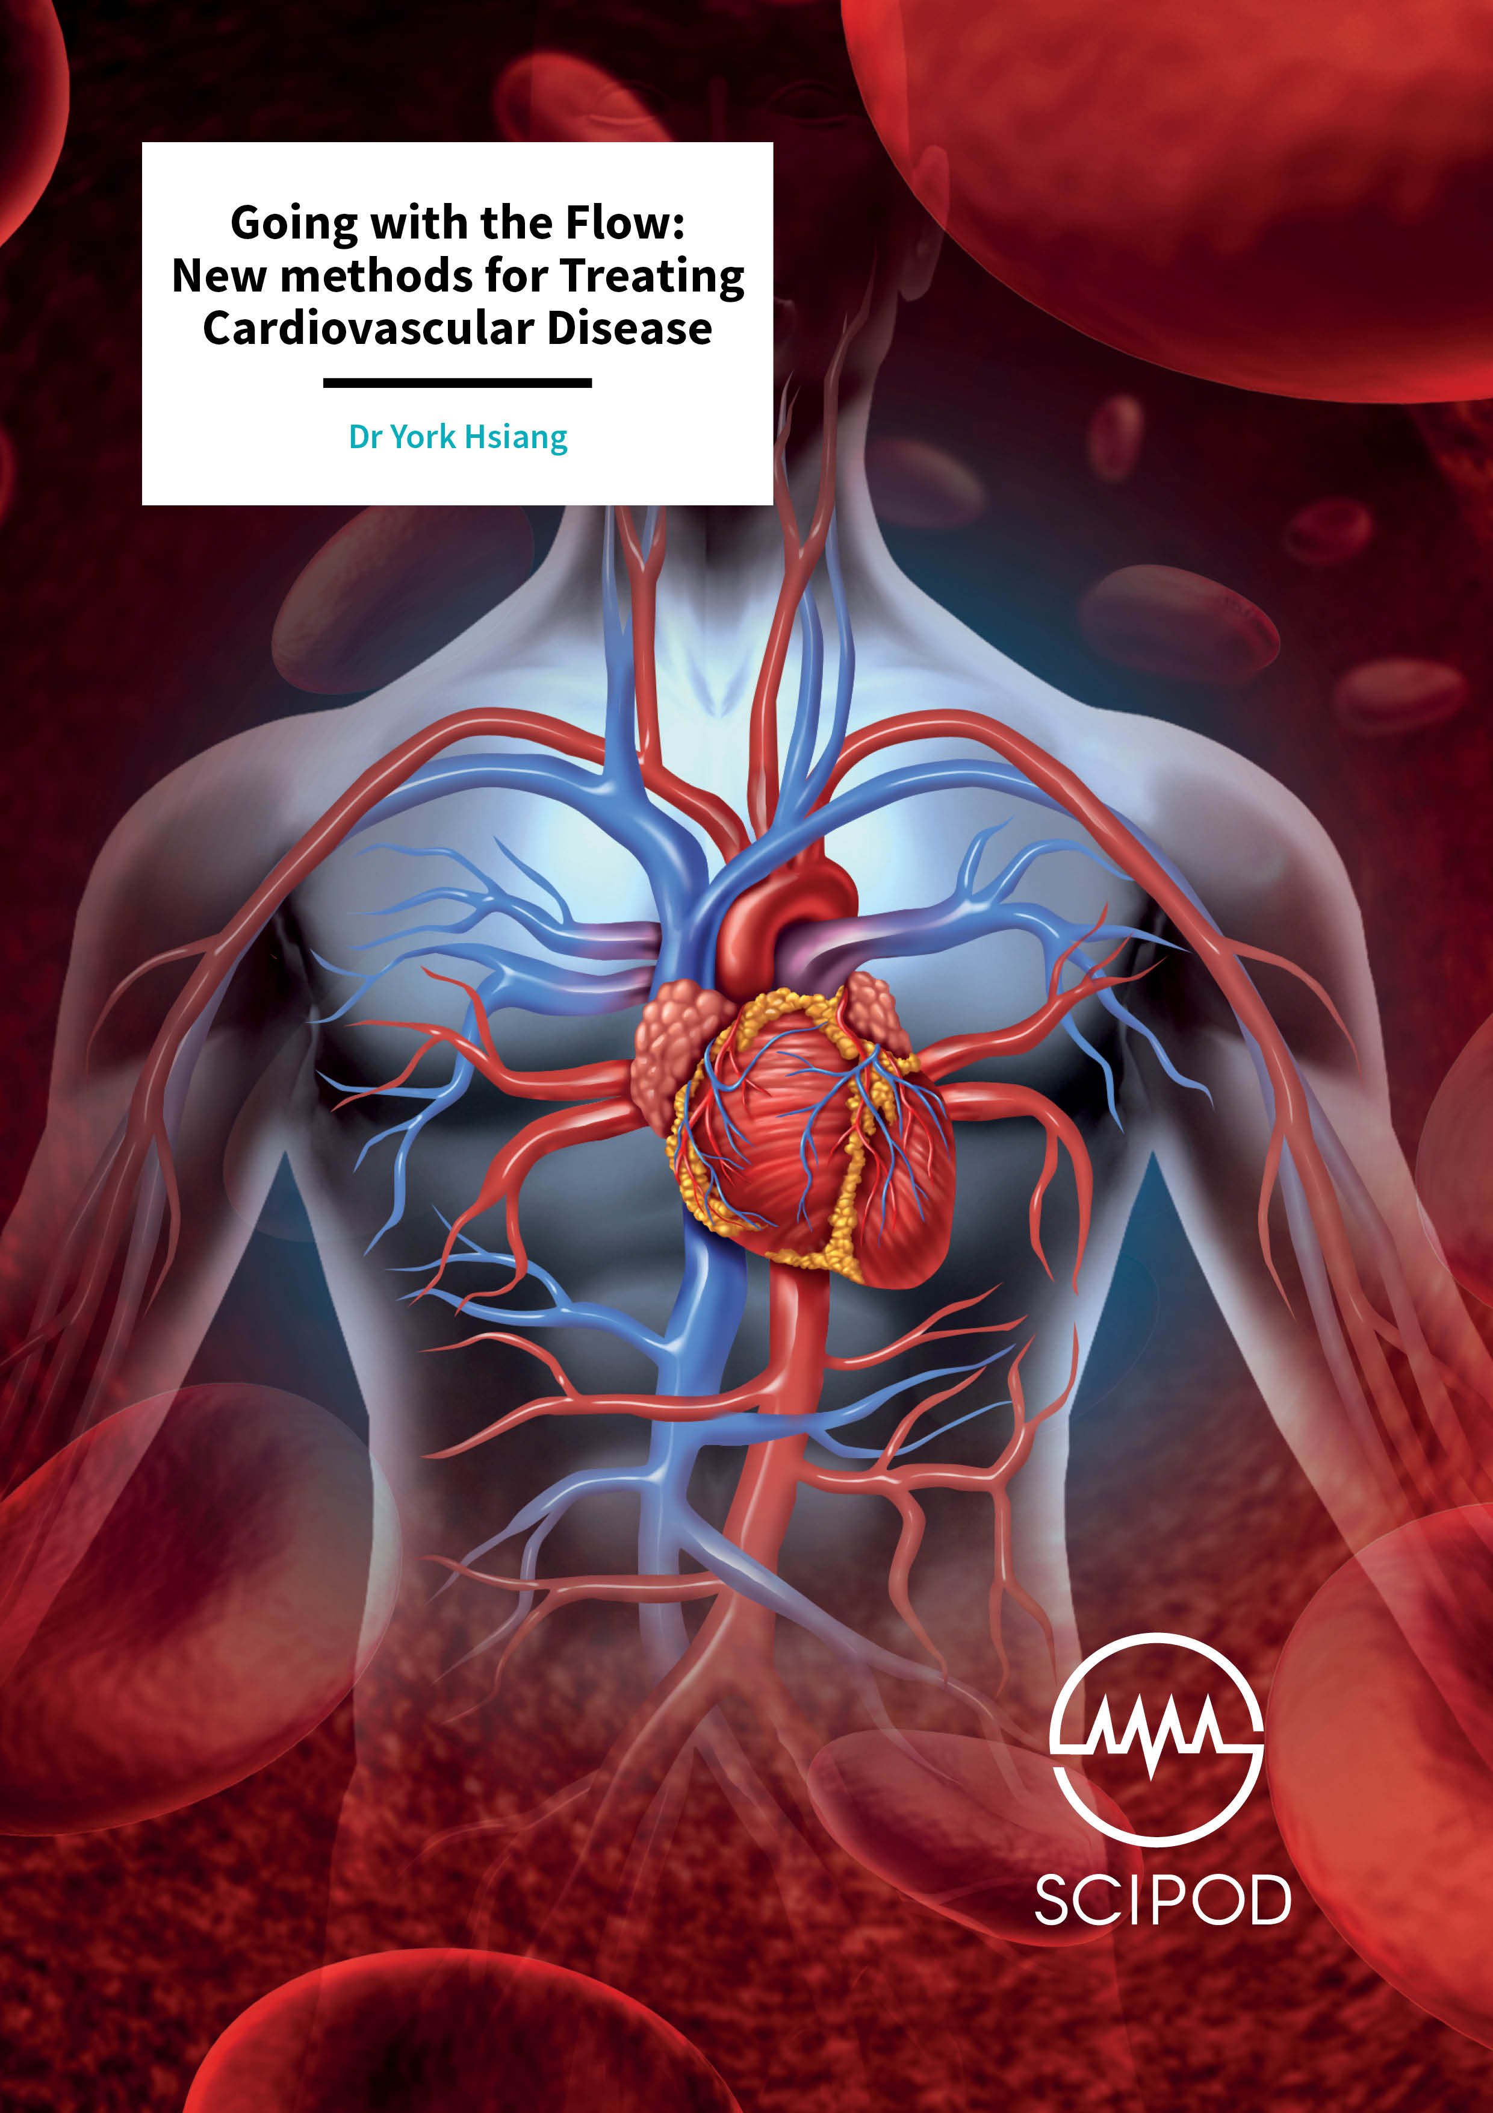
Introduction
If
disease remains one of the leading causes of death worldwide, affecting millions of people each year. It includes a range of conditions such as coronary artery disease, heart attacks, and other cardiovascular disorders. Early detection and prevention are crucial to reducing the risk and improving patient outcomes.
With the rapid growth of technology and healthcare data, machine learning and data analysis have become powerful tools in predicting heart disease. By analyzing factors such as age, blood pressure, cholesterol levels, and lifestyle habits, predictive models can help identify individuals at high risk before serious complications occur.
This project focuses on developing a heart disease prediction system using data-driven techniques. The aim is to assist healthcare professionals in making faster and more accurate decisions, ultimately improving patient care and saving lives
The main aim of THE HEART DISEASE PREDICTION is to develop a model that can analyze patient data and predict whether a person is likely to have a heart disease.The system can support healthcare proffessionals in early diagnosis,improve treatment planning,ultimately help in saving lives.
This Photo by Unknown Author is licensed under CC BY

Slide 3
PROBLEM STATEMENT
Develop a machine learning-based system to predict the presence of heart disease.
Input data set contains clinical parameters such as age, sex, blood pressure, cholesterol,
heart rate, etc.
Perform data preprocessing(handling missing values , normalization, encoding
categorical data).
Identify and select important features affecting heart disease using feature selection
techniques.
Train and test multiple classification algorithm(eg : Logistic Regression ,Decision tree,
Random Forest, SVM).
Optimize model performance using hyperparameter tuning.
Evaluate models using performance metrics such as accuracy , precision , recall, and
F-1 score.

Slide 4
DATA PREPROCESSING
It contains patients medical records used for predicting used for predicting heart disease
Total number of attributes:13-14 input features+1 target variable
The data used for heart prediction is commonly used from UCI machine Learning
KEY FEATURE
Age : age of the patient
Sex : gender
Chest pain type : type of chest pain
Resting Blood Pressure
Chol
Fbs
Restecg

Slide 5
METHODOLOGY
Collected dataset from reliable sources such as UCI Repository or Kaggle
Dataset contains medical records with multiple health-related attributes
Data Collection
2. Data Preprocessing
Handled missing or null values using imputation techniques
Converted categorical data into numerical form (encoding)
Normalized/standardized numerical features for better model performance
Removed duplicate and inconsistent data entries
3. Exploratory Data Analysis (EDA)
Analyzed distribution of features using statistical methods
Visualized relationships between variables using graphs (heatmaps, histograms)
Identified correlations between input features and target variable

Slide 6
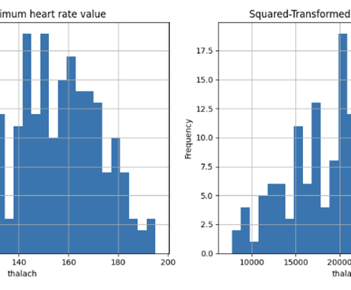
Data Collection:
Gather patient health data from hospitals, health surveys, or public datasets.
Include features such as age, gender, blood pressure, cholesterol levels, heart rate, smoking habits, diabetes, and physical activity.
Data Preprocessing and Cleaning:
Handle missing, inconsistent, or incorrect data.
Convert categorical data (like gender or chest pain type) into numeric format if needed.
Normalize or scale numerical values to ensure fair comparison.
This Photo by Unknown Author is licensed under CC BY-SA-NC

Slide 7
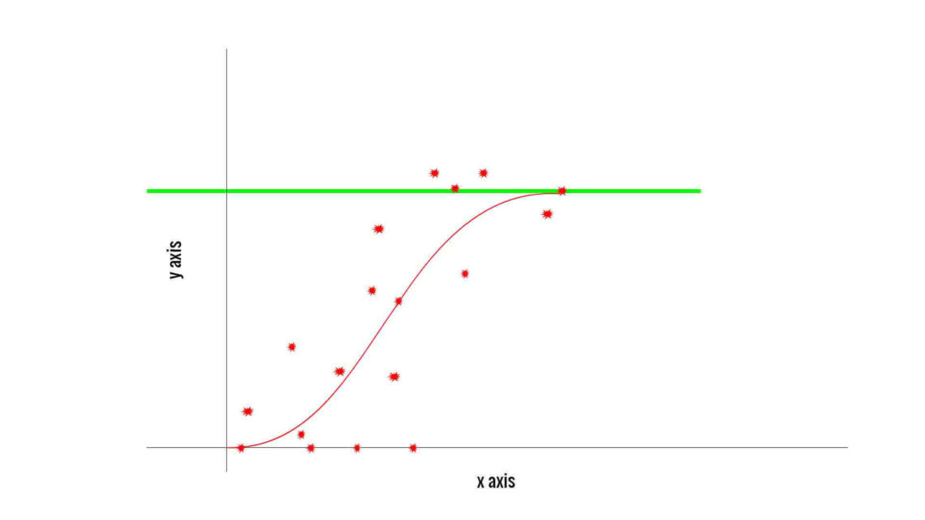
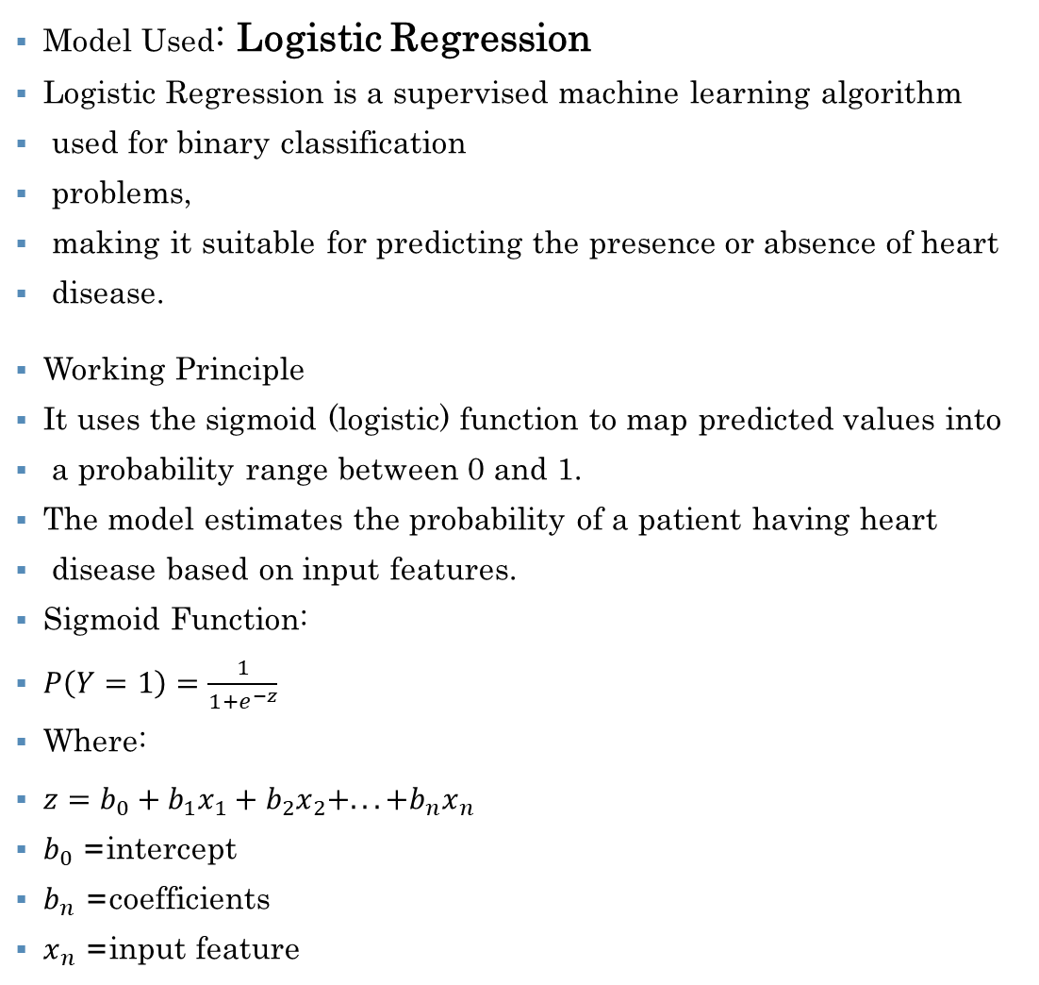
MODEL USED
Model Used: Logistic Regression
Logistic Regression is a supervised machine learning algorithm
used for binary classification
problems,
making it suitable for predicting the presence or absence of heart
disease.
Working Principle
It uses the sigmoid (logistic) function to map predicted values into
a probability range between 0 and 1.
The model estimates the probability of a patient having heart
disease based on input features.
Sigmoid Function:
$P\left(Y=1\right)=\frac{1}{1+e^{−z}}$
Where:
$z=b_{0}+b_{1}x_{1}+b_{2}x_{2}+...+b_{n}x_{n}$
$b_{0}$= intercept
$b_{n}$= coefficients
$x_{n}$= input feature
This Photo by Unknown Author is licensed under CC BY

Slide 8
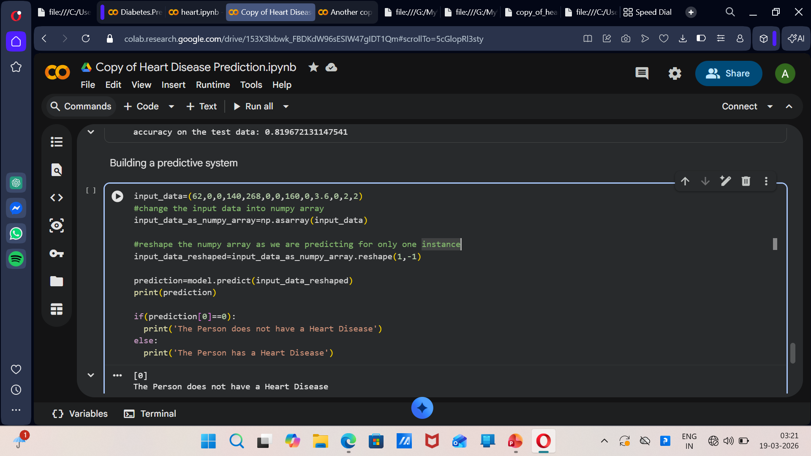
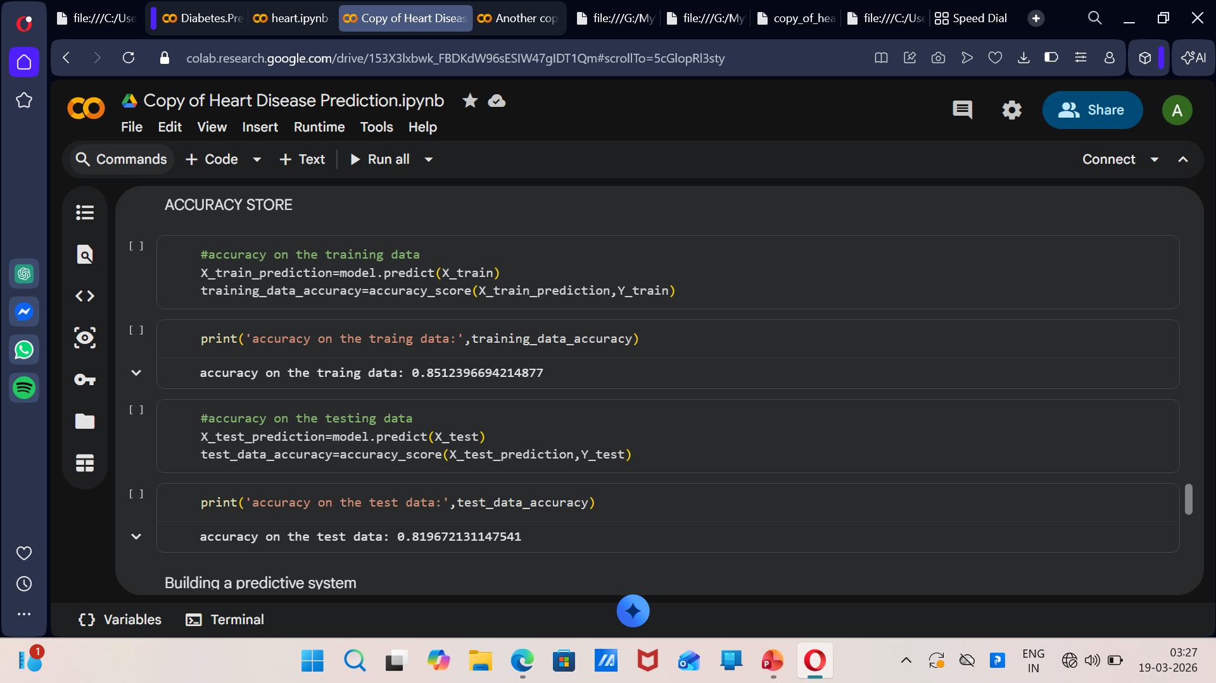
RESULTS
PREDICTIVE SYSTEM
ACCURACY STORE

Slide 9
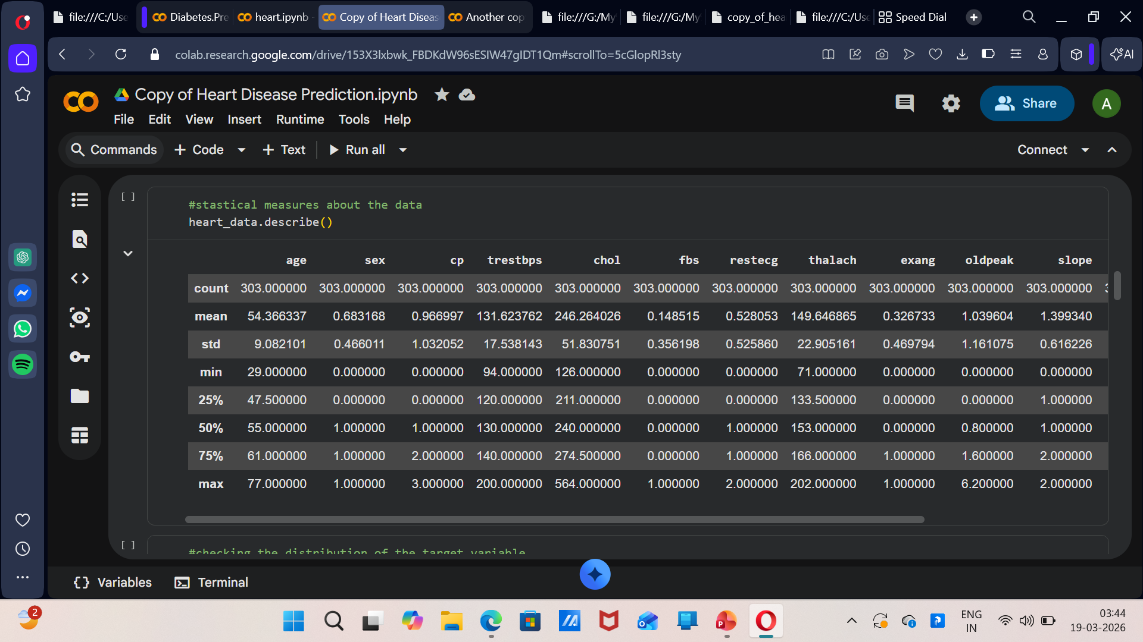
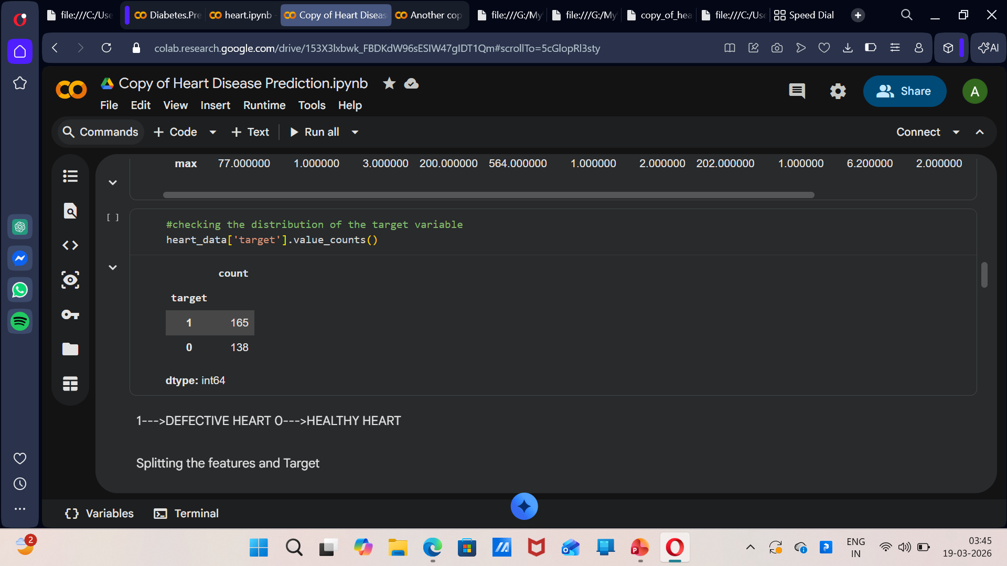
RESULTS
STATISTICAL DATA
DISTRIBUTION OF TARGET VARIABLE

Slide 10
CONCLUSION
Heart disease is one of the leading health risks, but early prediction can save lives. By using data and prediction methods, we can identify people at risk before serious problems occur. This helps doctors make better decisions and patients take preventive steps. In the future, these prediction tools can become more accurate and widely available, helping us fight heart disease more effectively.
Key takeaway: Early detection saves lives, and technology makes it possible.

