Slide 1

Seasonal Agriculture Performance Analysis
Name : MUSKAN
College : Pallavi Engineering College
AICTE STU ID : STU69799882239c51769576578

Slide 2

PROBLEM STATEMENT
(Agricultural activities are influenced by seasonal variations in environmental conditions, farming practices, resource availability and market conditions. As a result, agricultural performance may differ from one season to another.
However, raw agricultural data does not clearly explain how agricultural performance changes across seasons or what patterns can be observed in different seasonal conditions.
The problem is to analyze the given agricultural dataset and investigate seasonal differences in agricultural performance by identifying meaningful patterns, trends, relationships and variations within the available data.

Slide 3
Project Description
Analyze agricultural data across Kharif, Rabi and Zaid seasons.
Study environmental conditions, farming practices, resource usage and economic performance.
Clean and prepare the dataset using Python.
Use statistical aalysis and data visualizations to compare seasons.
Identify important patterns and provide data-driven recommendations.

Slide 4

WHO ARE THE END USERS?
👨‍🌾 Farmers
🌾 Agricultural Planners
🔬 Agricultural Researchers
🏛️ Government/Agriculture Departments
💼 Agribusiness Stakeholders

Slide 5

Technology Used
🐍 Python
🐼 Pandas & NumPy
📊 Matplotlib & Seaborn
📓 Jupyter Notebook
📄 CSV Dataset
🐙 GitHub

Slide 6
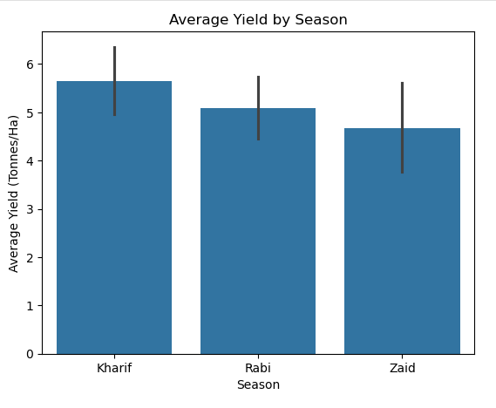
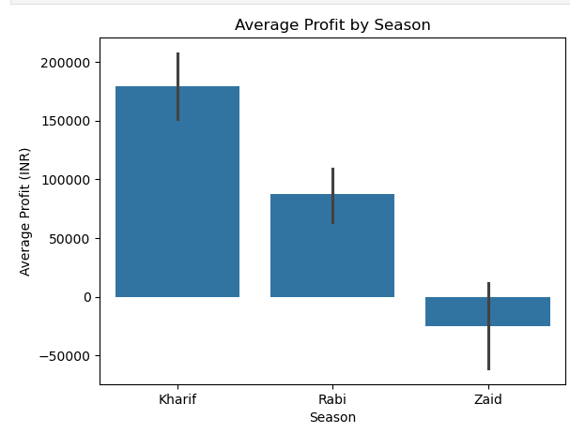
RESULTS
Kharif shows the best overall performance with the highest average yield, production, revenue, and profit, while Zaid shows the weakest economic performance.

Slide 7
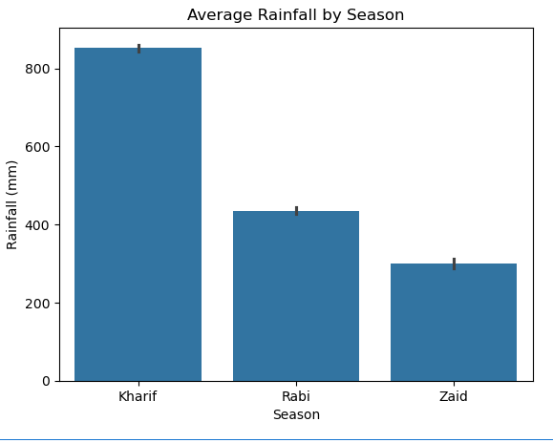
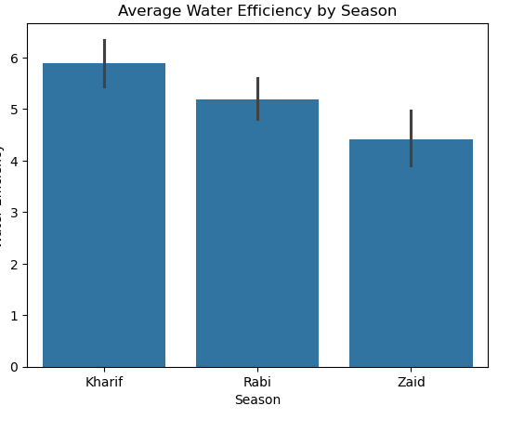
RESULTS
Kharif had the highest rainfall and water efficiency, while Zaid had the lowest water efficiency despite using more water.

Slide 8
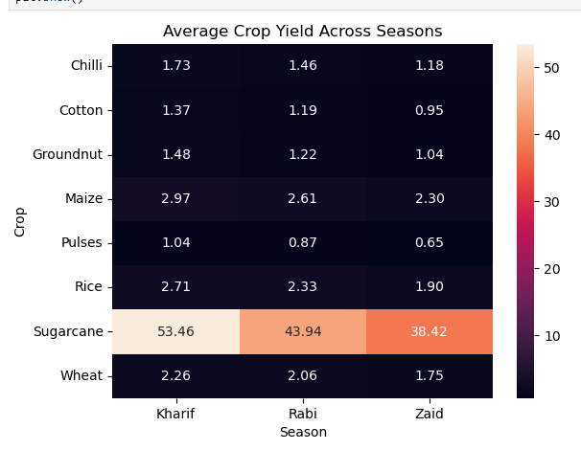
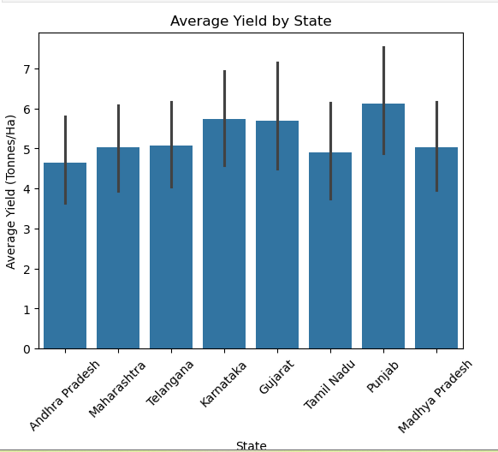
RESULTS
Sugarcane was the highest-yielding crop across all three seasons, while yield varied across different states.

Slide 9
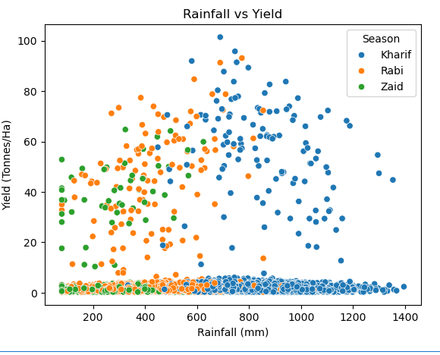
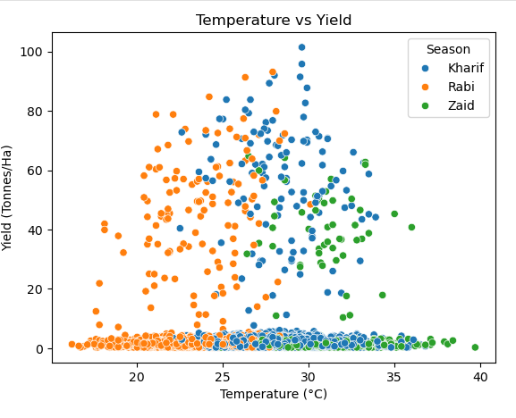
RESULTS
Environmental conditions show different relationships with yield across seasons, “rainfall and yield show an observed relationship/pattern.”

Slide 10
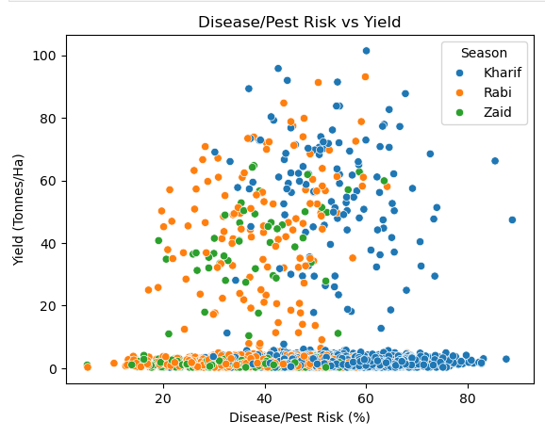
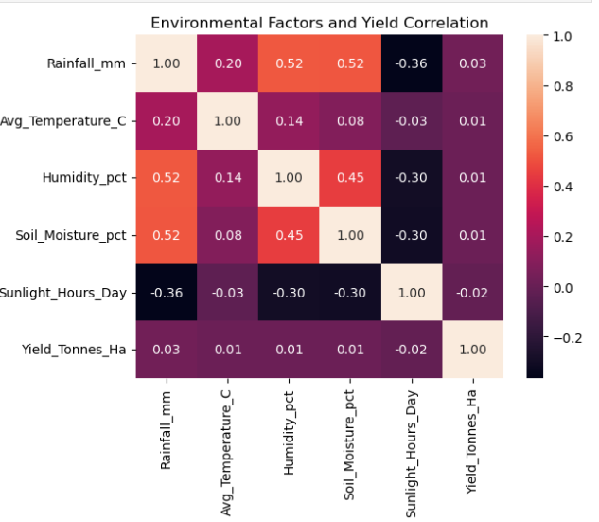
RESULTS
disease/pest risk was highest in Kharif.

Slide 11
RESULTS
Metric | Best Season
Average Yield | Kharif
Average Production | Kharif
Average Revenue | Kharif
Average Profit | Kharif
Water Efficiency | Kharif
observations:
Kharif was the strongest overall season.
Rabi showed moderate performance.
Zaid had the lowest average yield and negative average profit.
Sugarcane had the highest yield across all seasons.
Zaid had the lowest water efficiency.

Slide 12
Future scope
Develop a real-time agricultural dashboard.
Use more years of data to identify long-term seasonal trends.
Include real-timeweather and environmental data.
Build models to predict crop yield and profit.
Develop crop recommendation systems for better seasonal planning.

Slide 13

GitHub Link
https://github.com/Ayeshuuuuu/VOIS_Agricultural_Analysis

Slide 14

VOIS Course completion certificate -
Course name- Data Visualization

Slide 15
Thank you
.
.

