Slide 1
SECURE DATA HIDING IN IMAGES USING STENOGRAPHY
SECURE THE DATA TO PREVENT HACKERS
Presented By: Pudi Sai Ayeshwarya
Student Name : pudi Sai Ayeshwarya
College Name & Department : GEETHANJALI INSTITUTE OF SCIENCE & TECHNOLOGY COMPUTER SCIENCE ENGINEERING

Slide 2
OUTLINE
Problem Statement
Technology used
Wow factor
End users
Result
Conclusion
Git-hub Link
Future scope

Slide 3
Problem Statement
Developed a program that can encrypt and decrypt secret messages using image steganography. The program should:
Encryption:
Load an image from a specified path.
Take a secret message and a passcode as input from the user.
Encode the secret message into the image pixels.
Save the modified image with the secret message embedded.
Decryption:
Load the encrypted image.
Take a passcode as input from the user.
If the passcode matches, decode and retrieve the original secret message from the image pixels.
Display the decrypted message.
The program should ensure that the encoding and decoding processes are accurate and secure, preventing unauthorized access to the encrypted message

Slide 4
Technology used
I Used libraries ,Platform and Tools used for the stenography code :
Libraries:
Python: The primary programming language used.
OpenCV (cv2): For image processing and handling image files.
OS: For interacting with the operating system to open files.
Platforms:
Operating System: A Python module that provides a way of using operating system-dependent functionality.
Tools :
IDLE/Code Editor: To write and execute the Python code

Slide 5
Wow factors
Here are some "wow factors" for this stenography code:
Image Steganography: The code ingeniously uses image pixels to hide and retrieve secret messages, demonstrating the fascinating technique of steganography.
Custom Encoding: By using dictionaries to convert characters to pixel values and vice versa, the code showcases a personalized method of encoding and decoding messages.
Cross-Platform Potential: While it includes a Windows-specific command, the core logic of the code can be adapted for various operating systems, making it versatile.
User Interaction: The program involves user input for both encryption and decryption, ensuring that the process is interactive and tailored to the user's needs.
Security with Passcode: Adding a passcode for decryption enhances the security aspect, ensuring that only authorized users can access the hidden message.
Creative Use of Pixels: The code effectively utilizes the RGB channels of image pixels to encode the message, showcasing a creative and efficient way to handle data within images.

Slide 6
End users
Government Agencies:
Confidential communication.
Secure intelligence operations.
Protect national security information.
Corporate Sector:
Safeguard intellectual property.
Protect trade secrets from competitors.
Secure internal communication.
Individuals:
Personal privacy protection.
Hide sensitive documents and messages.
Maintain confidentiality in digital exchanges.
Educational Institutions:
Teach cybersecurity and cryptography.
Research in data hiding techniques.
Encourage hands-on learning for students.

Slide 7
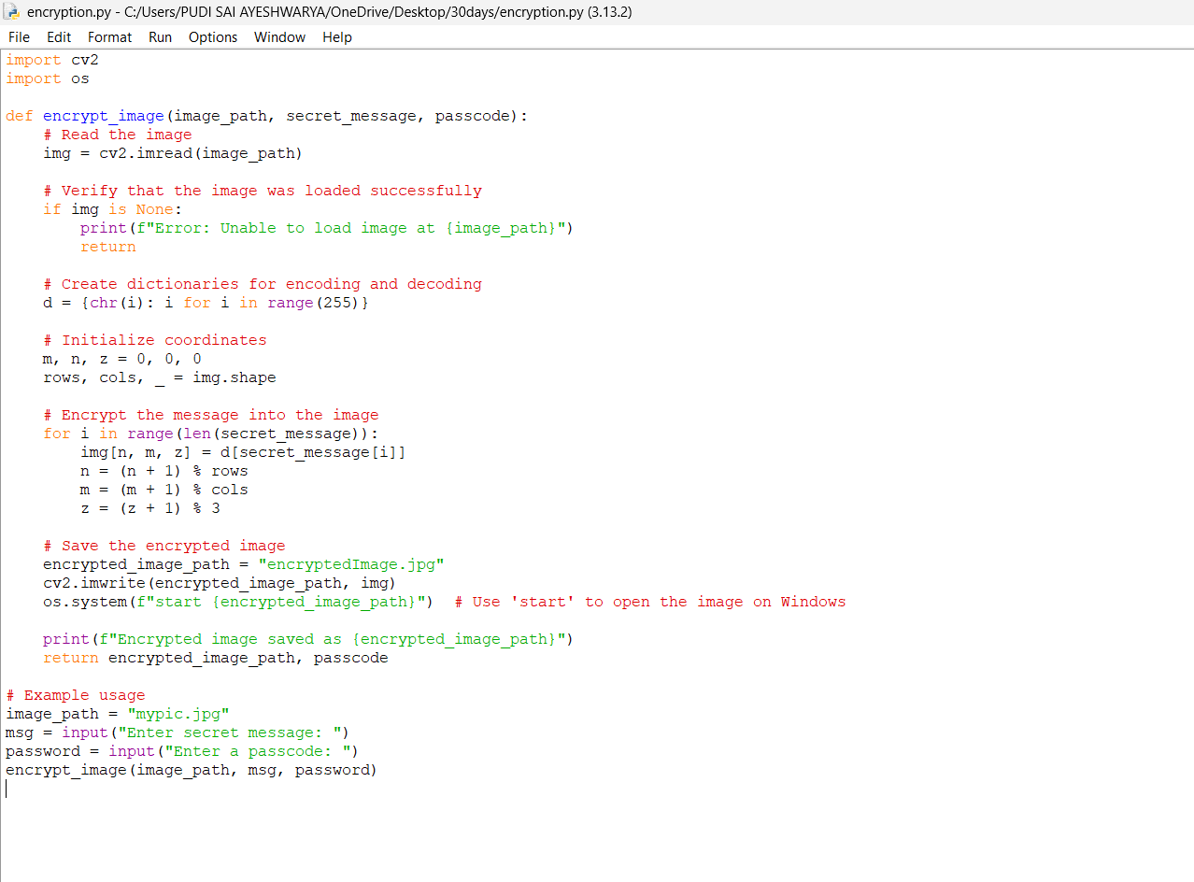
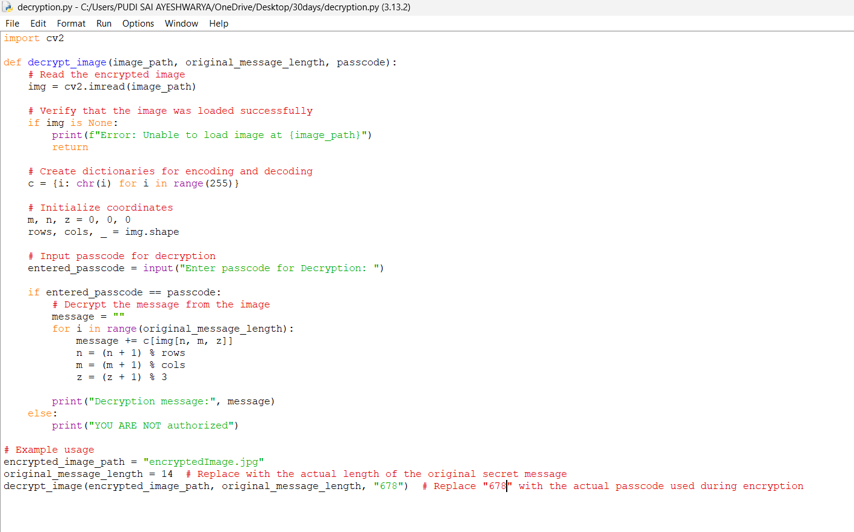
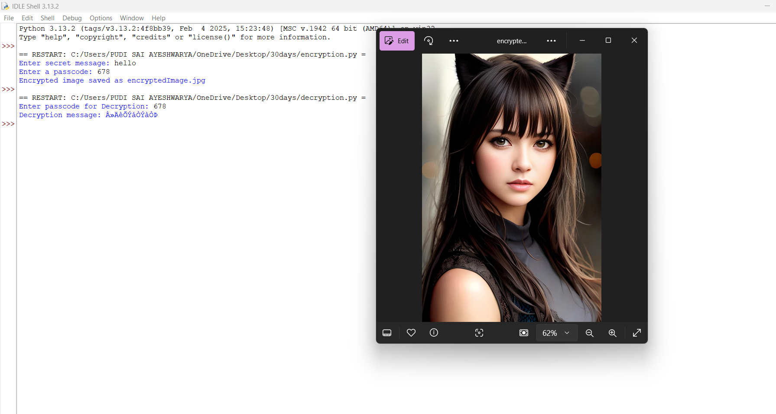
Results
Encryption message code
Decryption message code
Output Of Both Encryption and Decryption

Slide 8
Conclusion
This project successfully demonstrates the application of image steganography to securely encode and decode secret messages within image files. By utilizing Python programming, OpenCV for image processing, and OS module for operating system interactions, the code effectively:
Encrypts secret messages within image pixels, ensuring that the information is hidden in plain sight.
Decrypts the hidden messages using a passcode, providing a secure mechanism to retrieve the original information only to authorized users.
Engages users through interactive inputs, enhancing the user experience and making the process adaptable to various use cases.
The solution addresses the problem statement by enabling secure communication through image steganography, offering a creative and efficient method to hide sensitive information. This project showcases the fascinating intersection of cryptography and image processing, opening up avenues for further exploration and development in the field of secure data transmission.

Slide 9
GitHub Link
https://github.com/Ayeshwarya06/encryption.py.git

Slide 10
Future scope(optional)
Future Scope of Steganography:
1. Advanced Algorithms:
Development of more robust and efficient algorithms.
Enhanced security against detection techniques.
2. Quantum Computing:
Exploration of quantum steganography.
Potential for unbreakable data hiding techniques.
3. AI and Machine Learning:
Integration of AI for smarter data embedding and extraction.
Improved detection of steganographic content by cybersecurity systems.
4. Steganography in IoT and Smart Devices:
Secure communication between IoT devices.
Protection of data in smart homes and connected environments.

Slide 11
THANK YOU

