Slide 1
Chapter 2 Welcome App
Android How to Program, 3/e

Slide 2
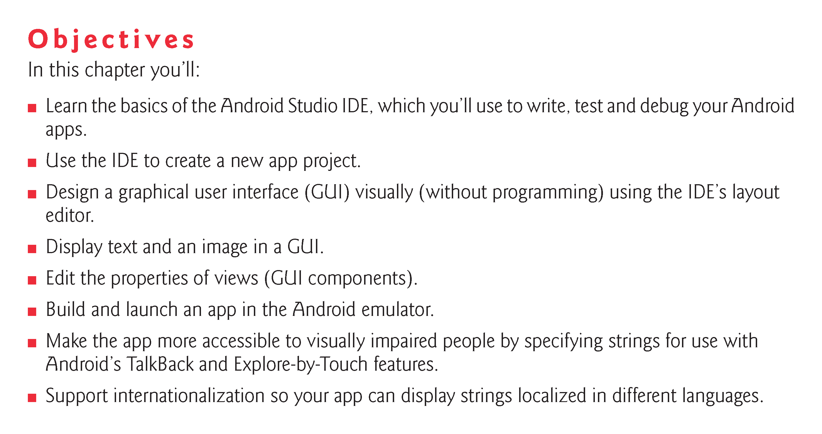

Slide 3
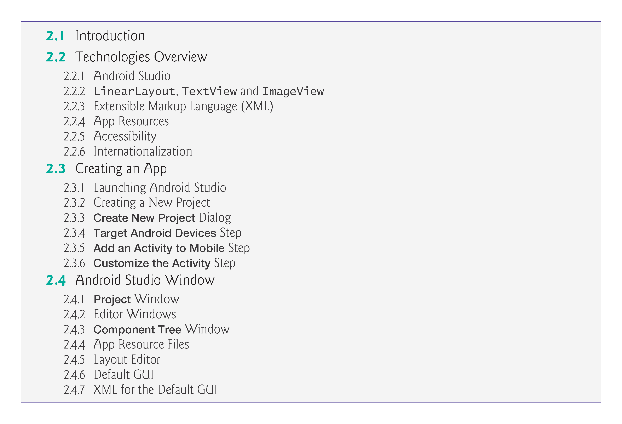

Slide 4
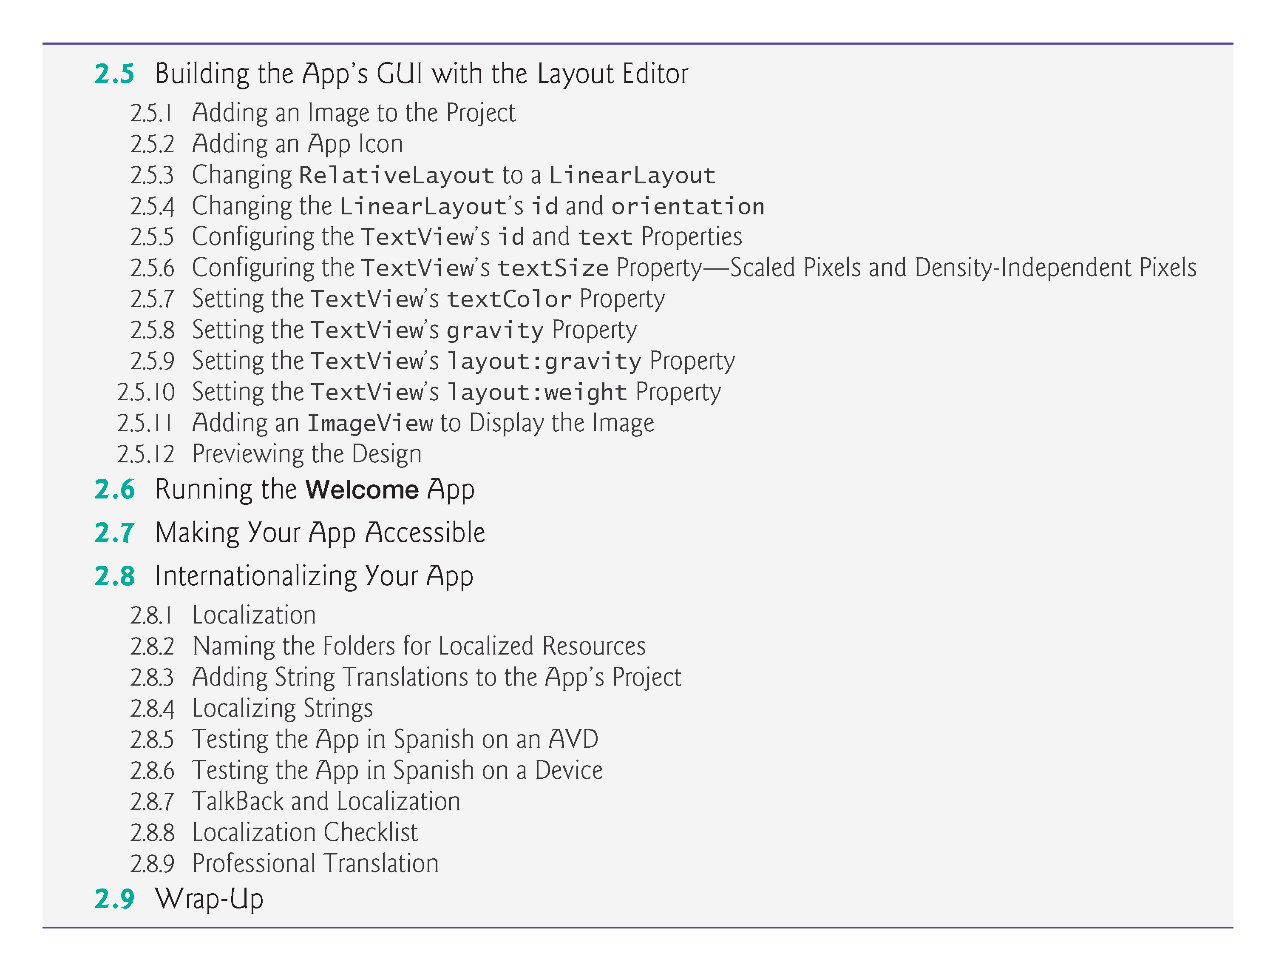

Slide 5
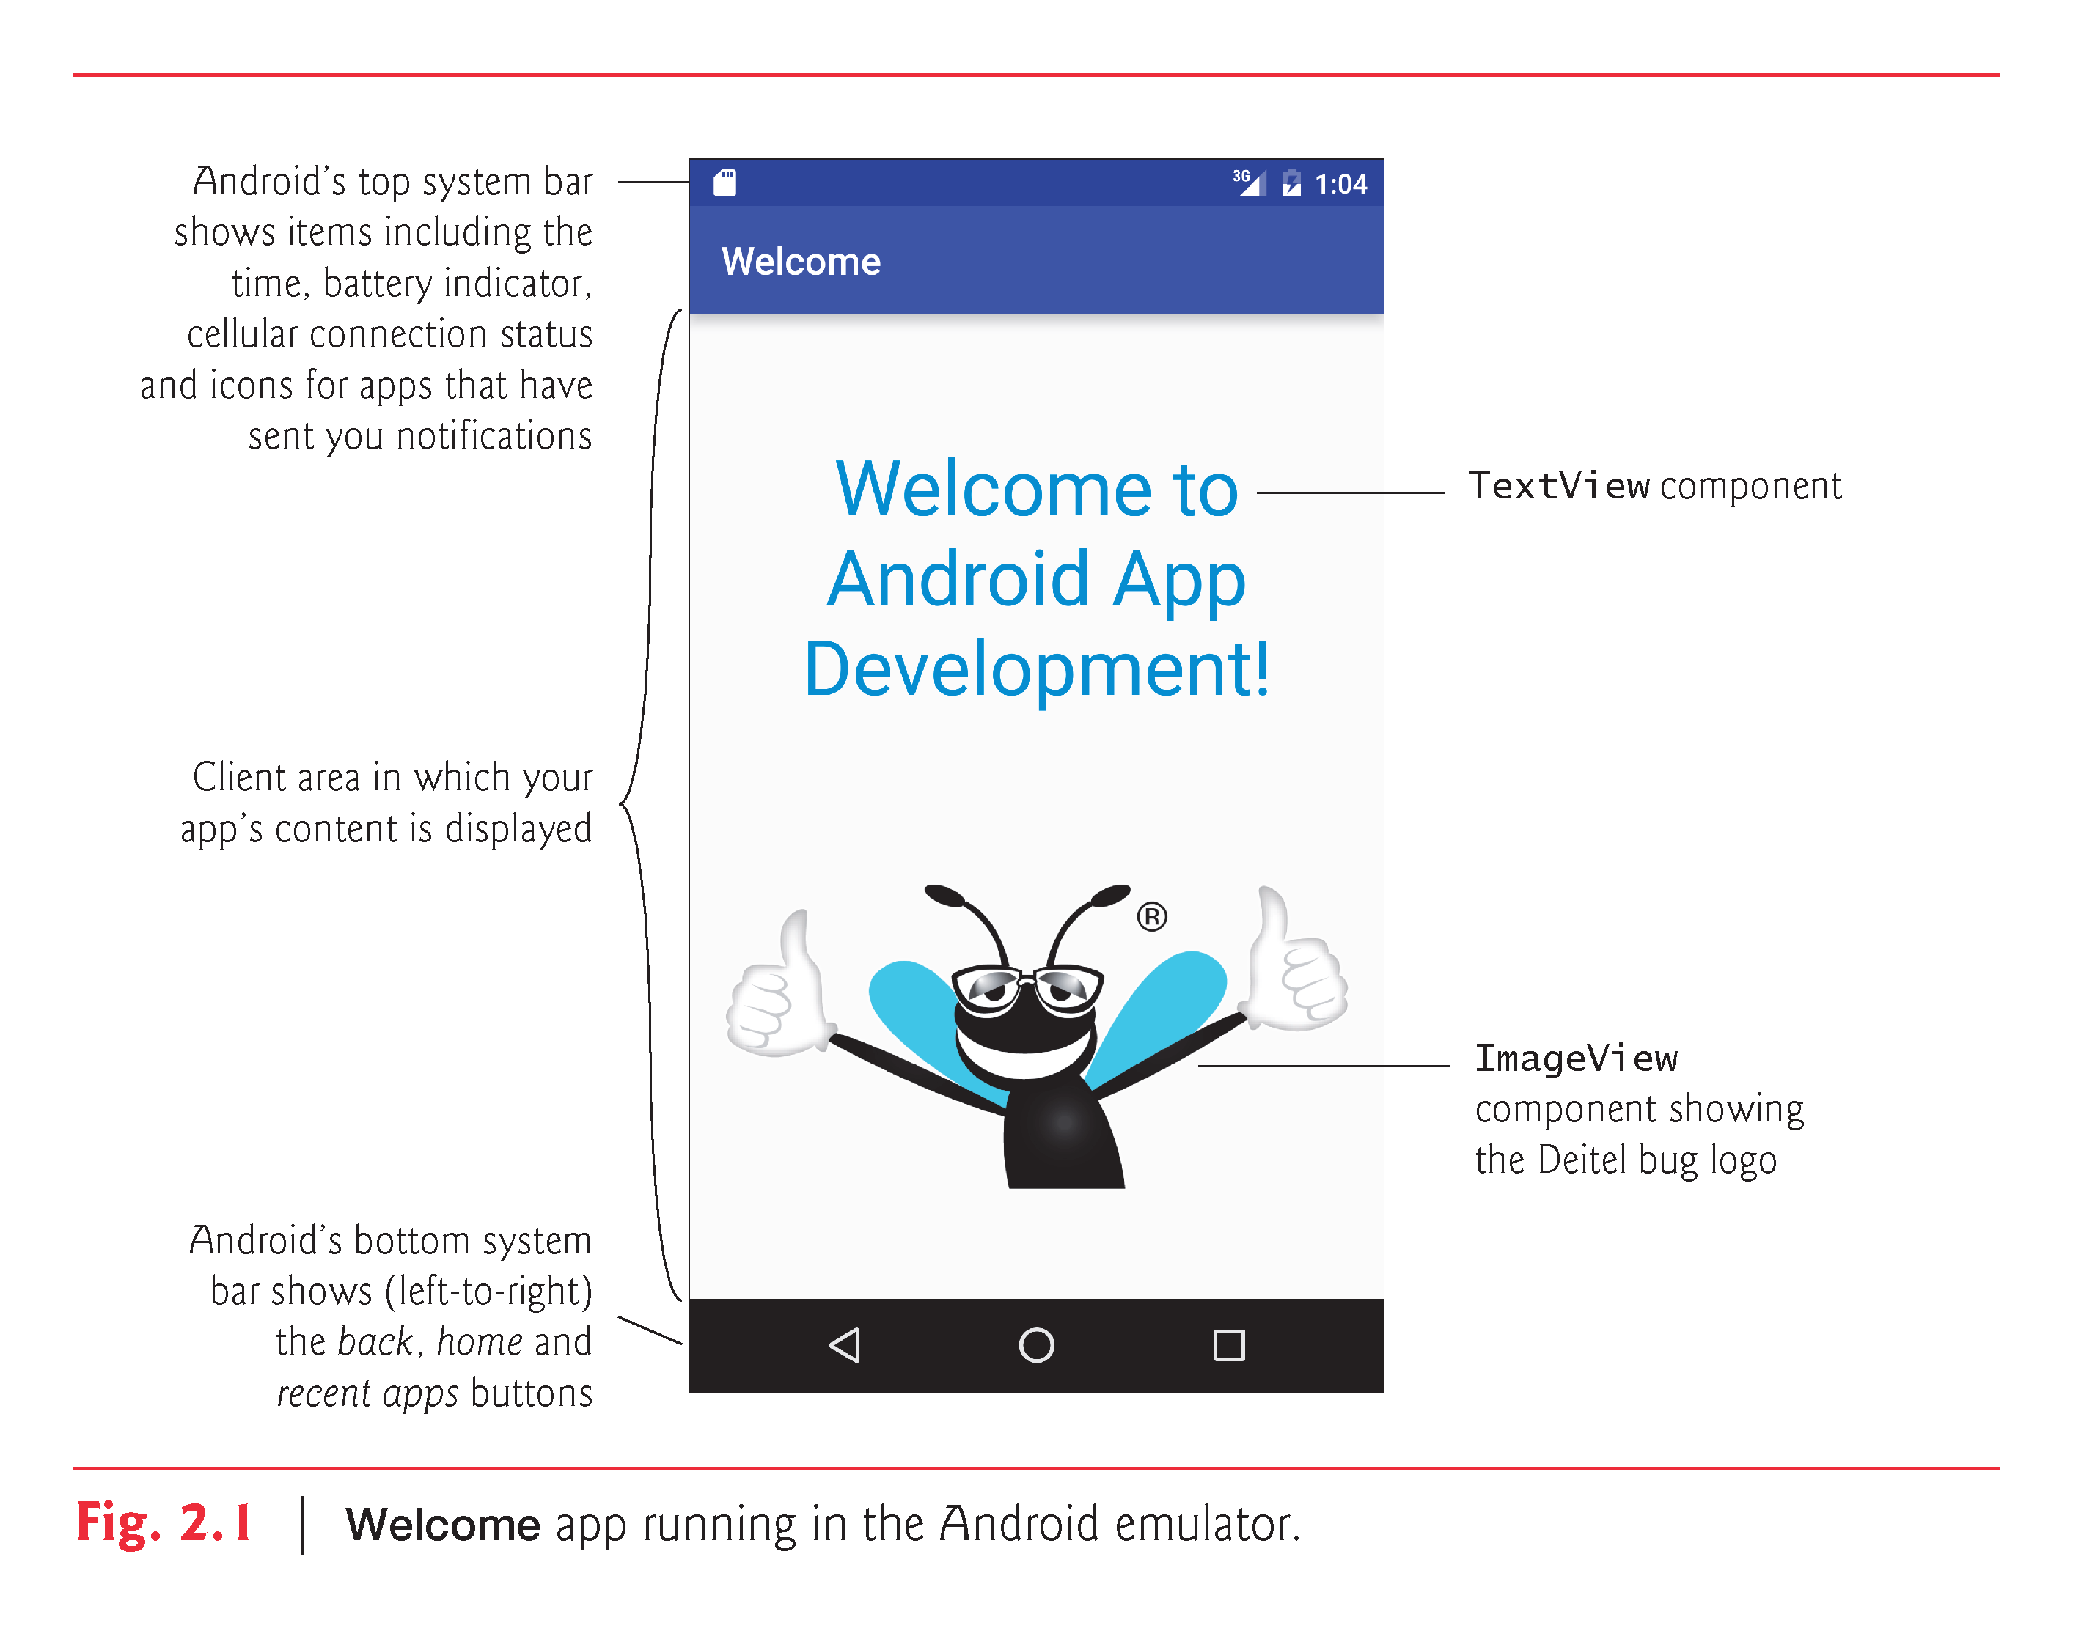

Slide 6
Technologies Overview
Android Studio
Create a new app
Default GUI
Layout editor’s Design and Text views
Properties window

Slide 7
Technologies Overview
Views
TextView
ImageView
Layout
View that contains and arrange other views
Vertical LinearLayout
Layout editor's Palette of views

Slide 8
Technologies Overview
Extensible Markup Language (XML)
Human and computer-readable
Specify the layouts and components to use, as well as their attributes
Android Studio parses the XML to display your design in the layout editor
XML also used for app resources, such as strings, numbers and colors

Slide 9
Technologies Overview
Good practice—define all strings, numeric values and other values in XML resource files
Placed in the subfolders of a project’s res folder
Create resources for strings and measurements (such as a font’s size)
Color resources based on Google’s Material Design color palette
http://www.google.com/design/spec/style/color.html

Slide 10
Technologies Overview
Accessibility
Help people with certain disabilities use their devices
TalkBack
Speaks screen text or text that you provide to help user understand the purpose and contents of a view
Explore by Touch
Enables the user to touch the screen to hear TalkBack speak what’s on the screen near the touch

Slide 11
Technologies Overview
To reach the widest audience, consider customizing apps for various locales and spoken languages
Internationalization
Configuring your app so that it can be customized for various locales
Localization
Customizing for a specific
The app on an AVD or device configured for Spanish

Slide 12
Scaled Pixels and Density-Independent Pixels
Density-independent (dp or dip)
Views and other on-screen elements
Scale-independent (sp)
Font sizes
Scale like dp, but also factor's in user's preferred font size

Slide 13
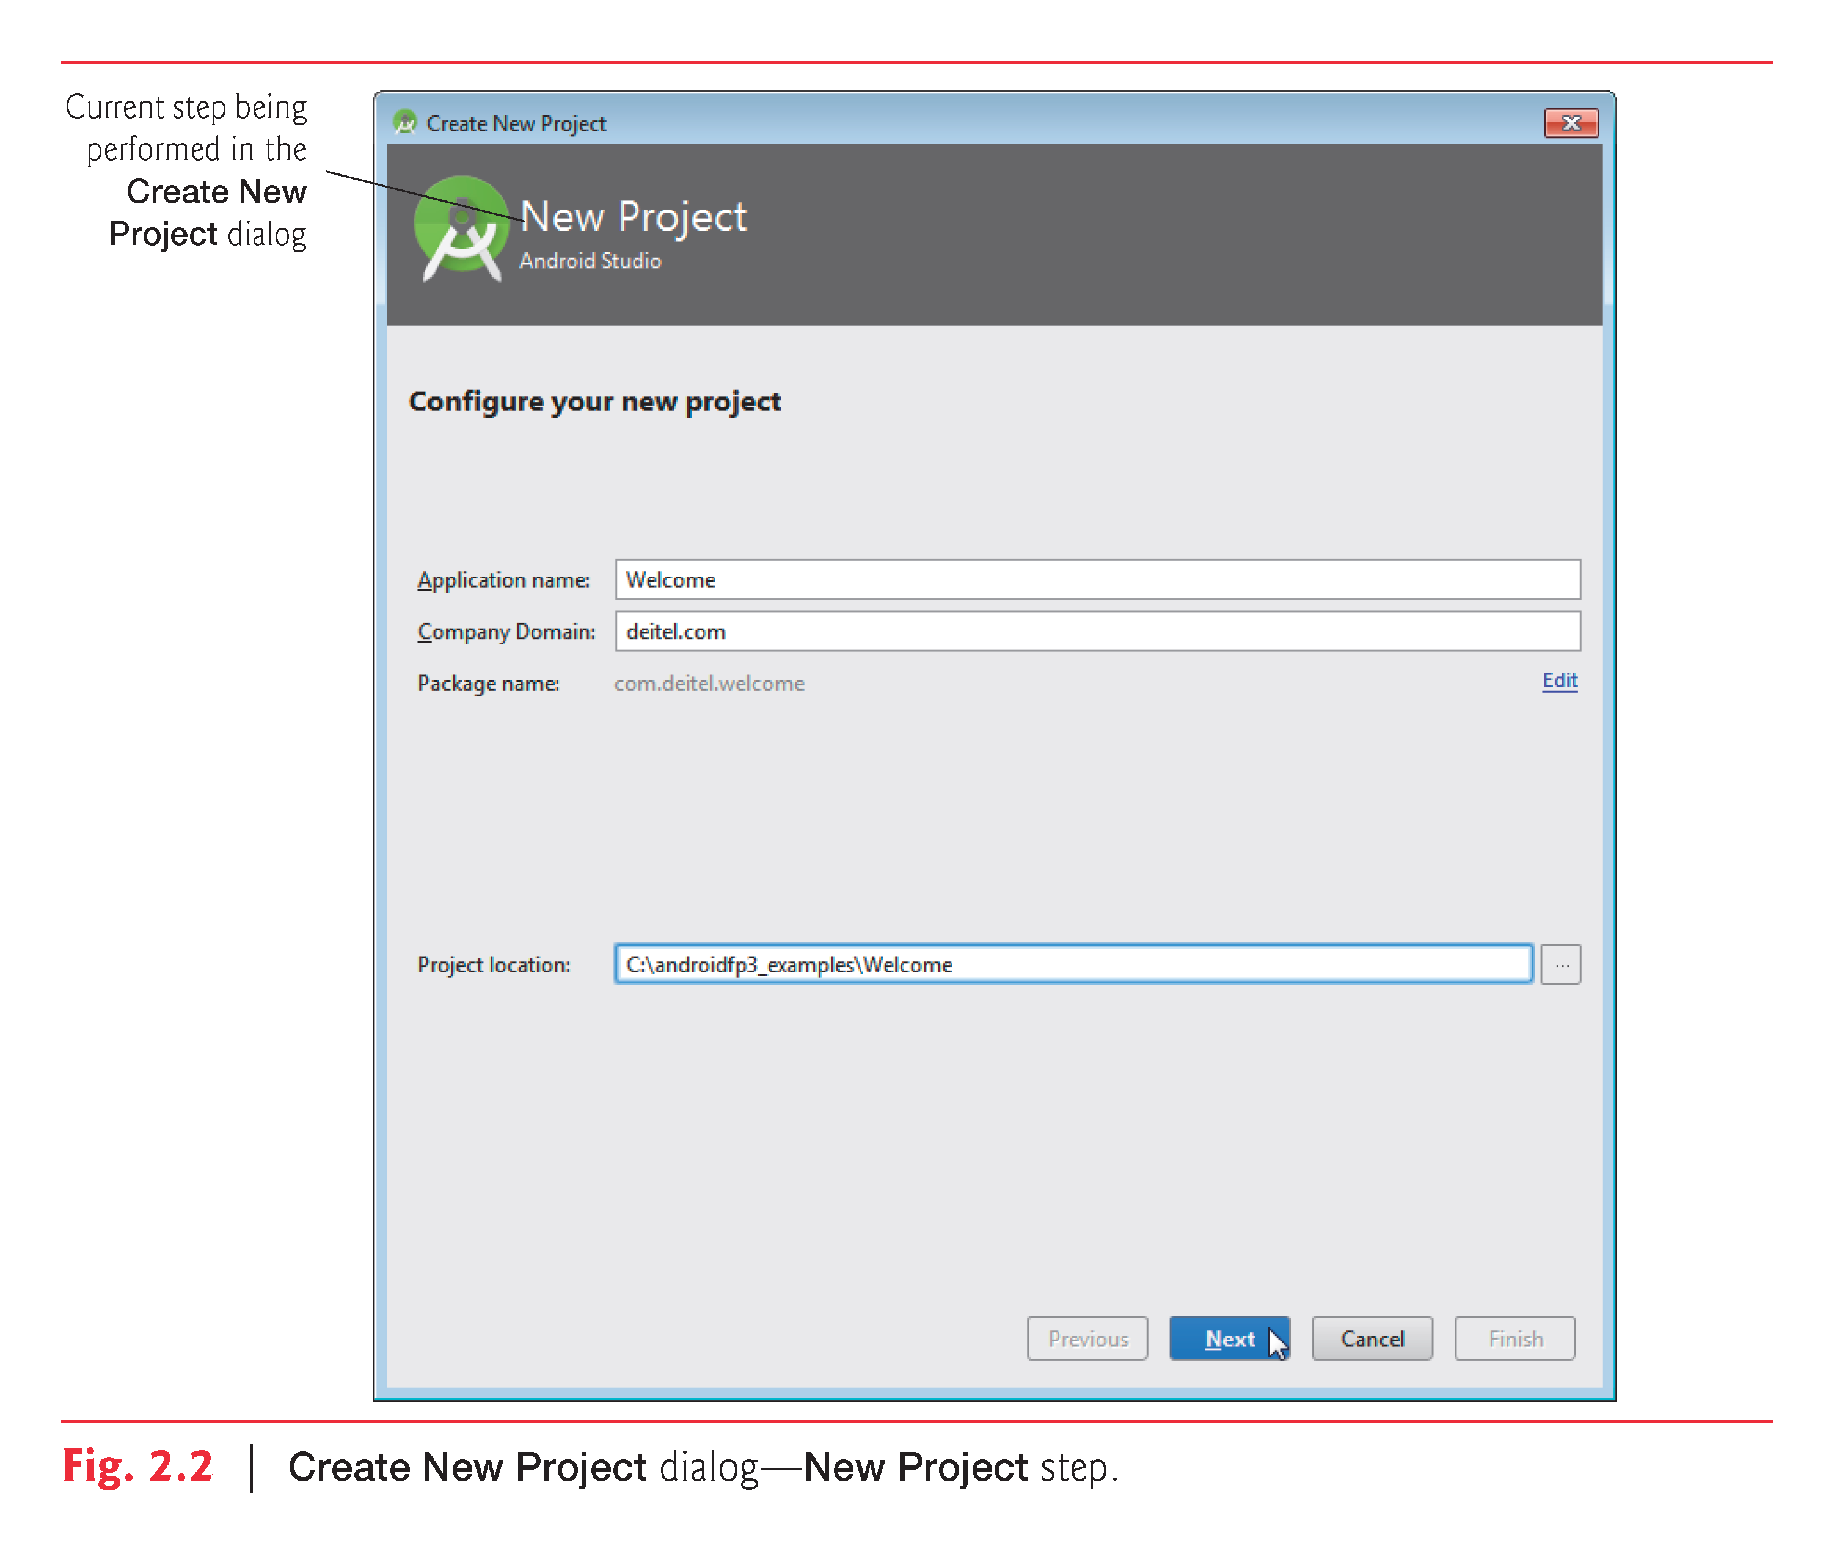

Slide 14
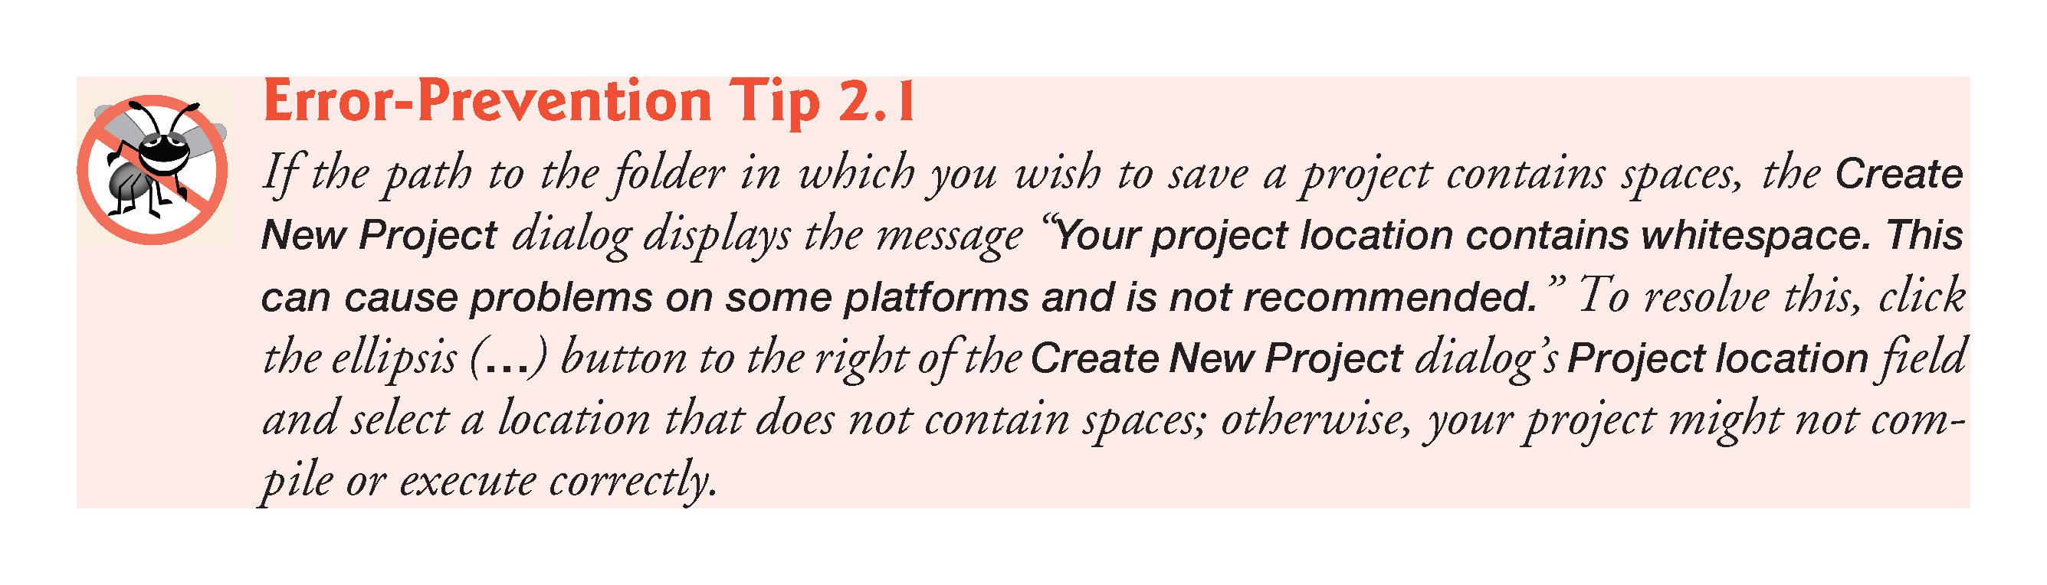

Slide 15
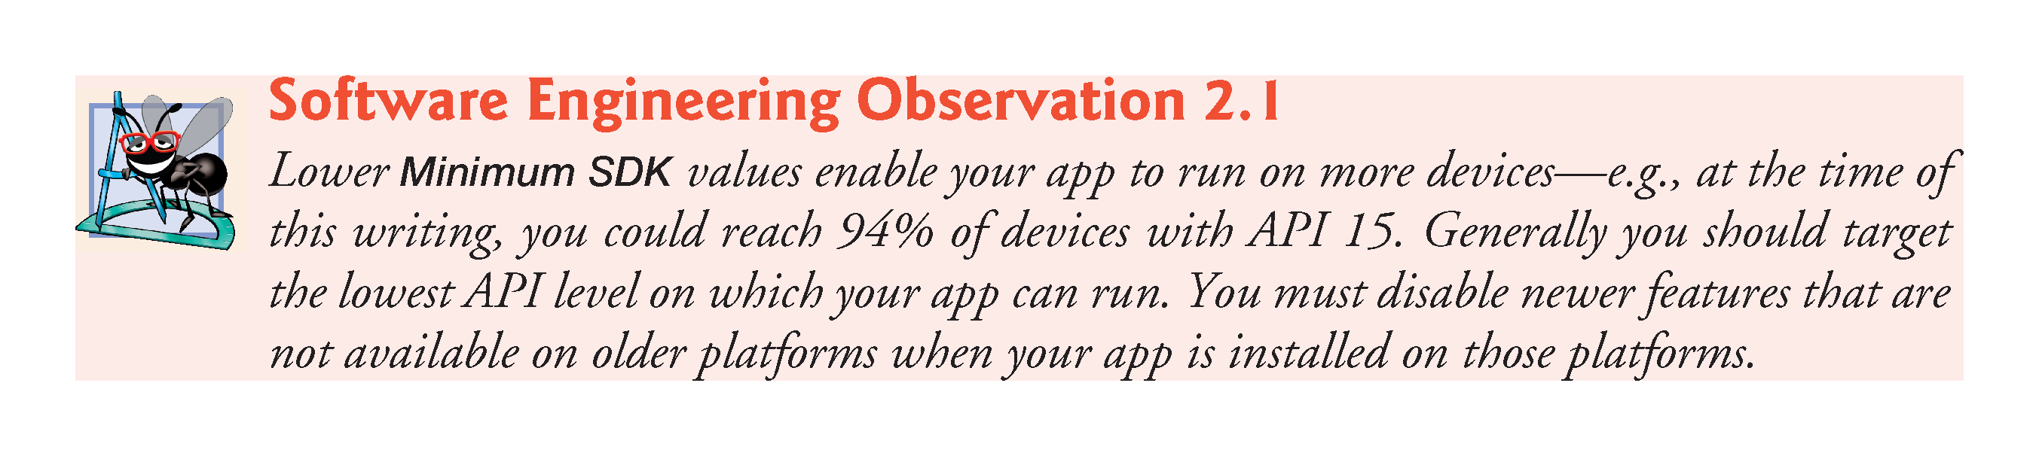

Slide 16
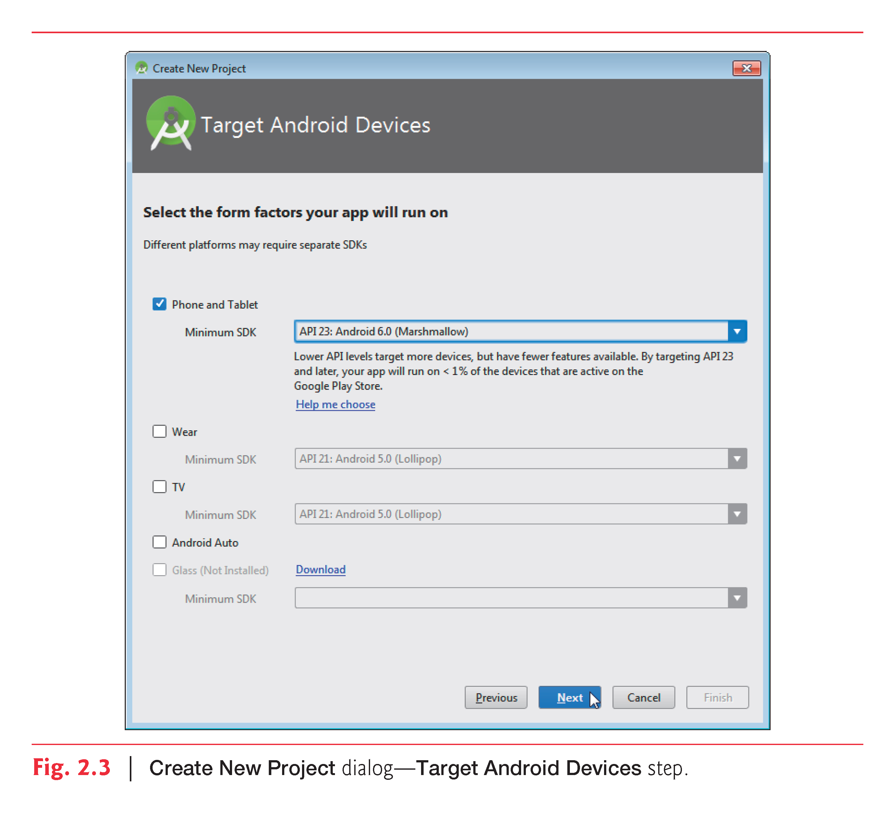

Slide 17
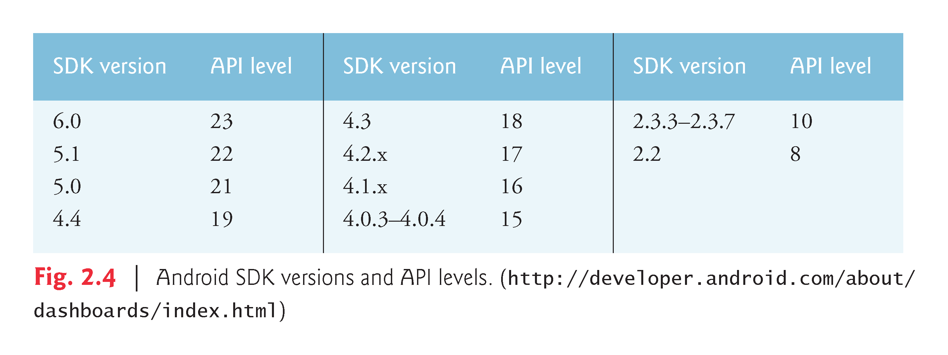

Slide 18
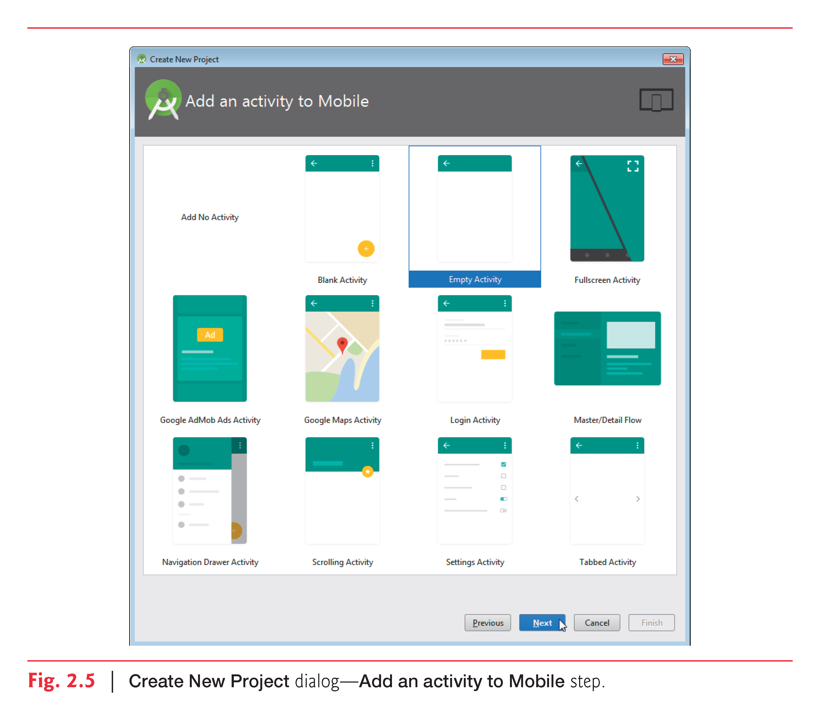

Slide 19
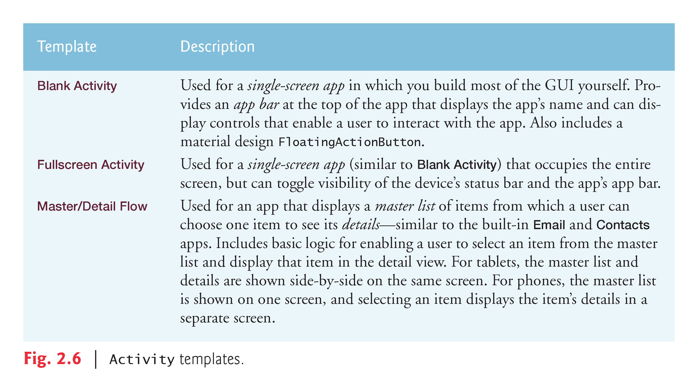

Slide 20
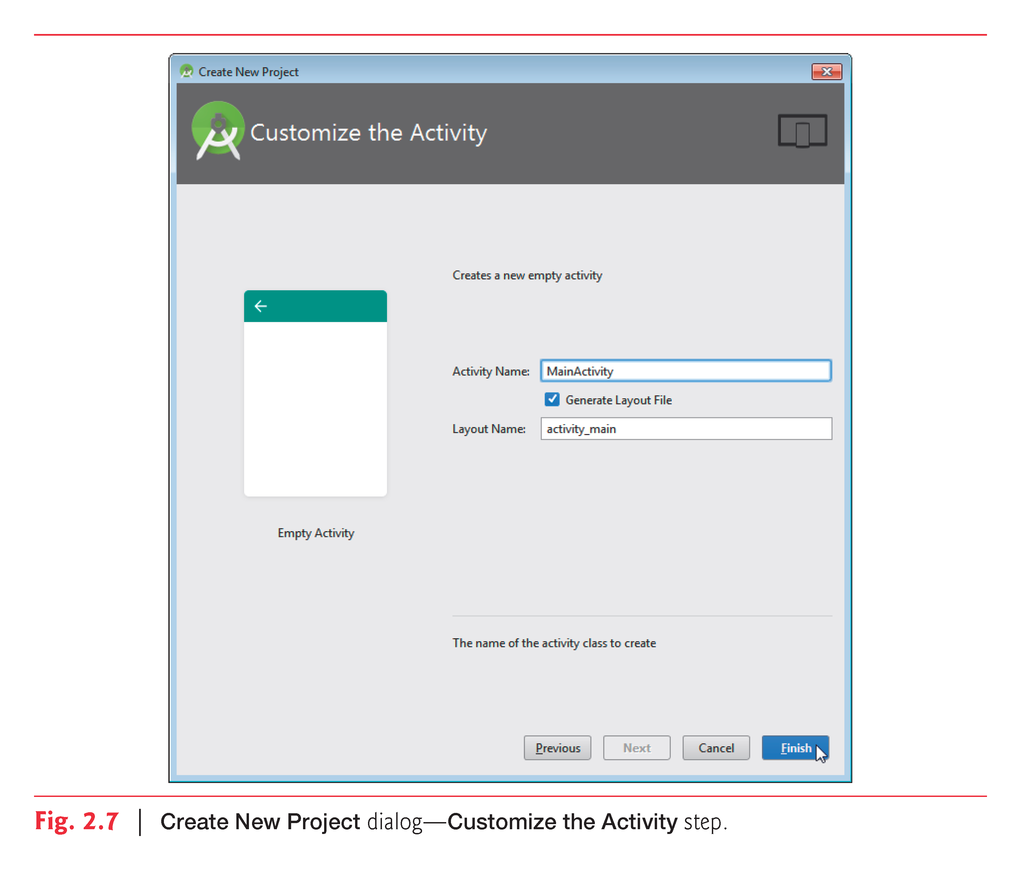

Slide 21
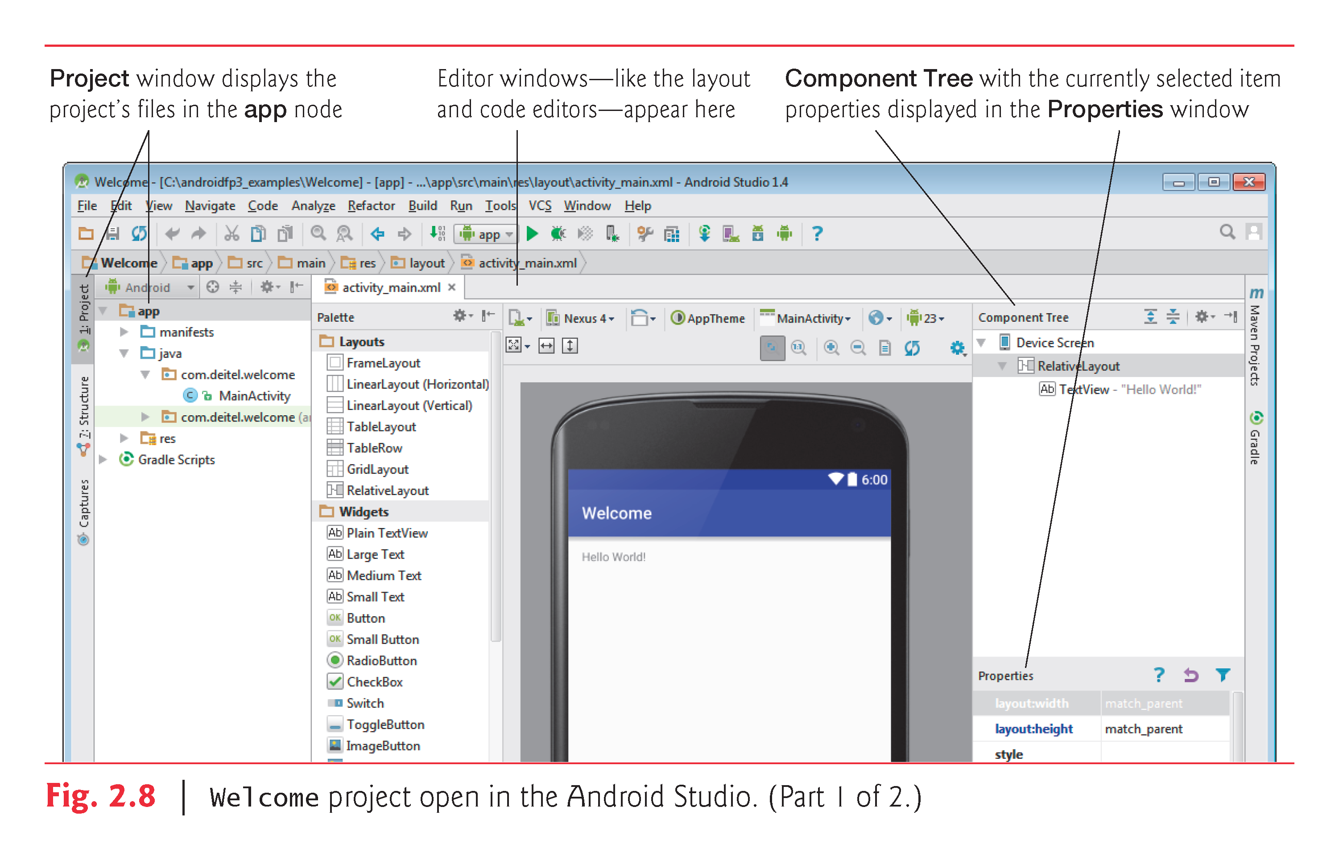

Slide 22
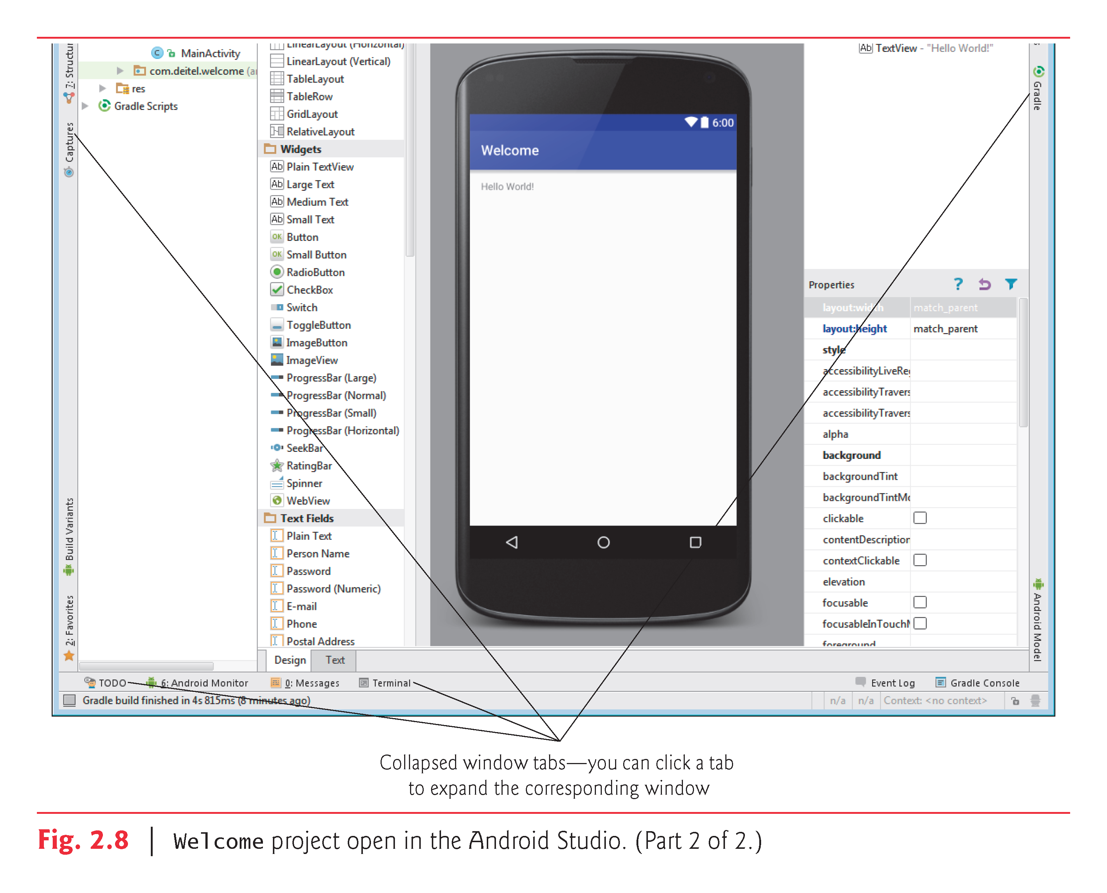

Slide 23
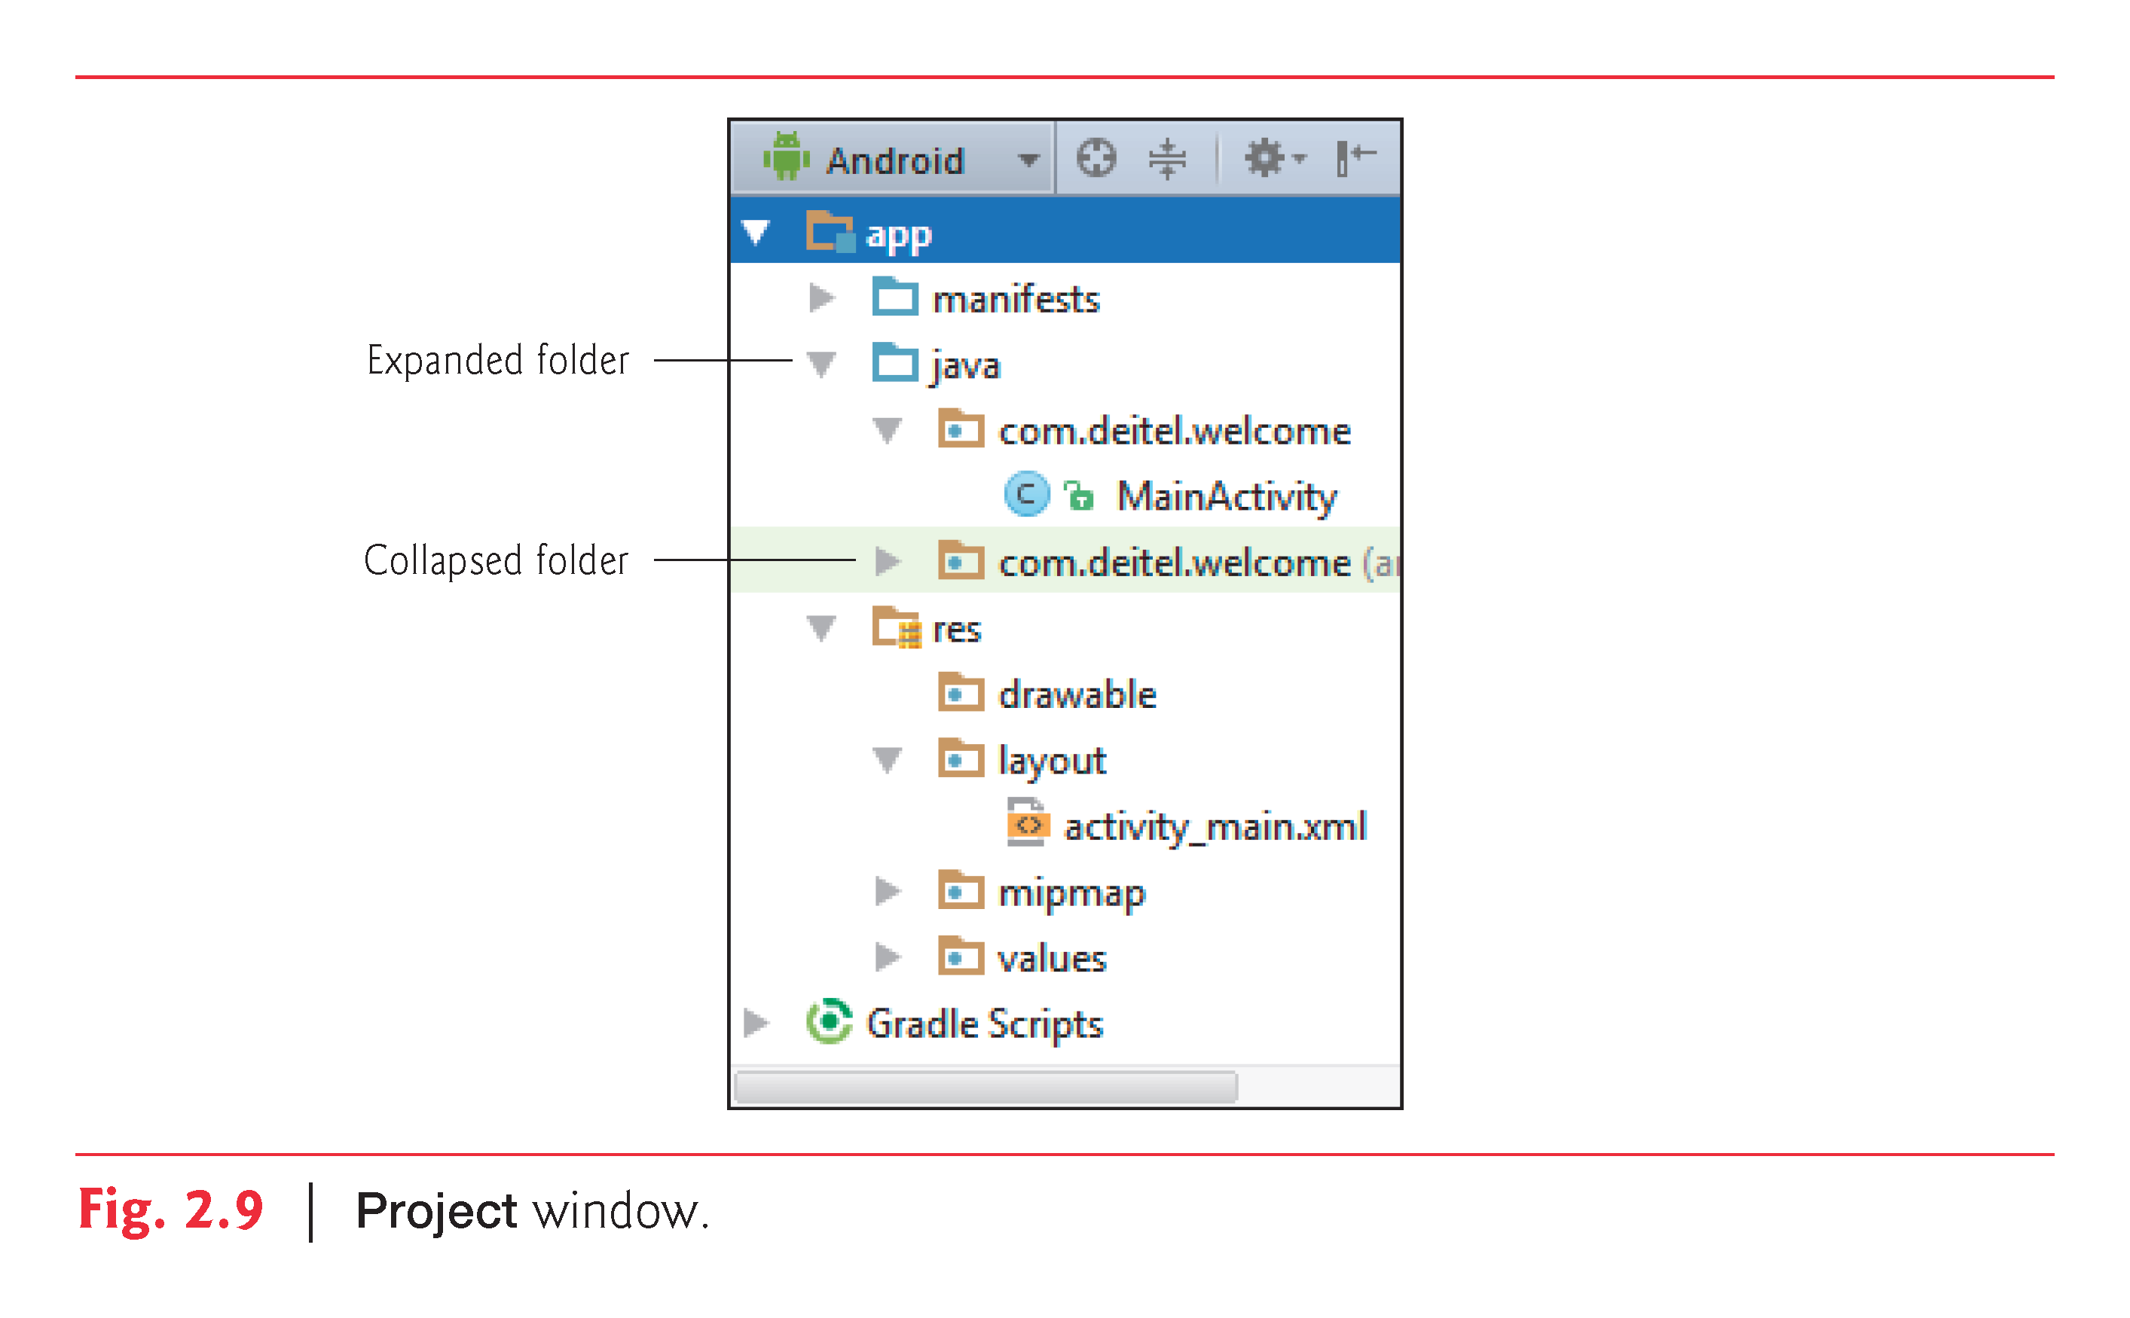

Slide 24
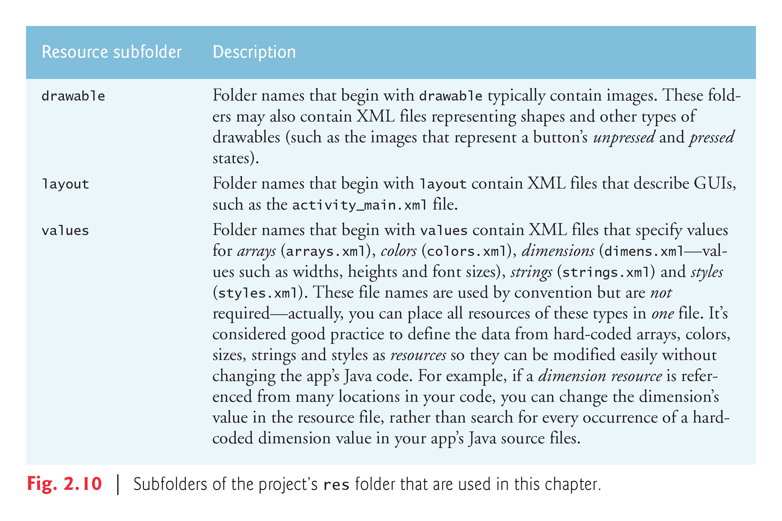

Slide 25
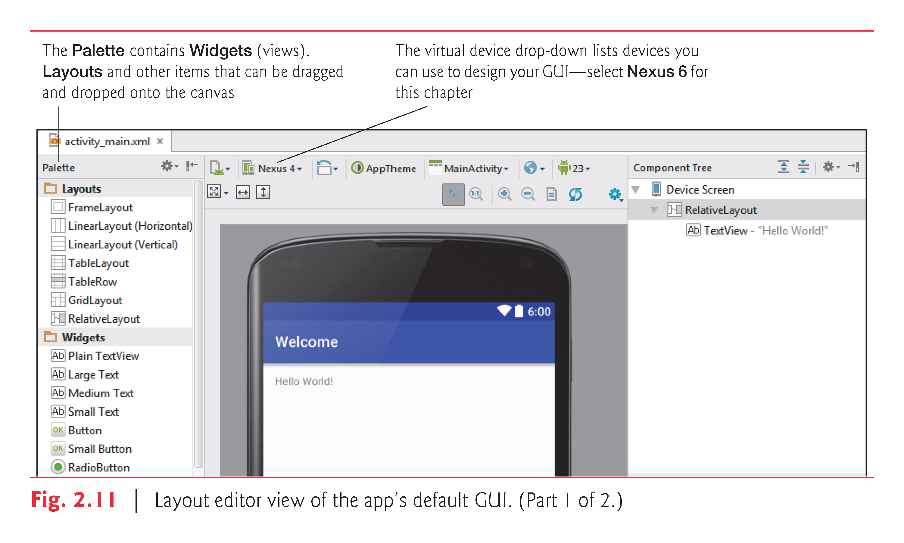

Slide 26
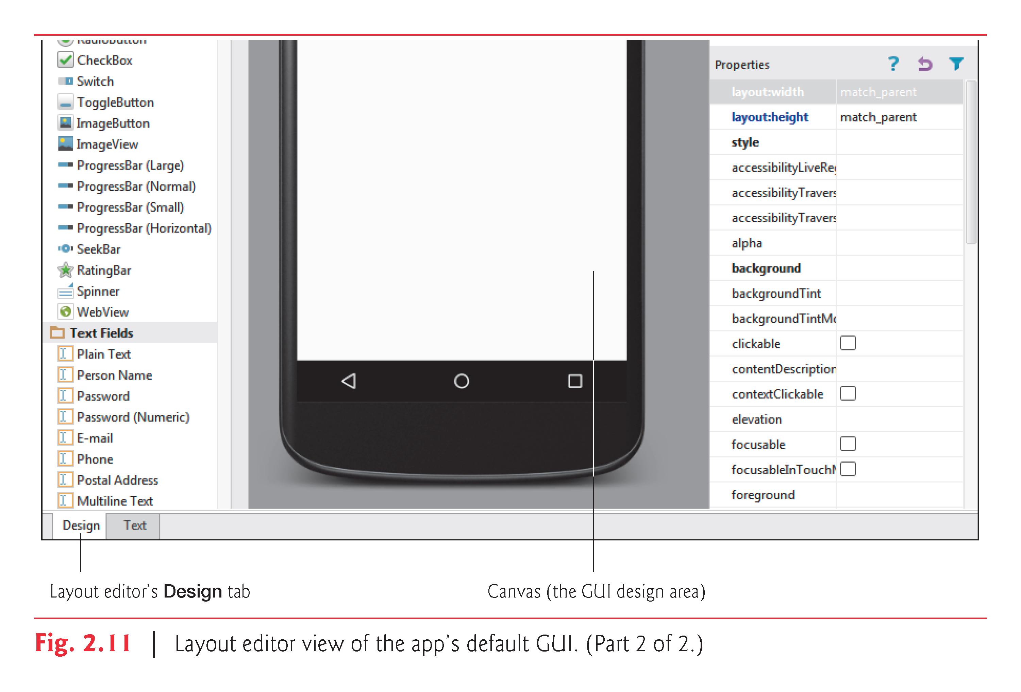

Slide 27
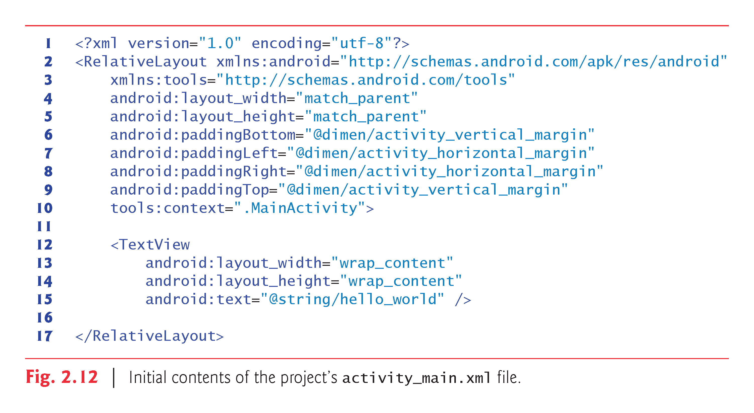

Slide 28
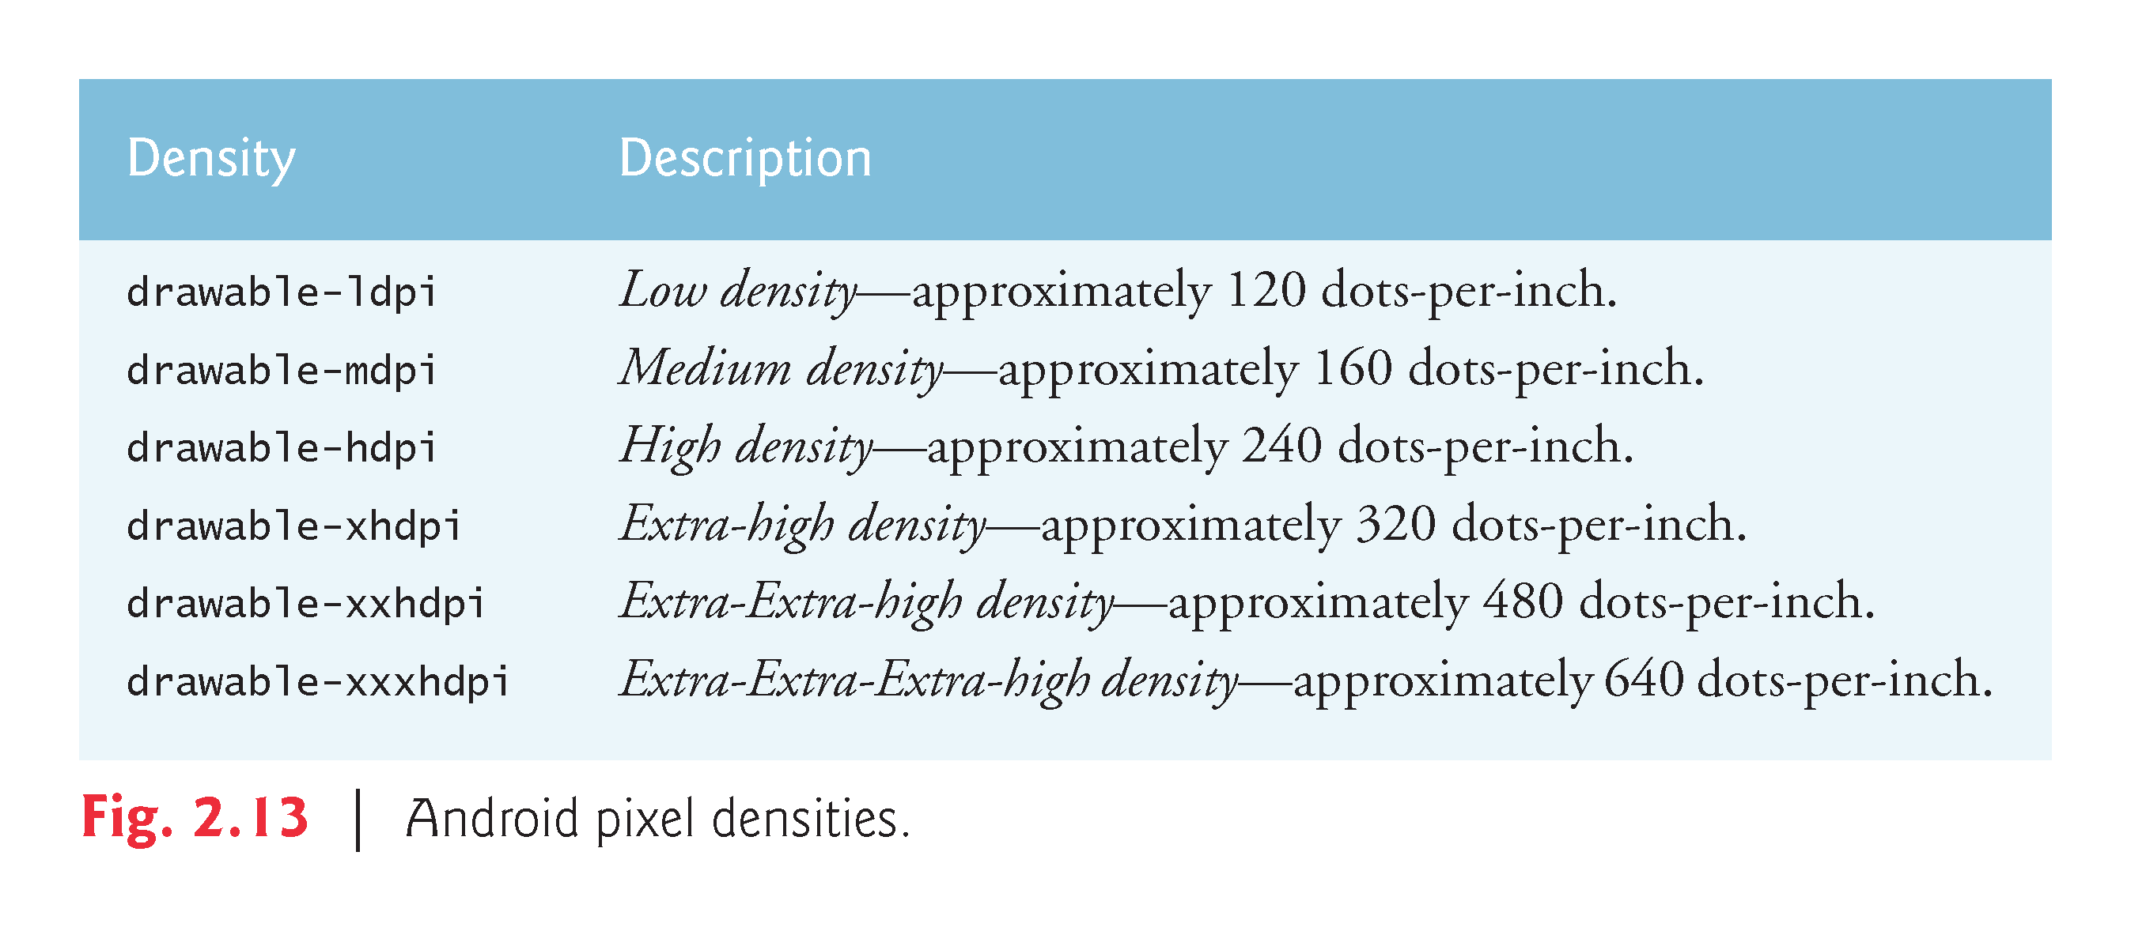

Slide 29
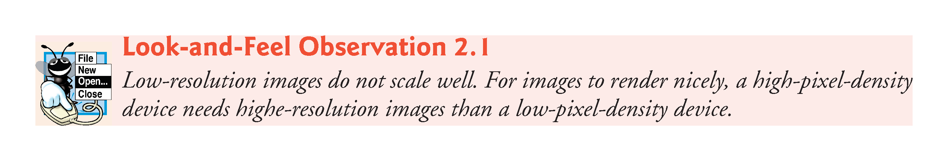

Slide 30
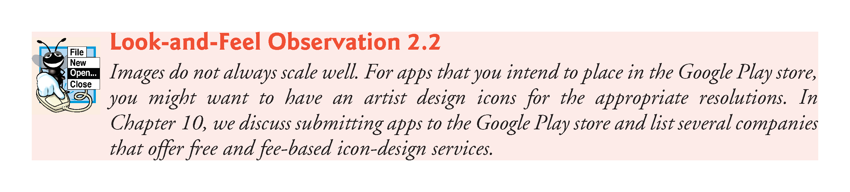

Slide 31
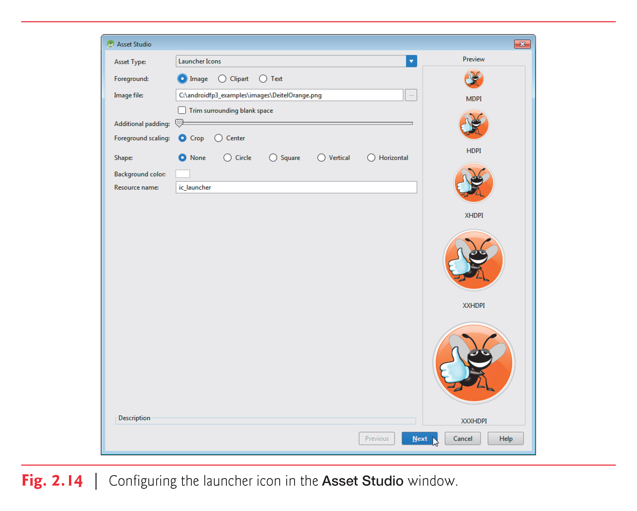

Slide 32
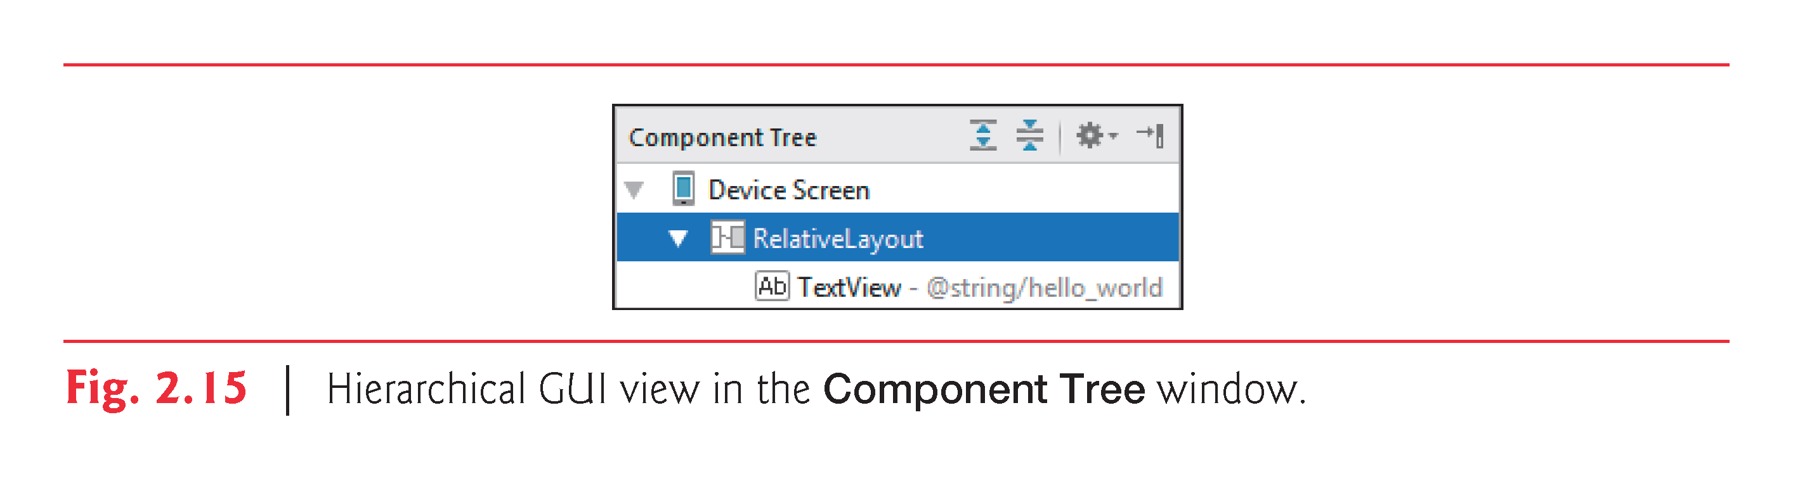

Slide 33
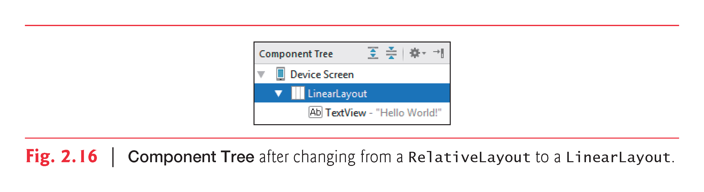

Slide 34
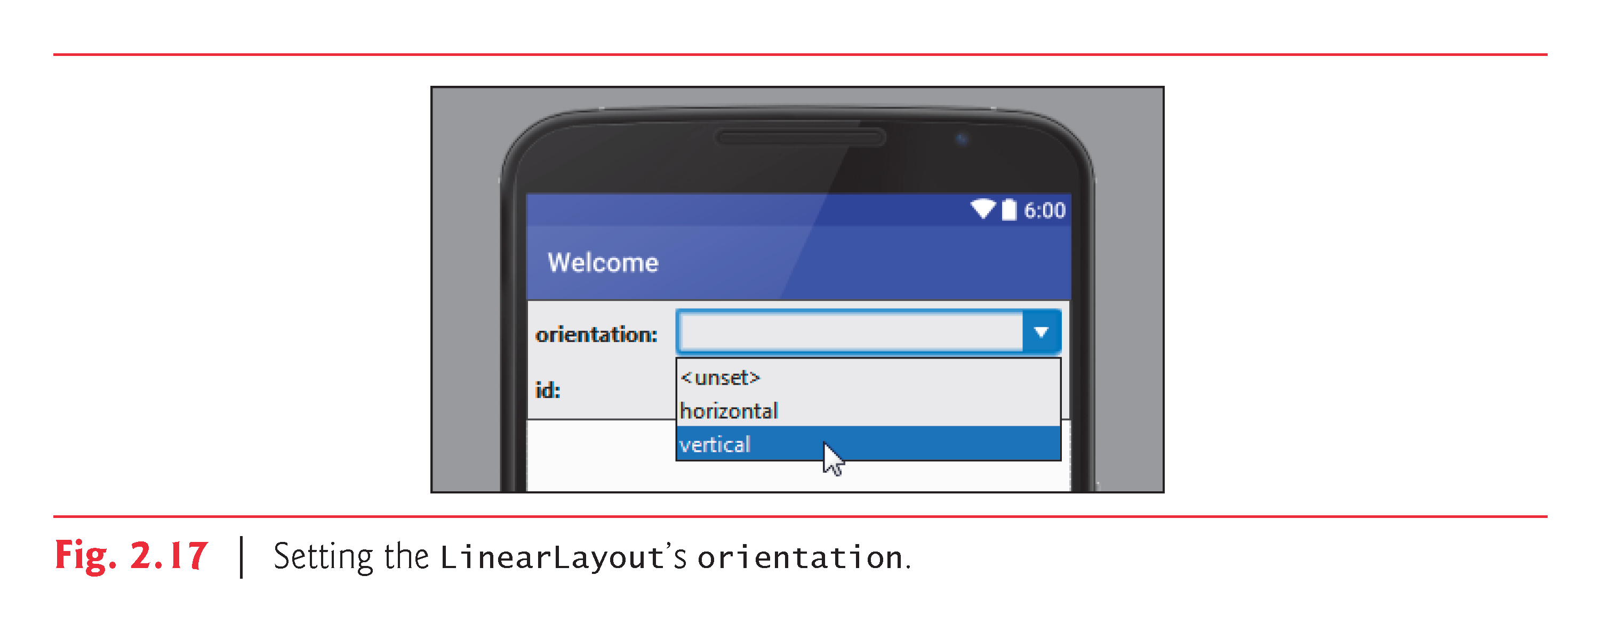

Slide 35
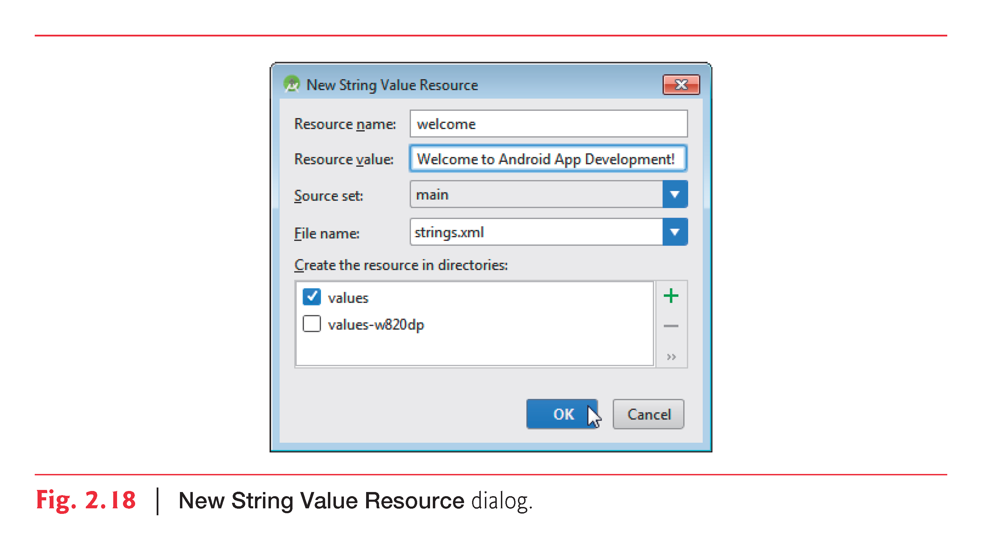

Slide 36
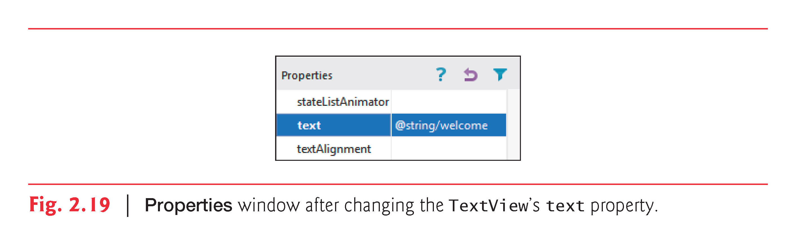

Slide 37
Scaled Pixels and Density-Independent Pixels
One density-independent pixel == one pixel on a 160-dpi screen
On a 240-dpi screen, each density-independent pixel will be scaled by a factor of 240/160 (i.e., 1.5)
100 density-independent pixels scales to 150 actual pixels
On a 120-dpi screen, each density-independent pixel is scaled by a factor of 120/160 (i.e., 0.75)
100 density-independent pixels scales to 75 actual pixels
http://developer.android.com/guide/practices/screens_support.html

Slide 38
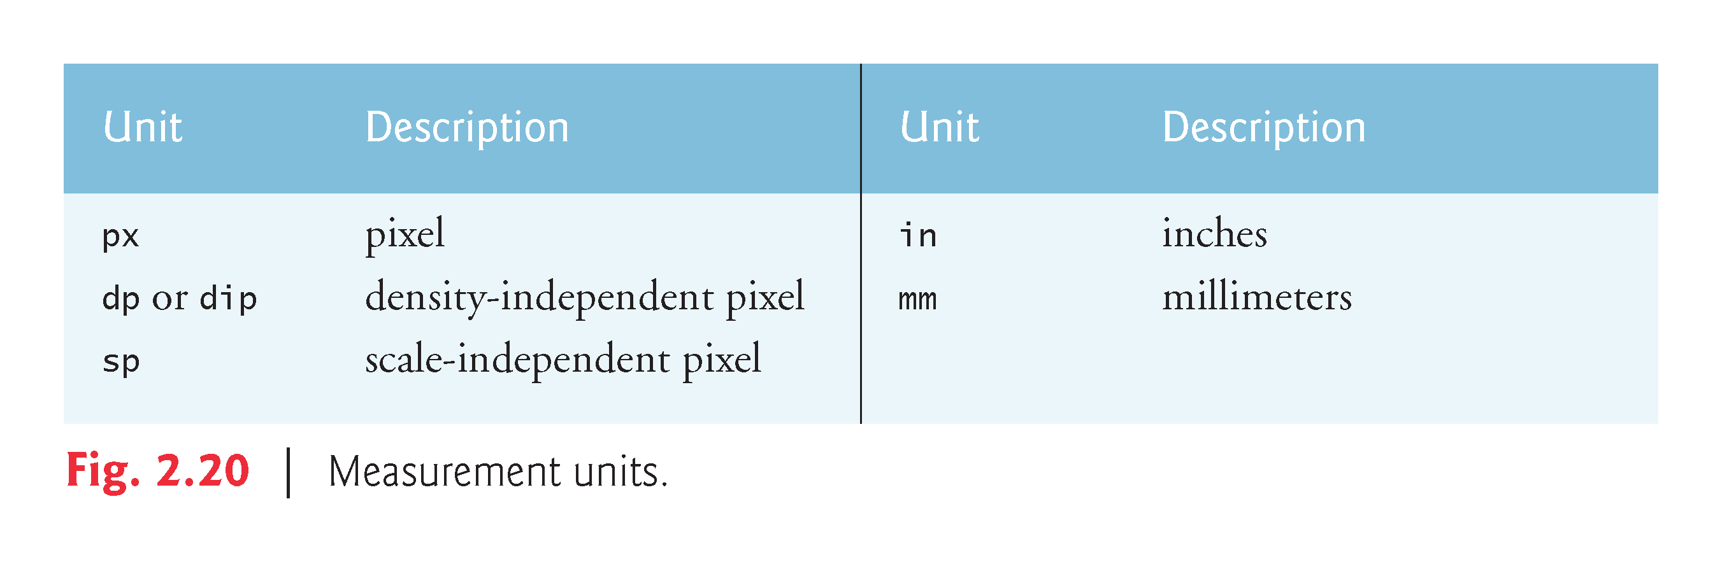

Slide 39
Colors
RGB
#RRGGBB
#RGB
ARGB
#AARRGGBB
#ARGB

Slide 40
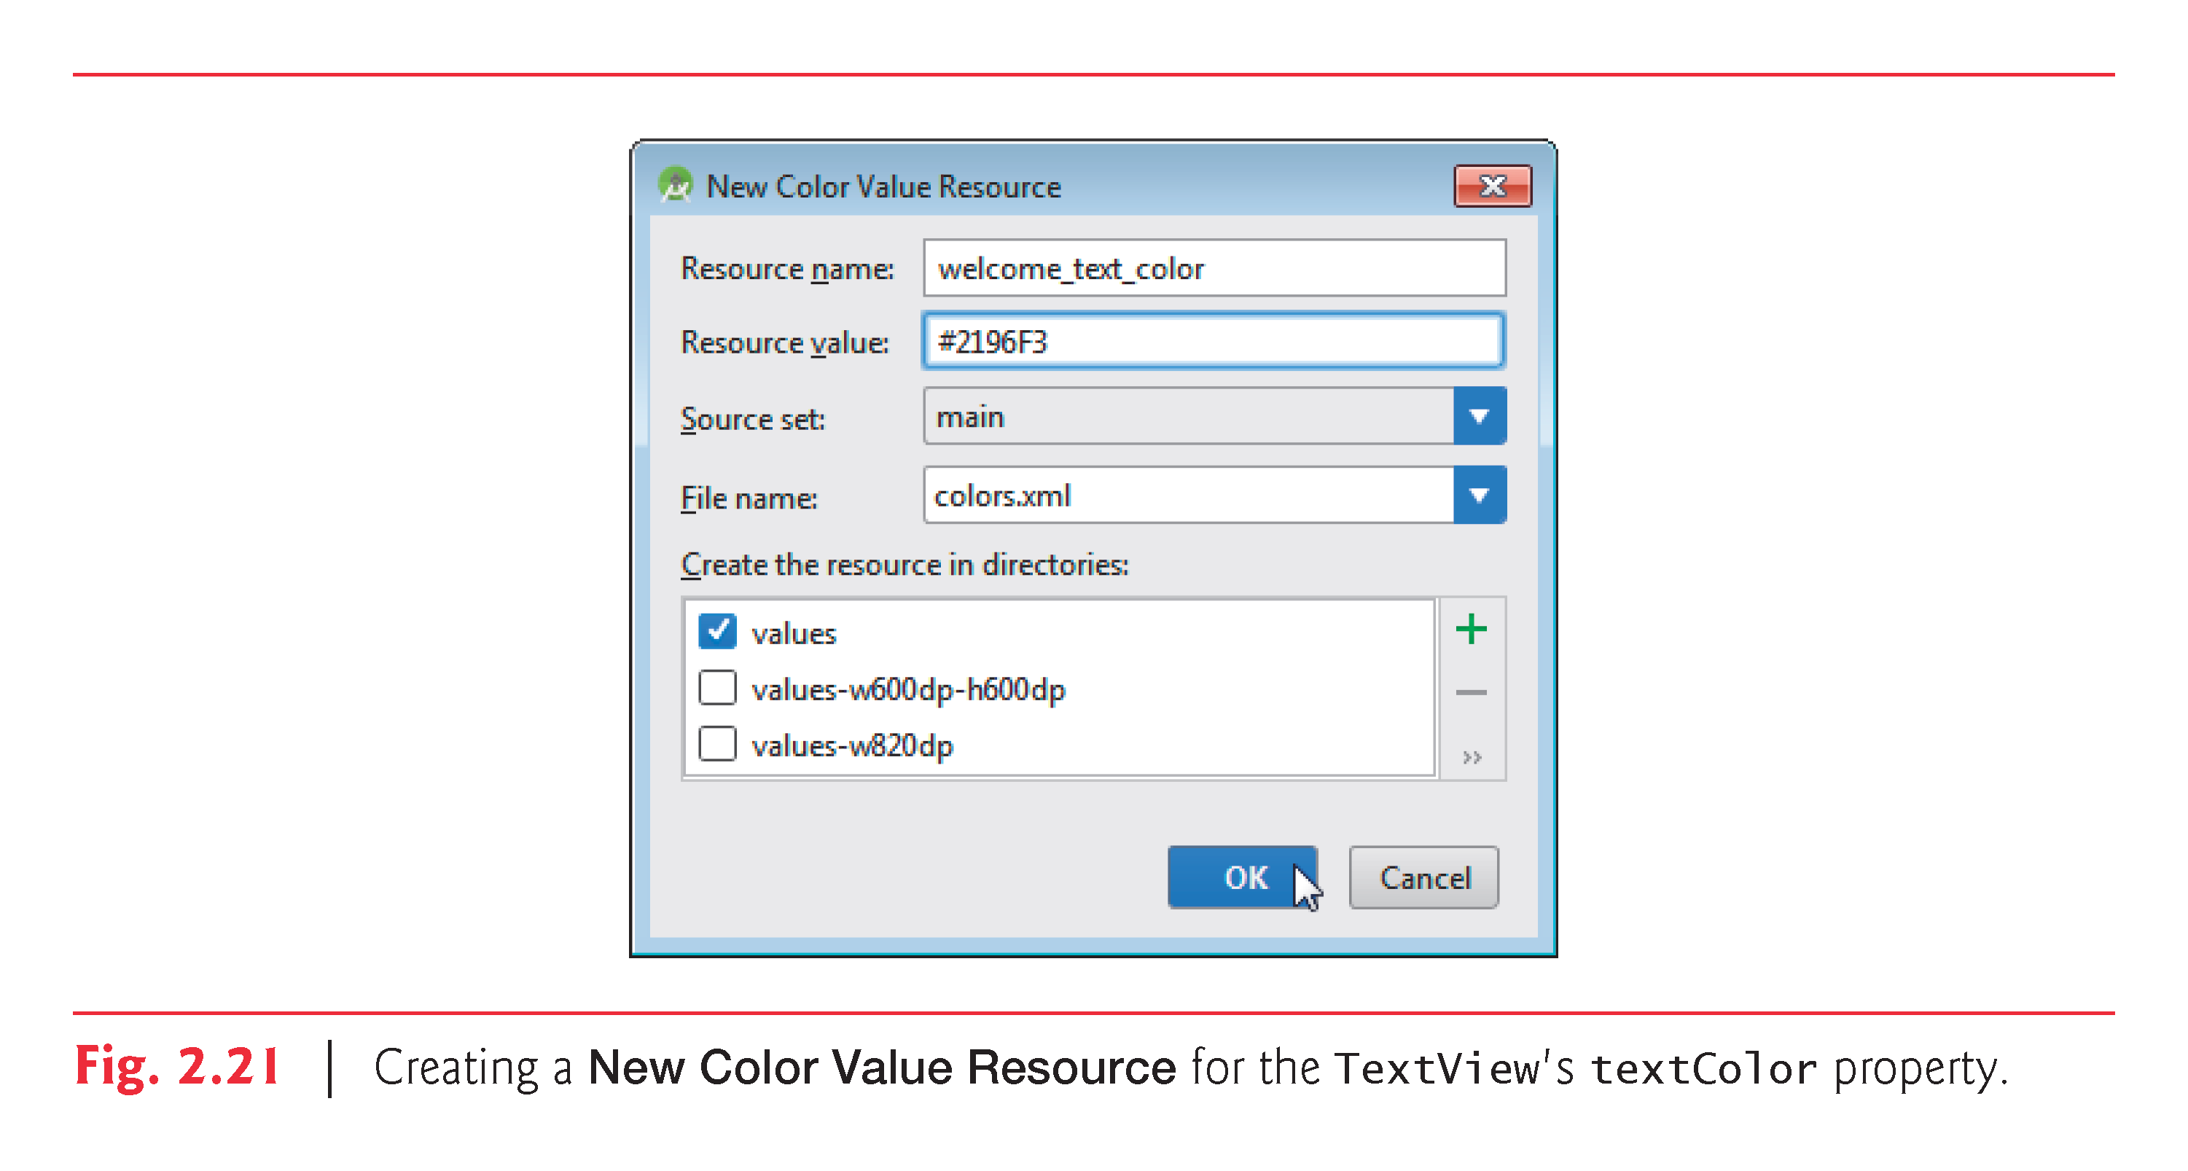

Slide 41
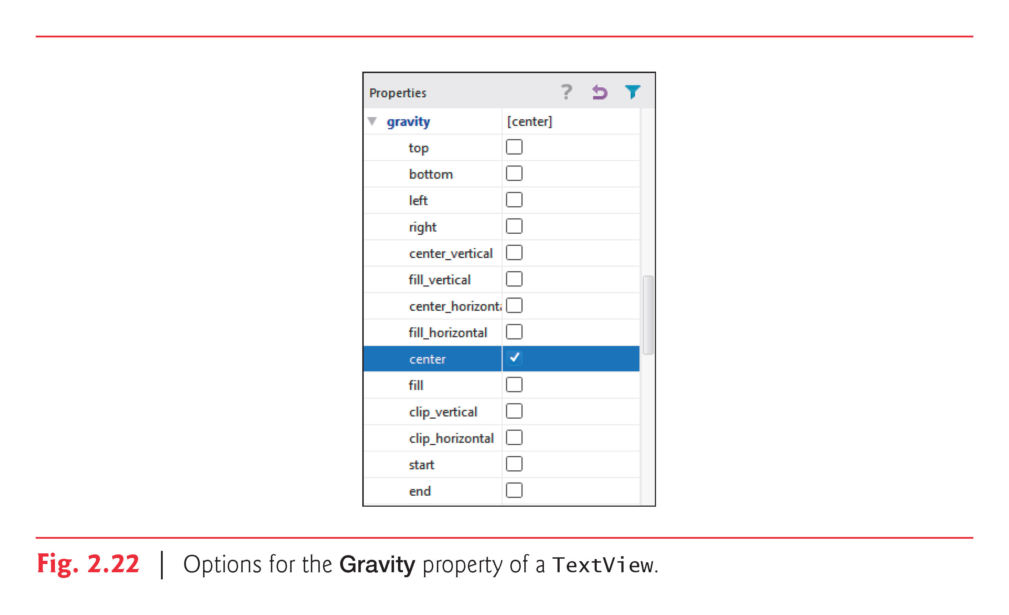

Slide 42
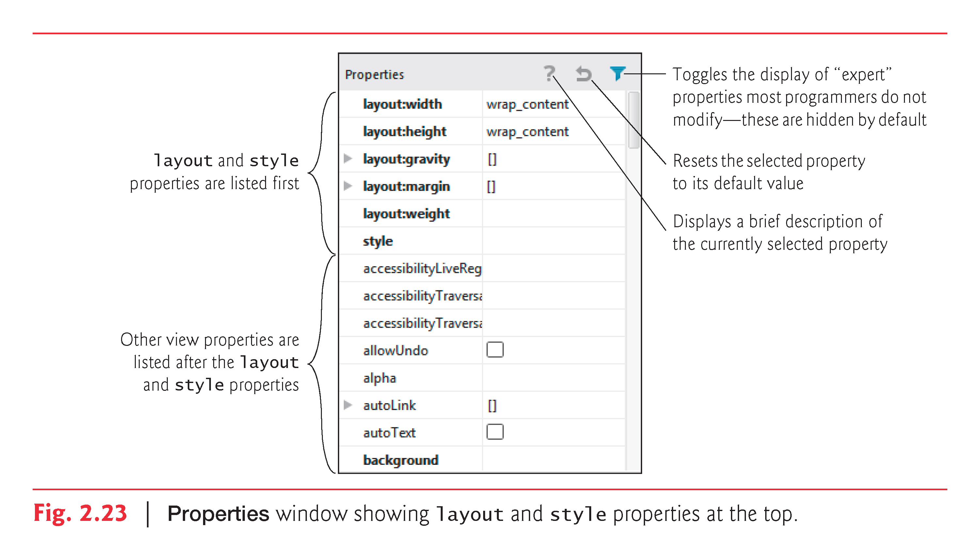

Slide 43
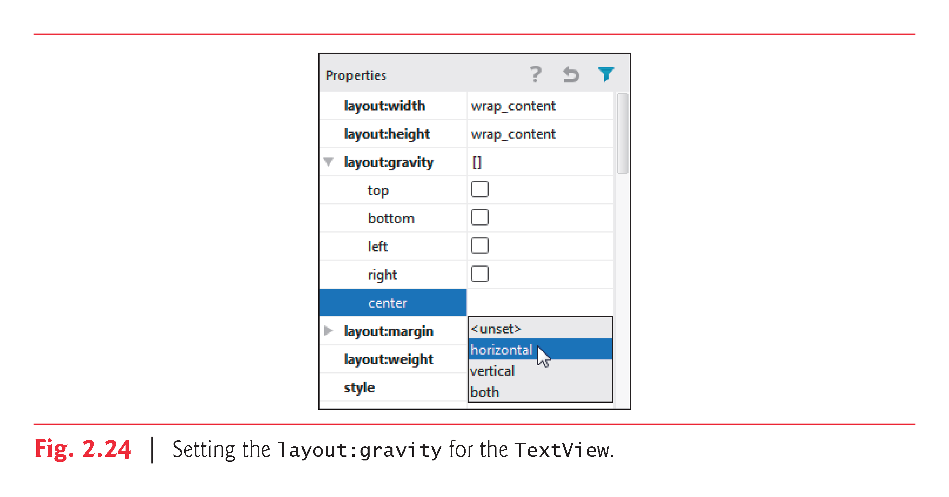

Slide 44
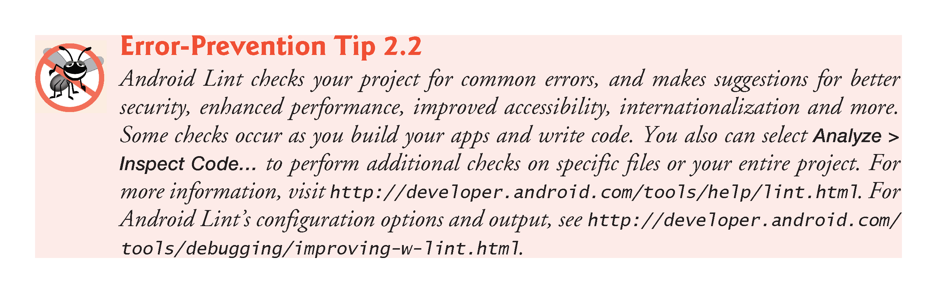

Slide 45
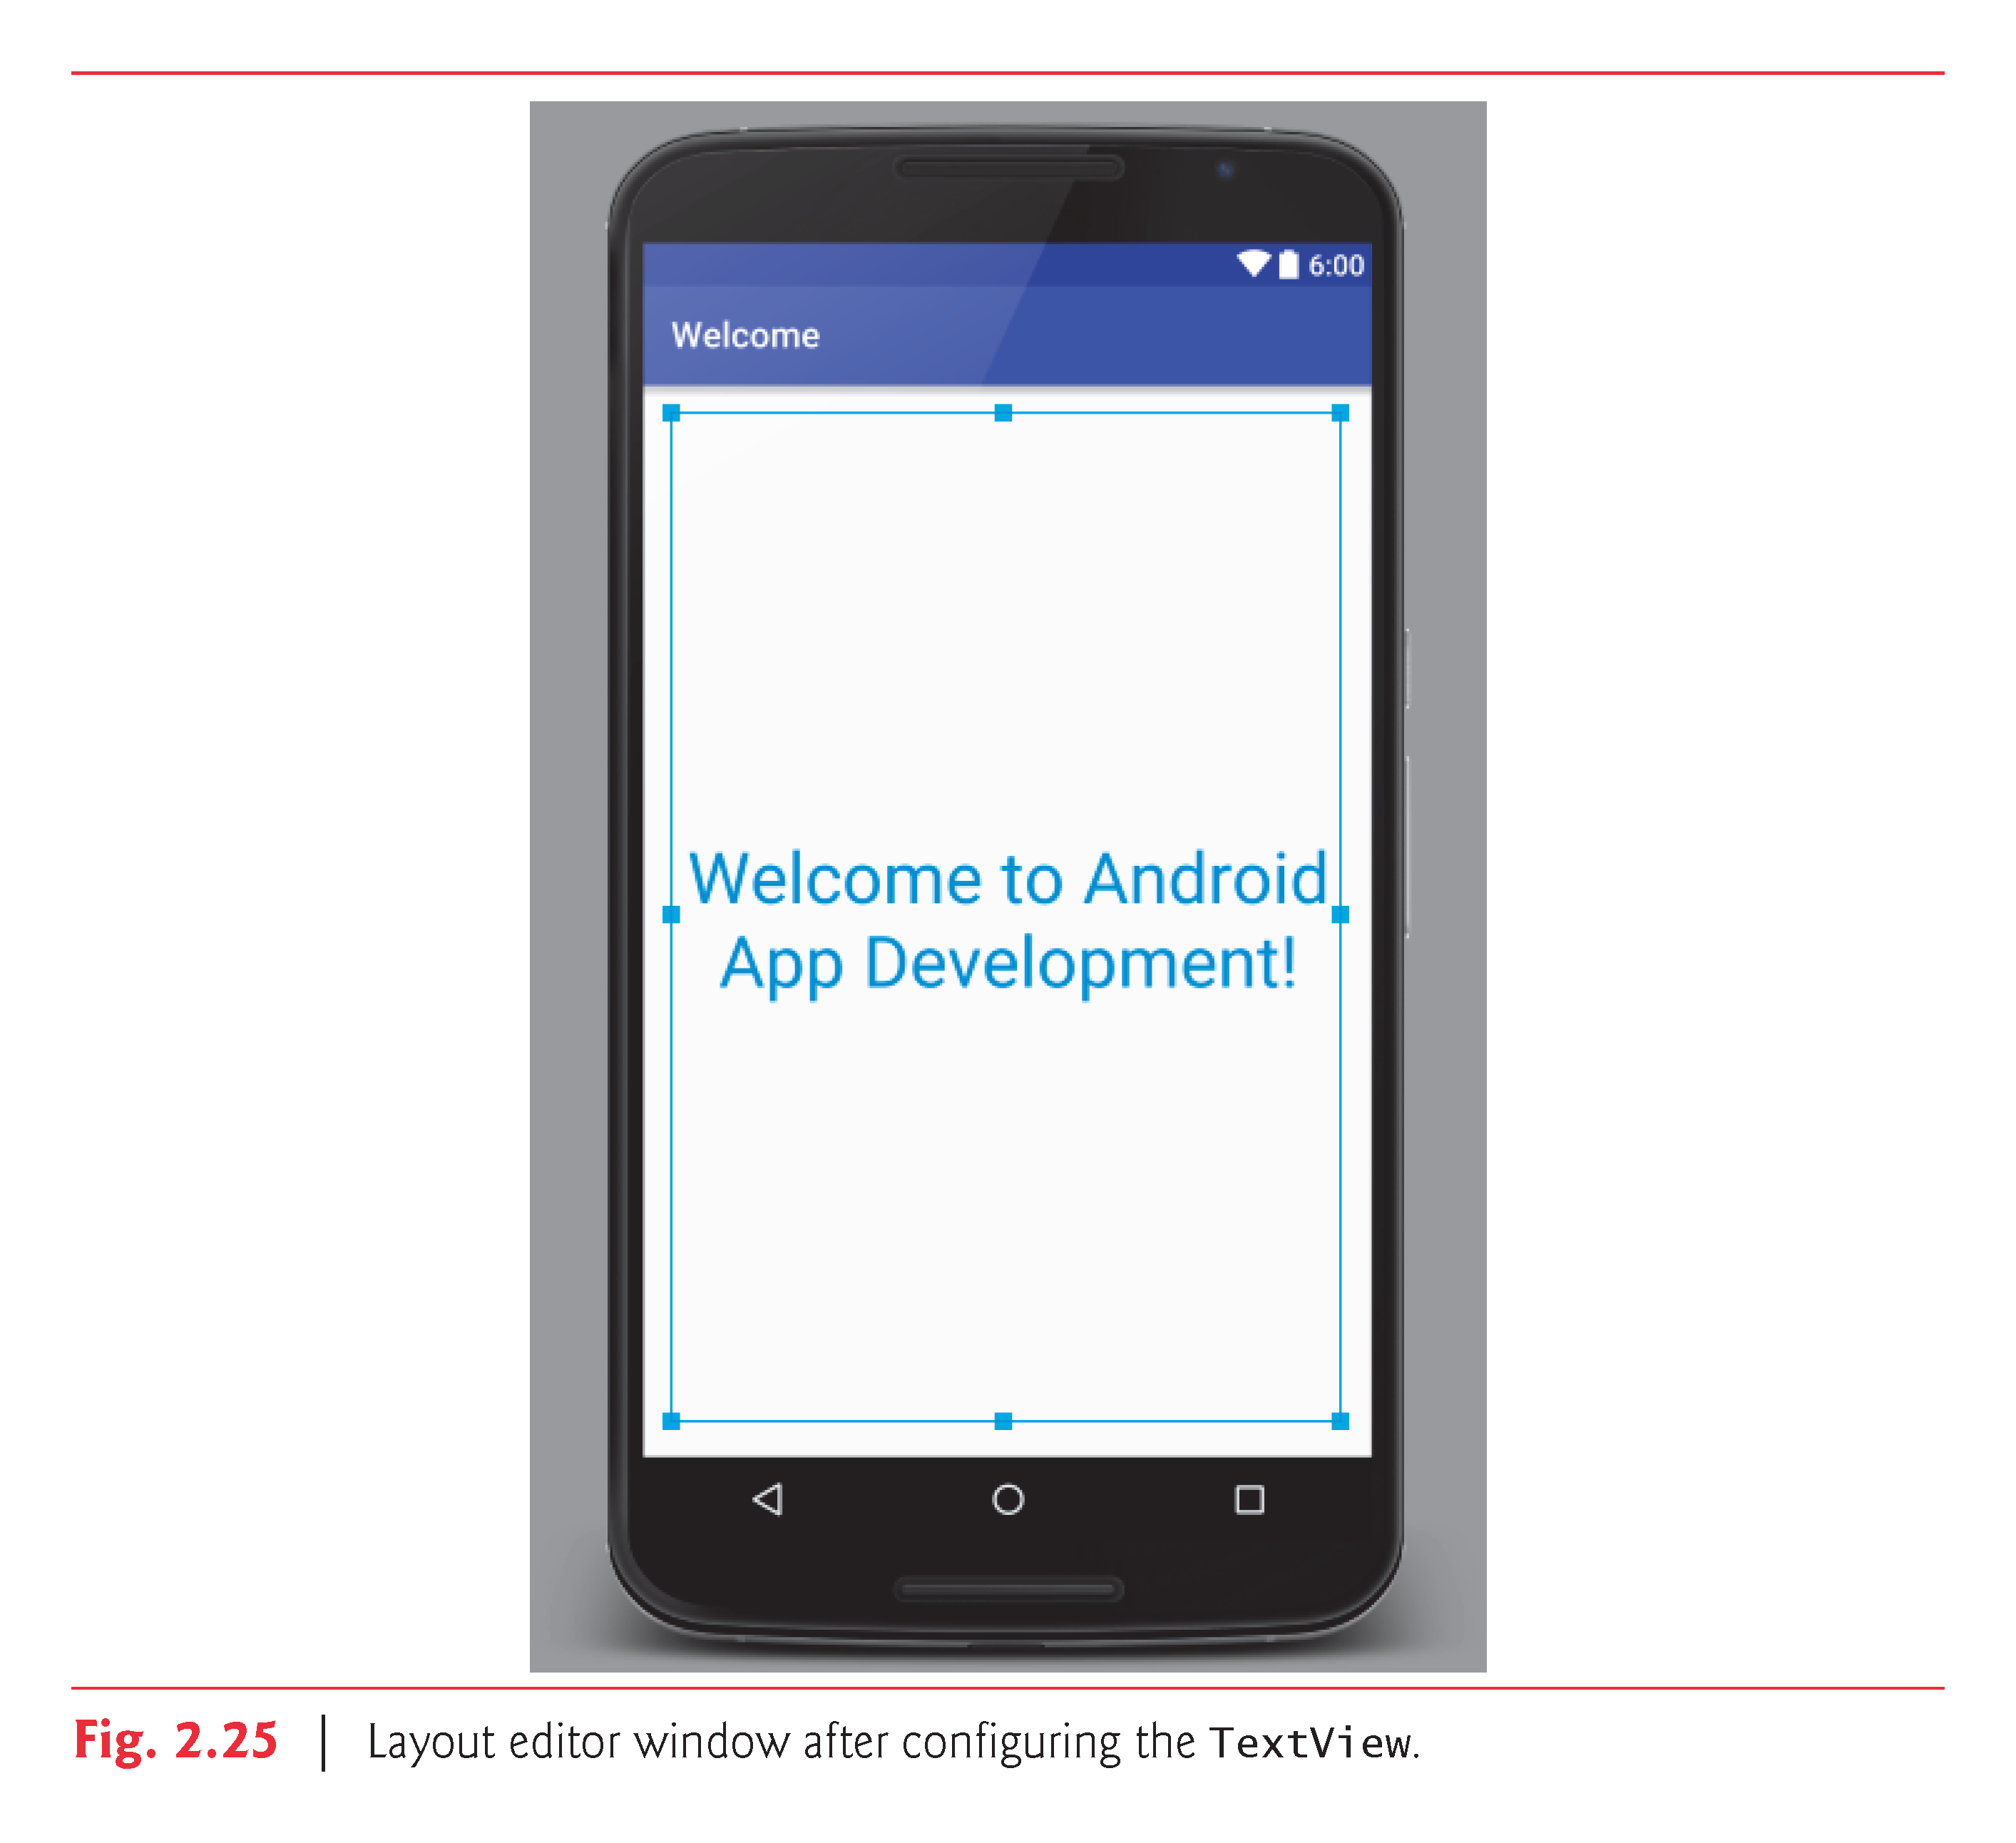

Slide 46
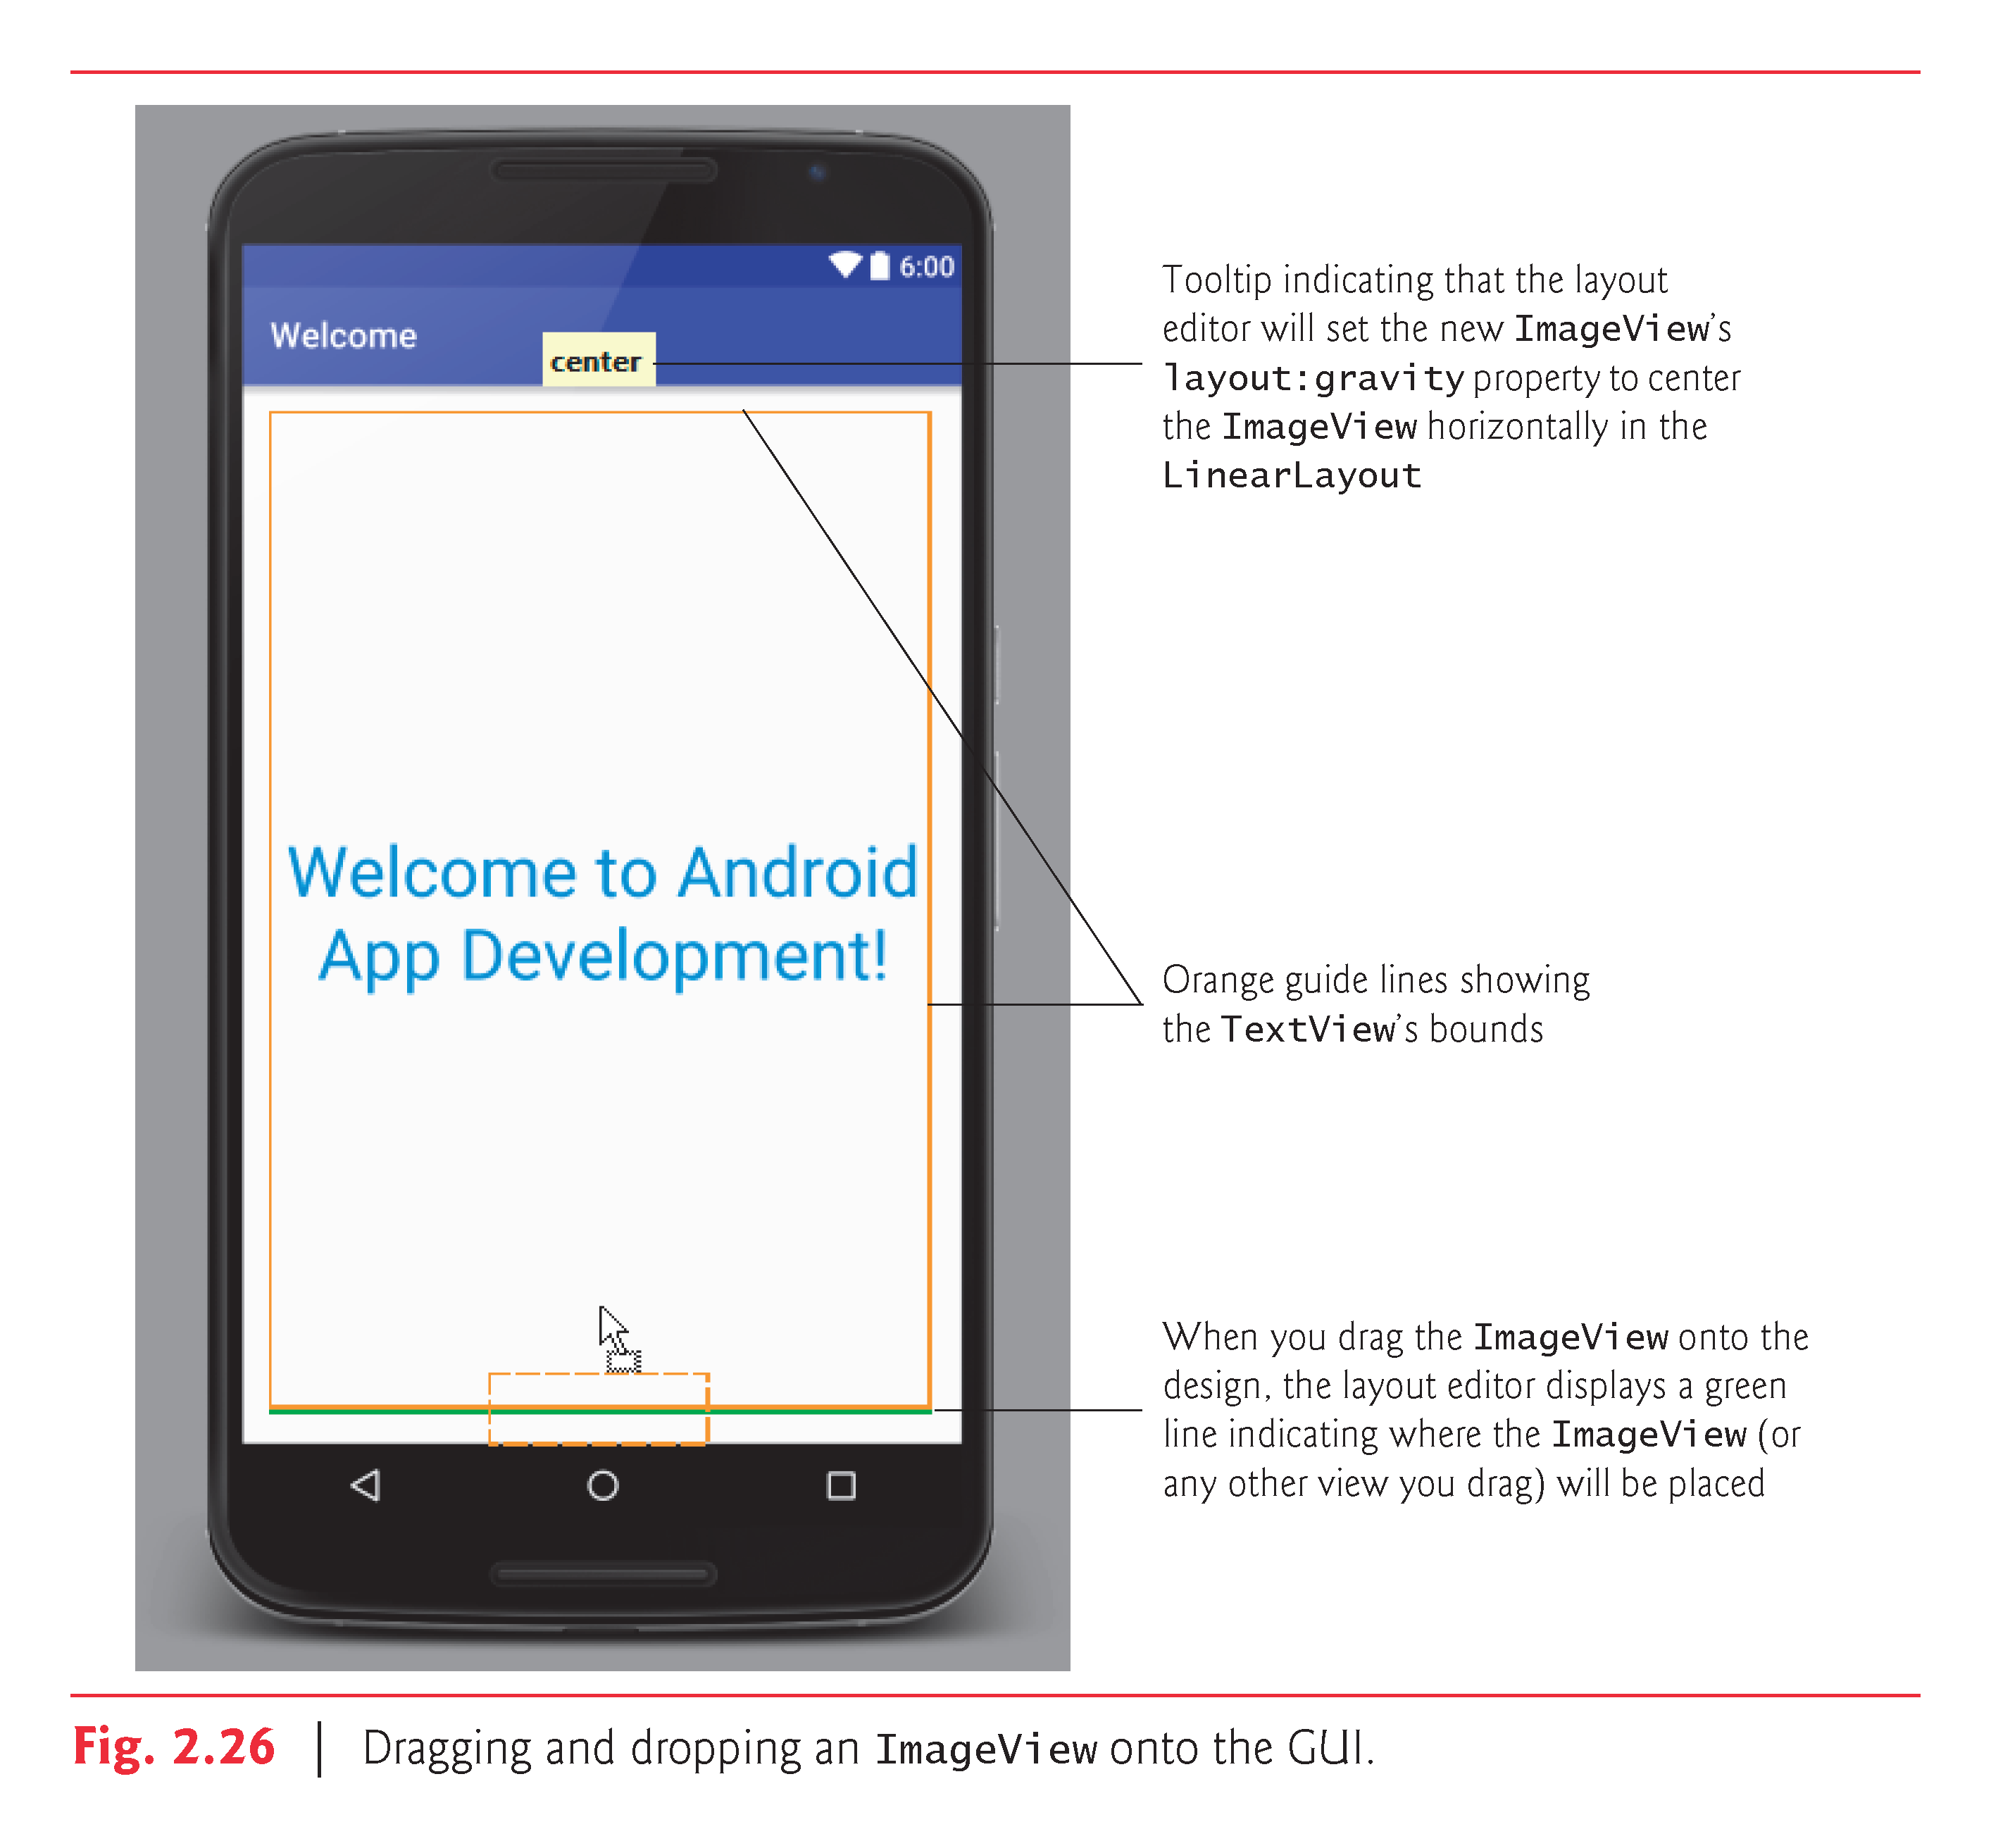

Slide 47
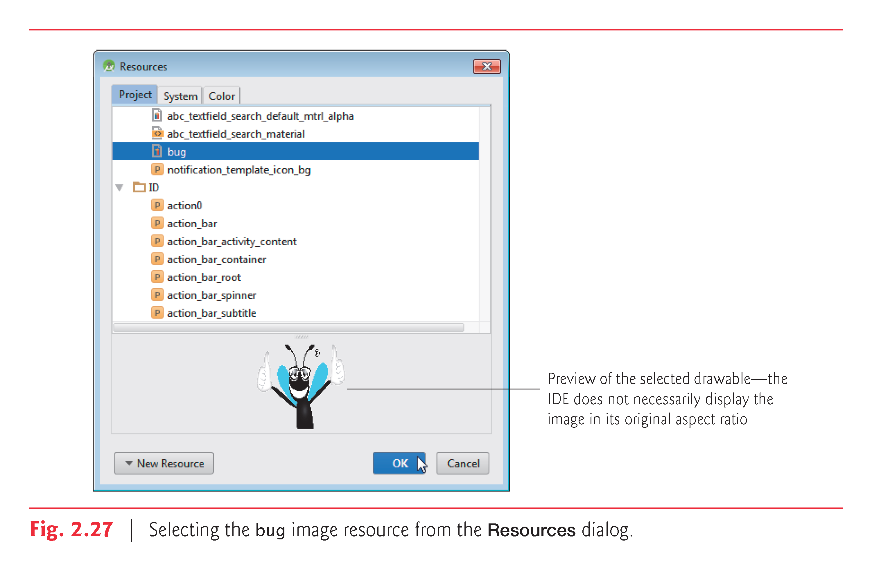

Slide 48
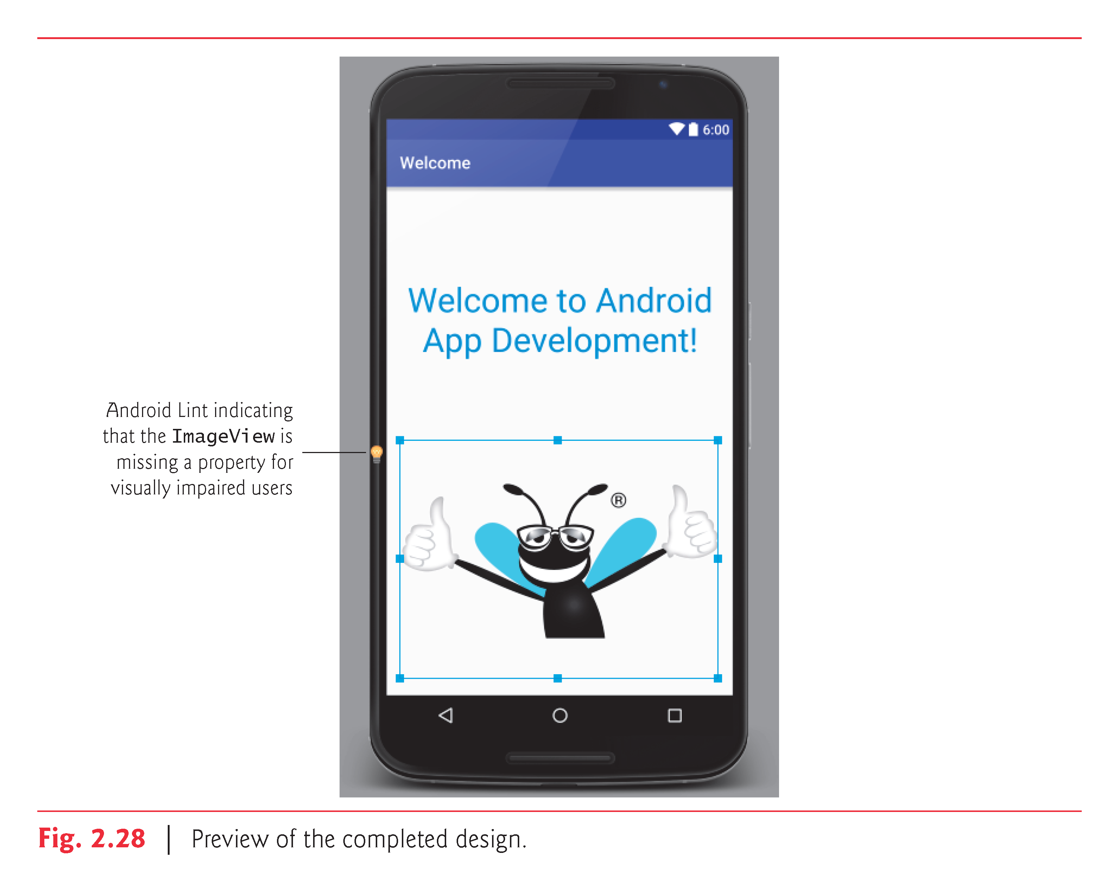

Slide 49
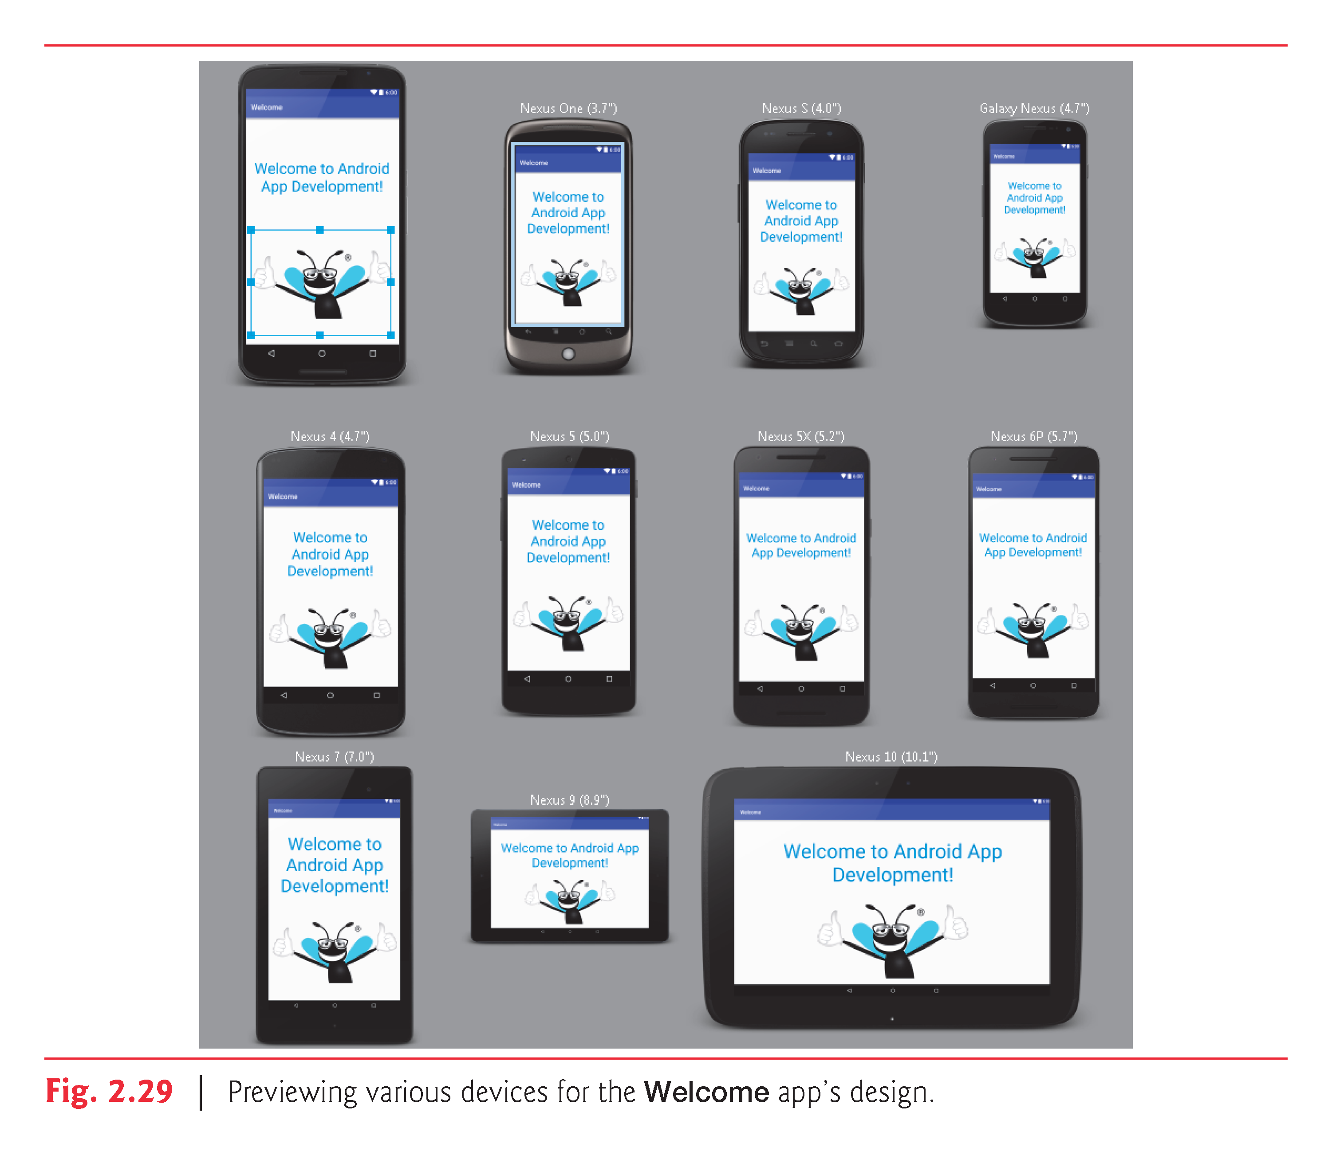

Slide 50
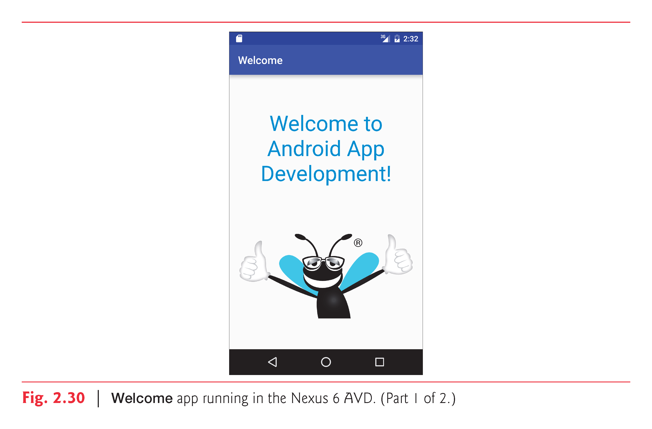

Slide 51
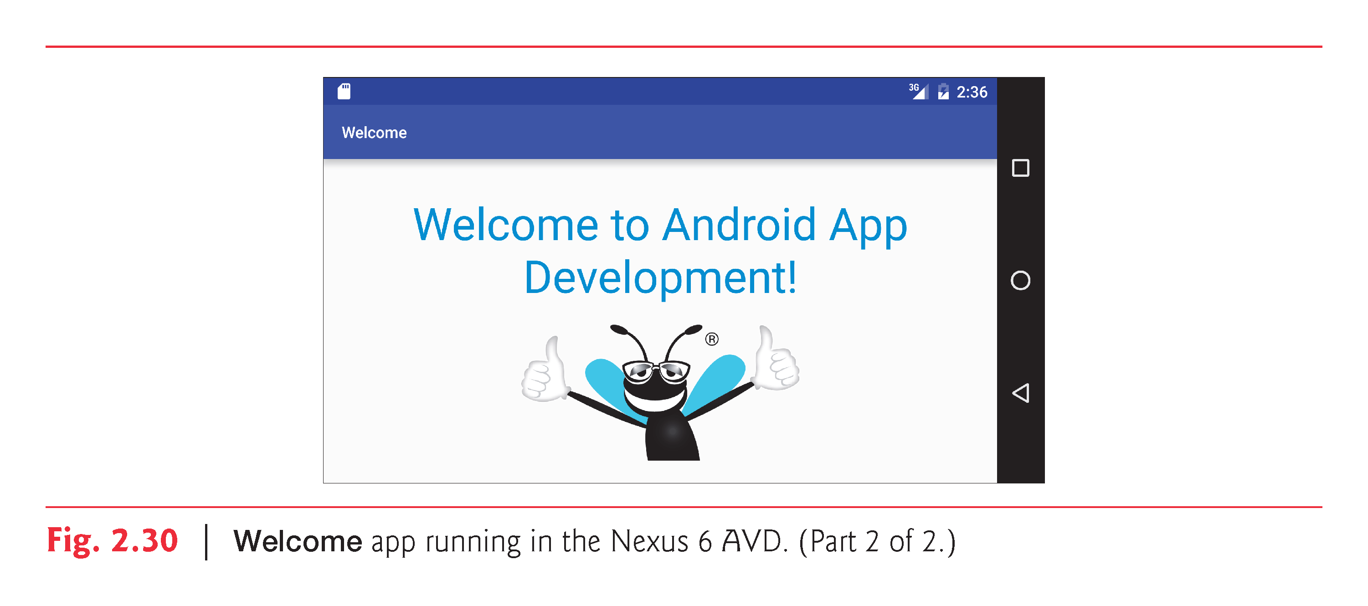

Slide 52
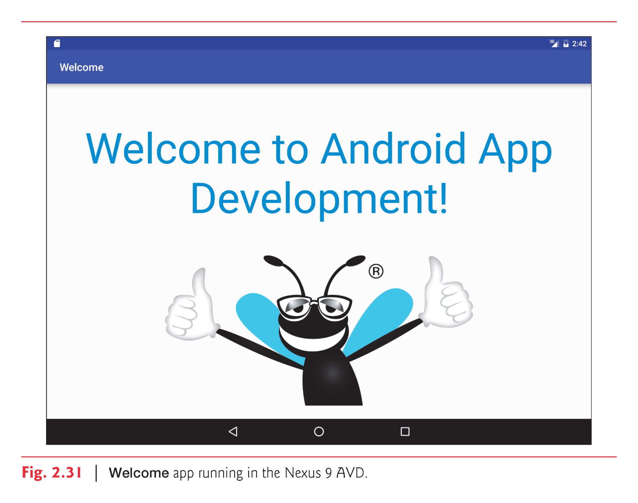

Slide 53
Naming Folders for Localized Resources
Localized strings placed in res subfolders
Android uses resource folder qualifiers to automatically choose the correct localized resources
values-fr would contain strings.xml for French
values-es would contain strings.xml for Spanish
May also include region information
values-en-rUS would contain strings.xml for U.S. English
values-en-rGB would contain strings.xml for U.K. English
Default resources used if localized ones not found

Slide 54
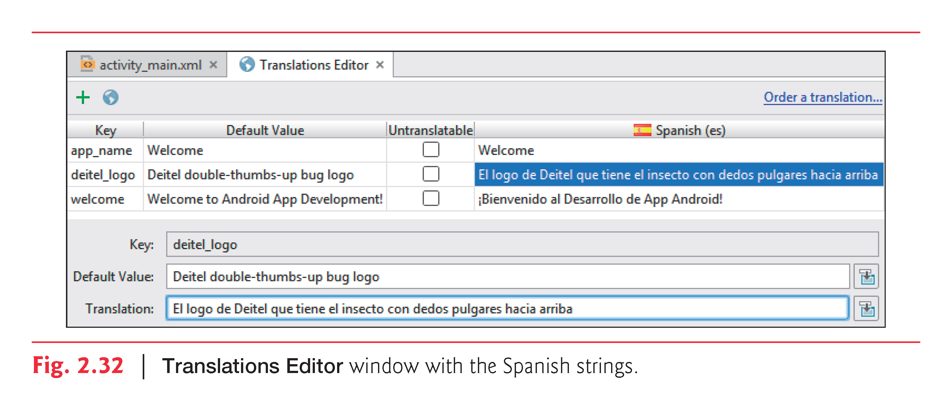

Slide 55
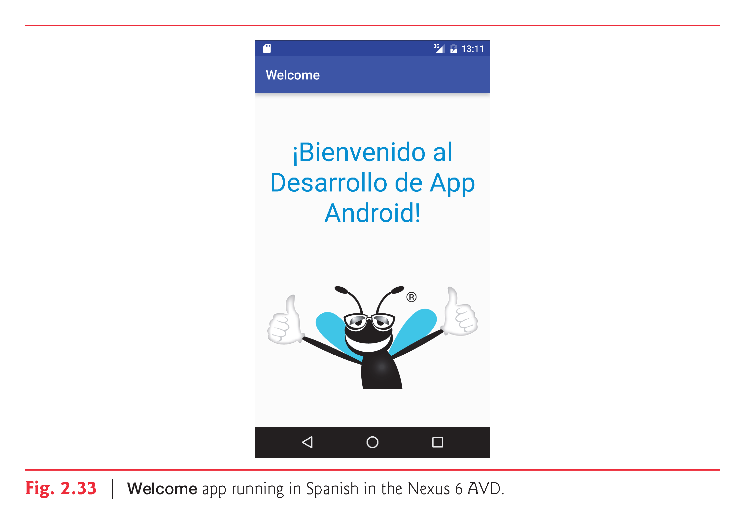

Slide 56


