Slide 1


"Time-Series Forecasting and Classification Models: A Machine Learning Approach"
Students
Omar Jabour 0224379
Layan Nofal 0228240
Ayham Obiedat 0221882
Alaa Al-Odat 2213116
Instructor: Dr. Ali Al-Rodan
Department of Artificial Intelligence / KASIT University of Jordan

Slide 2
Project Overview
The primary objective of this project is to evaluate the performance of various machine learning models on different types of datasets. By conducting a detailed comparison of these models, we aim to identify their advantages and disadvantages, ultimately determining the optimal model for each dataset type.
Classification Models
Naïve Bayes (NB): A probabilistic machine learning model based on Bayes Theorem, assuming independence between predictors, and is commonly used for classification tasks.
Support Vector Machine (SVM): A model that finds the hyperplane to separate data classes effectively.
Random Forest: An ensemble learning method using decision trees for robust classification.
Time-series Models
Echo State Network (ESN): A recurrent neural network using a fixed reservoir for time-series predictions.
Long Short-Term Memory (LSTM): A type of RNN designed to capture long-term dependencies in sequential data.
Bi-Directional LSTM (Bi-LSTM): An LSTM variant that processes input data in both forward and backward directions for improved context understanding.

Slide 3
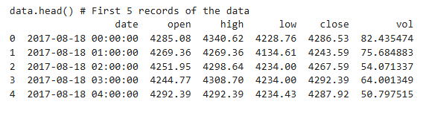
Datasets Description: Time-Series Data
For the time-series analysis, we utilized the 'Bitcoin Historical Price (1H, 2017.8-2020.3)' dataset, sourced from Kaggle. This dataset contains hourly price and volume data for Bitcoin (BTC), the most popular cryptocurrency, spanning from August 2017 to March 2020. The primary objective of this dataset was to forecast the open price for subsequent time intervals.
Dataset attributes
Date: Timestamps marking hourly intervals.
Open: The initial price of Bitcoin at the beginning of each hour.
High: The maximum price of Bitcoin within the hour.
Low: The minimum price of Bitcoin within the hour.
Close: The final price of Bitcoin at the end of the hour.
Vol: The total traded volume of Bitcoin within the hour.

Slide 4
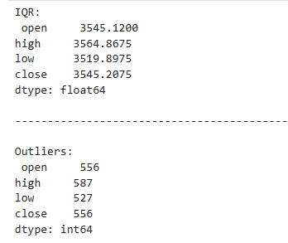
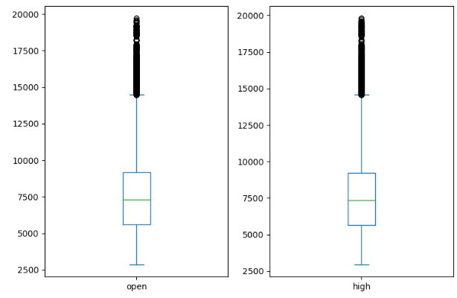
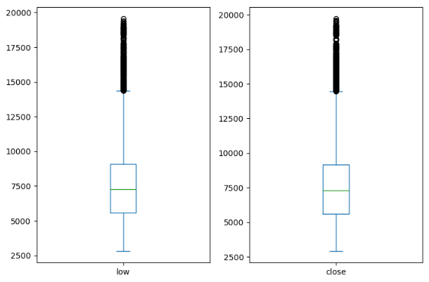
Time-series Preprocessing
Volume Column Removal:
The volume column was dropped as it was not relevant to the forecasting task, leading to improved model results.
Date Column Transformation:
The date column was converted into a pandas datetime format for better data manipulation and indexing.
Null Value Handling:
The dataset was checked for null values, and any rows or columns containing nulls were removed to avoid negative impacts on the data quality.
Outlier Detection and Analysis:
Outliers were identified using the Interquartile Range (IQR) method, revealing approximately 550 outliers per column. Upon further inspection, it was found that these outliers corresponded to a natural price pump in late 2018, which was considered valid and retained in the dataset.
Normalization:
The data was normalized using StandardScaler, which standardizes features by scaling them to have a mean of 0 and a standard deviation of 1. This step ensured that the data was ready for training.

Slide 5
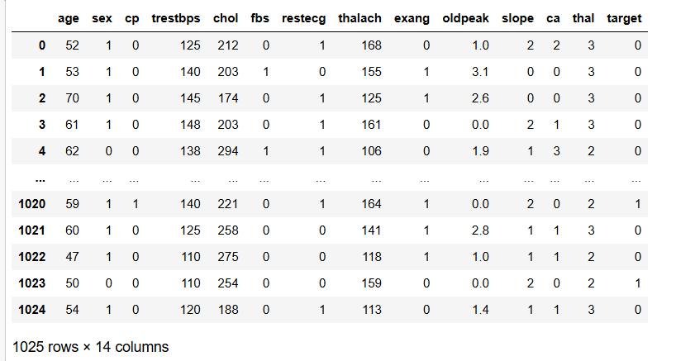
Datasets Description: Classification Data
About the dataset: This data set dates from 1988 and consists of four databases: Cleveland, Hungary, Switzerland, and Long Beach V. It contains 76 attributes, including the predicted attribute, but all published experiments refer to using a subset of 14 of them. The "target" field refers to the presence of heart disease in the patient. It is integer valued 0 = no disease and 1 = disease

Slide 6
Methodology (Time-series)
The dataset was divided into three subsets:
Training Set: 60% of the data
Validation Set: 9.5% of the data
Testing Set: 31.5% of the data
This split ratio was chosen as it provided the most efficient balance for our models, minimizing both underfitting and overfitting. Initially, we experimented with a split ratio of 70% training, 10% validation, and 20% testing, but this configuration resulted in suboptimal Mean Squared Error (MSE) values. Adjusting to the current split significantly improved the model's performance.
Echo State Network (ESN):
Model Architecture:
Reservoir: Contained 40 neurons with randomly initialized weights.
Readout Layer: Ridge regression was used for training the output layer.
Sequence Length: 50 time steps were used for creating input-output pairs.
Hyperparameters:
Reservoir size: 40 neurons.
Learning rate (lr): 0.5.
Sparsity (sn): 0.25.
Ridge regularization: 1×10−61 \times 10^{-6}.
Long Short-Term Memory (LSTM) & (Bi-LSTM):
Model Architecture:
Input Layer:
Shape: (14, 4)
LSTM Layer:
Units: 40
Dense Layer:
Units: 1
Activation: Linear
Hyperparameters:
Input Shape: (14, 4)
LSTM Units: 40
Dense Units: 1
Activation Function: Linear
Ephocs: 10

Slide 7



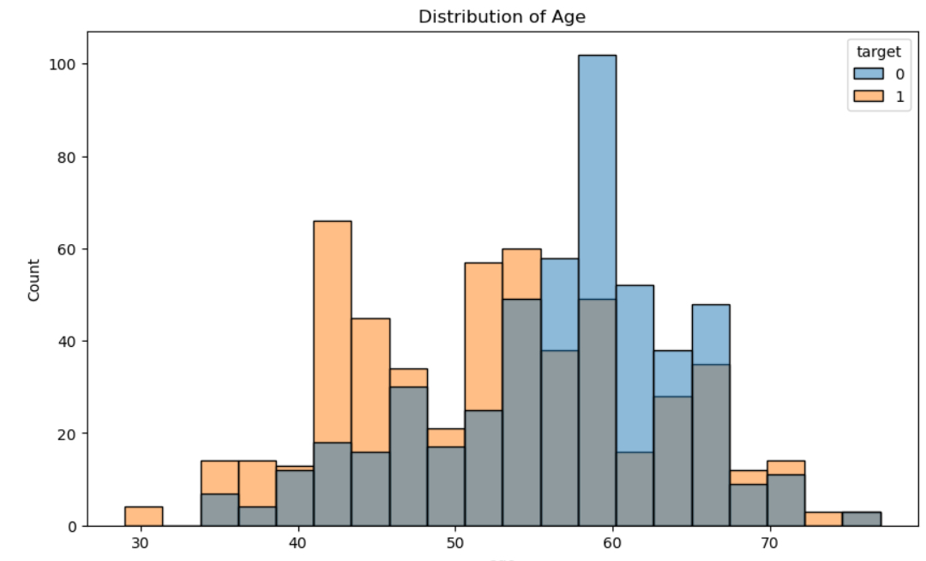
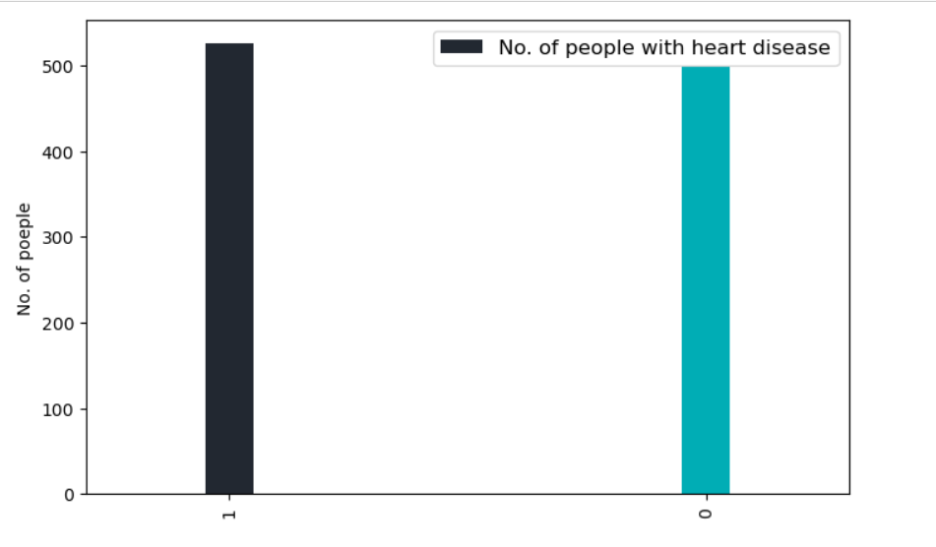
Methodology (Classification)
Data preparation
1- load the dataset:
2- see if there is any null or missing values: we found that there is no null or missing values
3- understand the data: from the plot we can see that There are approximately the same number of people with and without heart disease and that Most patients are between 50-65 years old
Disease (target=1) is more prevalent in middle-aged groups (50-60)
Very few cases below 35 or above 75 years

Slide 8

Training Process:
1- we split the data into testing and training
2-standardizing the features in dataset using the Z-score normalization
3-the models we are going to use are Random Forest, Support Vector Machine, Naïve Bayes.
4- we used hyperparameter tuning using Grid search for better accuracy results
5 – we evaluated the model performance using cross-validation

Slide 9
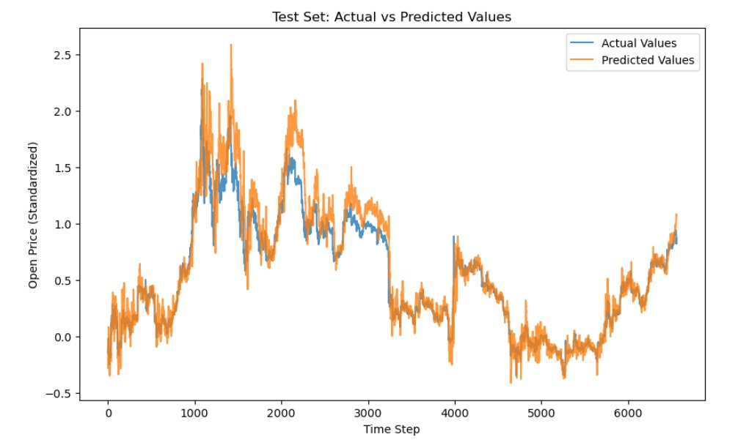
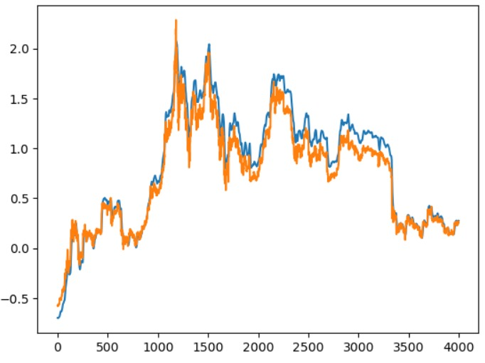
Results & Comparison (Time-series)
Those are the differences between the actual and the predicate values in the test data:
Echo-state-network(ESN):
MSE: 0.0285
R-squared: 0.8831
Long-Short-Term-Memory(LSTM):
MSE: 0.0147
R-squared: 0.9579
Bi-Directional-LSTM(BiLSTM):
MSE: 0.0160
R-squared: 0.9506
The LSTM model demonstrated the highest accuracy with an R-squared value of 0.9579, indicating that it can explain approximately 95.79% of the variance in the data. The low MSE value of 0.0147 suggests that the model's predictions are very close to the actual values. The ESN model had a higher MSE of 0.0285, indicating that its predictions are less accurate compared to the LSTM and Bi-LSTM models. This suggests that the ESN may not be as effective

Slide 10
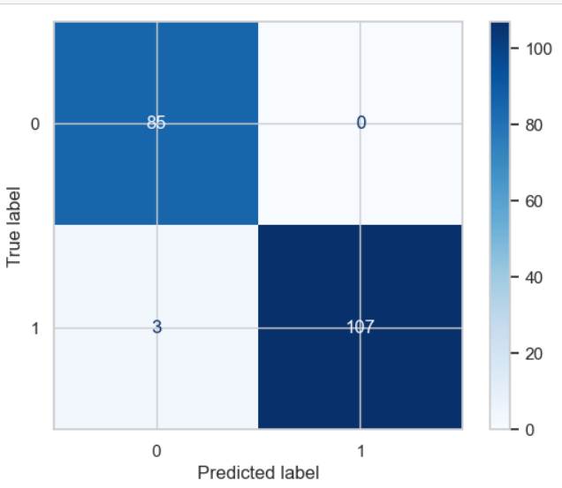
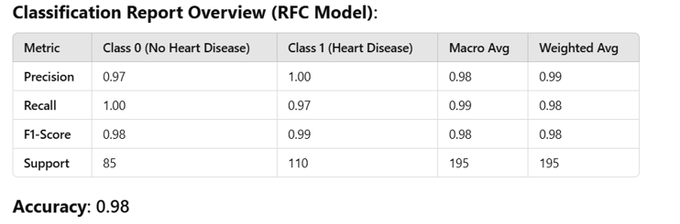
Results: Classification
For the Random Forest Model

Slide 11
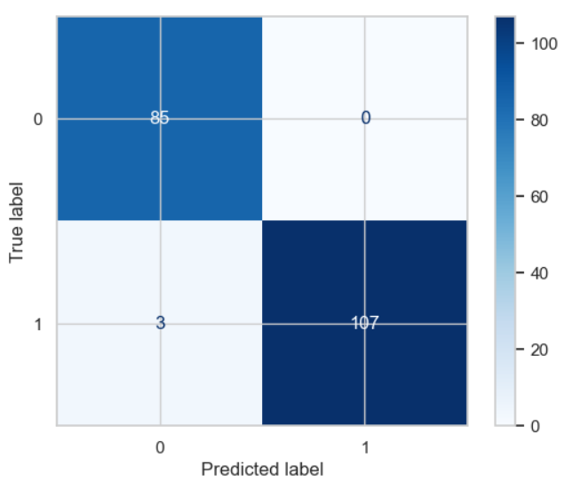
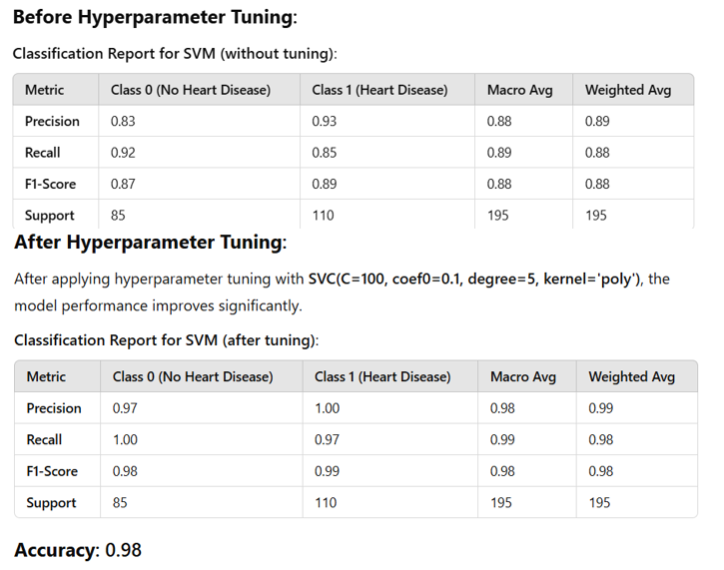
For the SVM Model

Slide 12
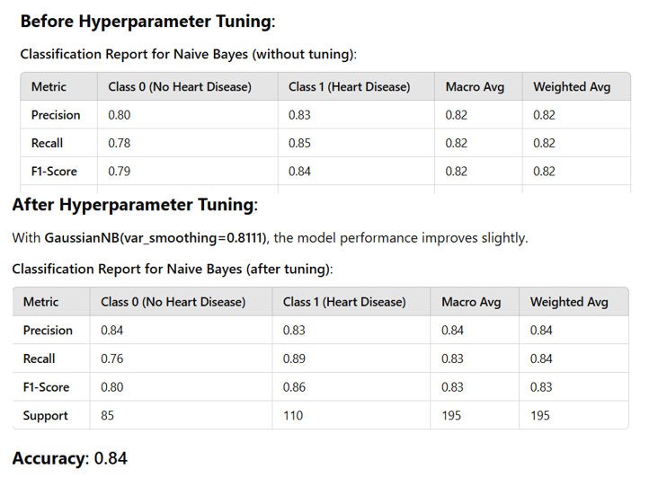
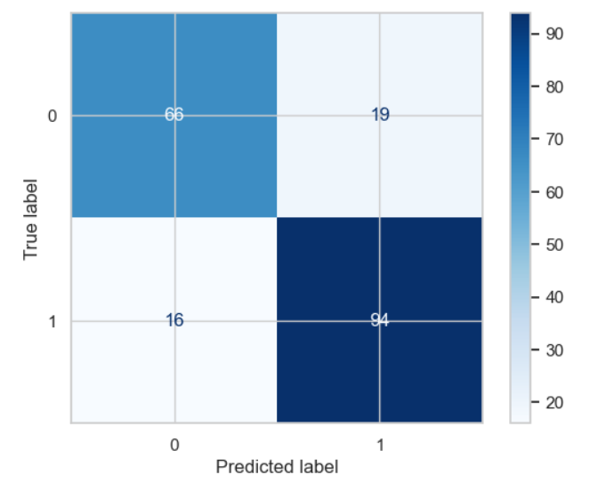
For the Naïve Bayes
Comparison:
Best performer: Random Forest Classifier (RFC) achieves the highest average recall score (0.9818), indicating the best performance overall in identifying positive cases.
Second-best performer: Support Vector Machine (SVM) follows closely with a recall score of 0.9790, making it a strong contender but slightly less effective than RFC.
Third-best performer: The NB model shows the lowest average recall score (0.8333), indicating that its ability to detect positive cases is considerably lower than the other two models.

Slide 13
Challenges and solutions (Time-series)
Handling the Volume Column
Initially, we faced challenges with the volume column since it does not represent a price, unlike the other attributes. After evaluating its impact on the data and model, we decided that dropping the column was the best approach to maintain consistency and relevance in our dataset.
Dealing with Outliers
During preprocessing, we identified potential outliers in the data. However, instead of removing them immediately, we thoroughly reviewed the data. Upon closer inspection, we found that these "outliers" were not actual anomalies but rather a result of a significant market pump in late 2018, which caused noticeable price variations. As a result, we retained these data points for accurate modeling.
Addressing Overfitting
Overfitting became a concern during model training. To mitigate this issue, we implemented the following solutions:
Reduced the size of the training set and increased the size of the test set to improve generalization.
Adjusted the reservoir size by reducing the number of neurons in the Echo State Network from 100 to 40. This configuration proved optimal for our dataset size, striking a balance between model complexity and performance.

Slide 14
Challenges and solutions.
We faced challenges with understanding the data since its medical data and we are not experts but we used graphs and EDA to help us understand the data and what effects the target results
We had a hard time knowing what to models to use but with testing multiple models we found the best 3(RF,SVM,NB)
Some models gave us low accuracy first but we increased the accuracy by Choosing optimal features and hyperparameters.

Slide 15
Conclusion and future directions
Conclusion: In this project, we evaluated three models for forecasting price data: LSTM, Bi-Directional LSTM (Bi-LSTM), and Echo State Network (ESN). Among these, the LSTM model demonstrated the best performance, achieving an R-squared value of 0.9579, which indicates it can explain approximately 95.79% of the variance in the data. Its low MSE value of 0.0147 further highlights its accuracy in making predictions.The Bi-LSTM model also performed strongly, with an R-squared value of 0.9506 and an MSE of 0.0160, showing results very close to those of the LSTM model. However, the ESN model had a significantly higher MSE of 0.0285, making it less efficient for this task compared to the LSTM-based models. This suggests that LSTM-based architectures are better suited for time-series forecasting of price data in this context.
Future Directions For future work on forecasting price datasets, we aim to improve model performance and
incorporate additional factors to enhance prediction accuracy. Specifically:
Inclusion of More Attributes: Expanding the dataset to include more technical indicators, such as moving averages, RSI (Relative Strength Index), and Bollinger Bands, could provide the models with richer features to learn from.
Market News as a Factor: Incorporating sentiment analysis from market news and social media trends can provide insights into external factors influencing prices.
Exploring Advanced Architectures: Testing more advanced models, such as Transformer-based architectures or hybrid models combining LSTM with external knowledge, could lead to better results.

Slide 16
Conclusion and future directions
Conclusion: Random Forest emerged as the best-performing model, balancing high accuracy with interpretability. It outperformed SVM and Naive Bayes on most metrics, making it the most suitable choice for deployment in this context.
future directions such as Exploring Additional Models like XGBoost, LightGBM, or CatBoost to potentially achieve better performance
Develop a user-friendly application to deploy the model for real-time predictions in clinical settings.
Test the model's performance in real-world scenarios to validate its effectiveness beyond the dataset.

