Slide 1
AIN-3009 Delivering AI Applications with MLOps
Customer Churn Prediction with MLflow
End-to-end machine learning lifecycle management for telecom churn: tracking, tuning, registry, serving, and monitoring.
7,043
63
v1
customer records
MLflow runs logged
production model
Ayhan Gurbangeldiyev
Term Project
AIN-3009 MLOps Term Project
01
Notes:
Hello, today I will present my MLOps term project: Customer Churn Prediction with MLflow. The goal is not only to train a model, but to manage the full machine learning lifecycle from experiments to deployment and monitoring.

Slide 2
PROBLEM AND DATASET
Predict customers likely to leave
5,174
non-churn customers
- Domain: telecommunications customer retention.
- Dataset: Telco Customer Churn with 7,043 rows and 21 columns.
- Target: Churn, encoded as a binary Yes or No outcome.
- Business value: identify high-risk customers before cancellation.
1,869
churn customers
26.5%
positive class share
AIN-3009 MLOps Term Project
02
Notes:
The selected problem is customer churn prediction in telecommunications. The model predicts whether a customer will leave. This is useful because companies can use churn risk to prioritize retention campaigns.

Slide 3
END-TO-END WORKFLOW
One repeatable MLflow pipeline
1
Preprocess
2
Train
3
Tune
Clean TotalCharges, drop customerID, encode Churn
Compare Logistic Regression, Random Forest, Gradient Boosting
RandomizedSearchCV with 20 candidates and 3-fold CV
4
Register
5
Serve
6
Monitor
Promote ChurnPredictionModel to staging and production
Expose production model through MLflow Models
Log batch-level drift and performance metrics
AIN-3009 MLOps Term Project
03
Notes:
This is the full lifecycle workflow. The project starts with preprocessing, then baseline training, hyperparameter tuning, model registry, serving, and finally simulated monitoring.

Slide 4
DATA PREPARATION AND MODELS
Preprocessing keeps training and inference consistent
Preprocessing pipeline
Models compared
- Drop customerID identifier
- Convert TotalCharges to numeric
- Encode Churn as 1/0
- Impute missing values
- Scale numeric features
- One-hot encode categoricals
LR
RF
GB
Logistic Regression
Random Forest
Gradient Boosting
AIN-3009 MLOps Term Project
04
Notes:
Preprocessing is implemented as a Scikit-learn pipeline. This is important because the same transformations are used during training and serving. I compared three baseline models before tuning.

Slide 5
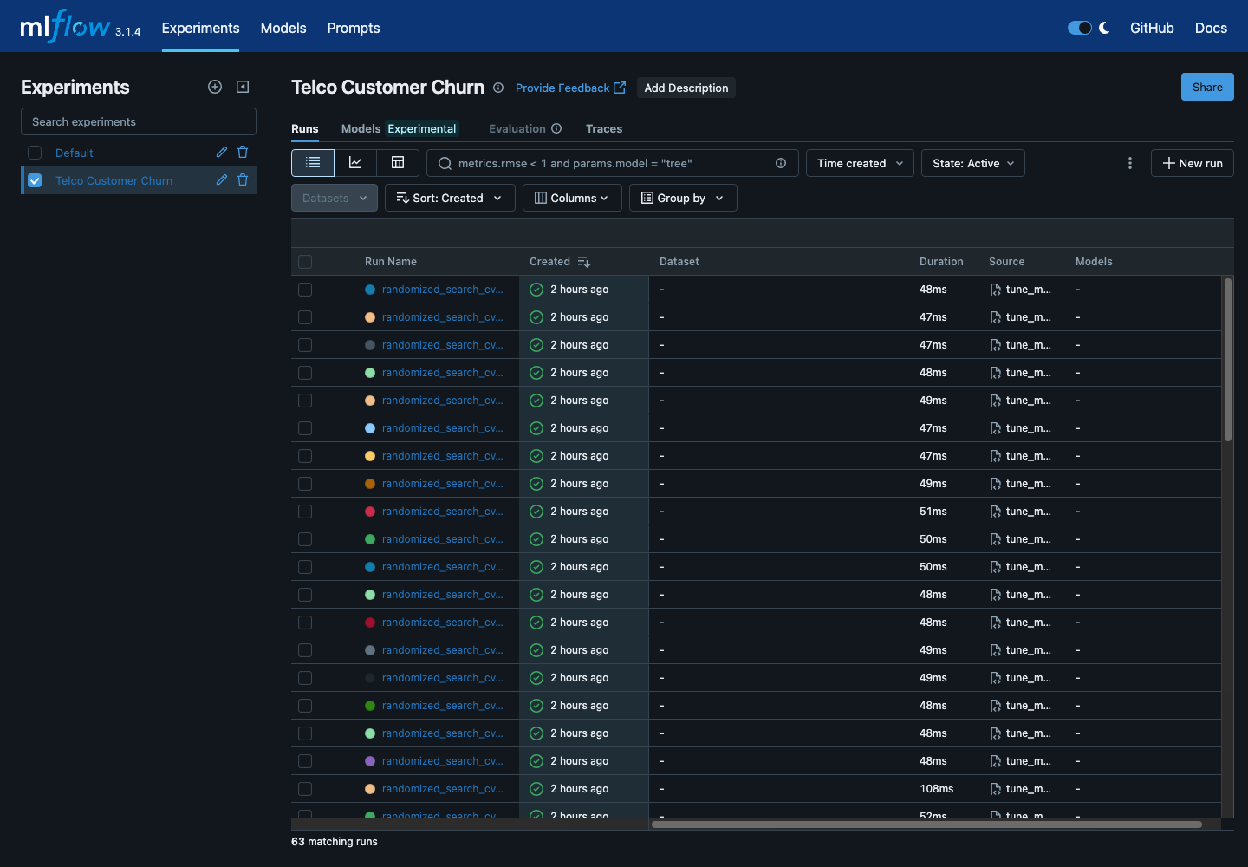
EXPERIMENT TRACKING EVIDENCE
MLflow records every experiment
Baseline, tuning, randomized search, and monitoring runs are visible in one experiment.
MLflow experiment run list: parameters, metrics, artifacts, and run types.
AIN-3009 MLOps Term Project
05
Notes:
This screenshot shows the MLflow experiment. Each run logs parameters, metrics, artifacts, and model outputs, making the comparison auditable and reproducible.

Slide 6
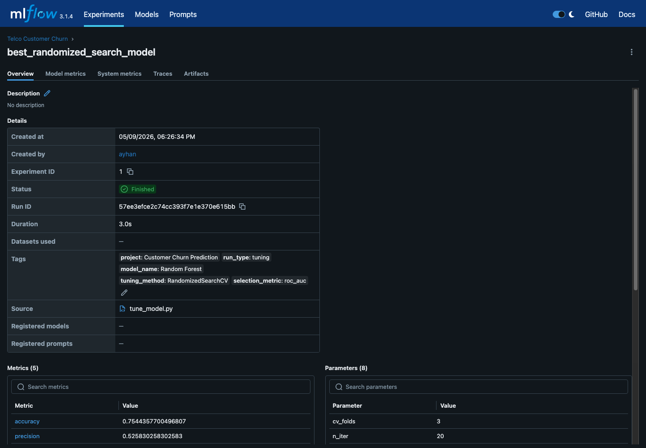
HYPERPARAMETER TUNING RESULTS
RandomizedSearchCV strengthens tuning
20
3-fold
0.8476
0.8411
sampled candidates
cross validation
best CV ROC-AUC
best tuned test ROC-AUC
Best randomized-search model run with metrics and artifacts.
AIN-3009 MLOps Term Project
06
Notes:
For tuning, I used RandomizedSearchCV instead of a manual grid. It samples a broader parameter space while keeping runtime manageable. The best cross-validation ROC-AUC was about 0.8476.

Slide 7
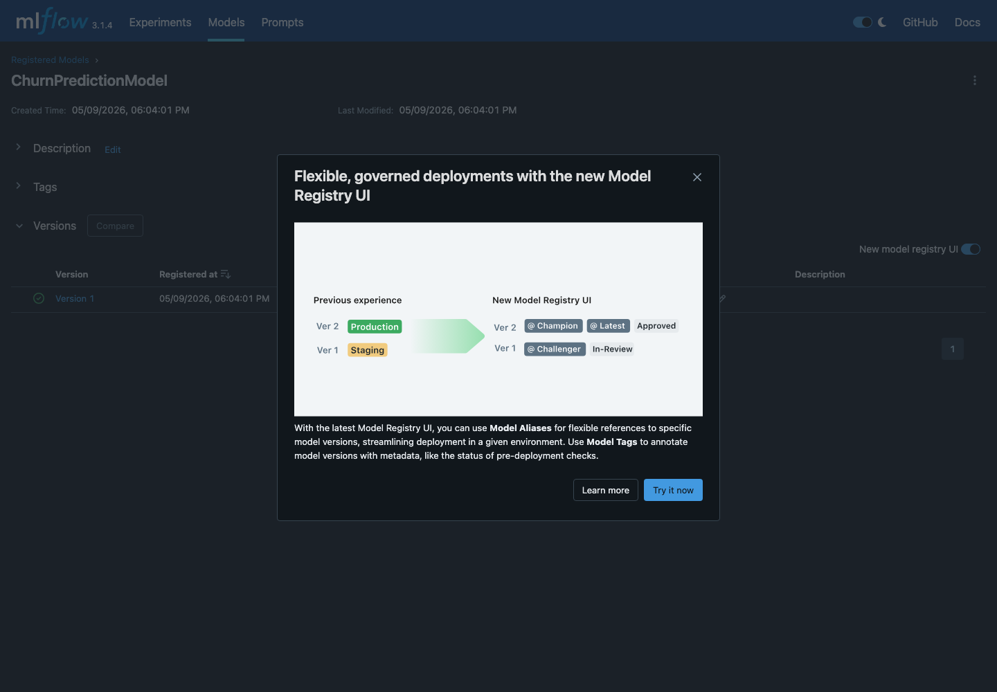
MODEL REGISTRY
Production model is versioned
Registered model: ChurnPredictionModel
- Version 1 registered in MLflow Model Registry.
- Production and staging aliases are assigned.
- Registry creates a clear handoff from experimentation to deployment.
MLflow Model Registry page with production/staging aliases.
AIN-3009 MLOps Term Project
07
Notes:
The best model is registered as ChurnPredictionModel. The registry demonstrates model versioning and lifecycle management, including staging and production aliases.

Slide 8
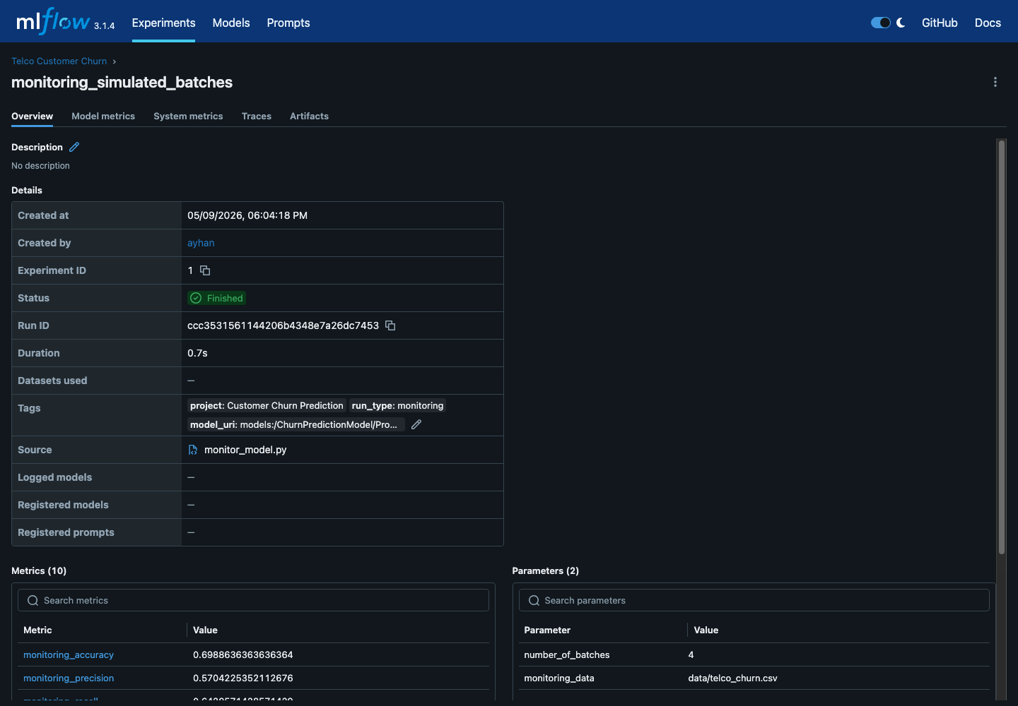
DEPLOYMENT AND MONITORING
Serving and monitoring complete the loop
Serving command
mlflow models serve -m "models:/ChurnPredictionModel/Production" -p 5001 --no-conda
Prediction response
{"predictions": [1]}
Sample customer predicted as churn risk.
Monitoring run: four simulated production-like batches logged to MLflow.
AIN-3009 MLOps Term Project
08
Notes:
The production model is served locally with MLflow Models. The serve_test script sends a sample customer and receives a prediction. Monitoring then evaluates four simulated batches and logs metrics like F1-score and ROC-AUC.

Slide 9
CONCLUSION AND DEMO CHECKLIST
MLflow turns a model into a managed lifecycle
Live demo order
- Experiment tracking makes model comparison auditable.
- RandomizedSearchCV makes tuning more defensible.
- Model Registry provides a production handoff.
- Serving demonstrates real-time inference.
- Monitoring shows how performance can be tracked over time.
- Open MLflow experiment
- Show best run metrics
- Open registry production model
- Show prediction response
- Show monitoring metrics
Repository:
github.com/Ayhan-Gurbangeldiyev/AIN-3009-MLflow-Customer-Churn
AIN-3009 MLOps Term Project
09
Notes:
To conclude, the project satisfies the main lifecycle requirements: tracking, training, tuning, registry, deployment, and monitoring. In the demo, I would show the MLflow experiment, best run, registry model, prediction response, and monitoring metrics.

