Slide 1
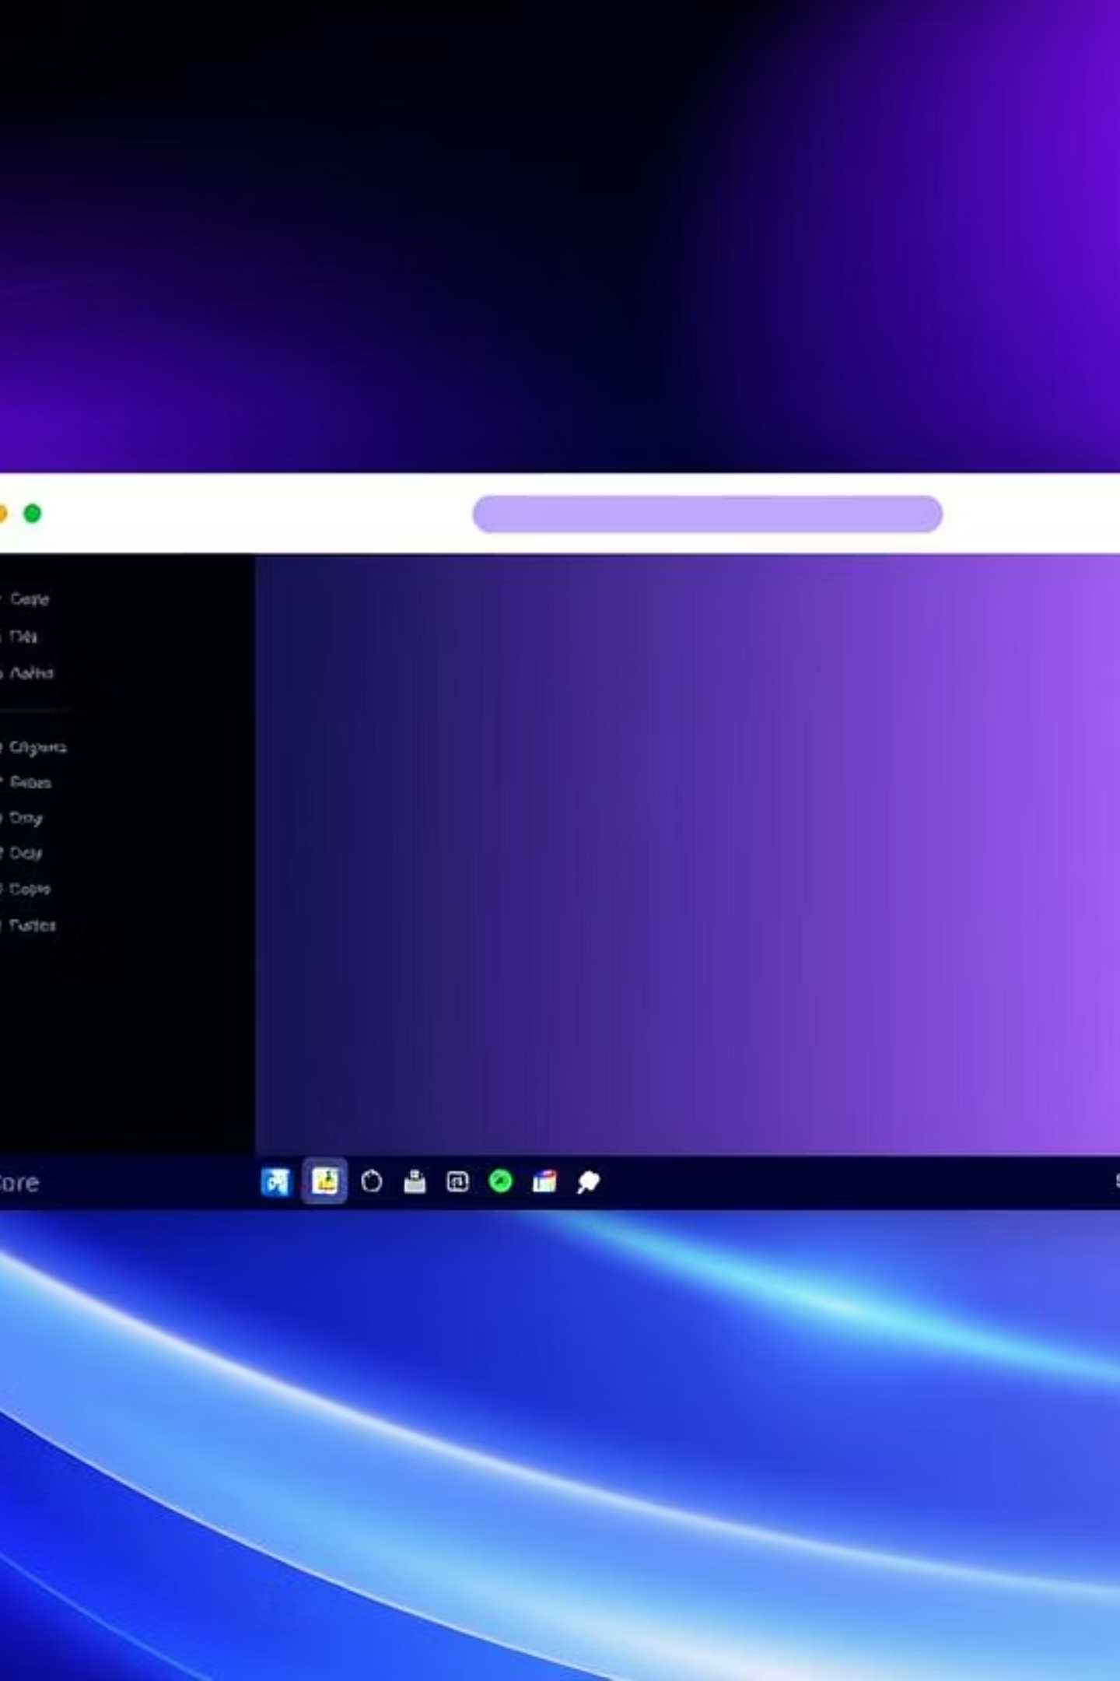
CheapShop Application Project Overview
Author: Ali Ayhan Gunder
Date: July 14, 2025

Slide 2

Introduction & Project Goals
What is CheapShop?
A Java-based desktop application using Swing
Facilitates catalog-based order management for retail
Primary Objective:
Provide a user-friendly interface for purchaser info, item entry, and invoice generation
Ensures data validation and accessibility
Key Goals:
Input and validate purchaser details (name, phone, address, payment)
Allow entry of multiple catalog items with dynamic totals
Generate comprehensive invoices
Provide a responsive and accessible UI with shortcuts and clear errors
Ensure robust input validation

Slide 3
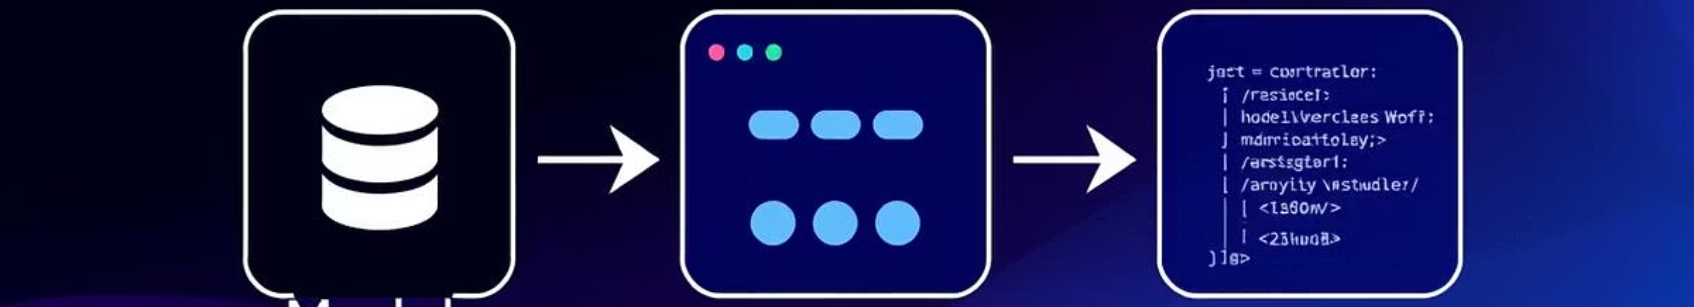
System Design - Architecture & UI
Architecture (MVC-inspired):
Model: CatalogItem and PurchaserInfo classes store data
View: Swing components (JTextField, JSpinner, JButton) organized into panels
Controller: Event listeners and action methods (addCatalogItem, triggerInvoice) manage user interaction and state
User Interface:
Purchaser Screen: Collects purchaser details and first catalog item
Catalog Screen: For subsequent item entry, displays running balance
Both screens use titled borders and dedicated buttons

Slide 4



Key Features
Input Validation
Dynamic Updates
Ensures valid formats for phone numbers, dates, credit card numbers using regex
Automatically calculates item totals based on quantity and cost
Checks for non-empty required fields and valid numeric inputs
Updates "Balance Owing" in real-time

Slide 5



Accessibility
Error Handling
State Management
Keyboard shortcuts: F5 for next item, F8 for invoice
Displays temporary dialogs for invalid inputs
Tracks purchaser information and catalog items using ArrayList
Mnemonics: Alt+N (Next), Alt+T (Trigger)
Provides detailed validation errors via JOptionPane
Manages purchaser entry status

Slide 6
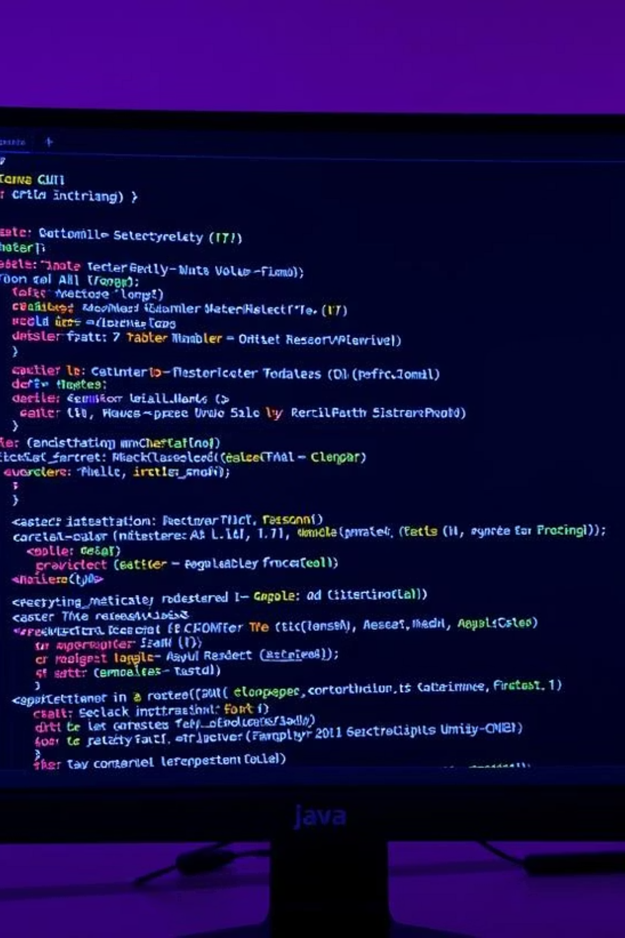
Implementation Details
Technologies Used:
Code Structure:
Java: Core programming language (Java 8+ for lambdas)
Single CheapShop class extending JFrame
Nested data classes: CatalogItem and PurchaserInfo
Swing: For GUI components and event handling
AWT: For layout management and event listeners
Standard Libraries: ArrayList for data structures

Slide 7
Key Methods:
initComponents()
showPurchaserScreen()
showCatalogScreen()
Initializes GUI components, sets listeners
Configures initial screen
Displays catalog-only screen
addCatalogItem()
triggerInvoice()
Validates, adds items, updates balance
Generates and displays invoice, resets application

Slide 8
Evaluation - Strengths & Limitations
Strengths:
Limitations:
Usability: Intuitive interface with clear labels and real-time feedback
Validation Gaps: Limited phone/date/postal code validation (e.g., no region-specific checks)
Robustness: Comprehensive validation prevents invalid data processing
Data Persistence: No storage mechanism; data loss on reset
Accessibility: Keyboard shortcuts and mnemonics enhance usability
Code Duplication: Catalog panel setup repeated across screen methods
Extensibility: Modular design allows for future enhancements
Edge Cases: Current item ignored if invoice triggered without adding it

Slide 9
Future Improvements
Enhanced Validation
Stricter phone, date (e.g., using LocalDate), and postal code validation
Data Persistence
Add file or database storage (JSON, SQLite)
Code Refactoring
Extract duplicate catalog panel code into reusable method
Edge Case Handling
Prompt to add current itemstick
Accessibility
Associate labels with fields using setLabelFor for screen readers
Internationalization
Externalize strings for multi-language support

Slide 10

Conclusion
Project Success: CheapShop successfully meets objectives for user-friendly catalog order management
Key Attributes: Robust validation, accessible design, and dynamic updates
Impact: Effective for small-scale retail use
Future Outlook: Addressing limitations will further improve functionality and reliability
Foundation: Demonstrates a solid foundation in Java Swing development with extensibility

