Slide 1
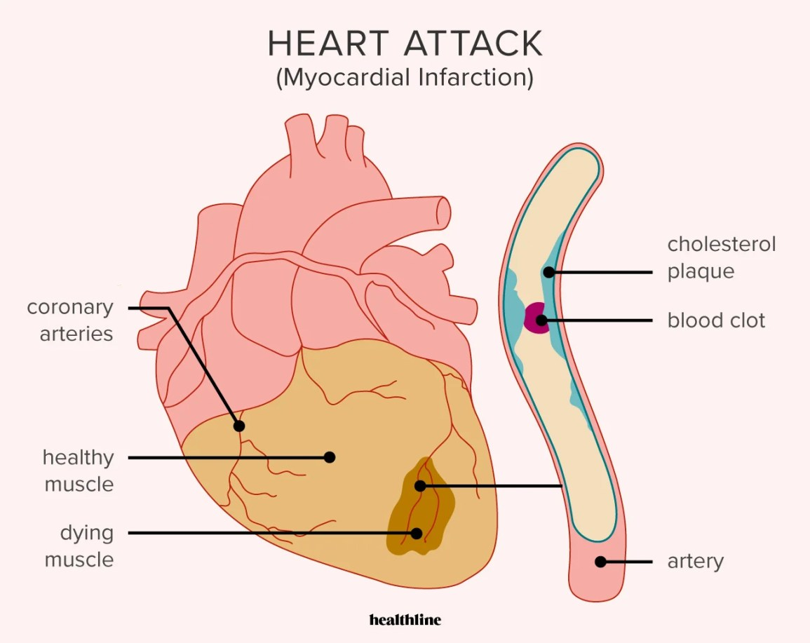
Analysis of Heart Attack Dataset
Ayhan Tan Açar

Slide 2
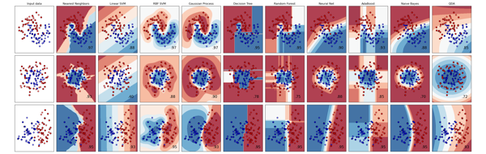
Introduction
Cardiovascular diseases (CVDs) are the leading cause of death globally, claiming 17.9 million lives annually, according to the World Health Organization. These diseases include coronary heart disease, strokes, and other heart and blood vessel conditions. Notably, heart attacks and strokes account for over 80% of CVD deaths, with one-third occurring before age 70.
This study focuses on identifying factors contributing to heart attacks using a dataset comprising 1,319 samples. This dataset provides valuable insights into the characteristics associated with heart attacks, facilitating better prediction and prevention strategies.

Slide 3

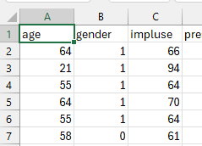
Dataset Description
Purpose: Identify factors contributing to heart attacks.
Dataset size: 1,319 samples.
Fields: 8 input features and 1 output field.
Input features: Age, gender (0 for Female, 1 for Male), heart rate, systolic BP, diastolic BP, blood sugar, CK-MB, Test-Troponin.
Output field: Presence of heart attack (negative for absence, positive for presence).

Slide 4

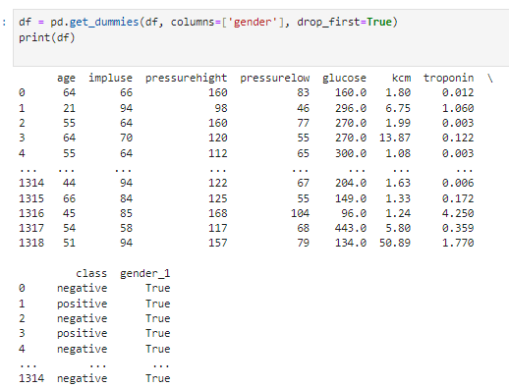
Data Cleaning and Pre-processing
age
gender
heart rate (impulse)
systolic BP (pressurehight)
diastolic BP (pressurelow)
blood sugar(glucose)
CK-MB (kcm)
Test-Troponin (troponin) are representing the input fields, while the output field pertains to the presence of
heart attack (class), which is divided into two categories (negative and positive); negative refers to the absence of a heart attack, while positive refers to the presence of a heart attack
Handling missing values
One-hot encoding is applied to convert categorical variables into numeric format.

Slide 5
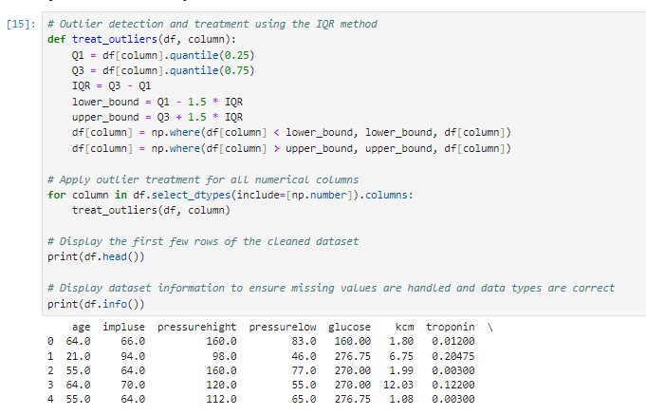
Change the values ​​1 and 0 in the Gender column to "male" and "female":
Outlier Detection and Treatment

Slide 6

Exploratory Data Analysis(EDA)
Descriptive statistics: Mean, median, standard deviation of key features.
Age distribution analysis: Histogram showing age distribution of patients.
Correlation matrix: Heatmap showing correlations between features.
Visuals: Include histograms, box plots, and scatter plots to visualize relationships.

Slide 7
Feature Engineering
New features: Created new features based on domain knowledge, such as age groups and interaction terms.
Feature selection: Used techniques like Recursive Feature Elimination (RFE) to select the most relevant features.

Slide 8
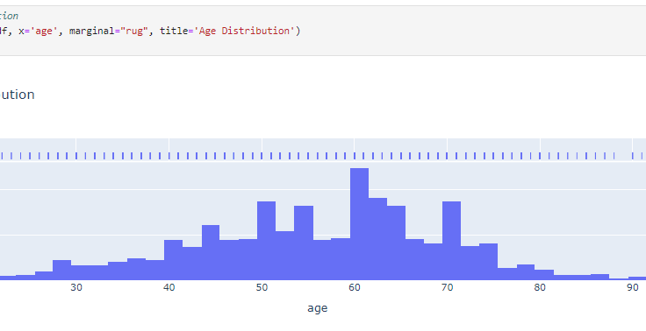

Slide 9
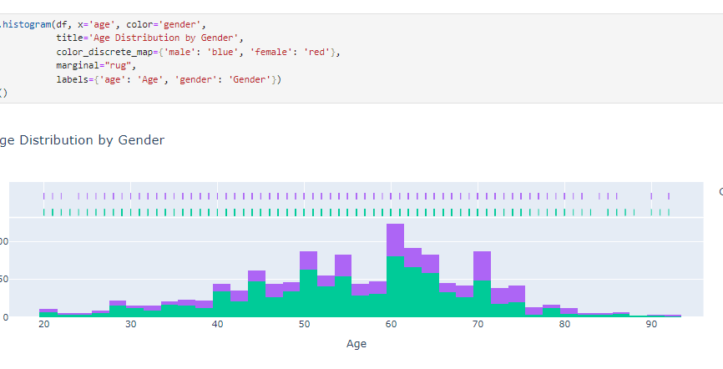

Slide 10
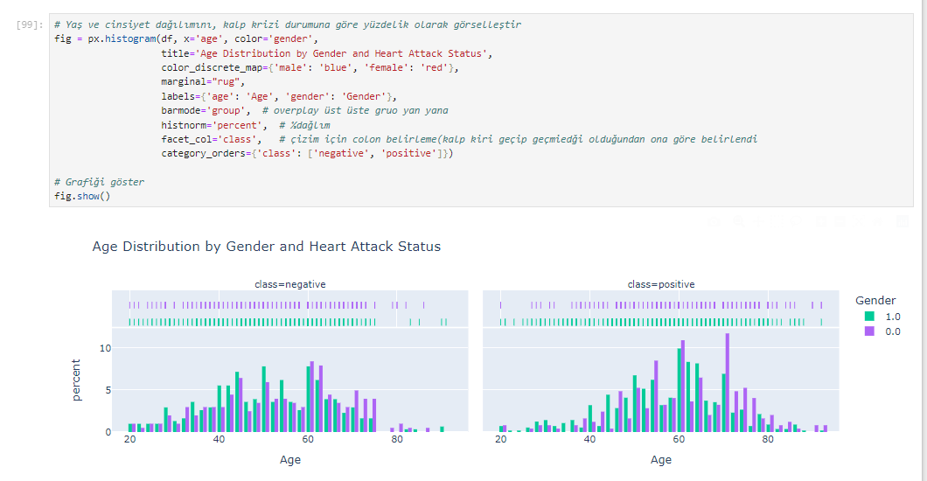

Slide 11
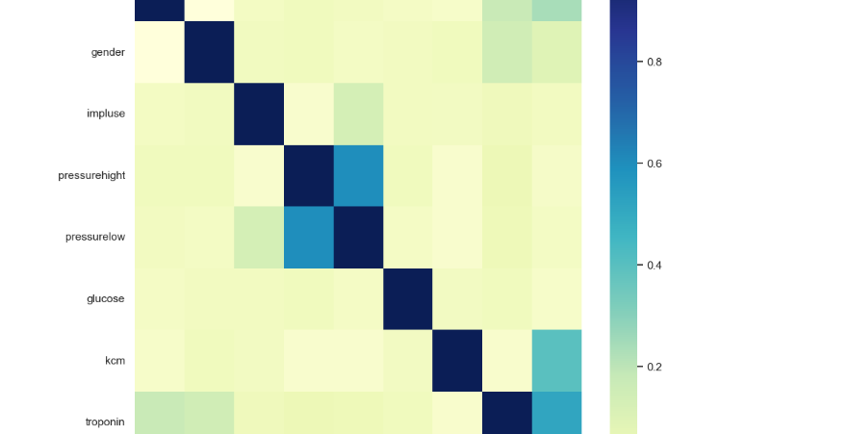

Slide 12
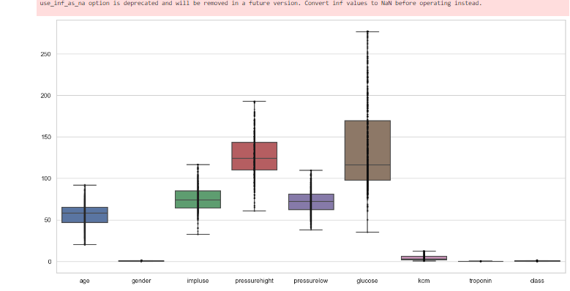

Slide 13
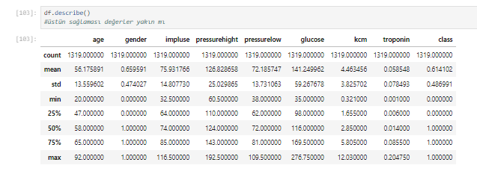

Slide 14
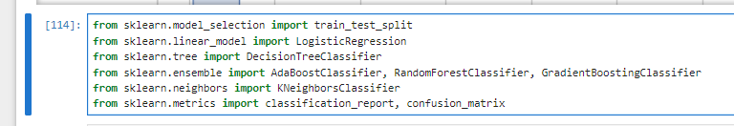
Machine Learning Algorithms
Algorithms used: Logistic Regression, Decision Tree, Random Forest, Support Vector Machine (SVM), K-Nearest Neighbors (KNN).
Model training: Split data into training and testing sets (80/20 split).
Hyperparameter tuning: Used Grid Search/Random Search for optimizing model parameters.

Slide 15

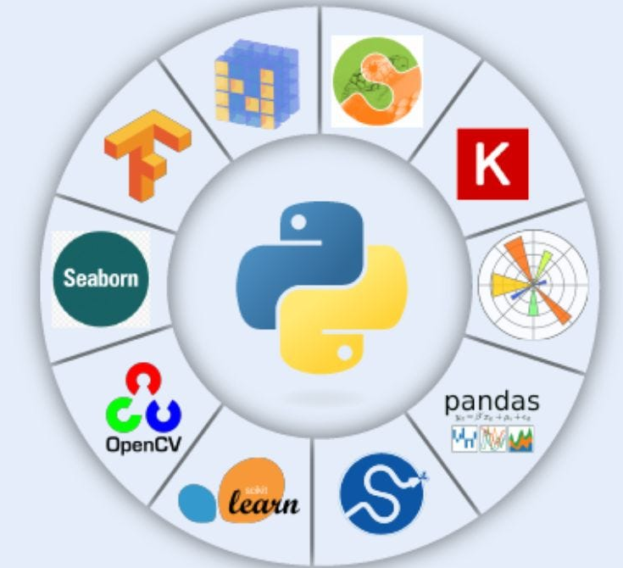
What is Scikit-learn?
Machine Learning Library: Scikit-learn offers a wide range of algorithms for classification, regression, clustering, and dimensionality reduction, among others.

Slide 16

User-Friendly: It is designed to be easy to use and accessible to both beginners and experienced practitioners.

Slide 17

Comprehensive: Includes various tools for model selection, evaluation, and preprocessing of data.

Slide 18

Scikit-learn is a powerful and versatile library that simplifies the process of implementing machine learning algorithms. Its extensive documentation and community support make it a go-to choice for both beginners and experienced data scientists.

Slide 19

Reference
https://www.kaggle.com/datasets/bharath011/heart-disease-classification-dataset/data
https://scikit-learn.org/stable/modules/generated/sklearn.model_selection.train_test_split.html
https://pandas.pydata.org/docs/getting_started/index.html#getting-started
https://seaborn.pydata.org/
https://numpy.org/
https://matplotlib.org/

