Slide 1

Fakulti Teknologi dan Sains Maklumat
GPS
TS6233 Client –server
Prepared by
IHAM.T.ISMAIL (p49071)
Email: Ayhem@ftsm.ukm.my
Prepared for
DR.MOHD ZAMRI
University Kabangsaan Malaysia

Slide 2
GPS
1-What is the concept of GPS?
2-How can use it?
3- The purpose of using GPS?
4-How does GPS work?
5-The benefits of GPS?
6- Who uses GPS?

Slide 3
GPS
What is GPS ?
The global Positioning System (GPS) is a satellite –based navigation system that sends and receives radio signals. A GPS receiver acquires these signals and provides with information using GPS technology , can determine location , velocity, and time , 24 hours a day , in any weather conditions anywhere in the world. firstly it was controlled b U.S. GPS operated by the U.S. military. Then now it uses for free.

Slide 4
GPS
Introduction:
Global Positioning System (GPS) technology is changing the way we work and play. We can use GPS technology when we are driving ,flying ,fishing ,sailing ,hiking ,working ,biking , running , or exploring with GPS receiver.

Slide 5
GPS
Here are some examples of how we can use GPS technology:
Know precisely how far you can have run and at what tracking your path so you can find your way home .
Pinpoint the perfect finishing spot on the water and easily relocate it.
Get the closest location of your favorite restaurant when you are out-of-town
Find the nearest airport or identify the type of airspace in which you are flying.

Slide 6
GPS
The purpose of GPS:
the purpose of this article to introduce the GPS and its use as a tool for dual sport riding and touring. The description of how it works was kept simple and to the point. A number of terms; waypoints, routes, trackback, and go to were explained to help you understand GPS operation.
To allocate the position and get the destination to make the driving , flying , sailing , or exploring more easier.
These days the vast organizations and companies using GPS. That’s because to monitor them drivers to be sure the are discipline in work

Slide 7
GPS
How does GPS technology work ?
GPS receiver collects information from the GPS satellites that are in view.
GPS receiver determines your current location , velocity , and time.
GPS receiver can collect other information , such as bearing , track , trip distance to destination , sunrise and sunset time , and so forth.
GPS receiver displays the applicable information on the screen.

Slide 8
GPS
The Benefits of GPS:
The GPS is a tool that should supplement good map reading skills. The GPS will make navigation easier and more precise over terrain that is not well mapped. It can help one determine trail heads, side roads and generally make navigation more enjoyable when landmarks are not well defined. It certainly provides a degree of security if one becomes disorientated (lost) and in an emergency situation it could make the difference in finding medical help quickly if a riding buddy were to become injured. The more one uses a GPS the more one finds additional uses that make travel more enjoyable!
The most important benefit for using GPS is to save your time and your money.

Slide 9
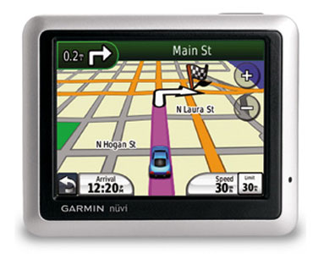
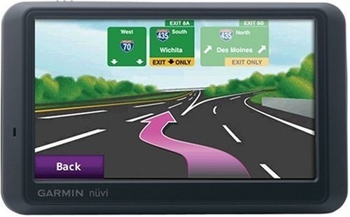
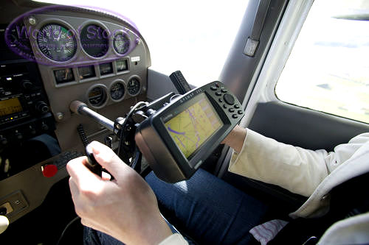
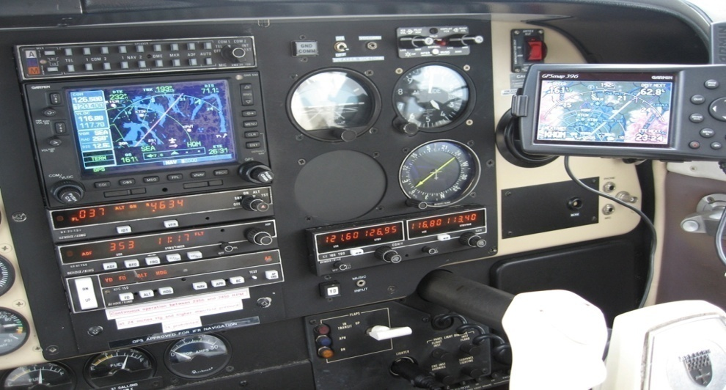
GPS
Here are some photos for some using of GPS:

Slide 10
GPS
Who uses GPS ?
GPS used from many specializations such as:
Agriculture : farmers they use it to monitor the fertilizer and pesticides . also for marking areas of disease or weed infestation.
Aviation : Aircraft pilots use GPS technology for en route navigation and airport approaches. Satellite navigation provides accurate aircraft location anywhere on near the earth.
Environment : GPS technology helps survey disaster areas and map the movement of environmental phenomena like forest fires , oil spills , or hurricanes.

Slide 11
GPS
Who uses GPS ?
GPS used from many specializations such as:
Military : Military aircraft , ships , submarines , tanks , jeeps , and equipment use GPS technology for many purpose including basic navigation , target , designation , close air support , weapon technology , and rendezvous
Ground transportation : GPS technology helps with automatic vehicle location and in-vehicle navigation systems. Many navigation systems show the vehicle location on an electronic street map, allowing drivers to keep track of where they are and look up other destinations.

Slide 12
GPS
Who uses GPS ?
GPS used from many specializations such as:
Public safety : Emergency and other specialty fleets use satellite navigation for location and status information.
Surveying : surveyors use GPS technology for simple task like defining property lines or for complex tasks such as building infrastructures in urban centers.
How Accurate is GPS ?
GPS technology depends on the accuracy of signal that travel from GPS satellite to GPS receiver . The accuracy can increase by ensuring that when use or at least when turn on the GPS receiver . When first turn on the GPS receiver .should stand in an open area for a few moments to allow the unit to get a good fix on the satellites especially if you are heading into an obstructed area. This gives better accuracy for longer period of time

Slide 13
GPS
Conclusion
In conclusion, GPS technology is an amazing technology . It enhanced many things like wasting time for reaching some place with out using GPS and to get whatever you like by GPS point of interest. Usually the tourists use GPS technology for get everything they want without get the help from paper map.
So it’s worth to use it
I have one tip before ending when you use this technology be sure to set your destination before driving , otherwise you will put your self in the risk place.
My best wishes for a safety to all drivers and enjoy with this technology .

Slide 14
THANK YOU

