Slide 1

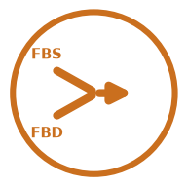







LInOG FBS + FBD InSAR processing workflow
ALOS-1 PALSAR, pipeline v4.0, one frame: each phase (left) and its output (right); read left to right, row by row.
Phase 0
OUTPUT
Phase 1
OUTPUT
Phase 2
OUTPUT
Set-up and pre-flight
Verified processing environment
Unpack and unify FBS + FBD
One unified SLC stack
DEM and network design
DEM + interferogram network
Install ISCE2, MintPy, GDAL, SNAPHU; check provenance; size the machine; count the archive
Unzip L1.1 granules; beam check; sort FBS / FBD; band-limit FBS to 14 MHz at native 4.68 m range sampling
Shared DEM; pairs with temporal baseline ≤ 730 d and perpendicular baseline ≤ 1,500 m
Software checked, parallel settings sized, scene count matched
All dates at one 14 MHz bandwidth; 19–24 dates per frame
Pair list and run files (123–180 pairs formed per frame)
NEW IN YEAR 2
provenance check
gates G1–G6
gate G17
Phase 3
OUTPUT
Phase 4
OUTPUT
Phase 4.5
OUTPUT
Coregistration
Coregistered SLC stack
Interferogram generation
Unwrapped interferograms
Visual quality control
Interferogram report grids
Align every SLC to one FBS reference date (4.68 m range grid; FBD resampled onto it)
Form interferograms; multilook 28 × 12 (~90 m × 90 m); filter; unwrap with SNAPHU
Phase and amplitude report pages for every interferogram
All acquisitions on the reference geometry
Interferograms and coherence for every admitted pair
Poor pairs flagged and excluded
gates G7–G9, G16, G21
gates G10, G11, G18, G20
visual check
Phase 5
OUTPUT
Phase 6
OUTPUT
Phase 7
OUTPUT
SBAS time-series analysis
Displacement time series
Geocoding and delivery
16 geocoded products per frame
Interpretation
Ground-deformation results
MintPy inversion; DEM-error correction; ramp removal; coherence and water masks
Geocode to a common 1/1200° (~90 m) grid; 16 products per frame; 27-check verification
Read the velocity maps; measure subsidence against nearby stable ground
LOS velocity, displacement per date, temporal coherence
LOS, vertical, horizontal GeoTIFFs; KMZ; hillshade maps
e.g. Cabanatuan 4.4–4.7 cm/yr vertical, two tracks
gates G12, G13, G15, G19, G22, G23
gate G14; 27 checks
two-track check
new for FBS+FBD processing
carried over from FBS-only
output of the phase
Green italic: automated quality gates (G1–G23); a failed gate stops the phase.

Slide 2
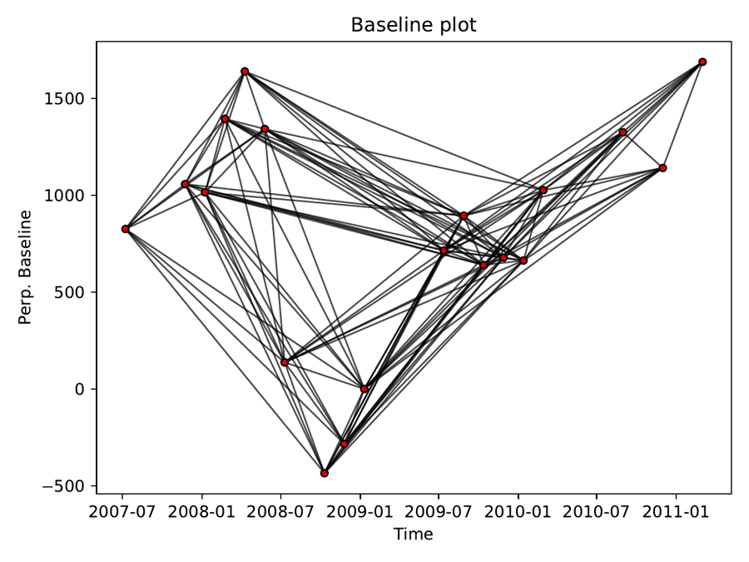
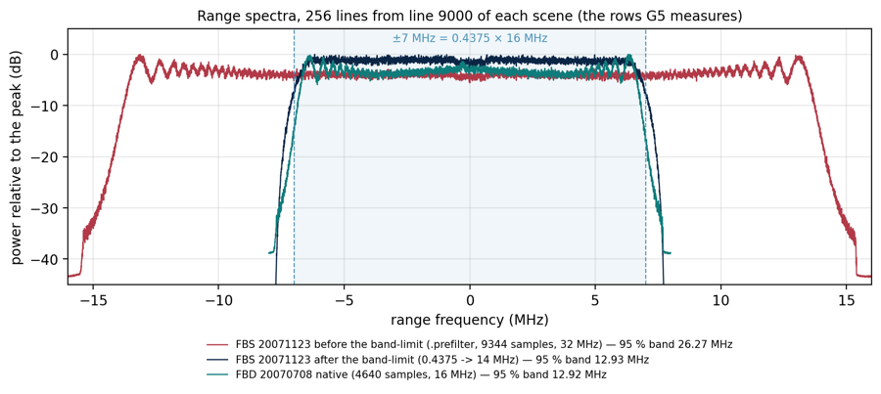
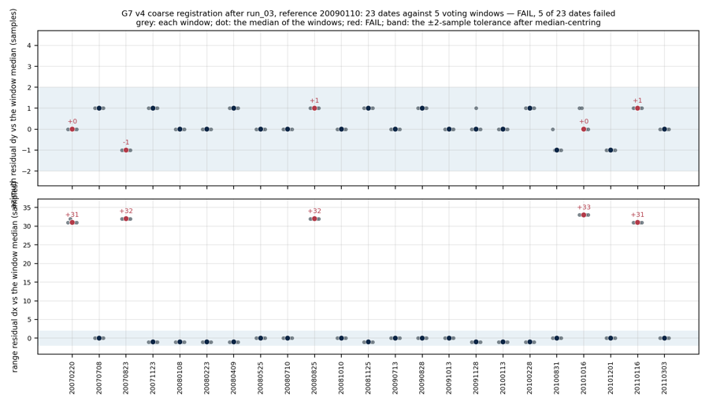
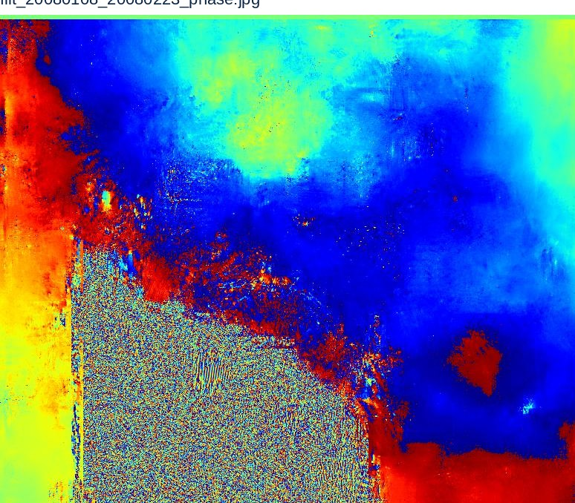
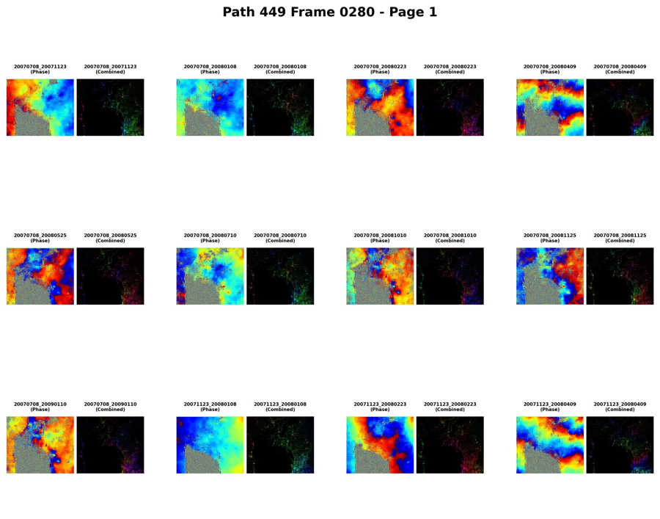
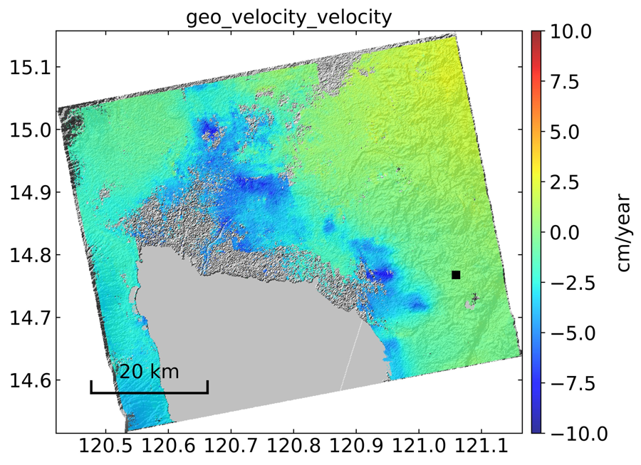
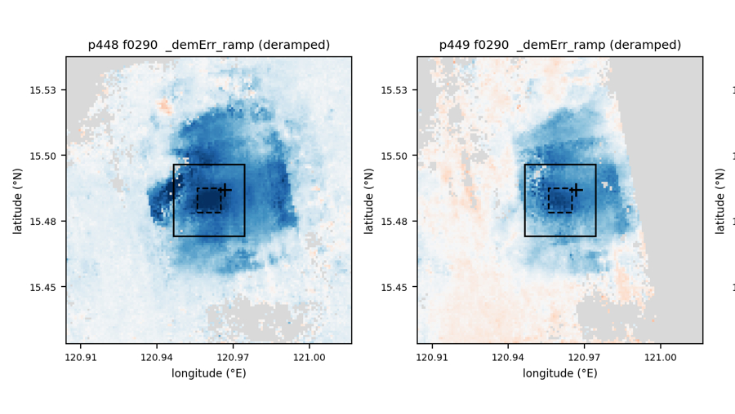
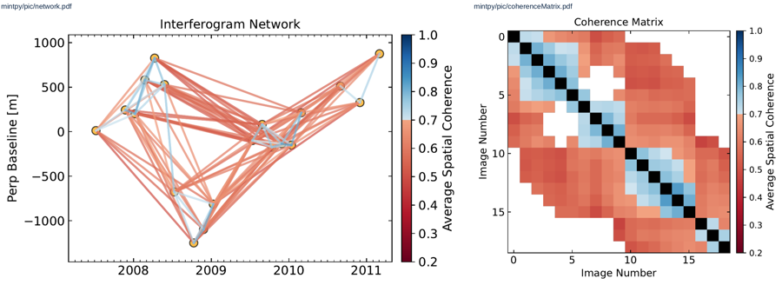
LInOG FBS + FBD InSAR processing workflow: real outputs
ALOS-1 PALSAR, pipeline v4.0, one frame: each phase (left) and its output (right); read left to right, row by row. Sample: Path 449 Frame 0280.
Phase 0
OUTPUT
Phase 1
OUTPUT
Phase 2
OUTPUT
Set-up and pre-flight
# pre-flight record (felix, 17 Sep 2026)
provenance ... OK
ISCE2 · MintPy · GDAL · SNAPHU OK
48 cores, 125 GB RAM
779 ALOS-1 L1.1 zips
RESULT: PASS 14/14
Unpack and unify FBS + FBD
DEM and network design
Install ISCE2, MintPy, GDAL, SNAPHU; check provenance; size the machine; count the archive
Unzip L1.1 granules; beam check; sort FBS / FBD; band-limit FBS to 14 MHz at native 4.68 m range sampling
Shared DEM; pairs with temporal baseline ≤ 730 d and perpendicular baseline ≤ 1,500 m
Summary of the pre-flight record: all 14 checks pass
NEW IN YEAR 2
Range spectra: FBS before / after band-limiting match FBD
Baseline network of the pairs, 2007–2011
provenance check
gates G1–G6
gate G17
Phase 3
OUTPUT
Phase 4
OUTPUT
Phase 4.5
OUTPUT
Coregistration
Interferogram generation
Visual quality control
Align every SLC to one FBS reference date (4.68 m range grid; FBD resampled onto it)
Form interferograms; multilook 28 × 12 (~90 m × 90 m); filter; unwrap with SNAPHU
Phase and amplitude report pages for every interferogram
gates G7–G9, G16, G21
Coregistration residuals per date
gates G10, G11, G18, G20
Filtered interferogram, 8 Jan – 23 Feb 2008
visual check
Report page used to inspect every pair
Phase 5
OUTPUT
Phase 6
OUTPUT
Phase 7
OUTPUT
SBAS time-series analysis
Geocoding and delivery
Interpretation
MintPy inversion; DEM-error correction; ramp removal; coherence and water masks
Geocode to a common 1/1200° (~90 m) grid; 16 products per frame; 27-check verification
Read the velocity maps; measure subsidence against nearby stable ground
gates G12, G13, G15, G19, G22, G23
Network coloured by coherence; coherence matrix
gate G14; 27 checks
Delivered LOS velocity map (cm/yr)
two-track check
Cabanatuan bowl, Path 448 and Path 449
new for FBS+FBD processing
carried over from FBS-only
output of the phase
Green italic: automated quality gates (G1–G23); a failed gate stops the phase.

Slide 3
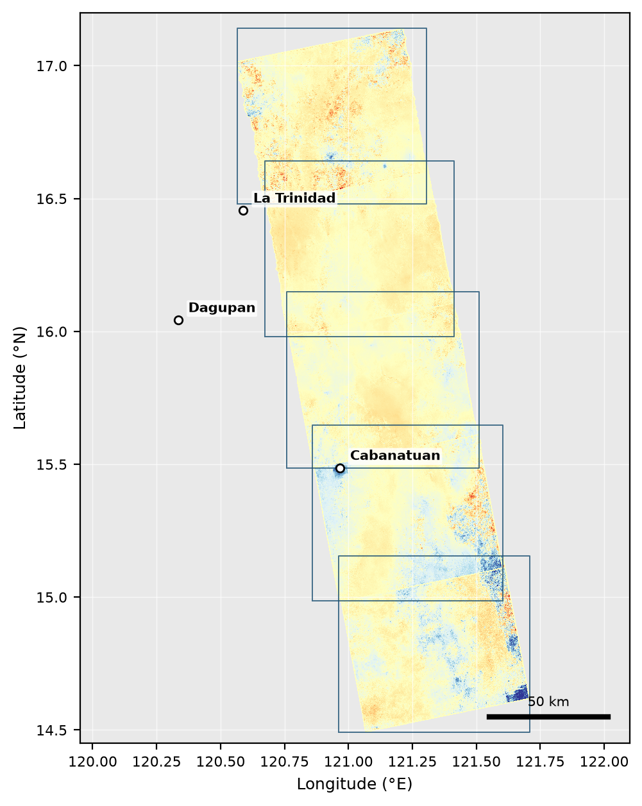
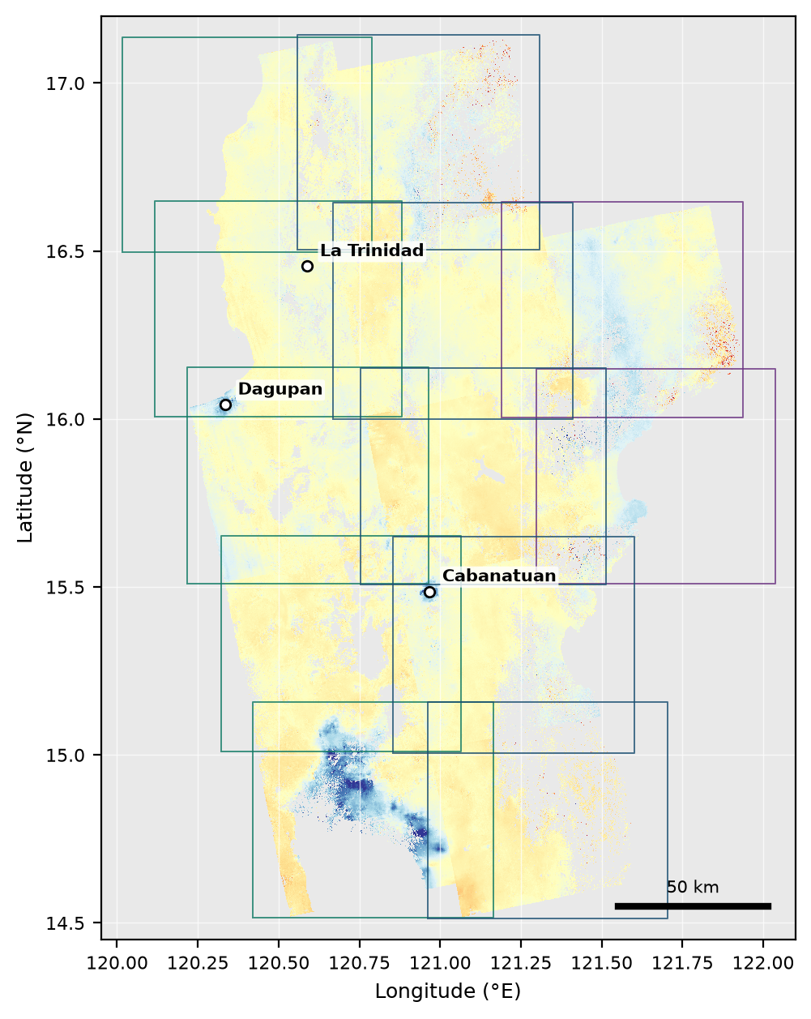
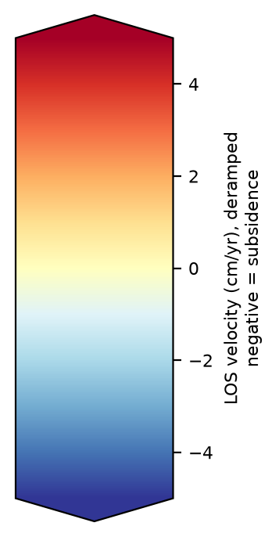
Progression of LInOG ground-velocity coverage, 2007–2011
ALOS-1 PALSAR ascending tracks, deramped LOS velocity, same ±5 cm/yr colour scale
YEAR 1 (reported June 2026)
YEAR 2, QUARTER 2 (this report)
FBS only · Path 448 · 5 frames
FBS + FBD · Paths 447–449 · 12 frames
10 dates/frame · 34–36 interferograms/frame
~10,000 km² reported · no water mask
19–24 dates/frame · 1,634 interferograms in total
27,893 km² with valid data · water-masked (v1.2)

Slide 4

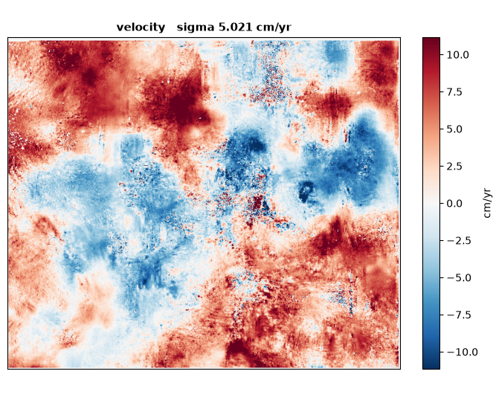
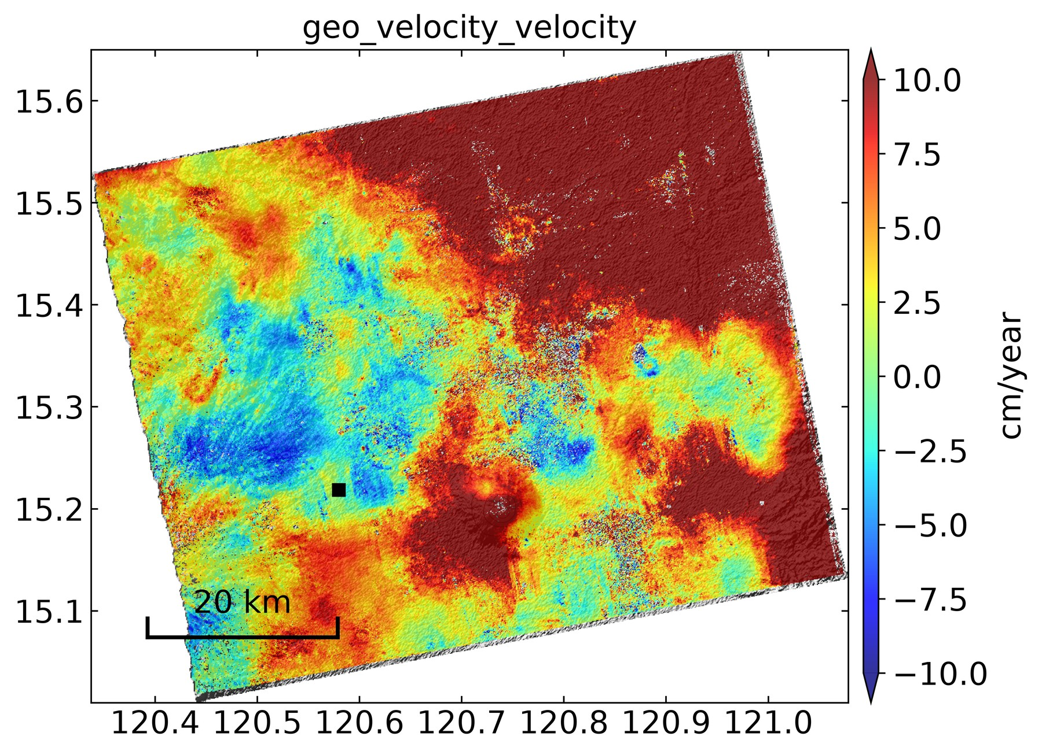
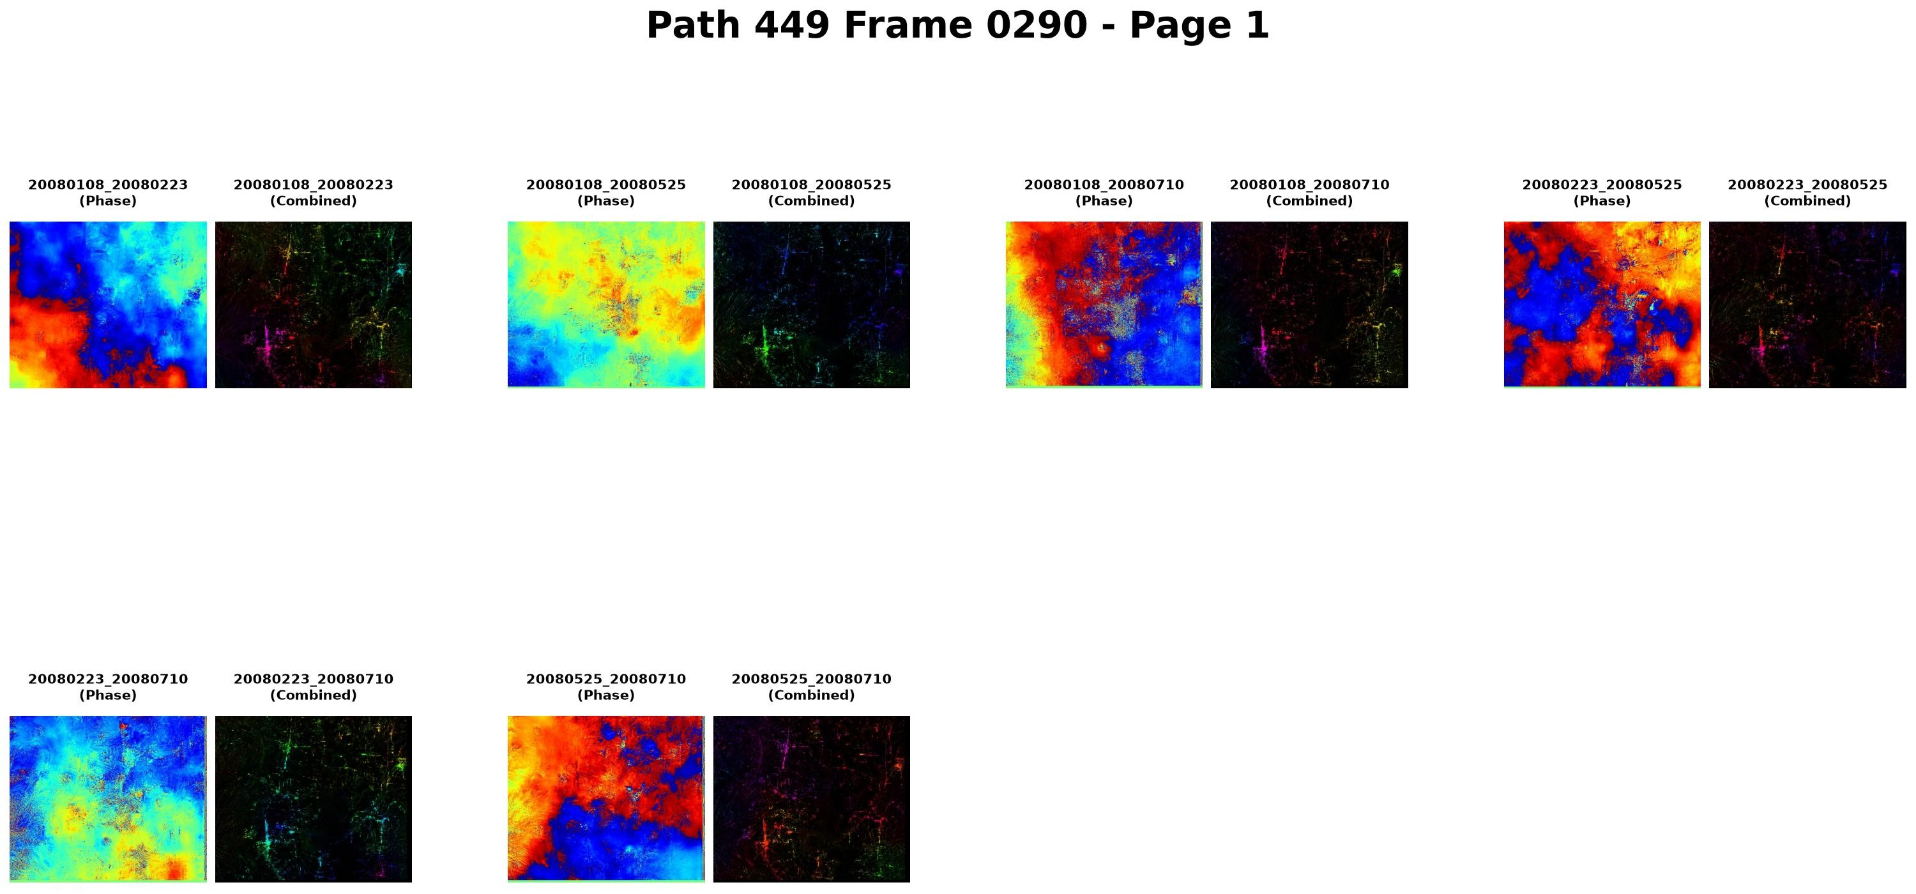
LInOG tutorial route on EarthScope GeoLab (manual v4.0, Chapter 11)
Browser-based JupyterLab server: trainees run the LInOG notebook on a four-date demonstration stack, without access to the project server
Step 1
Step 2
Step 3
Step 4
Step 5
Step 6
EarthScope account
Start a server
One-time install
Demonstration stack
Run the notebook
Check and deliver
Google log-in to the GeoLab hub
29 GB profile: 3.66 CPU cores, 29,776 MiB memory
ISCE2, MintPy, GDAL, SNAPHU into home (~7 min)
Path 449 Frame 0290: 4 dates, 6 pairs (2008)
Cells 0–18 call the LInOG scripts, Phases 0–6
18-item run check; 16 products
REAL OUTPUTS PRODUCED ON GEOLAB (September 2026; four-date demonstration stack, for training only)
Phase 4.5: interferogram report sheet (GeoLab, 20 Sept 2026)
Phase 5: velocity in radar coordinates (GeoLab, 22 Sept 2026)
Phase 6: delivered velocity map, cm/yr (GeoLab, 20 Sept 2026)

