Slide 1

Inter Disciplinary Project
Simulation
Notes:
Good morning every body, My name is jyothsna Boni and I am here to give

Slide 2

SIMGEMS
Supervised by:
Claudia Krull
Team members:
Sai Rajesh Vanimireddy
Boni Jyothsna
Sateesh Reddy Gurram
Deepak Togarla
Nagasai Krishna
Gopi Krishna Burranagari
Notes:
Goob morning everybody my name is Jyothsna Boni. I along with my team mate naga sai are going to give a presentation of our project on behalf of our team. Our team name is simgems . These are our team members. Our project is supervised by Prof Claudia Krull.

Slide 3
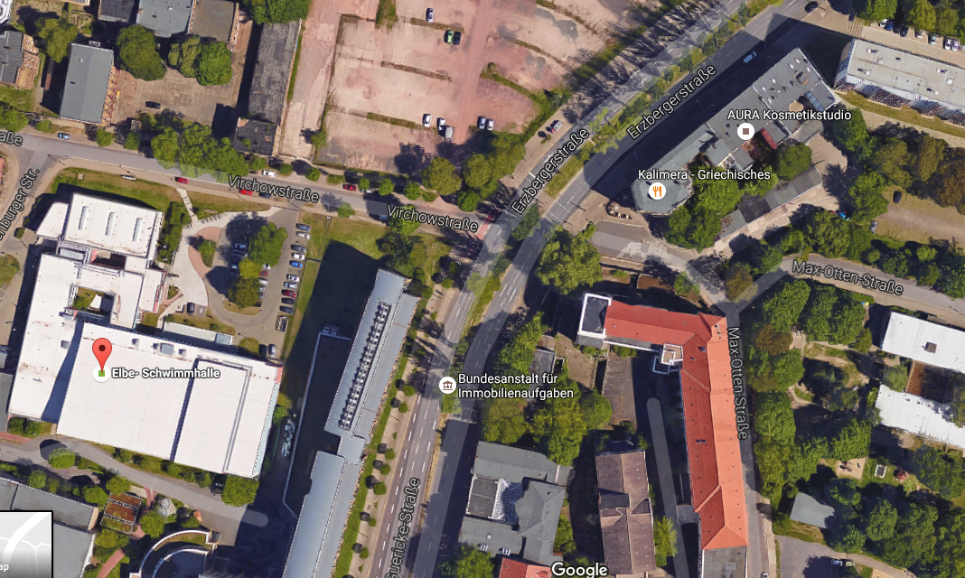
Project Goal
Elbe Schwimmhalle road
3
Notes:
Coming to the project goal, we have taken the Elbe Schwimmhalle road network. The particular road under consideration has many improvement options, like a dead end lane which can be connected to our main road. And the road has two waiting points because of the pedestrian crossing. The signals will be activated only when there are pedestrians. The main aim of our project is to overcome as many problems as possible so that we can improve the real time system.

Slide 4
Agenda
CONCEPTUAL MODEL
DATA ANALYSIS
SIMULATION PROGRAMMING
VERIFICATION AND VALIDATION
EXPERIMENTATION
CONCLUSION
4
Notes:
Coming to the agenda of our project. These are the steps that we have followed in our simulation project. Initially we have observed the real time system and then created a pictorial representation of it. To create the conceptual model we have used the petrinets. Then we have data analysis phase where we have collected the input and output data for our simulation model. Finally using the representation in the conceptual model, we have created an exact representation of the road system using anylogic software. Then we have verified and validated the simulated model against the real time system. Finally we have performed some experiments which can show certain improvements in the system if implemented.

Slide 5
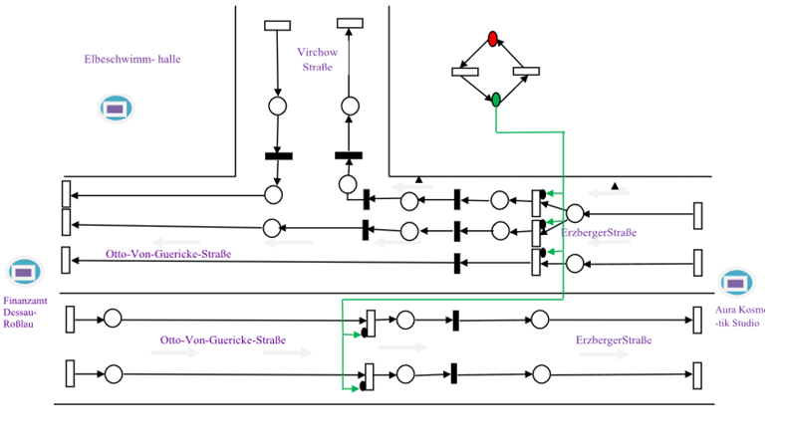
CONCEPTUAL DIAGRAM
5
Notes:
The diagram here shows the pictorial representation of the real time system. We have clearly mentioned erzberger strasse and Otto Von geurike strasse roads along with the number of lanes on each road. There are two wait points in the system which are activated by the pedestrian crossing signals. In the real time system, the two roads have different activation points when the pedestrians cross the road. Since there is a minute difference in both the signal activation, we have considered as a single activation point for both the roads in our simulated model. Additional information for the model is , there are junctions before and after the road which gives a wave like input of cars into the system.

Slide 6
DATA ANALYSIS
Collected Data
Estimated distribution function
Estimated Parameters
Tested data to check similarity between
guessed data and real data
6
Notes:
After the conceptual model, we have collected required data for the input and out put for our simulation program. Then using the collected data we have estimated the distribution function and with that we got the input parameters for the simulated program. To know whether the estimated data is correct, we have performed tests to check similarity.

Slide 7
COLLECTED DATA:
Queue length
Inter arrival time
Signal times
ESTIMATED DISTRIBUTION FUNCTION:
Lognormal distribution
ESTIMATED PARAMETERS:
Chi square test to check the similarity between guessed and real data
Notes:
To estimate input for the simulated program, we have collected inter arrival times and to check the correctness of the output, we have collected the queue lengths and calculated the average queue length. In addition we have collected signal times to check the difference between both the signal activation times. Using the histograms between inter arrival times and number of cars, we have estimated the distribution function which is lognormal distribution. And the estimated parameters for input are as shown in the table. To check the similarity between the guessed data and the real data, we have performed chi square test. And the hypothesis is proven which states that the guessed data is not wrong. My team mate nagasai will take over the presentation from here.

Slide 8
SIMULATION PROGRAMMING
Software used: Any Logic
Data acquired from Data analysis
Design from Conceptual Model
Implementation of the model
8

Slide 9
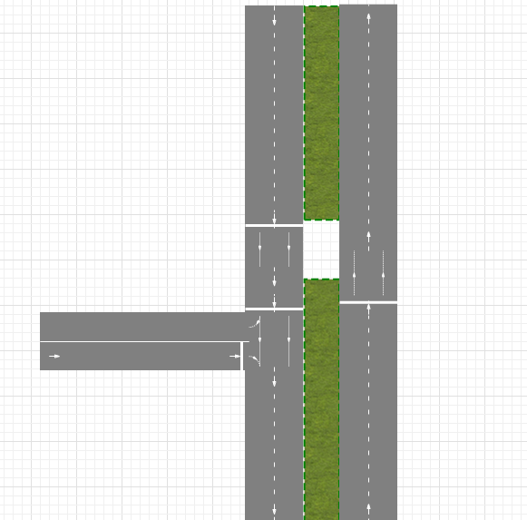
Design
Road modeling in Any Logic
9

Slide 10
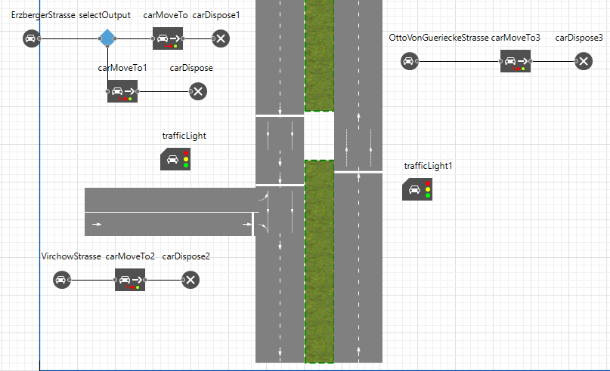
Implementation
10

Slide 11
VERIFICATION AND VALIDATION
Verification
Comparing the conceptual model with its implementation
Checking the correctness of the model
Validation
Building a model which reassembles the real field model
Comparing output of the built model with the data collected in the real field model
11

Slide 12
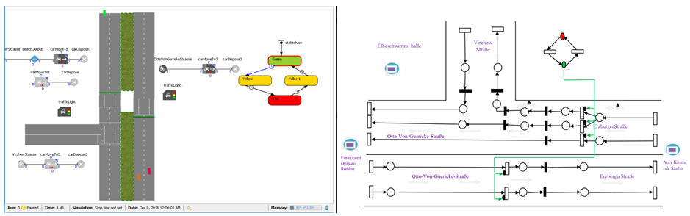
Comparison of implemented model and conceptual model
12

Slide 13
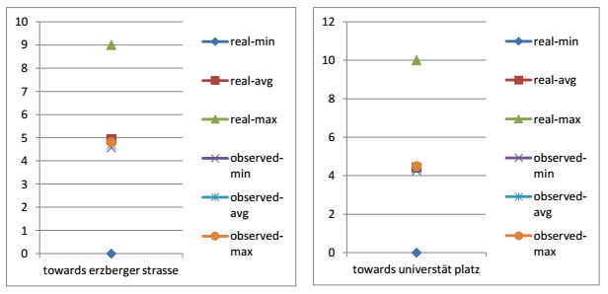
Validation
Confidence interval graphs of queue lengths of real and simulated model
13

Slide 14
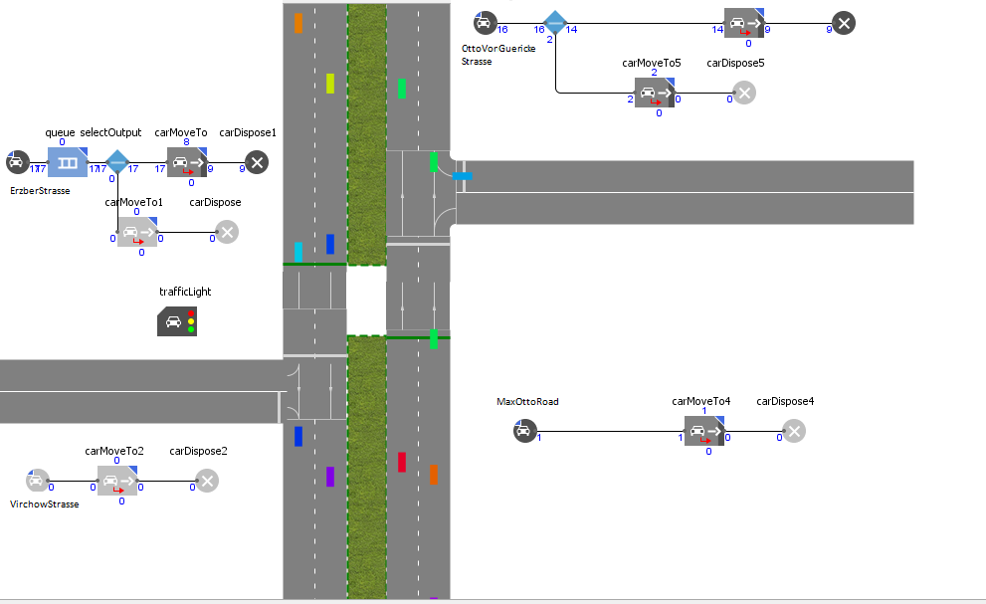
EXPERIMENTS
Experiment1:
Adding additional road (MaxOttoStrasse)
14

Slide 15
Observing queue lengths by increasing number of cars every hour.
15

Slide 16
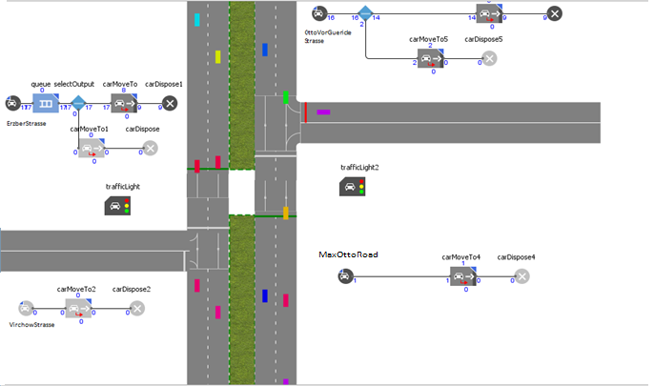
Experiment2:
Adding signal to additional road (MaxOttoStrasse)
16

Slide 17
Observing queue lengths by increasing number of cars every hour.
17

Slide 18
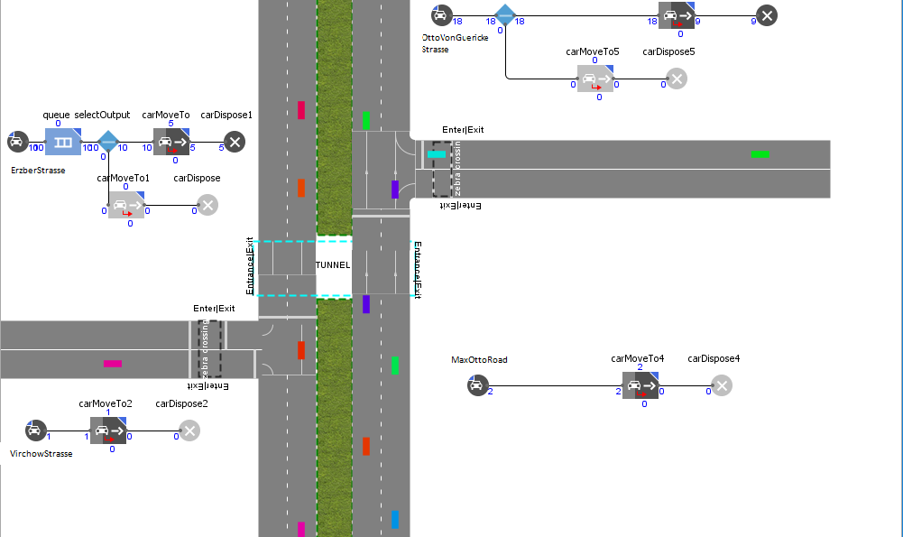
Experiment3:
Adding tunnel, speed limits, zebra crossings to road network
18

Slide 19
Observing queue lengths by increasing number of cars every hour.
19

Slide 20
CONCLUSION
Observed decrease in queue length
Improved safety because of the adding zebra crossings, speed limits
Reduction in traffic is observed and ease of use for the people who use the additional road.
20

Slide 21
Thank you… ☺
21

