Slide 1
SRINIVAS INSTITUTE OF TECHNOLOGY
Internship Review Presentation-2
“Android App Development using Generative AI”
Name: Ayishath Nafiya B
USN: 4SN22AI015
Department : AIML
Role: Android App Development Intern
Organization: MindMatrix
Duration: 15 weeks
Guide Name : Prof Madhusudhan
Kavya-Kanaja | Android App Development using GenAI
01

Slide 2
ಕಾವ್ಯ ಕಣಜ
Kavya-Kanaja
A Literary Revival Android App for Kannada Poetry
Project Title 76 | Android App Development using GenAI
“Kavya-Kanaja” is a Kannada literary revival Android app that helps youth understand and enjoy classical Kannada poetry in a modern way. The app provides a daily poem, audio recitations, simple word meanings, and poem explanations. Users can tap difficult words to learn meanings instantly and explore famous Kannada poets through the “Poet’s Corner.” Built using Jetpack Compose, MediaPlayer, and local JSON storage, the app aims to preserve Kannada culture and make literature engaging for Gen-Z students.
Kavya-Kanaja | Android App Development using GenAI
01

Slide 3
PROBLEM
Kannada literary pride is fading because access feels difficult.
Young learners often see classical poetry as hard to read, hard to hear, and hard to understand.
Old Kannada gap
Difficult words stop students before they reach the meaning.
Student Need
Low daily exposure
A calm app that makes Kannada poems readable, listenable, and explainable in one place.
Poetry is usually encountered only during exams or textbooks.
Audio absence
Students rarely hear rhythm, emotion, and pronunciation together.
Context missing
Poet biographies and cultural background stay separate from reading.
Kavya-Kanaja | Android App Development using GenAI
02

Slide 4
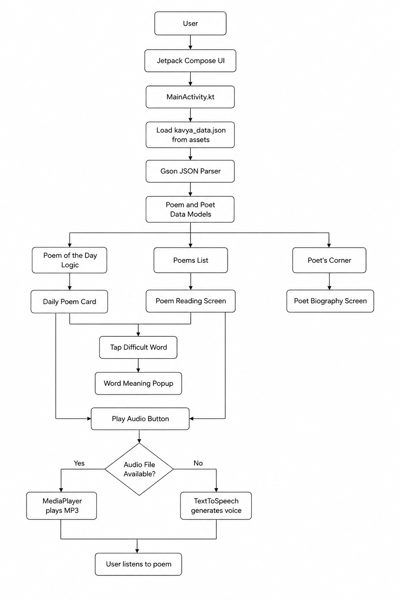
VISION
System Architecture
Kavya-Kanaja | Android App Development using GenAI
03

Slide 5
USER FLOW
A beginner can move from poem to meaning in five simple taps.
The flow is intentionally distraction-free: each screen helps the student do one learning action.
1
2
3
4
5
Open app
Read poem
Tap word
Play audio
Explore poet
Poem of the Day appears
Elegant card layout
Meaning popup opens
TTS or MP3 recitation
Biography and famous works
Kavya-Kanaja | Android App Development using GenAI
04

Slide 6
Technology Stack - Backend
Technology | Purpose
Local JSON File | Stores 52 poems, word meanings, Bhavartha, and poet biographies
Android Assets Folder | Keeps kavya_data.json bundled inside the app
Gson Library | Converts JSON data into Kotlin data classes
Kotlin Data Classes | Represents poem, word meaning, poet, and full app data
Date API / LocalDate | Selects the Poem of the Day automatically
MediaPlayer | Plays MP3 poem recitations if audio files are added
TextToSpeech | Generates AI-style voice recitation when MP3 is not available
Offline-First Storage | Allows poem reading without internet
Repository-like Data Flow | Centralizes poem data loading from assets to UI
Gradle Dependencies | Manages app libraries like Compose, Gson, and Material UI
Kavya-Kanaja | Android App Development using GenAI
05

Slide 7
Technology Stack – Frontend / UI
Technology | Purpose
Kotlin | Main programming language for Android logic
Jetpack Compose | Builds the complete app UI using Kotlin
Material Design 3 | Provides modern UI components like cards, navigation, and dialogs
Navigation Bar | Allows switching between Today, Poems, and Poets screens
AlertDialog | Shows difficult word meanings in popup form
Compose State | Updates UI when poem, selected word, or audio state changes
LazyColumn | Displays scrollable poem and poet lists
Card UI | Shows poem content in a clean book-like layout
Icons Extended | Provides icons for Today, Poems, Poets, Play, and Pause
Android Emulator | Used to test the app before installing on a real phone
Kavya-Kanaja | Android App Development using GenAI
06

Slide 8
DAILY POEM LOGIC
The Poem of the Day changes automatically using today’s date.
Kotlin Logic
Day 1
Day 2
Day 3
...
Day 52
val day = LocalDate.now().dayOfYear
val poem = poems[(day - 1) % poems.size]
After poem 52, the modulo calculation cycles back to the start.
Kavya-Kanaja | Android App Development using GenAI
07

Slide 9
WORD MEANINGS
Tappable words turn difficult poetry into guided reading.
ನುಡಿಯ ಬೆಳಕು ಮನದಲಿ ಹೊಳೆಯಲಿ
ಕನ್ನಡ ಕಿರಣ ಜಗದಲಿ ಹರಡಲಿ
Meaning Popup
ನುಡಿಯ
Meaning: Of language or speech
Modern Kannada: ಭಾಷೆಯ
Example: ನುಡಿಯ ಮೌಲ್ಯವನ್ನು ತಿಳಿಯಬೇಕು.
ನುಡಿಯ
Kavya-Kanaja | Android App Development using GenAI
08

Slide 10
AUDIO / AI VOICE
The audio button works even without recording 52 separate MP3 files.
Play MP3
MediaPlayer
User taps Play
audioFile exists?
Recitation
starts
Generate voice
TextToSpeech
Kavya-Kanaja | Android App Development using GenAI
09

Slide 11
DATA MODEL
The content is easy to update because poems are stored in one JSON file.
title
poet
kavya_data.json
Poem name
Author/source label
52 poems
8 poet biographies
Offline asset file
text
bhavartha
Kannada verse
Simple explanation
audioFile
difficultWords
Optional MP3 path
Tap-word meanings
Kavya-Kanaja | Android App Development using GenAI
10

Slide 12
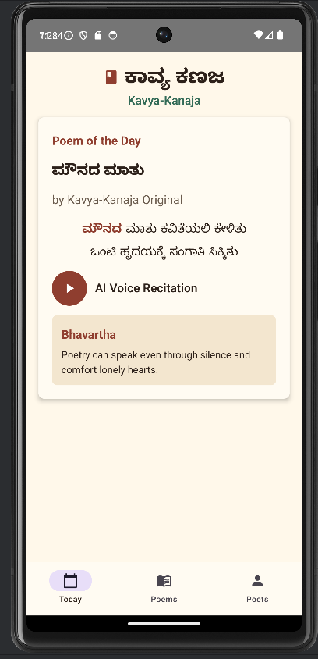
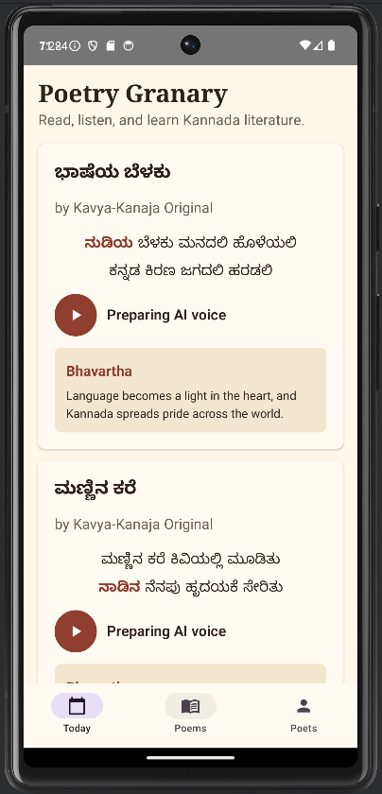
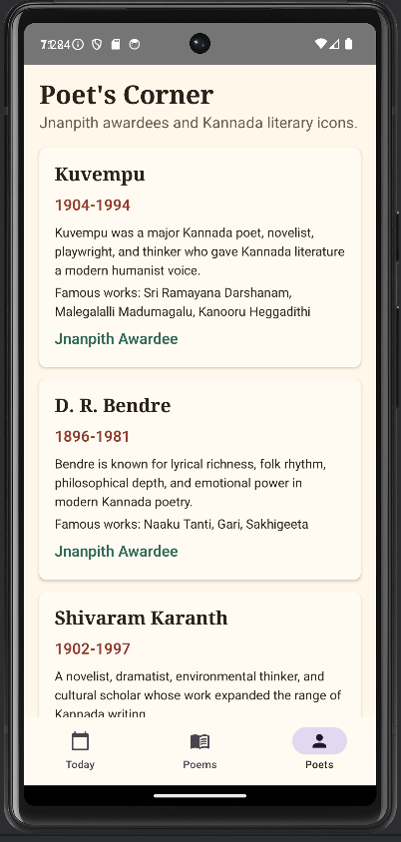
Kavya-Kanaja | Android App Development using GenAI
10

Slide 13
DEMO + FUTURE SCOPE
The current build is ready for demo, with clear next improvements.
Ready Now
Future Scope
1. 52 local poems
1. Add real recitation MP3s
2. Poem of the Day
2. Add quiz and streaks
3. Tappable word meanings
3. Public-domain poem library
4. Bhavartha explanation
4. Search by poet or era
5. TTS audio fallback
5. Offline favorites
Conclusion: Kavya-Kanaja makes Kannada poetry more accessible, emotional, and student-friendly.
Kavya-Kanaja | Android App Development using GenAI
12

